Slide 1

MANAGEMENT : AN INTRODUCTION
Written by: Dr. Vipin Aggarwal
Revised by: Dr. Virender Kaushal

Slide 2

1.1 LEARNING OBJECTIVES
After studying this chapter students will be able to understand :-
The meaning of term management
Nature/characteristics of management
Importance of management
Summary

Slide 3
1.2 INTRODUCTION
In very simple terms, Management means “To manage”. We use this term in our everyday life.
In the context of a business or an organization in most simplistic way management can be defined as
“Art of getting things done from others”
The very first thing about management is that it is not only an art but also a science. It involves designing principles as well as their subjectives and creative application in various situations.
Secondly, Management is not a term describing a single activity rather it is a process consisting of various activities such as planning, organizing, staffing, directing, controlling.
Thirdly, the above definition makes management a directionless and blind activity done with no goals and purpose. That is why it is incomplete because setting up goals and objectives and achieving them is what management is all about.
Lastly, It is an art/science of getting things done with and through others with an overall purpose of achieving efficiency and effectiveness.

Slide 4
1.3 NATURE OF MANAGEMENT
Both science as well as an art : Management is a discipline which makes the best of two worlds i.e. world of science and world of art.
World of science is based on experiments, facts and figures. The goal of science is to achieve perfection. The outcomes of science are so perfect that they are universally applicable and acceptable.
On the other hand, is the World of art is completely opposite to science. Here, there is no place for rigidity and experimentation. It is all about creativity, thinking and imagination. Art does not define and neither accepts a perfect outcome.
Both the worlds being opposite to each other have their own set advantages and disvantages.

Slide 5
Process : As already described management involves a series of activities done one after another in a systematic manner.
Multidimensional : Management has a journey of evolution. As the organisations grew larger and larger in size and scale, the need of management was realized more and more.
Dynamic : Management is ever changing. This is because management needs to adjust itself in accordance with changing situations.
Continuous : The functions of management can be depicted in a cyclical manner which further indicates continuity. As soon as one function of management ends it kick-starts the next function.
Pervasive : Management is present and needed everyday-starting from an individual, to a group, to a community , to organization to a nation and worlds.
Goal-oriented : The very first step that puts the management into place is setting up of goals and objectives. Management has no existence without goals and objectives.
Coordinate : As we studied, that management consists of various activities. All these activities are interrelated and independent on each other. The entire process may fail if the activities are not coordinated with each other.

Slide 6
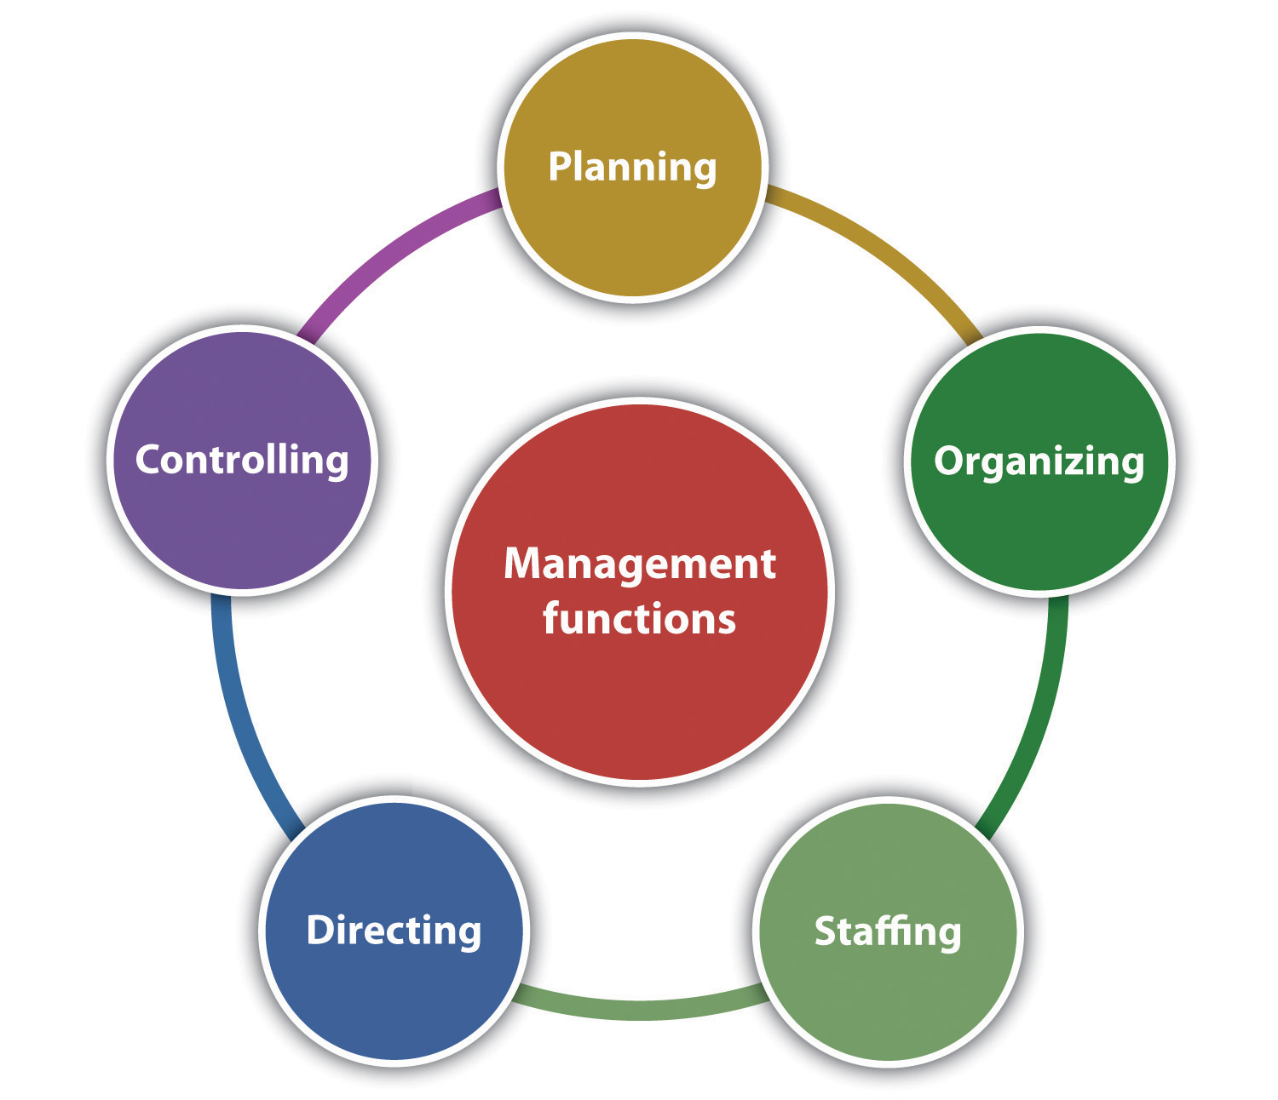
1.4 FUNCTIONS OF MANAGEMENT
This Photo by Unknown Author is licensed under CC BY-SA-NC

Slide 7
Planning : It is the first and primary function of management. It involves setting up long term and short term goals of an organization and deciding the best possible course of action to achieve them.
Organising : it is the second function of management. It is the function which brings plans into action. The objective is to arrange and organize all the resources required for fulfilment of plan.
Staffing : It is the third function of management which can also be called as extension of organizing function. This is because staffing is also about organising resources .
Directing : Once the plans are put into action, it is important to follow up and keep a track so that organization does not lose its direction and this is the objective of the directing function of management.
Controlling : This is the last function of management. This function completes one cycle of management process. It is the stage where actual performance for a time period is accessed and compared with standards laid down under plans.

Slide 8
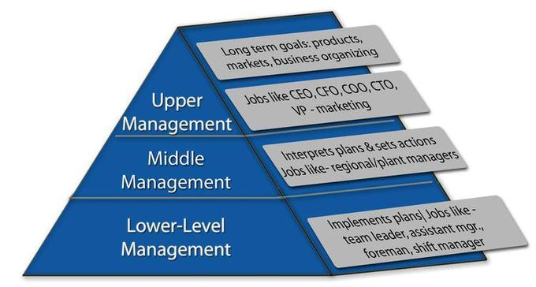
1.5 LEVELS OF MANAGEMENT

Slide 9
1.6 SUMMARY
Art is a wise combination of science and art; it proves the principles, but how these principles are applied is a matter of art. The way someone manages their team or entire workforce has a direct impact on the organization’s growth and profitability. Understanding management’s evolution can assist you in determining which management practices are best for your team and organization. The management function of coordination involves harmonization of various activities that are performed by various activities that are performed by various people and groups in an organization. Coordination eliminates the duplication of effort, thereby eliminating wastages and facilities saving of time, effort and cost. Every department has to organize the activities of its employees, coordinate with other departments of the organization.

Slide 10


