Slide 1
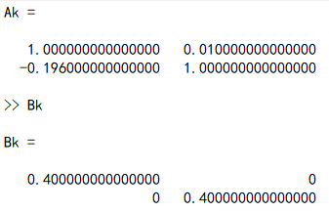
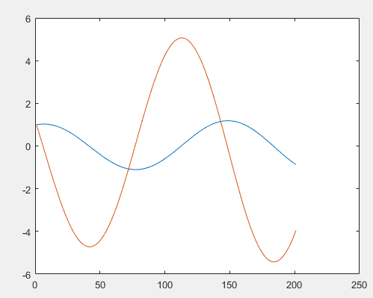
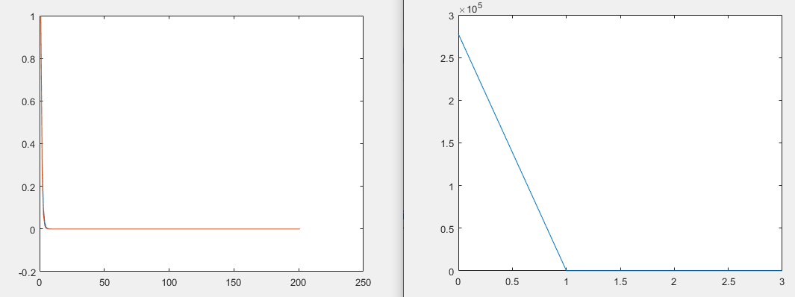
Ilqr+least square central difference sysid+LTI system
Weiwei li 2004
Initial trajectory
Ilqr trajectory
Ilqr cost

Slide 2
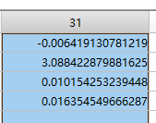
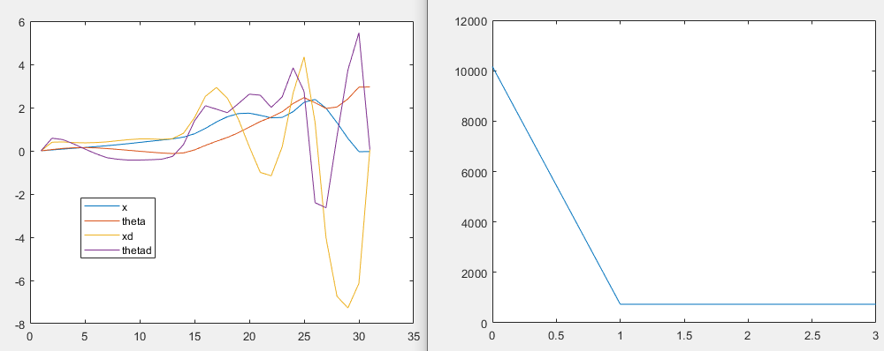
Ilqr+ Ltv cartpole + LSCD

Slide 3
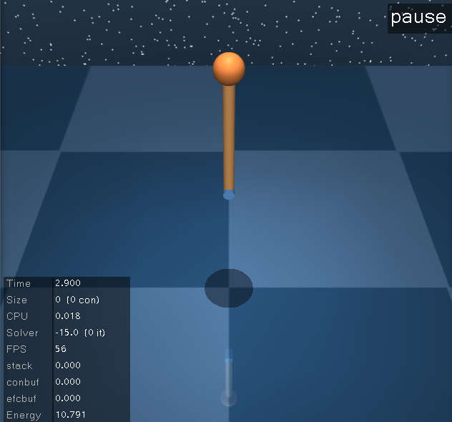
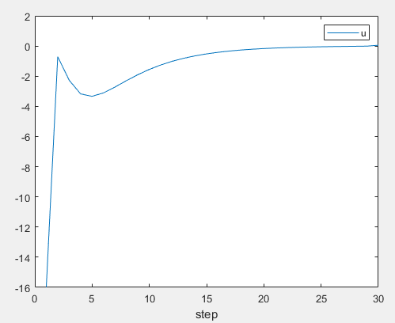
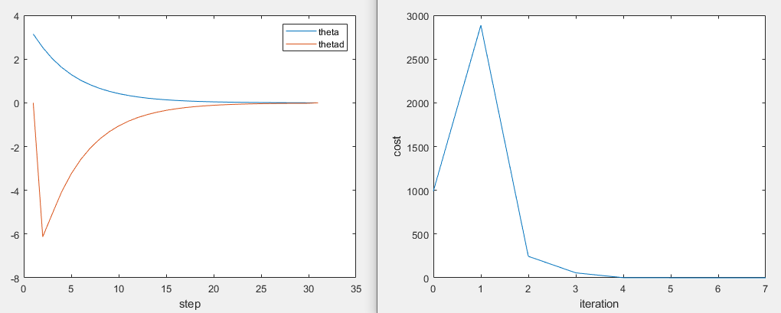

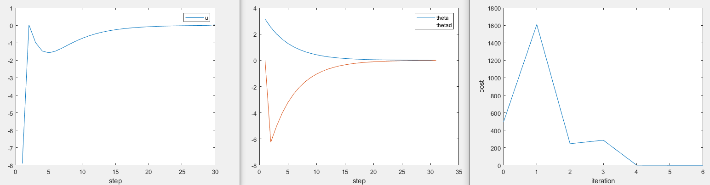
Ilqr+ pendulum + LSCD
Same cost as in Weiwei li paper
Add x-x_target to incremental cost, Q,R same

Slide 4
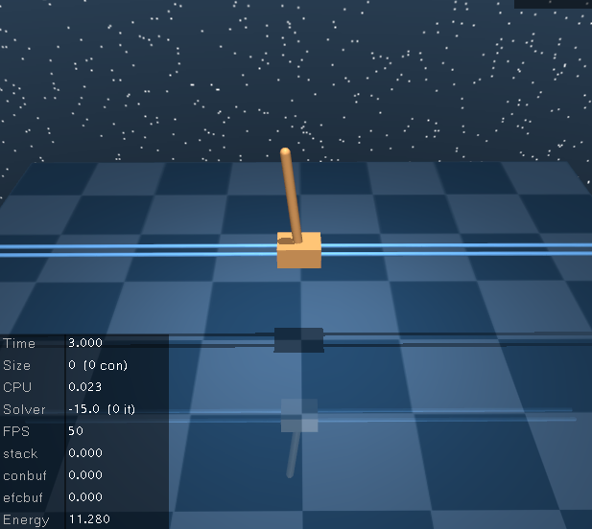
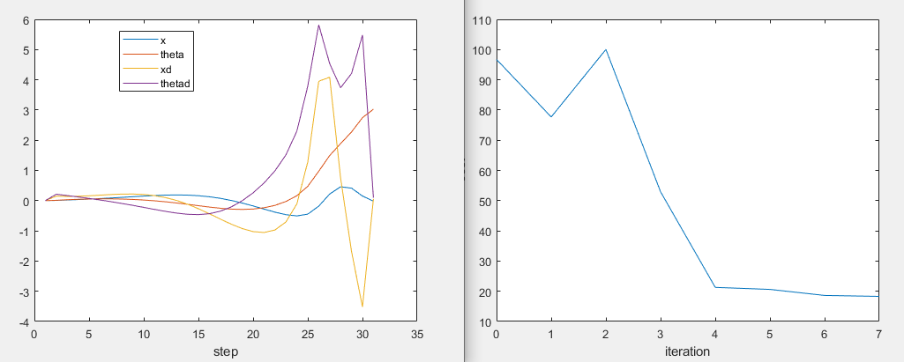
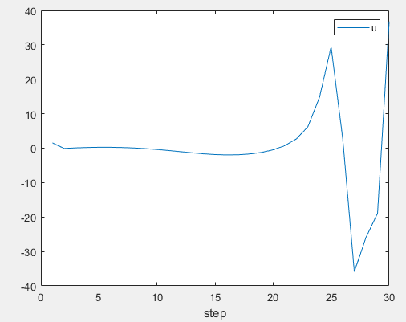
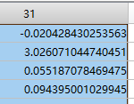
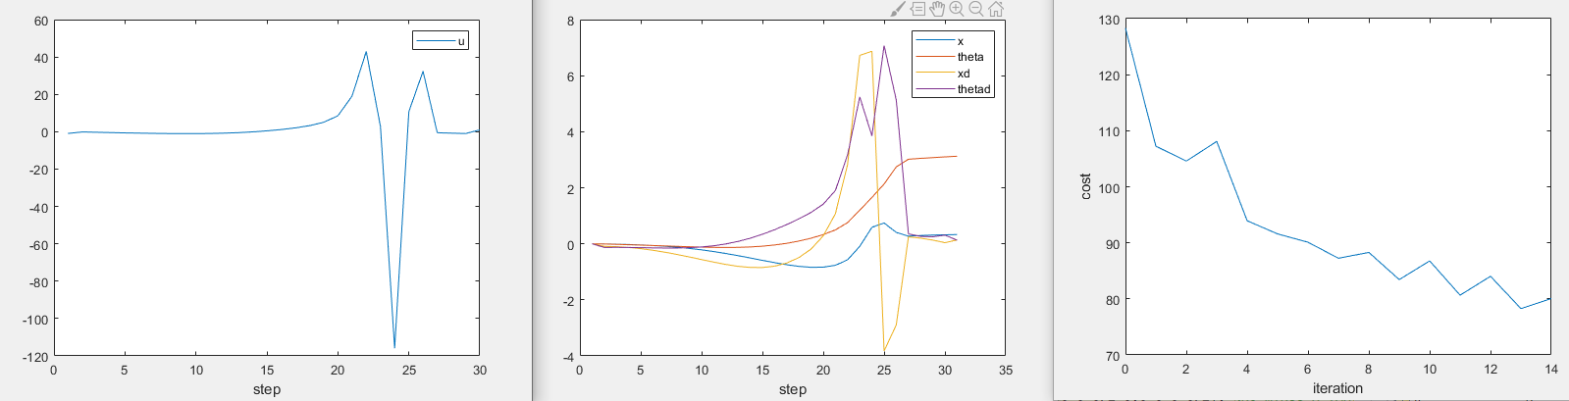
Ilqr+ cartpole + LSCD
Same cost as in Weiwei li paper
Add x-x_target to incremental cost

Slide 5
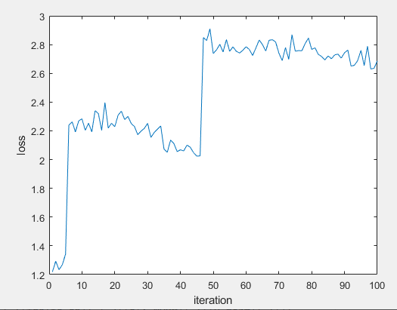
Spsa id

Slide 6
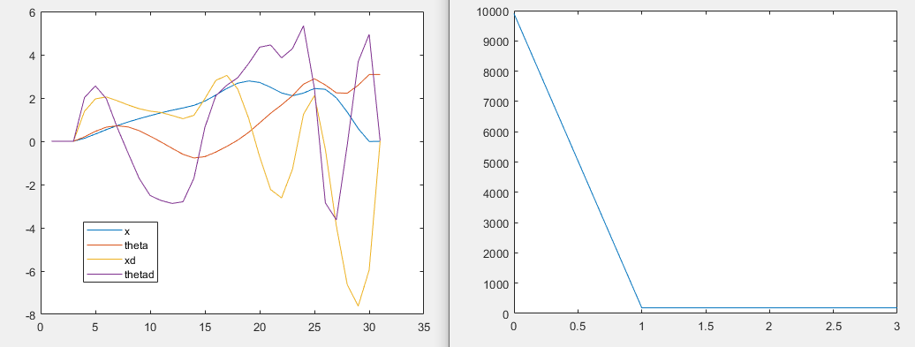
Ilqr+ Ltv cartpole + ARMA
C=I, qx=qu=1

Slide 7
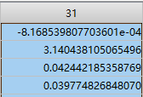
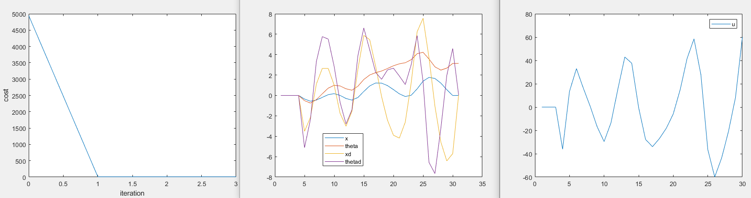
Ilqr+ Ltv cartpole + ARMA
C=pos only, qx=qu=2

Slide 8

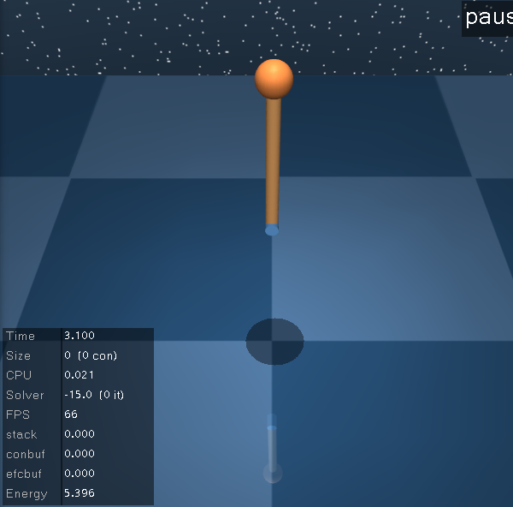
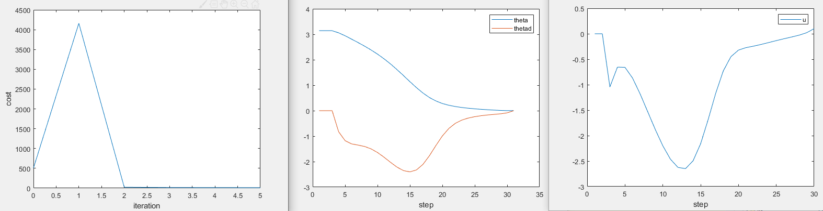
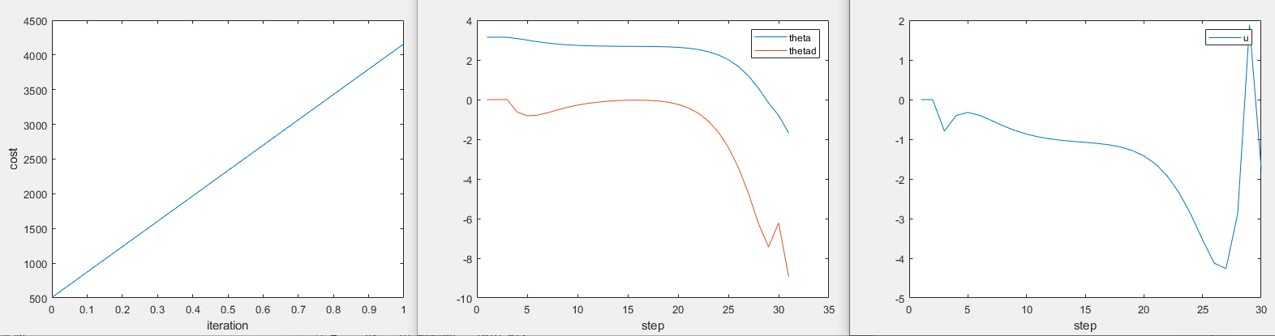
Ilqr+ pendulum+ ARMA
C=I, qx=qu=1

Slide 9
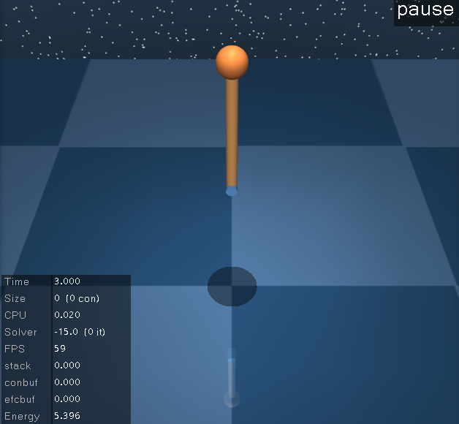

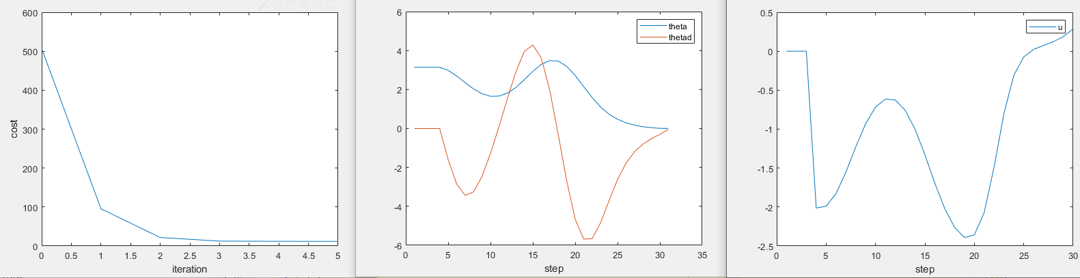
Ilqr+ pendulum+ ARMA
C=pos only, qx=qu=2

Slide 10
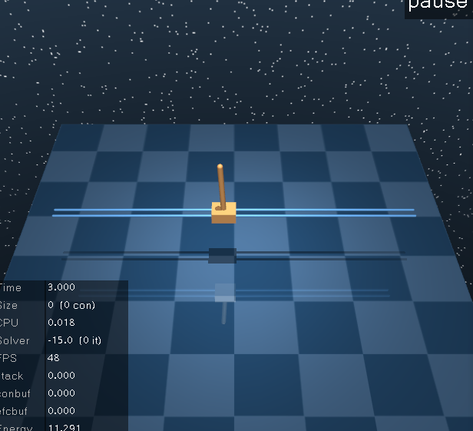
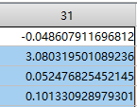
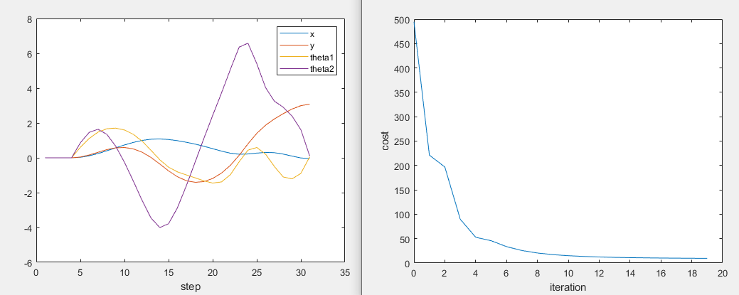
Ilqr+ cartpole+ ARMA
C=I, qx=qu=1

Slide 11
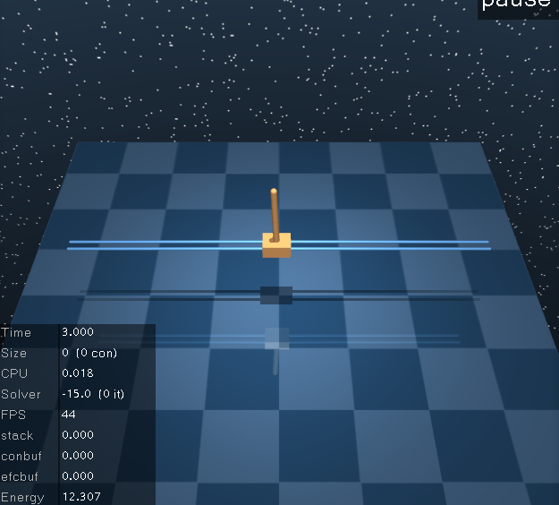
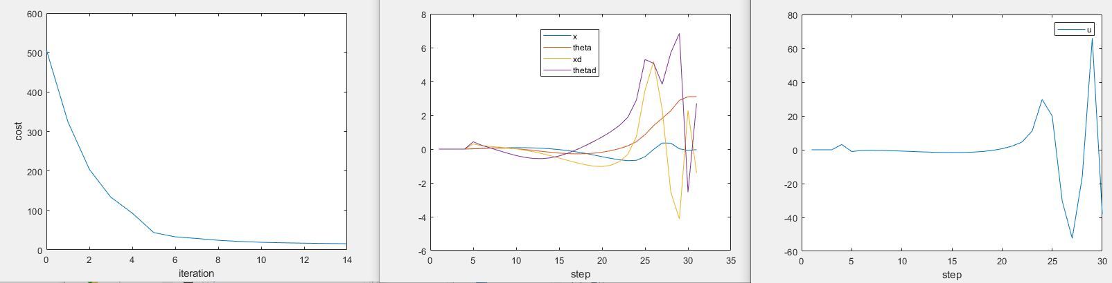
Ilqr+ cartpole+ ARMA
C=pos only, qx=qu=2

Slide 12
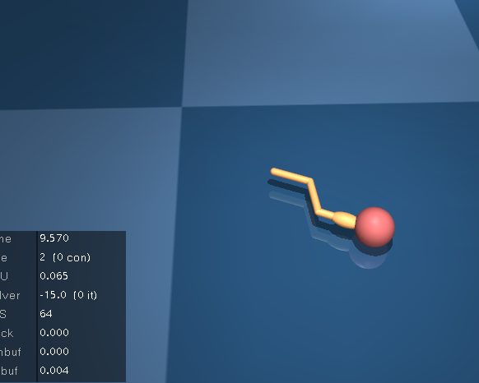
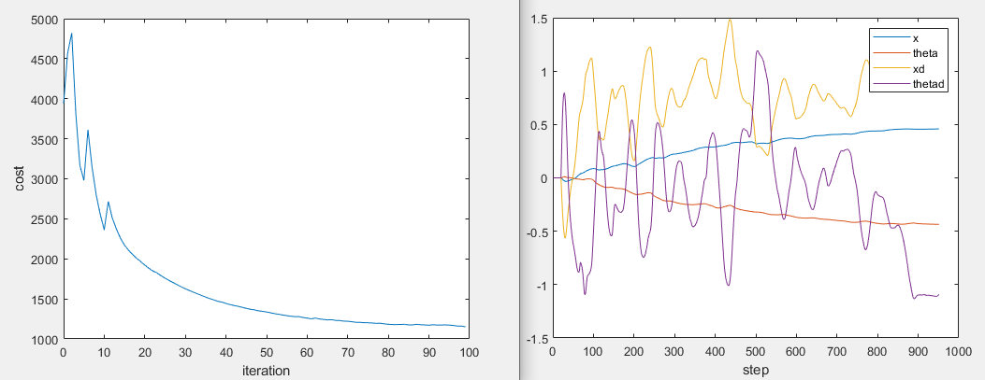
Ilqr+ swimmer3+ ARMA
C=I, qx=qu=1

Slide 13
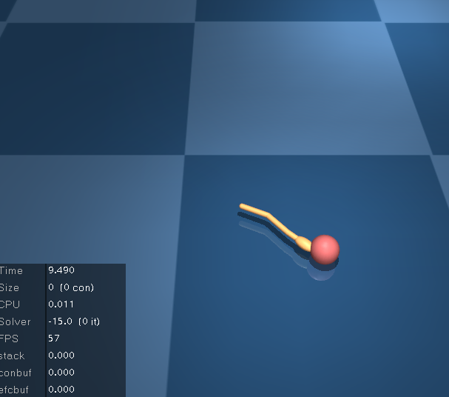
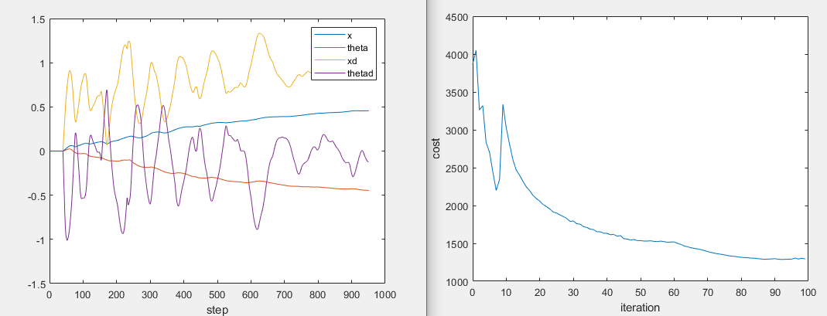
Ilqr+ swimmer3+ ARMA
Pos only, qx=qu=2

Slide 14
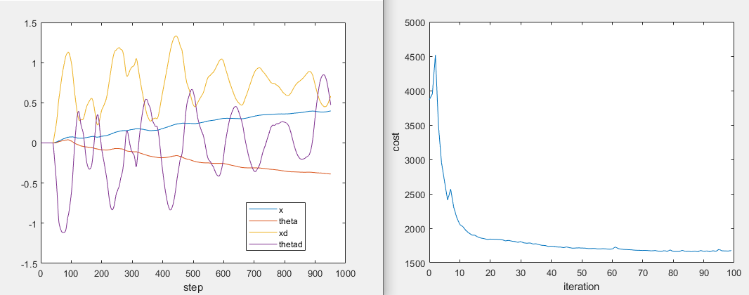
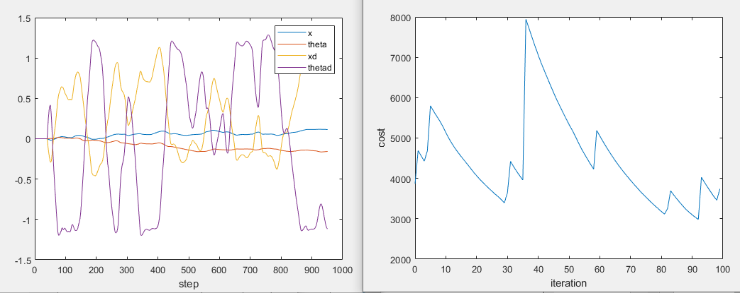
swimmer3
Alpha=0.9*alpha
Line search IROS12 paper

Slide 15
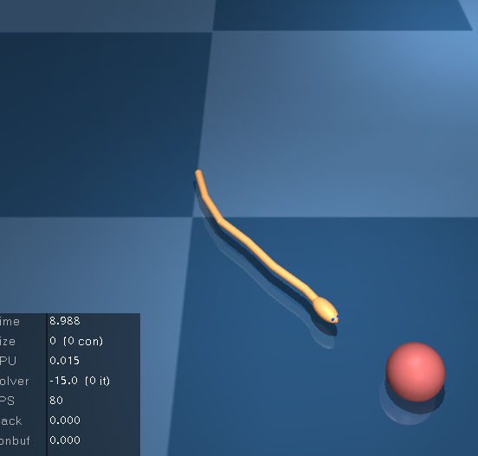
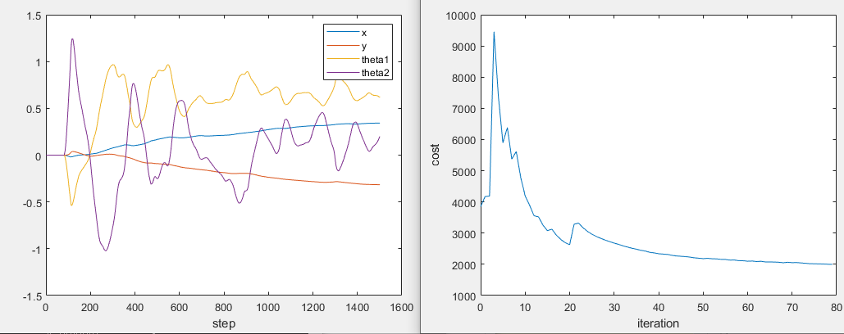
Ilqr+ swimmer6+ ARMA
C=I, qx=qu=1，no batching

Slide 16
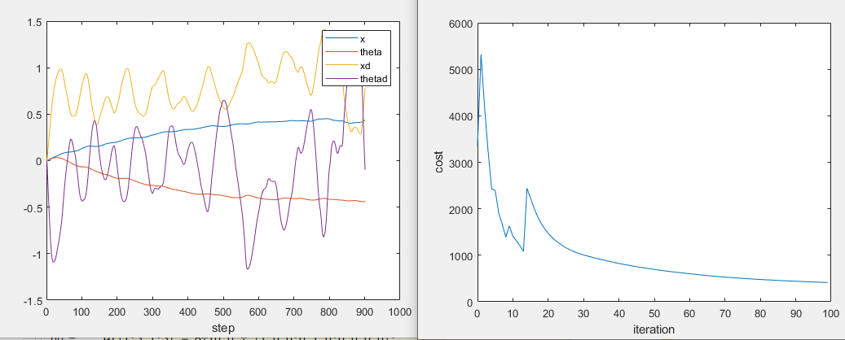
Ilqr+ swimmer6+ LSID
C=I, qx=qu=1，no batching
900，0.01
0.44

Slide 17
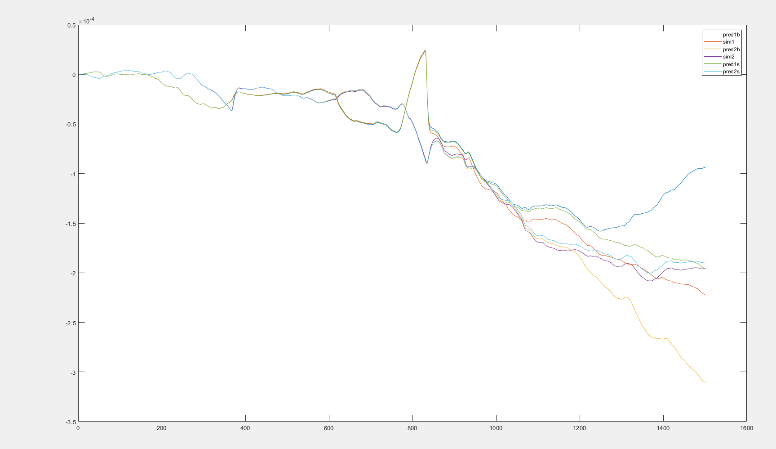
Batch=4
Skip 40 steps

Slide 18
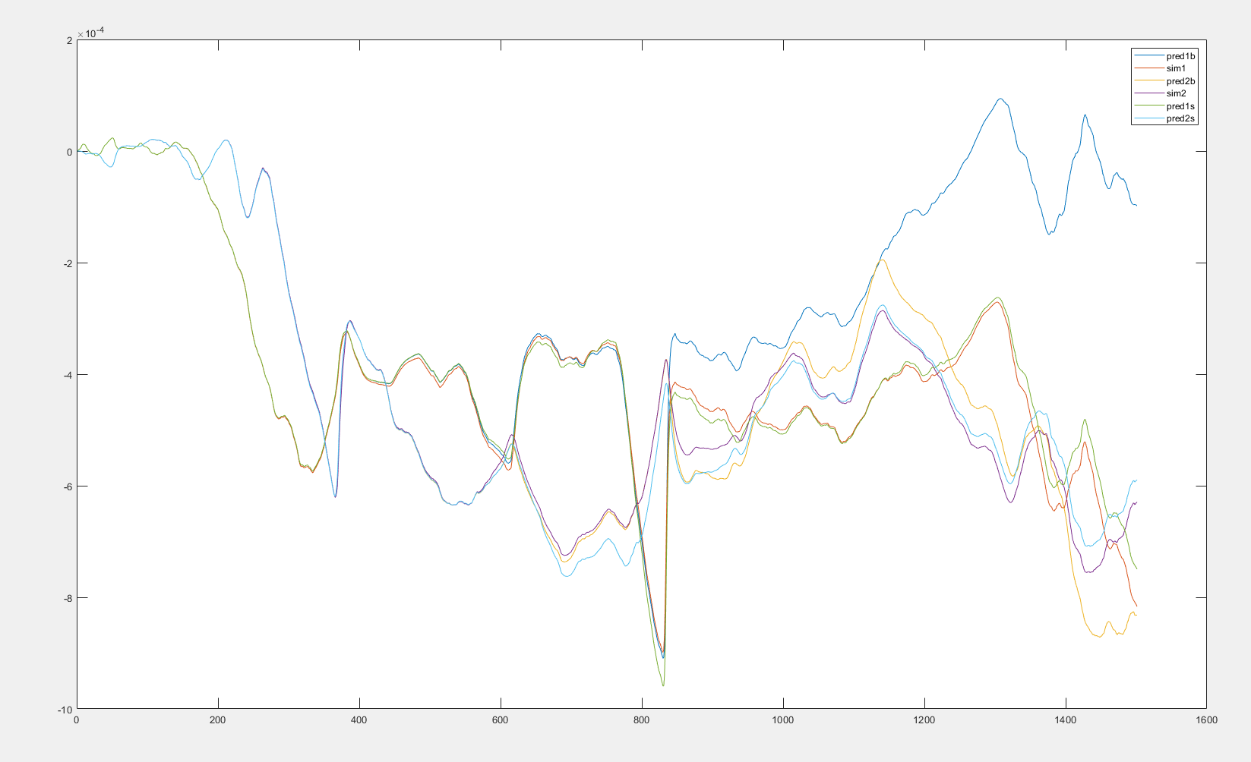
Batch=4
Skip 40 steps

Slide 19
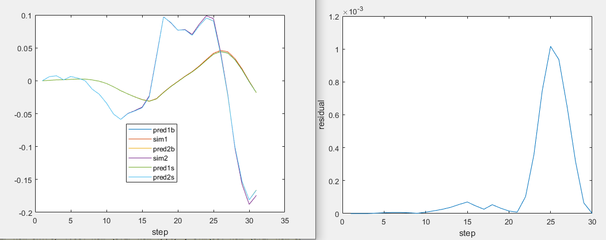
Pendulum+arma+single batch residual

