Slide 1
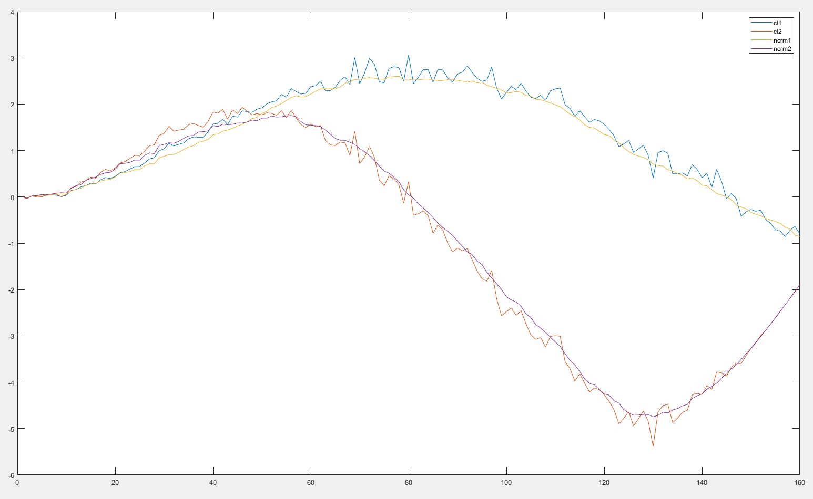
cartpole
cdc2017 lqg
current D!=0
Batch=60
noise=20%
Averaged over 500

Slide 2
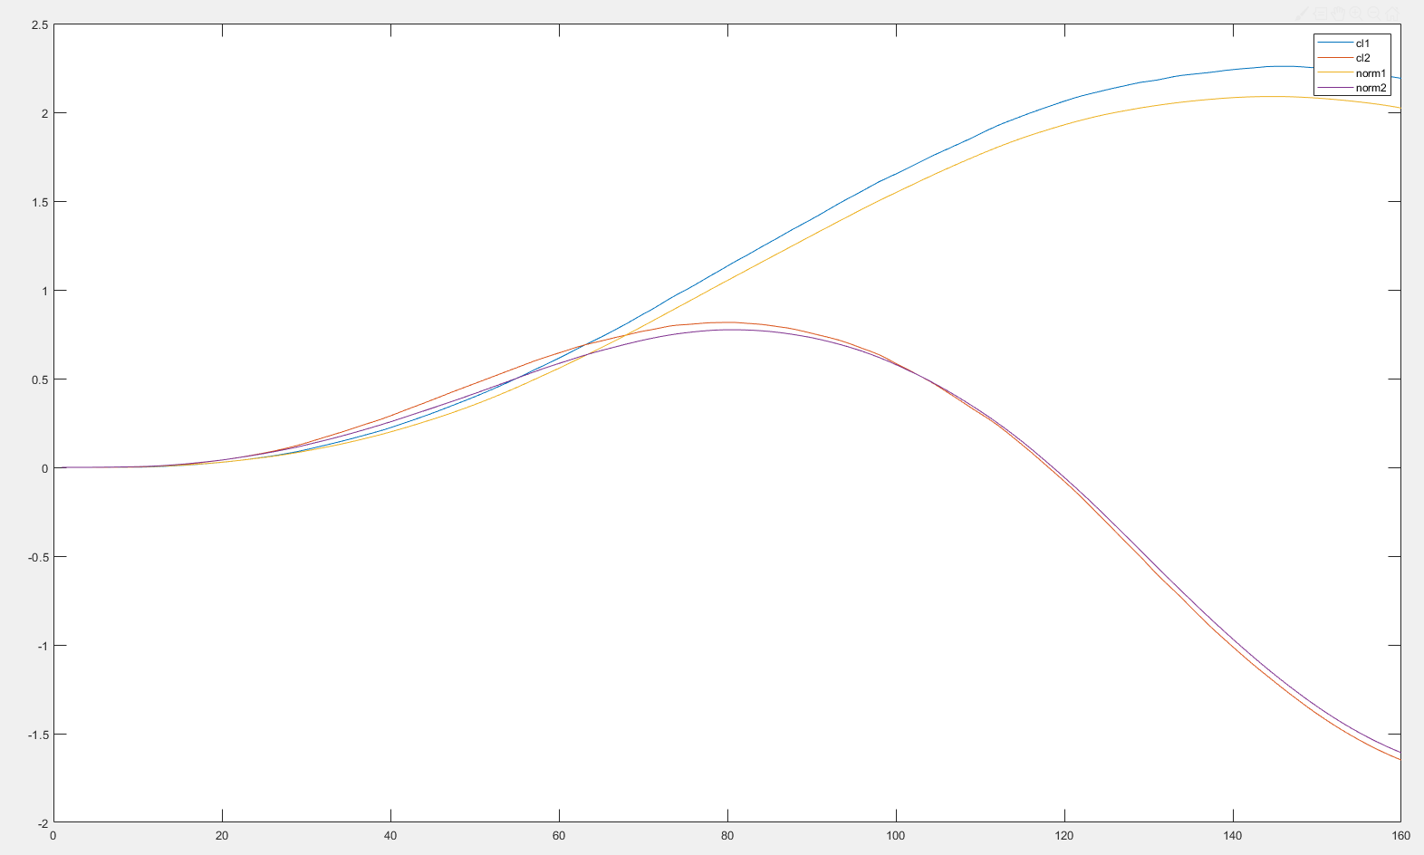
cartpole
cdc2017 lqg
current D!=0
Batch=60
noise=20%
Averaged over 500

Slide 3
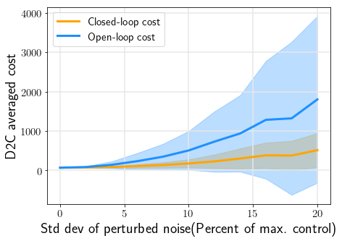
Cartpole
Batch=60
Averaged over 400

Slide 4
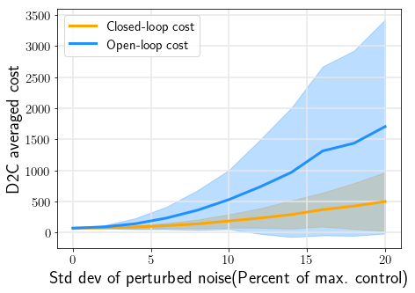
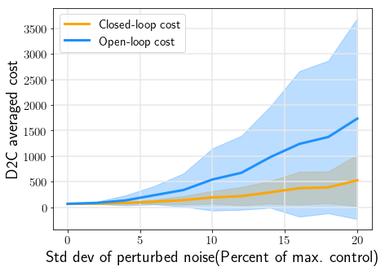
Cartpole
Batch=260
Averaged over 400

Slide 5
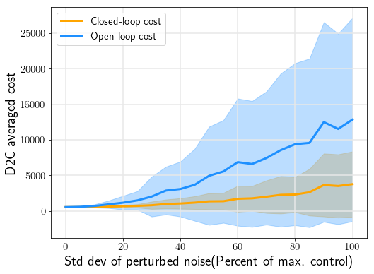
Pendulum
Batch=20
Averaged over 400

Slide 6
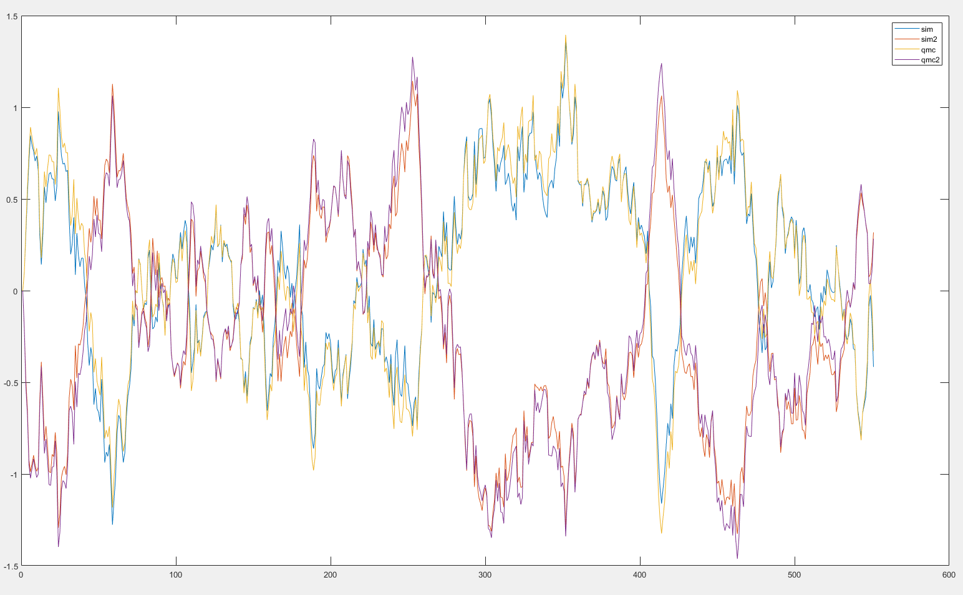
Swimmer3
Batch=110
Averaged over 1
dt=0.001s
Noise=10%
y_sim vs y_qmc
Index=9:10

Slide 7
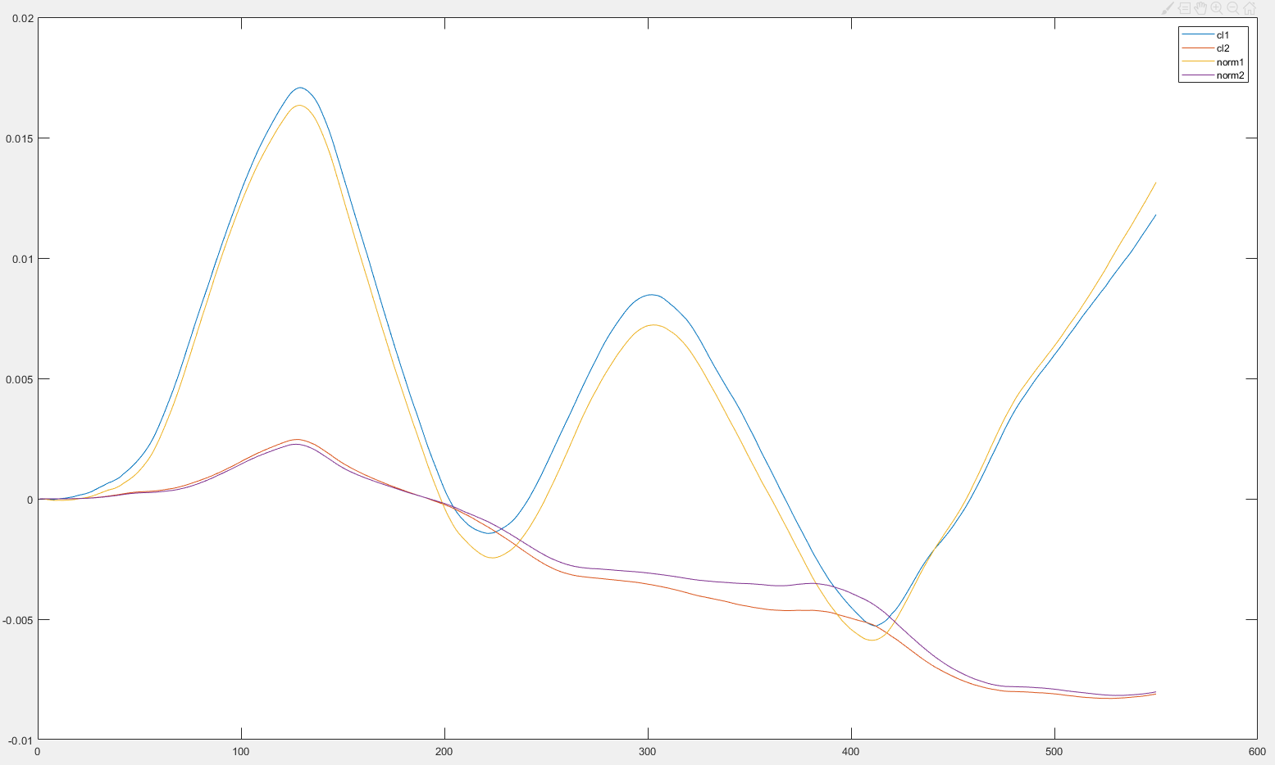
Swimmer3
Batch=110
Averaged over 500
dt=0.001s
Noise=10%
Closedloop
Y(1:2)

Slide 8
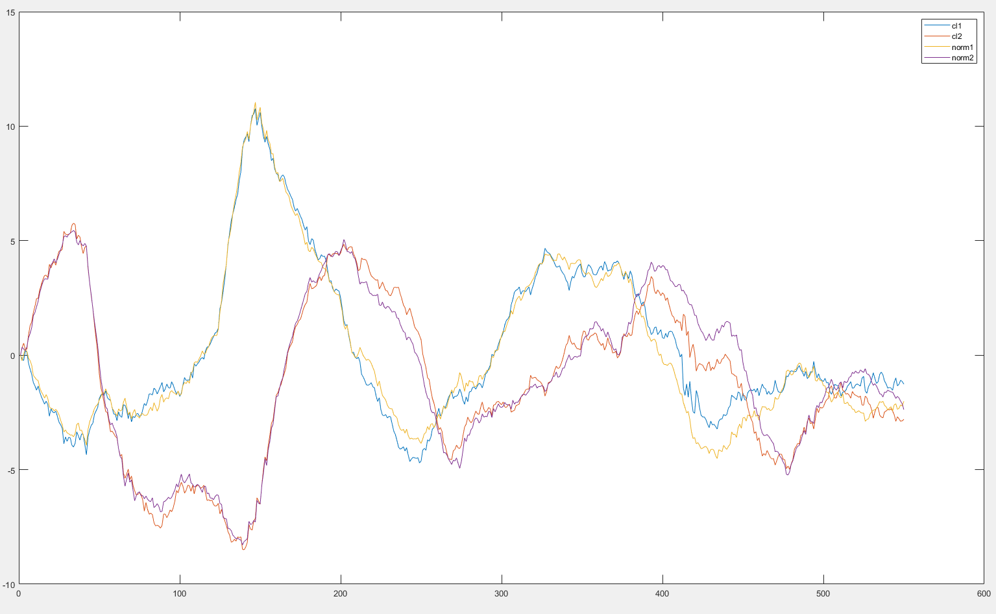
Swimmer3
Batch=110
Averaged over 500
dt=0.001s
Noise=10%
Closedloop
Y(9:10)

Slide 9
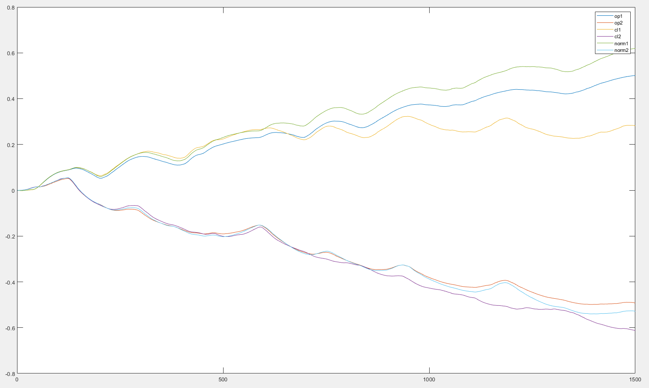
Swimmer3
Batch=1500
Averaged over 1
dt=0.005s
Noise=10%
Closedloop
Y(1:2)

Slide 10
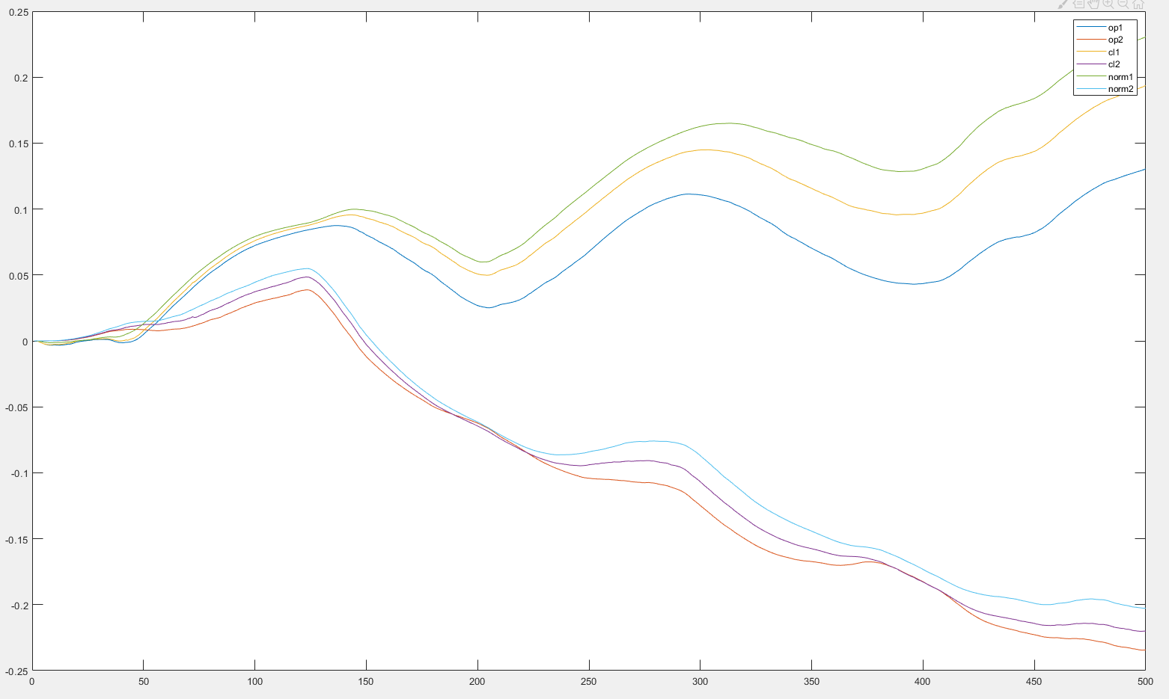
Swimmer3
Batch=500
Averaged over 1
dt=0.005s
Noise=10%
Closedloop
Y(1:2)

Slide 11
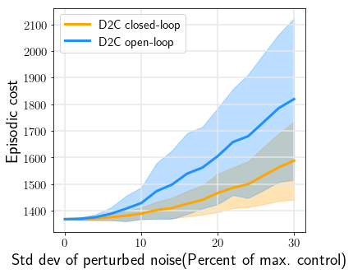
Swimmer3
First 500 steps
Averaged over 400
dt=0.005s
Closedloop vs openloop

Slide 12
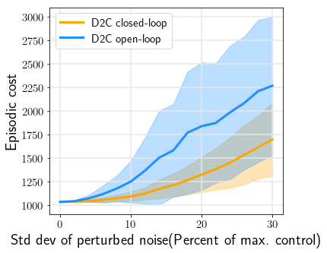
Swimmer3
First 1300 steps
Averaged over 400
dt=0.005s
Closedloop vs openloop

Slide 13
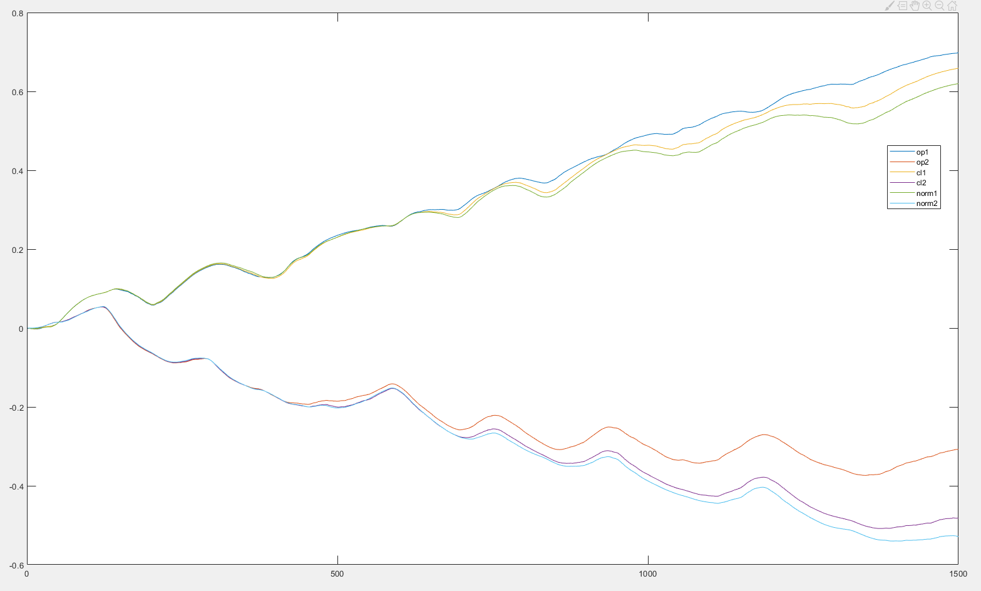
Swimmer3
Batch=770
Zero init
Averaged over 1
dt=0.005s
Noise=10%
Closedloop
Y(1:2)

Slide 14
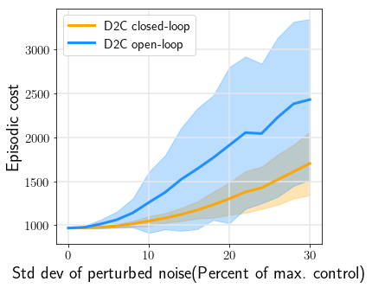
Swimmer3
1500 steps
Zero init
Averaged over 400
dt=0.005s
Closedloop vs openloop

Slide 15
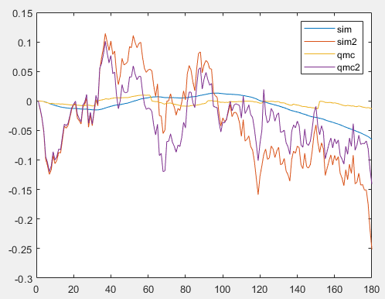
Pendulum
Batch=30
Zero init
Averaged over 1
dt=0.01s
Noise=10%
Sim vs qmc
Y(1:2)
Pert_noise=0.1umax

Slide 16
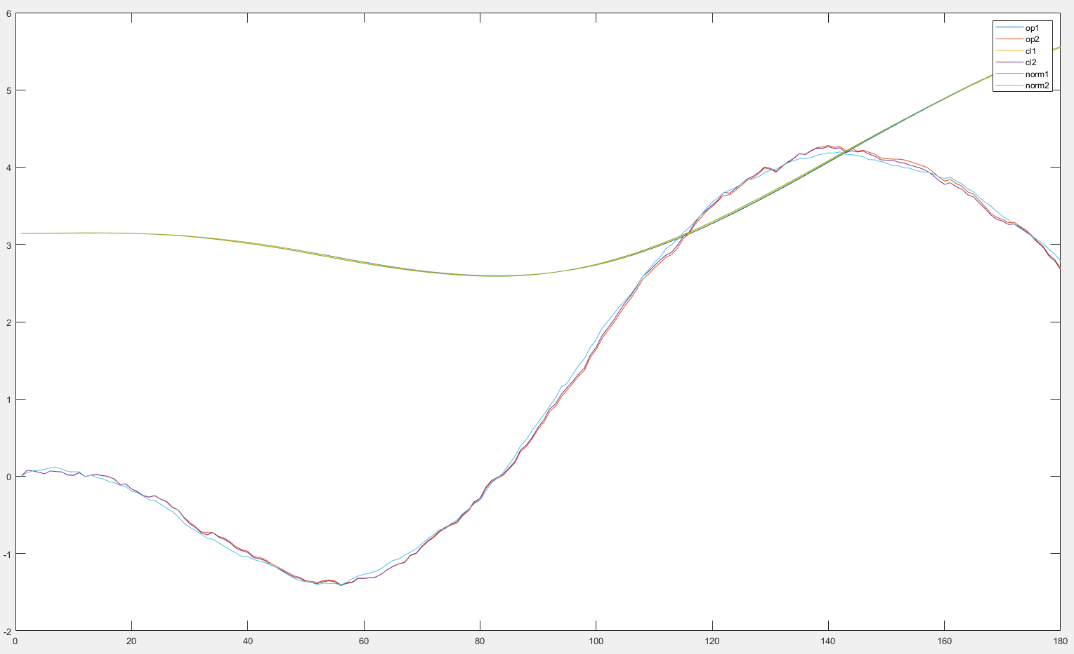
Pendulum
Batch=30
Zero init
Averaged over 1
dt=0.01s
Noise=10%
closedloop
Y(1:2)
Pert_noise=0.1umax

Slide 17
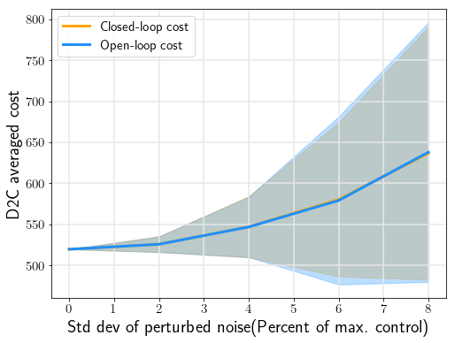
Pendulum
Batch=30
Zero init
Averaged over 400
dt=0.01s
Closedloop vs openloop
Pert_noise=0.1umax

Slide 18
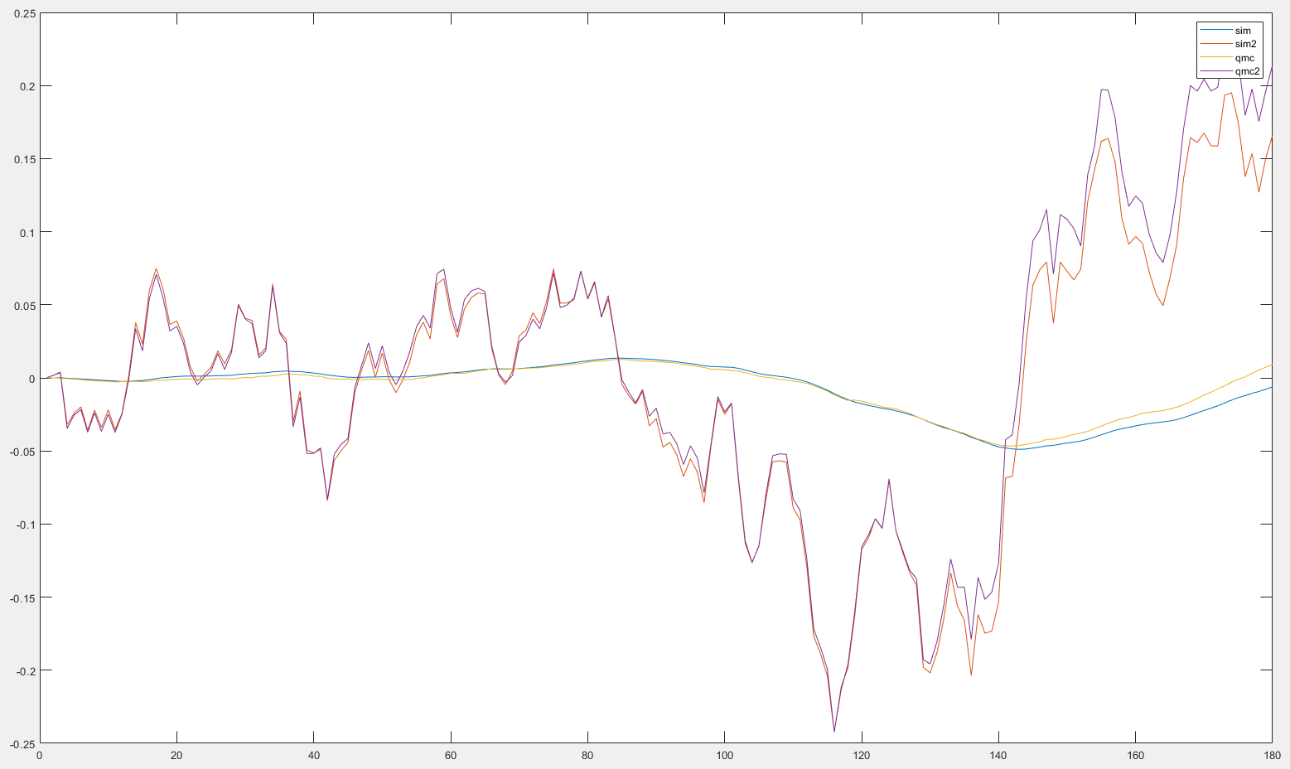
Pendulum
Batch=30
nonzero init
Averaged over 1
dt=0.01s
Noise=10%
Sim vs qmc
Y(1:2)
Sysid Pert_noise=0.1umax

Slide 19
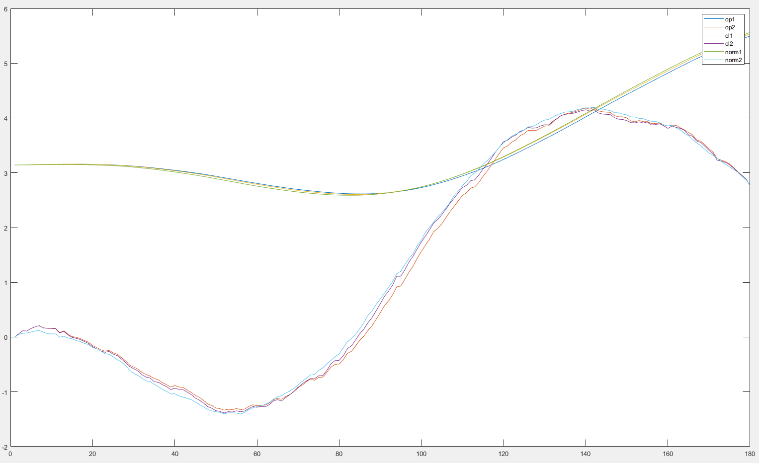
Pendulum
Batch=30
nonzero init
Averaged over 1
dt=0.01s
Noise=10%
closedloop
Y(1:2)
Sysid Pert_noise=0.1umax

Slide 20
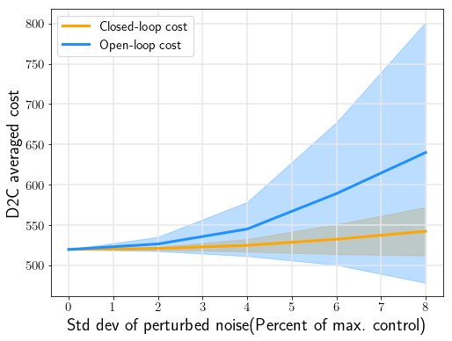
Pendulum
Batch=30
nonzero init
Averaged over 400
dt=0.01s
Closedloop vs openloop
Sysid Pert_noise=0.1umax

Slide 21
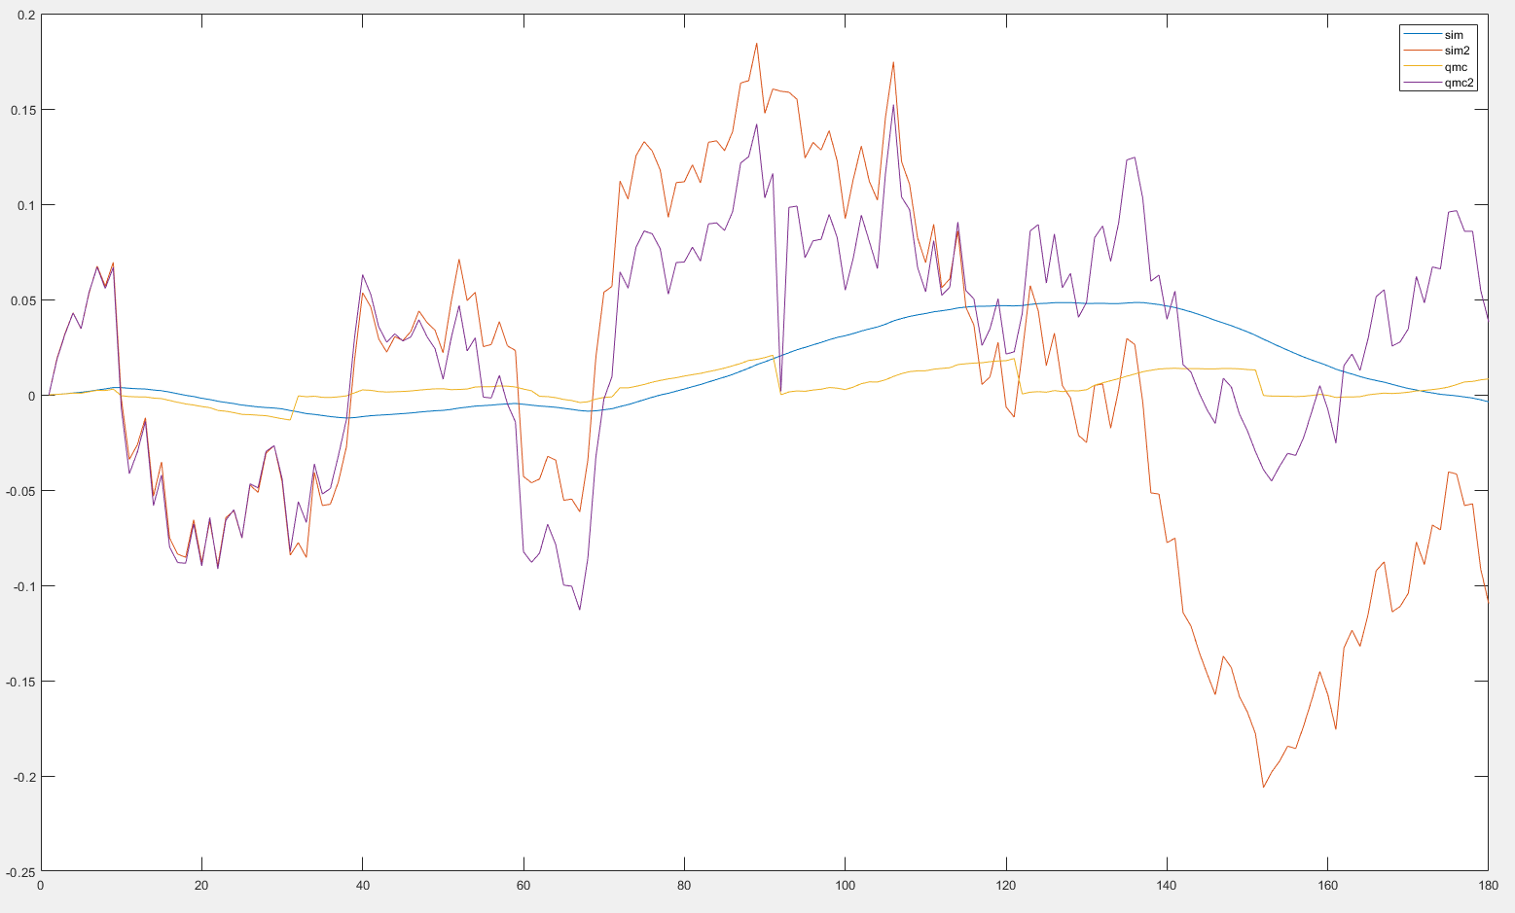
Pendulum
Batch=30
zero init
Averaged over 1
dt=0.01s
Noise=10%
Sim vs qmc
Y(1:2)
Pert_noise=0.5umax

Slide 22
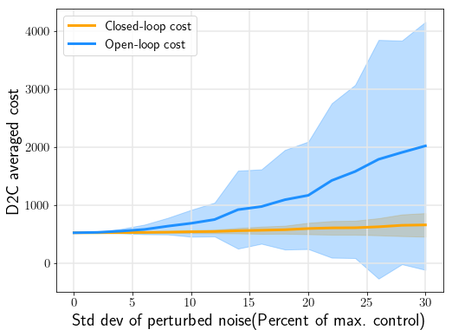
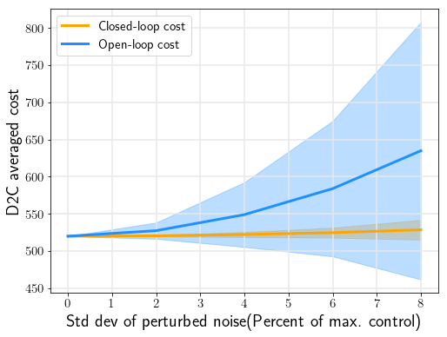
Pendulum
Batch=30
zero init
Averaged over 400
dt=0.01s
Closedloop vs openloop
Pert_noise=0.5umax

Slide 23
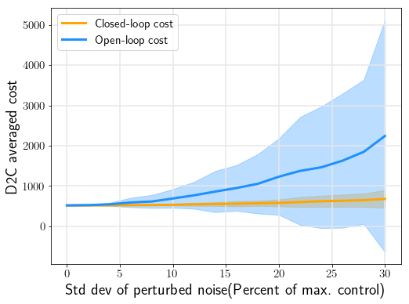
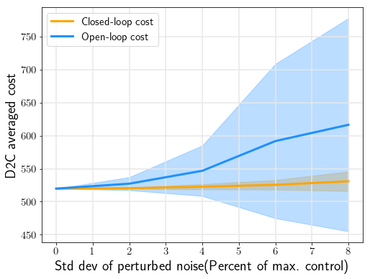
Pendulum
Batch=30
nonzero init
Averaged over 400
dt=0.01s
Closedloop vs openloop
Pert_noise=0.5umax

Slide 24
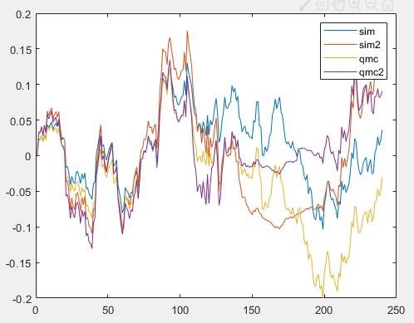
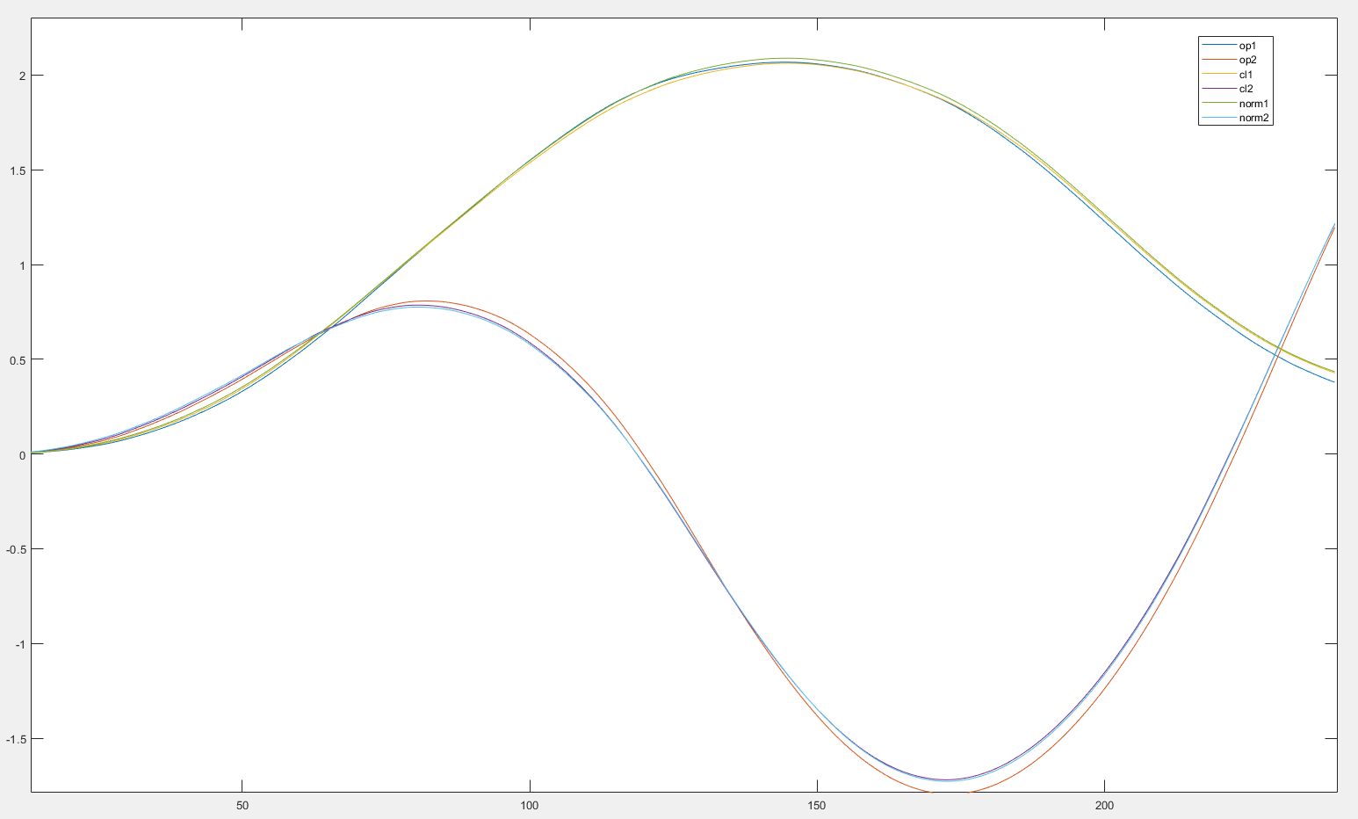
Cartpole
Batch=60
zero init
Averaged over 1
dt=0.01s
Noise=10%
Sim vs qmc
Y(1:2)
Sysid Pert_noise=0.5umax

Slide 25
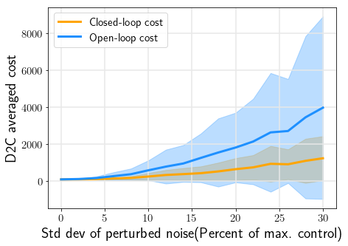
Cartpole
Batch=60
zero init
Averaged over 400
dt=0.01s
Closedloop vs openloop
Sysid Pert_noise=0.5umax

Slide 26
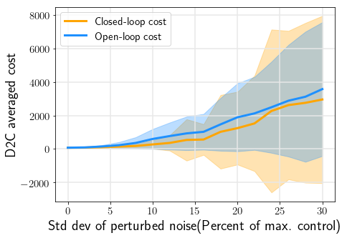
Cartpole
Batch=20
zero init
Averaged over 400
dt=0.01s
Closedloop vs openloop
Sysid Pert_noise=0.5umax

Slide 27
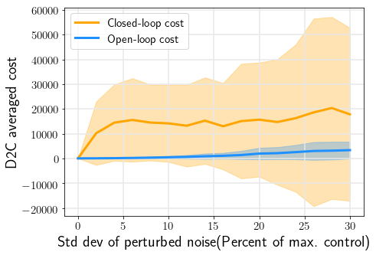
Cartpole
Batch=10
zero init
Averaged over 400
dt=0.01s
Closedloop vs openloop
Sysid Pert_noise=0.5umax

Slide 28
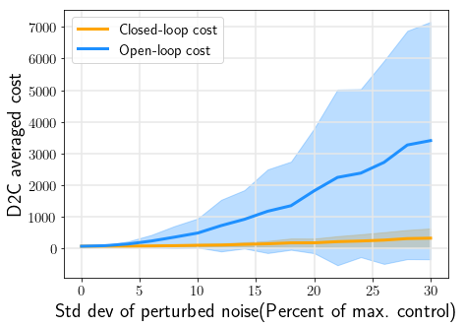
Cartpole
Batch=20
Init=0.1
Averaged over 400
dt=0.01s
Closedloop vs openloop
Sysid Pert_noise=0.5umax

Slide 29
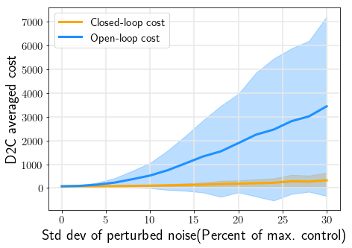
Cartpole
Batch=10
Init=0.1
Averaged over 400
dt=0.01s
Closedloop vs openloop
Sysid Pert_noise=0.5umax

Slide 30
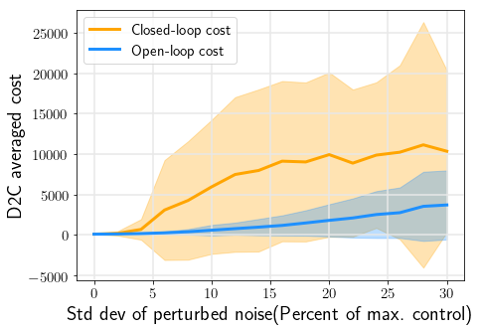
Cartpole
Batch=10
Init=0.001
Averaged over 400
dt=0.01s
Closedloop vs openloop
Sysid Pert_noise=0.5umax

Slide 31
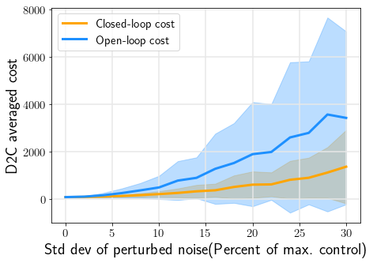
Cartpole
Batch=60
zero init
Averaged over 400
dt=0.01s
Closedloop vs openloop
Sysid Pert_noise=0.5umax
Sysid trialnum=200

Slide 32
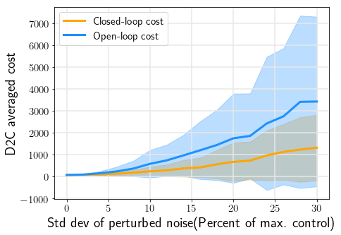
Cartpole
Batch=60
Init=0.1
Averaged over 400
dt=0.01s
Closedloop vs openloop
Sysid Pert_noise=0.5umax
Sysid trialnum=200

Slide 33
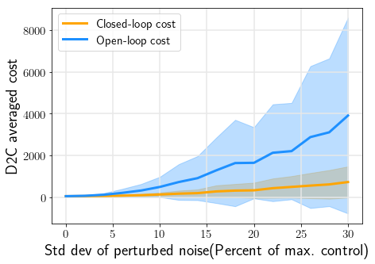
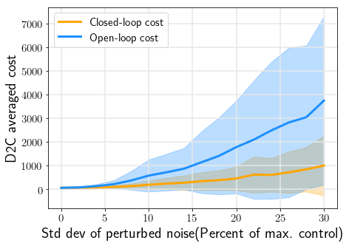
Cartpole
Batch=60
Init=0.2
Averaged over 400
dt=0.01s
Closedloop vs openloop
Sysid Pert_noise=0.5umax
Sysid trialnum=200

Slide 34
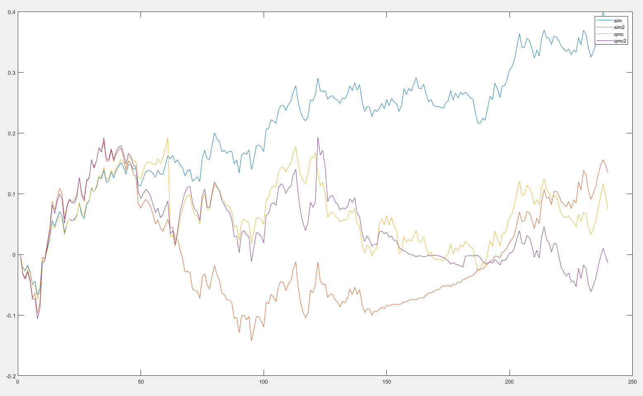
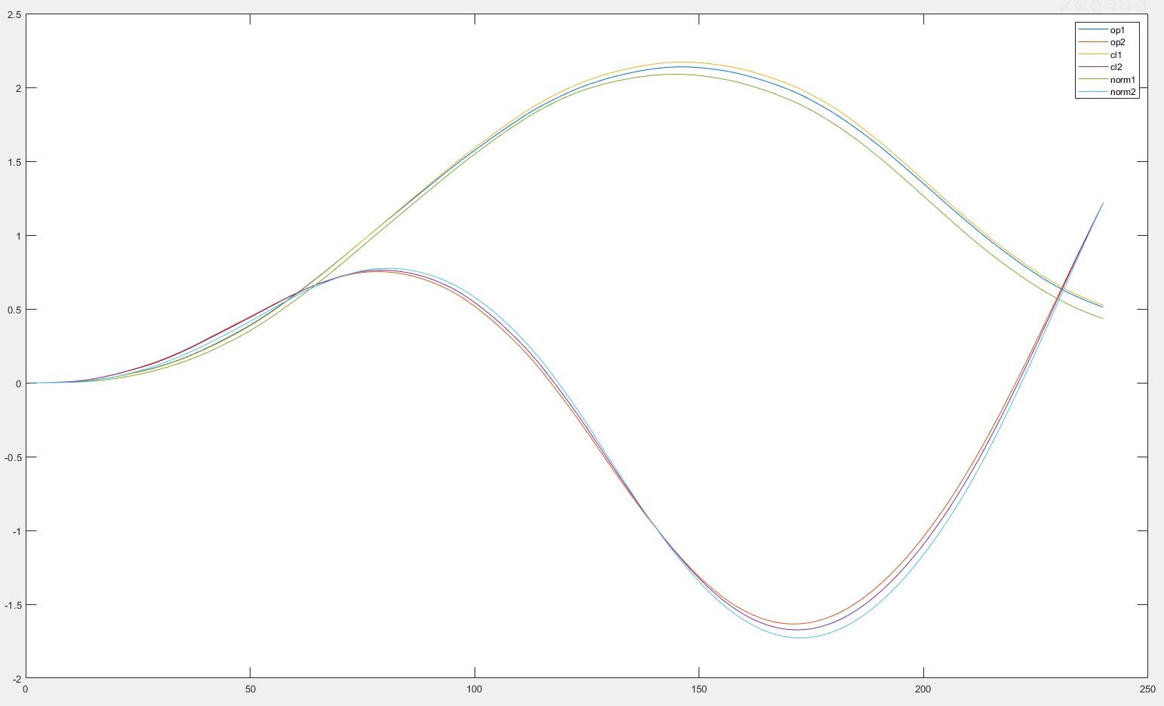
Cartpole
Batch=60
zero init
Averaged over 1
dt=0.01s
Noise=10%
Sim vs qmc
Y(1:2)
Sysid Pert_noise=0.12umax

Slide 35
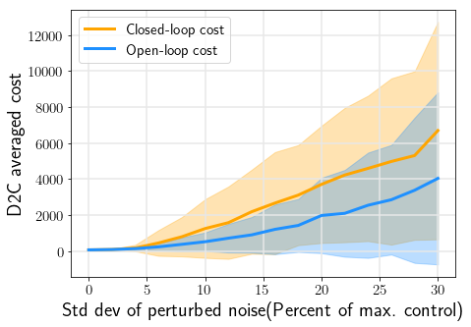
Cartpole
Batch=60
zero init
Averaged over 400
dt=0.01s
Closedloop vs openloop
Sysid Pert_noise=0.12umax

Slide 36
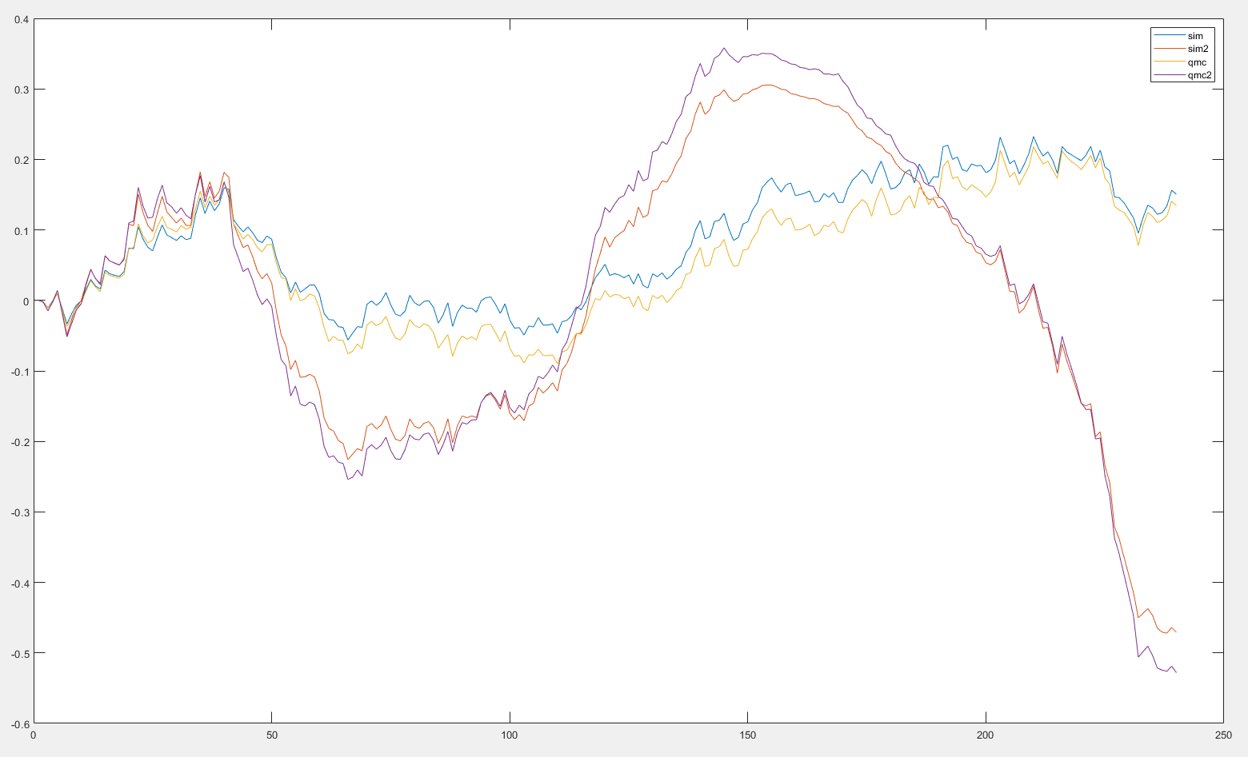
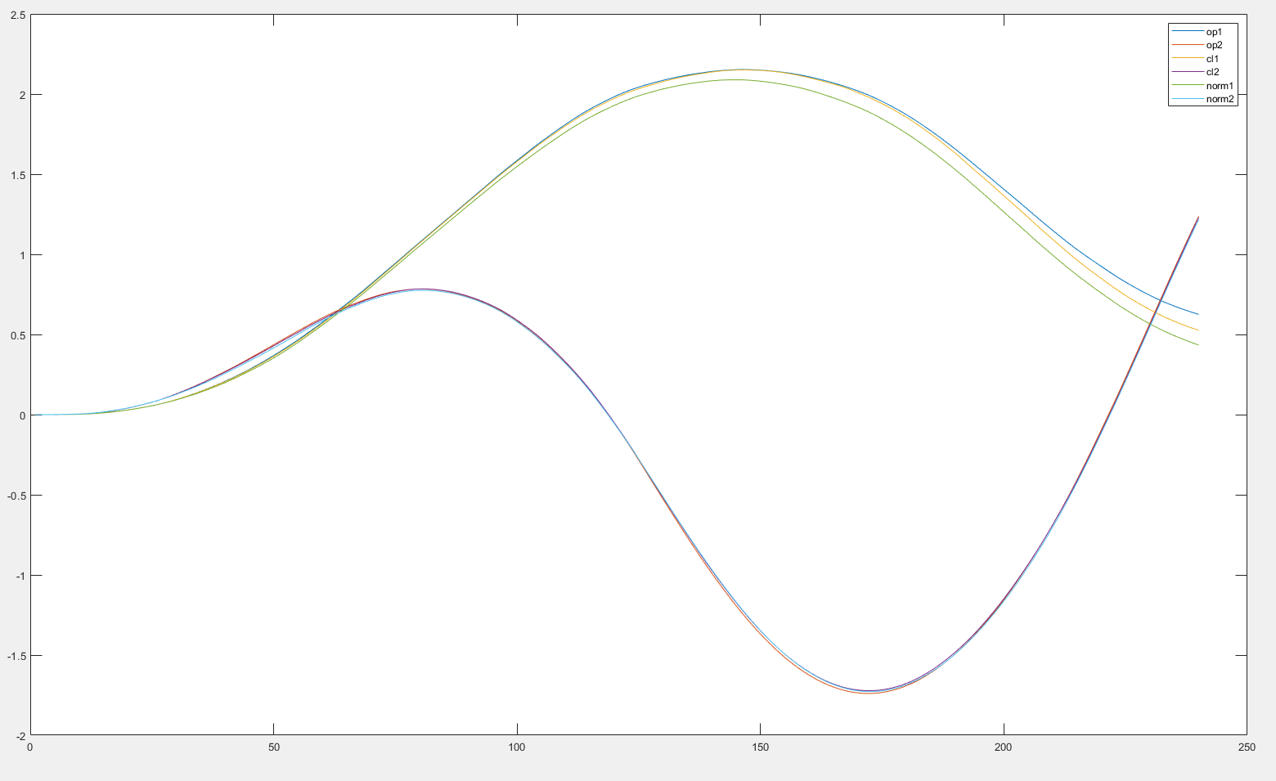
Cartpole
Batch=60
nonzero init
Averaged over 1
dt=0.01s
Noise=10%
Sim vs qmc
Y(1:2)
Sysid Pert_noise=0.12umax

Slide 37
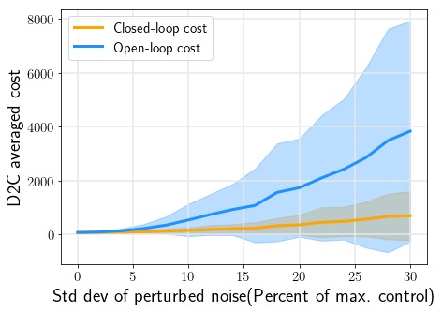
Cartpole
Batch=60
nonzero init
Averaged over 400
dt=0.01s
Closedloop vs openloop
Sysid Pert_noise=0.12umax

Slide 38
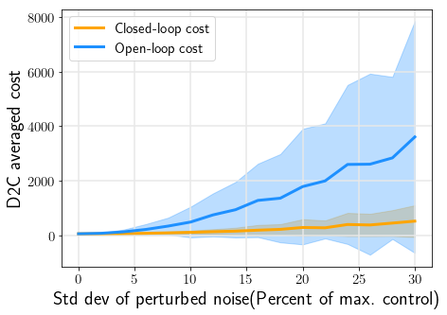
Cartpole
Batch=60
nonzero init
Averaged over 400
dt=0.01s
Closedloop vs openloop
Sysid Pert_noise=0.5umax

Slide 39
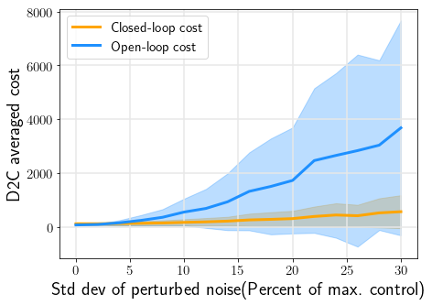
Cartpole
Batch=60
nonzero init=0.2
Averaged over 400
dt=0.01s
Closedloop vs openloop
Sysid Pert_noise=0.5umax
Sysid trial_num=200
Measurement noise=N(0,0.1)

Slide 40
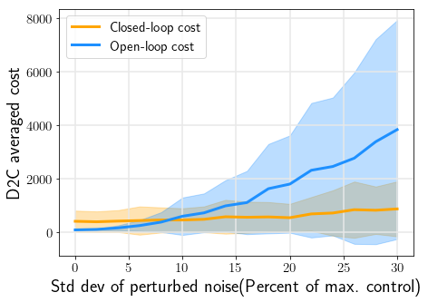
Cartpole
Batch=60
nonzero init=0.2
Averaged over 400
dt=0.01s
Closedloop vs openloop
Sysid Pert_noise=0.5umax
Sysid trial_num=200
Measurement noise=N(0,0.3)

Slide 41

Cartpole
Batch=60
nonzero init
Averaged over 400
dt=0.01s
Closedloop vs openloop
Sysid Pert_noise=0.8umax
Sysid trialnum=2000

Slide 42
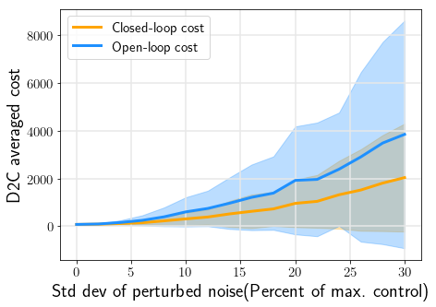
Cartpole
Batch=60
zero init
Matchq=4(all not mentioned were 8)
Averaged over 400
dt=0.01s
Closedloop vs openloop
Sysid Pert_noise=0.12umax

Slide 43
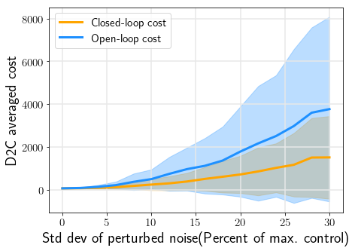
Cartpole
Batch=60
nonzero init
Matchq=8
Averaged over 400
dt=0.01s
Closedloop vs openloop
Sysid Pert_noise=0.8umax
Sysid trail_num=200

Slide 44
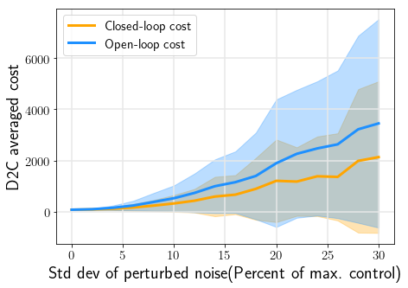
Cartpole
Batch=60
nonzero init
Matchq=8
Averaged over 400
dt=0.01s
Closedloop vs openloop
Sysid Pert_noise=0.8umax
Sysid trail_num=200

Slide 45

Cartpole
Batch=60
nonzero init
Matchq=8
Averaged over 400
dt=0.01s
Closedloop vs openloop
Sysid Pert_noise=0.12umax
Sysid trail_num=200

Slide 46


swimmer3
Batch=770
Init=0
Matchq=10
Averaged over 400
dt=0.005s
Closedloop vs openloop
Sysid Pert_noise=0.05umax
Sysid trail_num=3000

Slide 47

swimmer3
Batch=520
Init=0
Matchq=10
Averaged over 400
dt=0.005s
Closedloop vs openloop
Sysid Pert_noise=0.02umax
Sysid trail_num=3000

Slide 48


swimmer3
Batch=200
Init=0.01
Matchq=10
Averaged over 400
dt=0.005s
Closedloop vs openloop
Sysid Pert_noise=0.02umax
Sysid trail_num=3000

Slide 49

swimmer3
Batch=155
Init=0.01
Matchq=10
Averaged over 400
dt=0.005s
Closedloop vs openloop
Sysid Pert_noise=0.02umax
Sysid trail_num=10000

Slide 50

swimmer3
Batch=155
Init=0.01
Matchq=10
Averaged over 400
dt=0.005s
Closedloop vs openloop
Sysid Pert_noise=0.04umax
Sysid trail_num=10000

Slide 51

swimmer3
Batch=155
Init=0
Matchq=10
Averaged over 400
dt=0.005s
Closedloop vs openloop
Sysid Pert_noise=0.04umax
Sysid trail_num=10000

Slide 52

swimmer3
Batch=155
Init=0.01
Matchq=10
Averaged over 400
dt=0.005s
Closedloop vs openloop
Sysid Pert_noise=0.04umax
Sysid trail_num=10000
Measurement noise N(0,2)

Slide 53

cartpole
Batch=60
Init=0.02
Matchq=4dt=0.01s
Sim vs qmc
Sysid Pert_noise=0.5umax
Sysid trail_num=2000
Only velocity

Slide 54

cartpole
Batch=60
Init=0.02
Matchq=4dt=0.01s
Closedloop vs openloop
Sysid Pert_noise=0.5umax
Sysid trail_num=2000
Only velocity

