Slide 1
Online Shopping Cart
Maulana Azad National Institute of
Technology
Ramankit Singh
122106188
MCA
Date:- 29-10-2013

Slide 2
Acknowledgement
I am extremely thankful to our Institute, Maulana Azad National Institute of Technology, Bhopal for giving us the opportunity to work on this project.
We would also like to show our gratitude to our internal guide, Dr. Sanjay Sharma, for being our pillar of support at all times.
Lastly we would like to thank all of our family, friends and well wishers for their support and encouragement.

Slide 3
Index
System Analysis
Abstract
Existing system
Need for new system
Stakeholders
Administrator
User
Seller
Minimum hardware requirement
Minimum software requirement
Data Flow Diagrams
Data Dictionary
ER Diagrams
Queries
Future scope

Slide 4
SYSTEM ANALYSIS

Slide 5
Abstract
Shopping Cart is an online digital store that enables website owners and sellers to sell their product online. It is a web based shopping cart that allows user to browse and buy item using a web browser.
The System helps the Customer to purchase the products with the help of internet and various payments options
It includes sophisticated product and customer management modules.
This website will be useful to anyone who wants to purchase items using internet.
Generates the Reports related to the system.

Slide 6
Existing System
In the existing system all transactions, dealings of products, purchasing of products were done manually which is time consuming.
Reports are prepared manually as and when needed. Maintaining of reports is very tedious task.
To buy any product user has to collect information about it either by visiting the shop or asking people which is the better one.
There is no computer system for handling payments. All calculations are performed manually which may not be accurate always. Maintaining the record is really a tedious task.

Slide 7
Need for the New System
Online Shopping Portal is a specific requirement of the client that integrates the buying and selling services specifically to their customers.
Need for the new system is due to major drawbacks of existing system.
Reports can be generated at any time within few seconds, so that manual labor is not required, and also analysis can be performe d much more frequently which helps in taking decision.

Slide 8
Need for the New System
The details regarding all users, products can also be maintained as their information is very helpful and sometimes becomes a critical requirement.
Allows user to get registered from their places and do transaction for the required product.
To overcome these problems in existing system we develop “
OnlineShopping Cart”.

Slide 9
Need for the New System
Any internet user can use this existing website to search for any kind of products, select particular products from a wide range of products.
Once they make of their mind to purchase any particular thing they can place an order and make a payment throw various available payment option.
User can ask for refunds if he/she isn’t satisfied with the product
User can write reviews for the awareness of other users

Slide 10
Stakeholders
Administrator
User
Seller

Slide 11
Administrator
Generate Report
User Management
Product Management

Slide 12
Seller
Put product listing
Request features and category addition
Has a payment history
Controls shipping module
Send messages
Has a store
Can generate reports related to sales

Slide 13
Minimum Hardware Requirements
32 bit processor
25 GB of storage
Input device(Mouse, Keyboard)
Output Device(Monitor, Printer)

Slide 14
Minimum Software Requirements
Server Side
Oracle
LAMP/WAMP STACK
Client Side
Web browser

Slide 15
Data Flow Diagrams

Slide 16
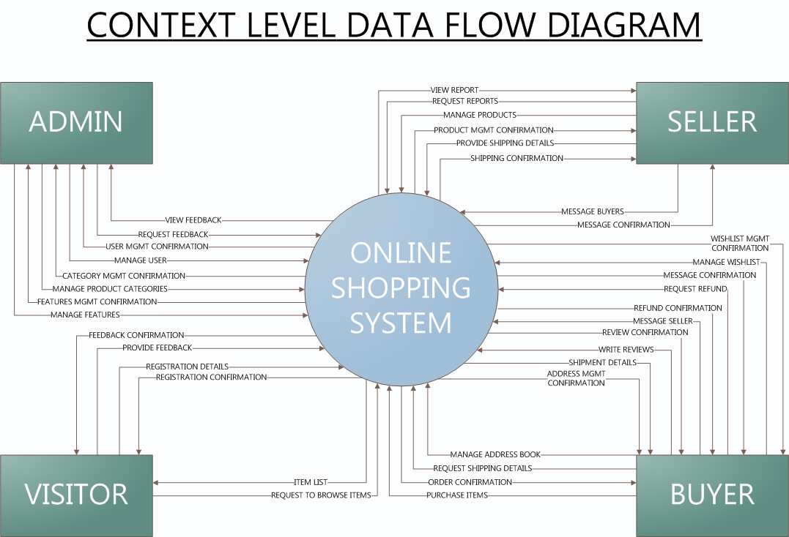

Slide 17
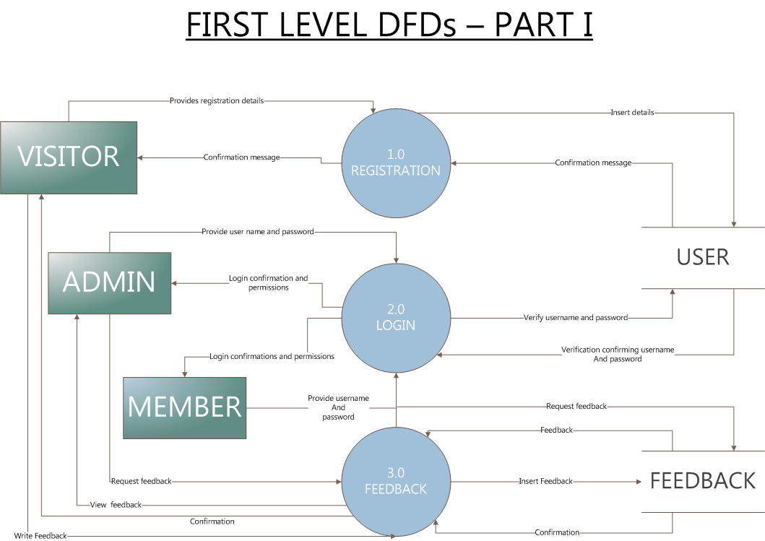

Slide 18
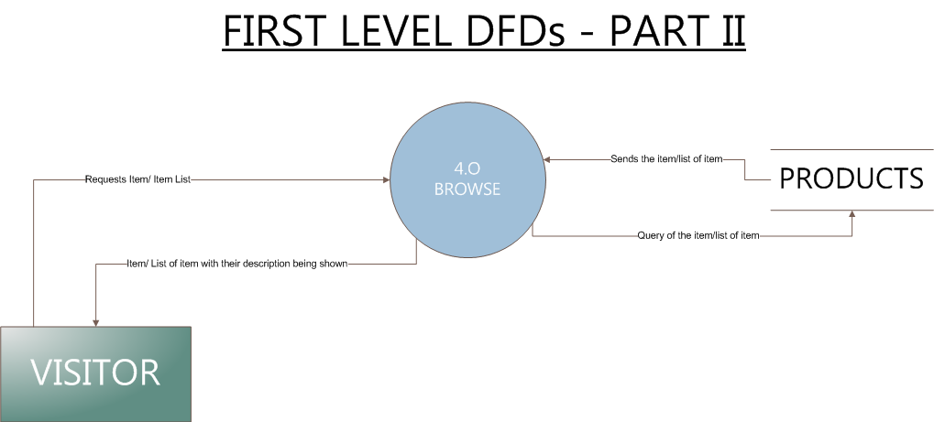

Slide 19
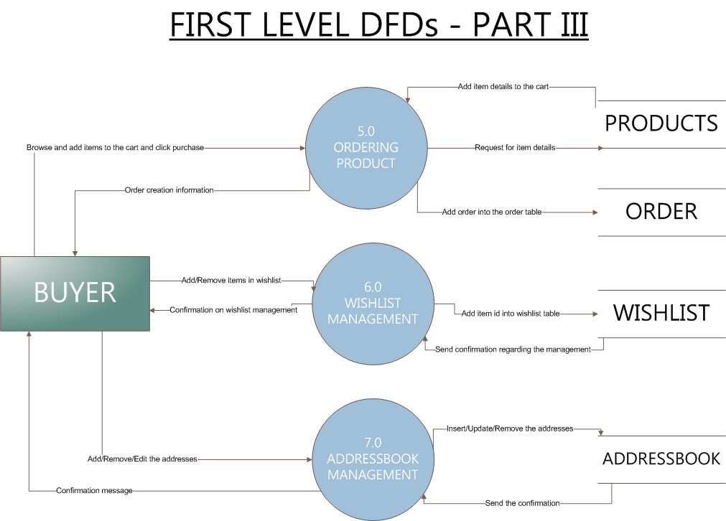

Slide 20


Slide 21
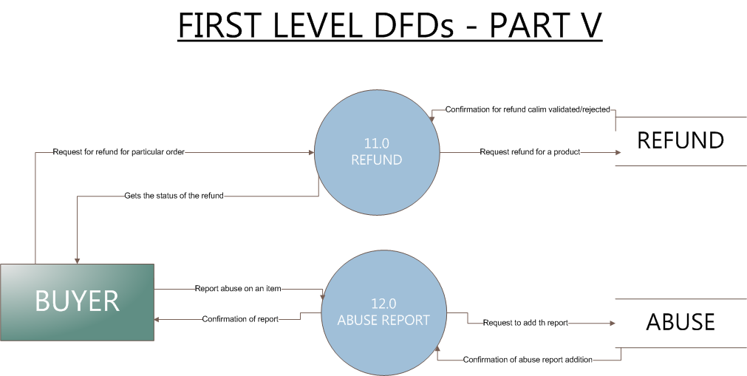

Slide 22


Slide 23
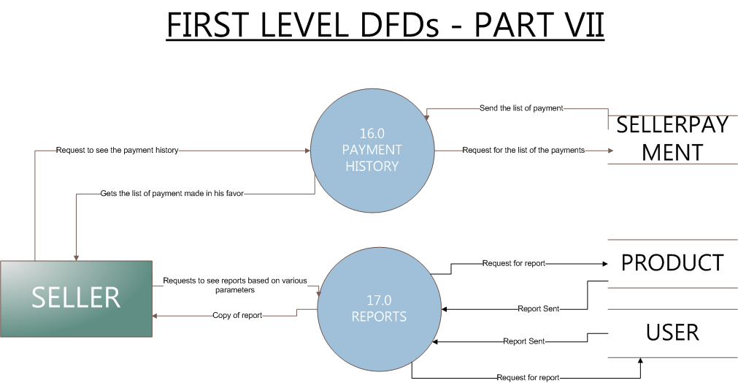

Slide 24
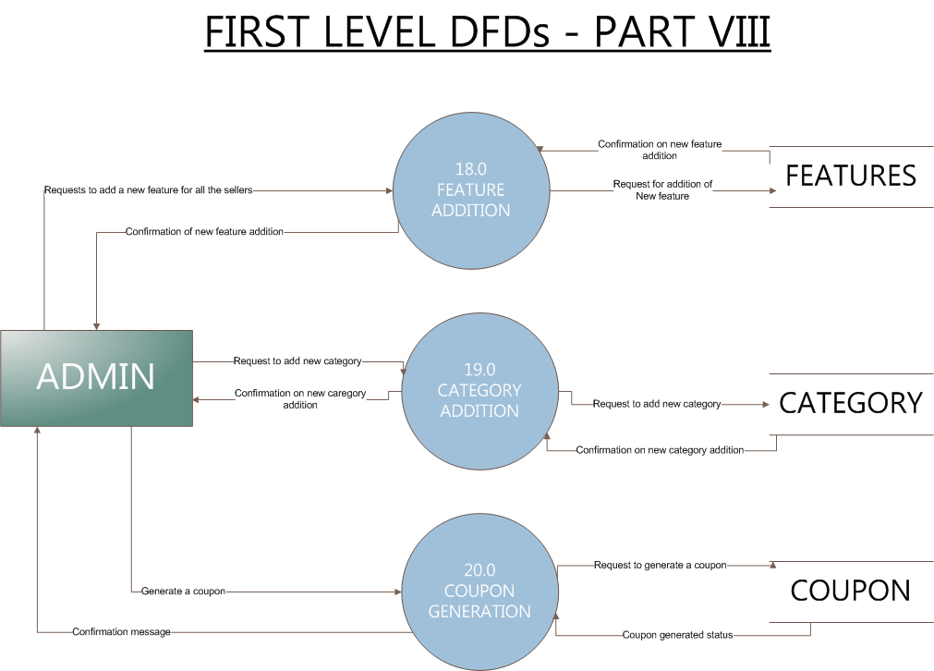

Slide 25
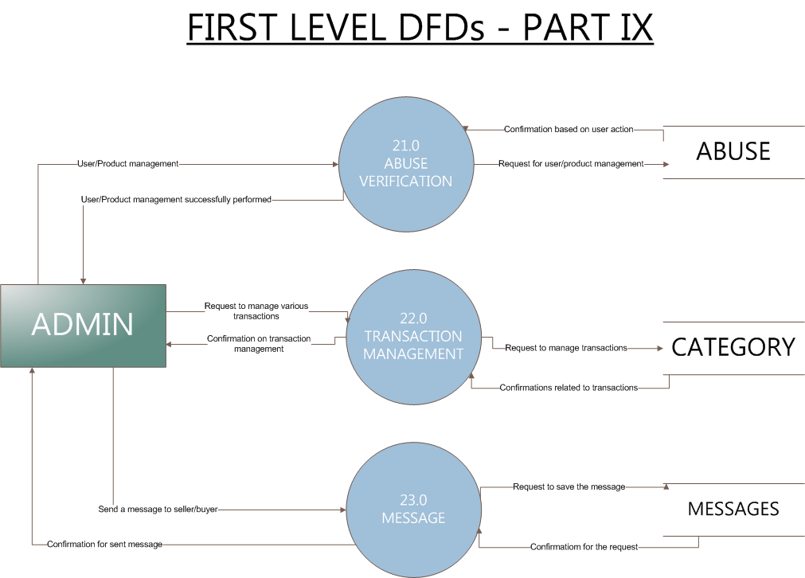

Slide 26
DATA-DICTIONARY

Slide 27
Abuse
Column | Type | Null | Default | Comments | Key
abuseID | number(11) | No |  | This field contains the ID of the abuse | Primary
Products_productID | number(11) | No |  | This field contains produt id for which the complanumber has been filed | Foreign
User_userID | number(11) | No |  | This field contains the id of the user who filed the report
abuseDescription | varchar2(128) | Yes | NULL | This field contains the description of the abuse by the user

Slide 28
Addressbook
Column | Type | Null | Default | Comments | Key
AddressID | number(11) | No |  | This field serves as primary key for addresses | Primary
User_userID | number(11) | No |  | This field serves a foreign key to identify addresses associated with a perticular user | Foreign
Name | varchar2(128) | No |  | This field contains name of the person
Address | varchar2(512) | No |  | This field contains address of the person
District | varchar2(64) | No |  | This field contains district for the given address
pinCode | number(11) | No |  | This field contains pin code for the given address
mobileNumber | number(11) | No |  | This field contains mobile number for the given address
phoneNumber | varchar2(45) | Yes | NULL | This field contains optional phone number for the given address
States_stateID | number(11) | No |  | This field contains ID of the state as foreign key

Slide 29
Category
Column | Type | Null | Default | Comments | Key
categoryID | number(11) | No |  | This field will store categoryID as a primary number. | Primary
categoryName | varchar2(128) | No |  | This field contains name of the category
parentCategoryID | number(11) | Yes | NULL | This field contains id of the parent category

Slide 30
CouponGroup
Column | Type | Null | Default | Comments | Key
couponGroupID | number(11) | No |  | This field contains primary key for the table | Primary
CouponMetaName | varchar2(48) | No |  | This field contains the name of the group on which coupon will be applied. group could be category,sub-category, manufacturer, seller or an individual product

Slide 31
Coupons
Column | Type | Null | Default | Comments | Key
couponCode | varchar2(64) | No |  | This field contains the primary key. It is a randomly generated unique string to be used as the coupon. | Primary
CouponType_couponTypeID | number(11) | No |  | This field contains type of coupon as a foreign key indicating what form of coupon is beling applied ie flat discount or % based discount | Foreign
CouponGroup_couponGroupID | number(11) | No |  | This field contains the foreign key indicating exactly on what object coupon will be applied. Object could be a category, seller, manufacturer or an individual product. | Foreign
couponGroupMetaValue | number(11) | No |  | This field contains the value as ID of the field on which the coupon is to be applied(manufacturer id, seller id, product id etc etc)
couponStartDate | datetime | No |  | This field contains the value from which the coupon will become available to the customer.
couponExpiryDate | datetime | No |  | This field contains the date on which the coupon will expire.
minAmount | number(11) | No | 0 | This field contains value of minimum purchase amount if any on the product for a coupon to become eligible
maxDiscount | number(11) | No | 1500 | This field contains the maximum amount which can be availed under a given discount
couponMaxUsage | number(11) | No | 1 | This field contains the number of times a coupon can be availed by a single user

Slide 32
CouponType
Column | Type | Null | Default | Comments | Key
couponTypeID | number(11) | No |  | This field serves as primary key as an numbereger for this table | Primary
typeName | varchar2(48) | Yes | NULL | This field contains the name of the coupon type .ie type of coupon like flat off or % off

Slide 33
Features
Column | Type | Null | Default | Comments | Key
featureId | number(11) | No |  | This field is the primary key for the features table | Primary
featureName | varchar2(256) | No |  | This field contains the name of the feature of a product
Category_categoryID | number(11) | No |  | This field contains foreign key for the category the feature belongs to.t | Foreign

Slide 34
Feedback
Column | Type | Null | Default | Comments | Key
feedbackID | number(11) | No |  | This field acts as the primary key for the table | Primary
feedbackEmaiil | varchar2(128) | No |  | This field contains email address of the person providing the feedback
feedbackSubject | varchar2(256) | Yes | NULL | This field contains the subject of the feedback
feedbackContent | varchar2(1024) | No |  | This field contains the content of feedback

Slide 35
Image
Column | Type | Null | Default | Comments | Key
imageID | number(11) | No |  | This field contains primary key for image table. | Primary
products_productID | number(11) | No |  | This field contains ID of the product for which the image is being put | Foreign
imagePath | varchar2(512) | No |  | This field contains the path of the image on server
imageUploadDate | datetime | No |  | This field contains date and time of upload of image.
primaryImage | number(1) | No |  | This feature tells if the image is the first one to load

Slide 36
Manufacturer
Column | Type | Null | Default | Comments | Key
manufacturerID | number(11) | No |  | This field name contains ID of the manufacturer. | Primary
manufacturerName | varchar2(64) | No |  | This field contains name of the manufacturer
manufacturerDescription | varchar2(512) | Yes | NULL | This field contains description of the manufacturer

Slide 37
Message
Column | Type | Null | Default | Comments | Key
messageID | number(11) | No |  | This field serves as primary key for the messages table | Primary
User_userIDFrom | number(11) | No |  | This field contains ID of the user who will send the message | Foreign
User_userIDTo | number(11) | No |  | This field contains ID of the user to whom message is being sent | Foreign
messageSubject | varchar2(48) | Yes | NULL | This field contains the subject of the message to be delivered
messsageContent | varchar2(512) | No |  | This field contains the text of the message
messageTime | datetime | No |  | This field contains date and time on which the message was sent

Slide 38
OrderDetails
Column | Type | Null | Default | Comments | Key
Orders_orderID | number(11) | No |  | This field contains the order id so as to get all the items related to the given order | Foreign
Products_productID | number(11) | No |  | this field contains product in an order | Foreign
quantity | number(11) | No |  | this field contains the number of items for a given product to be bought

Slide 39
Orders
Column | Type | Null | Default | Comments | Key
orderID | number(11) | No |  | This field serves as primary key for the orders received by the consumer | Primary
orderDate | datetime | No |  | This field contains the date on which the order was made
User_userID | number(11) | No |  | this field serves as foreign key with information to the user who ordered the product | Foreign
Addressbook_AddressID | number(11) | No |  | This field contains the address on which the given item has to be delivered. | Foreign
Coupons_couponCode | varchar2(64) | Yes | NULL | This field contains the id of the coupon if applied on the product | Foreign

Slide 40
ProductFeature
Column | Type | Null | Default | Comments | Key
products_productID | number(11) | No |  | This field contains foreign key as product id on which the feature is available | Foreign
Features_featureId | number(11) | No |  | this field contains foreign key which tells what feature are available on a certain feature | Foreign

Slide 41
Product
Column | Type | Null | Default | Comments | Key
productID | number(11) | No |  | This field contains the primary key to a given product | Primary
User_userID | number(11) | No |  | This field is a foreign key which contains info about the user(seller) who posted the listing. | Foreign
Category_categoryID | number(11) | No |  | This field contains foreign key from category table for recognizing/assigning item's category | Foreign
Manufacturer_manufacturerID | number(11) | No |  | This field contains foreign key representing the manufacturer of the product | Foreign
productnName | varchar2(128) | No |  | This field contains the name of the product
productDescription | varchar2(1024) | Yes | NULL | This field contains additional information about the product
productPrice | number(11) | No |  | This field contains the price of the product
productPostDate | datetime | No |  | This field contains Date and time of the item listing.
productExpiryDate | datetime | No |  | This field contains product listings end time.
productCount | number(11) | No |  | This field contains amount of product being listed
productWarranty | number(11) | Yes | 0 | This field contains product warranty in months

Slide 42
Refund
Column | Type | Null | Default | Comments | Key
refundID | number(11) | No |  | This field contains primary key for the refund table | Primary
RefundStatus_statusID | number(11) | No |  | This field contains the refund status as a foreign key | Foreign
Orders_orderID | number(11) | No |  | This field contains id of the order for which refund has been ordered | Foreign
refundReason | varchar2(128) | Yes | NULL | This field contains the reason for the refund

Slide 43
RefundStatus
Column | Type | Null | Default | Comments | Key
statusID | number(11) | No |  | This field contains the id of the refund status | Primary
statusValue | varchar2(48) | Yes | NULL | This field contains the value of the refund status

Slide 44
Review
Column | Type | Null | Default | Comments | Key
User_userID | number(11) | No |  | This field contains a foreign key which will act as a conjugate primary key. Contains information about the user whi bought the product. | Foreign
Products_productID | number(11) | No |  | This is a foreign key field. Identifies the product being reviewd. | Foreign
rating | number(11) | Yes | NULL | This field contains rating of a product by the shopper
reviewDescription | varchar2(512) | Yes | NULL | This field contains the detailed review of the product
reviewDate | datetime | Yes | NULL | This field contains date and time for the comment made.

Slide 45
SellerPayment
Column | Type | Null | Default | Comments | Key
paypalID | varchar2(48) | No |  | This field contains the paypal ID of the user in which amount for the item sold will be transferred
User_userID | number(11) | No |  | This field contains foreign key which relates to user id in whch amount is to be credited | Foreign

Slide 46
SellerPaymentHistory
Column | Type | Null | Default | Comments | Key
Orders_orderID | number(11) | No |  | This field contains the order id as a foreign key to identify for what order the payment is being made. | Foreign
sellerPaymentDate | datetime | No |  | This field contains the date on which the transaction of money transfer takes place
amount | number(11) | No |  | This field contains the amount of money to be transferred numbero user's paypal account
User_userID | number(11) | No |  | This field acts as a primary key for the user for whom the payment is being made | Foreign

Slide 47
Shipping
Column | Type | Null | Default | Comments | Key
Orders_orderID | number(11) | No |  | this field contains the order for which transaction details are to be obtained | Foreign
trackingID | varchar2(48) | Yes | NULL | This field contains the tracking id of the product
shippingCompany_shippingCompanyID | number(11) | No |  | This field contains the id of the shipping company as a foreign key | Foreign
deliveryDate | date | Yes | NULL | This field contains the date on which the product was delivered

Slide 48
ShippingCompany
Column | Type | Null | Default | Comments | Key
shippingCompanyID | number(11) | No |  | This field contains the primary key for the tracking company | Primary
shippingCompanyName | varchar2(45) | No |  | This field contains nam of the shipping company
trackURL | varchar2(256) | No |  | this field contains the web url of th compnay for tracking an item

Slide 49
States
Column | Type | Null | Default | Comments | Key
stateID | number(11) | No |  | This field contains the id of the state as primary key | Primary
stateName | varchar2(128) | Yes | NULL | This field contains the value as the name of the state

Slide 50
Transactions
Column | Type | Null | Default | Comments | Key
idtransactions | varchar2(64) | No |  | this field contains the transactionID for the given transfer | Primary
Orders_orderID | number(11) | No |  | this field contains the orderID for which transaction will take place | Foreign
status | tinynumber(1) | Yes | NULL | this field checks if the transaction have been succesfully conducted or not
transactionTime | datetime | Yes | NULL | This field contains information regarding date and time of transaction

Slide 51
User
Column | Type | Null | Default | Comments | Key
userID | number(11) | No |  | This is a primary key for the table Users | Primary
userFirstName | varchar2(256) | No |  | This field will store the first name of the user
userMiddleName | varchar2(45) | Yes | NULL | This field will store the middle name of the user
userLastName | varchar2(128) | No |  | This field will store the last name of the user
userDateOfBirth | date | No |  | This field will store the date of birth of the user
userEmail | varchar2(256) | No |  | This field will store the email of the user
userPassword | varchar2(32) | No |  | this field will store the password hash
userRegistered | datetime | No |  | This field will store date and time when user registered on site.
usertypeID | number(11) | Yes | NULL | This field contains foreign key declaring type of user ie seller or buyer or admin | Foreign
userAlternateEmail | varchar2(128) | Yes | NULL | This field contains the alternate email address of the user in case of password recovery
userSecurityQuestion | varchar2(128) | No |  | This field contains the security question provided by the user
userSecurityAnswer | varchar2(48) | No |  | This field contains the answer to the security question selected by the user

Slide 52
UserAddress
Column | Type | Null | Default | Comments | Key
isPrimary | tnumber(1) | No |  | This field contains id of the address which is the default shipping address for a given user
User_userID | number(11) | No |  | This field contains the user to whom perticular address is related to | Foreign
Addressbook_AddressID | number(11) | No |  | This field contains ID of the address as a foreign key | Foreign

Slide 53
UserType
Column | Type | Null | Default | Comments | Key
typeID | number(11) | No |  | This field serves as primary key to the table | Primary
userTypeName | varchar2(64) | Nao |  | This field keeps the value of the type of user i.e seller, buyer, admin, visitor
userTypeDescription | varchar2(256) | Yes | NULL | This is an additional field for some description regarding each user type

Slide 54
Wishlist
Column | Type | Null | Default | Comments | Key
User_userID | number(11) | No |  | This field contains the id of the user who is adding item to the wishlist | Foreign
Products_productID | number(11) | No |  | This field contains id of the product which is being added to the wishlist | Foreign

Slide 55
ER-DIAGRAMS

Slide 56
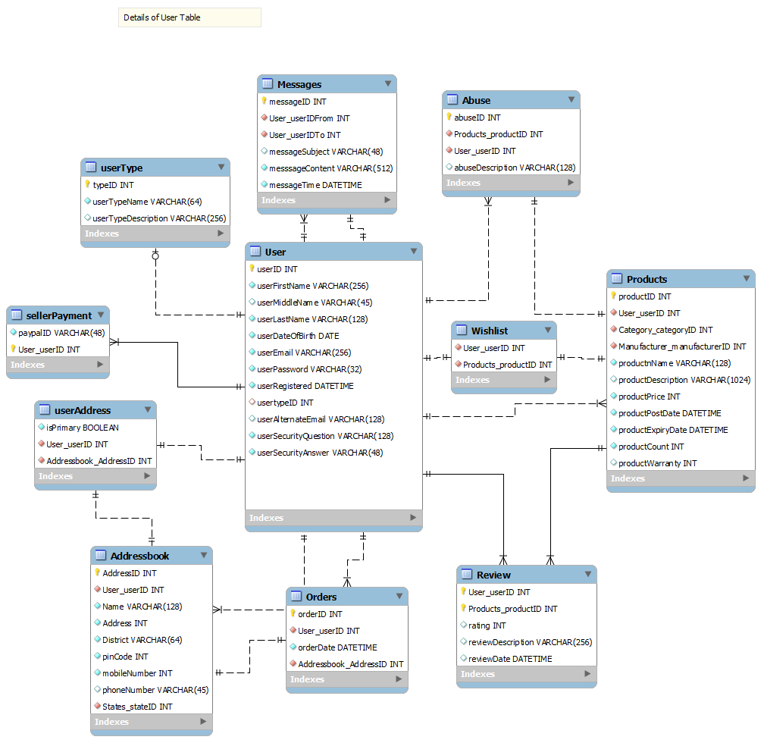
User and its relations

Slide 57
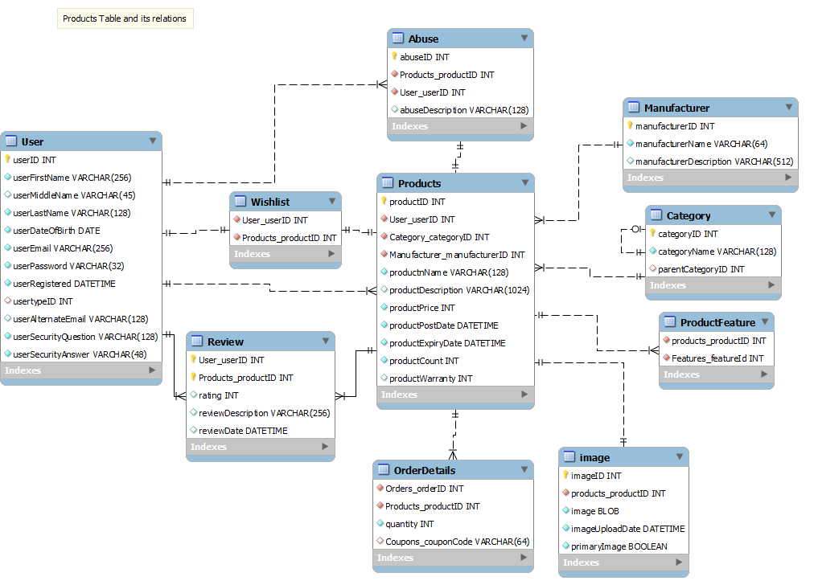
Product and its relations

Slide 58
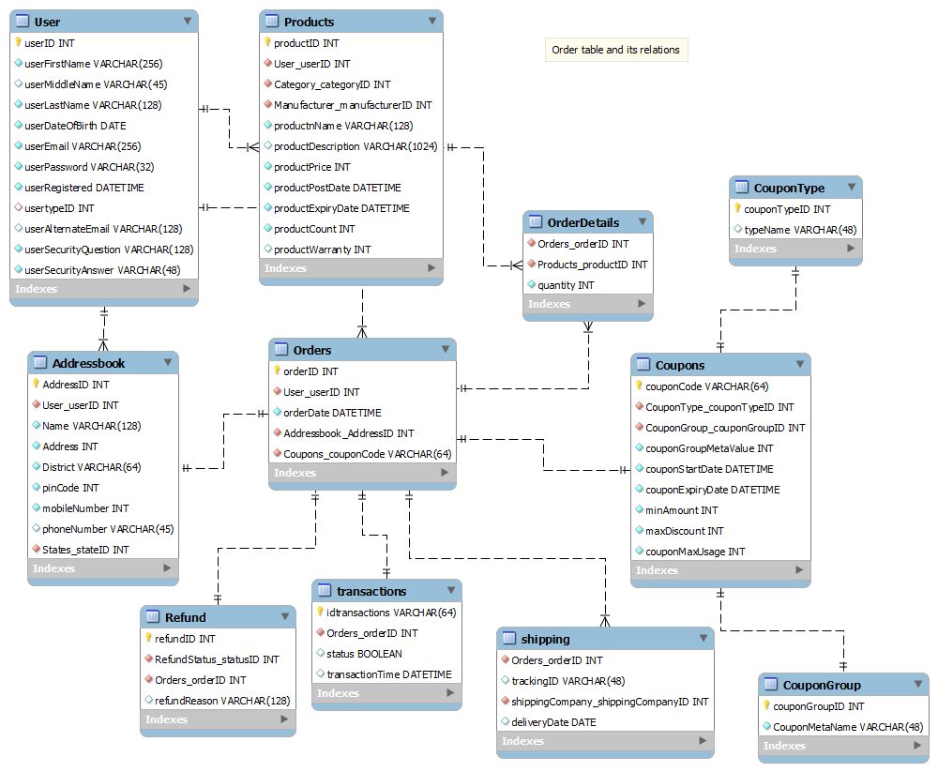
Order and its relations

Slide 59
Full ER-DIAGRAM
Click to see enlarged E.R DIAGRAM

Slide 60
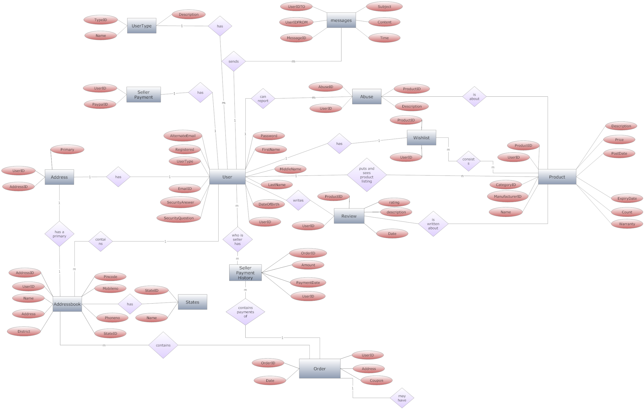
User and its relations(Chen’s notation)

Slide 61
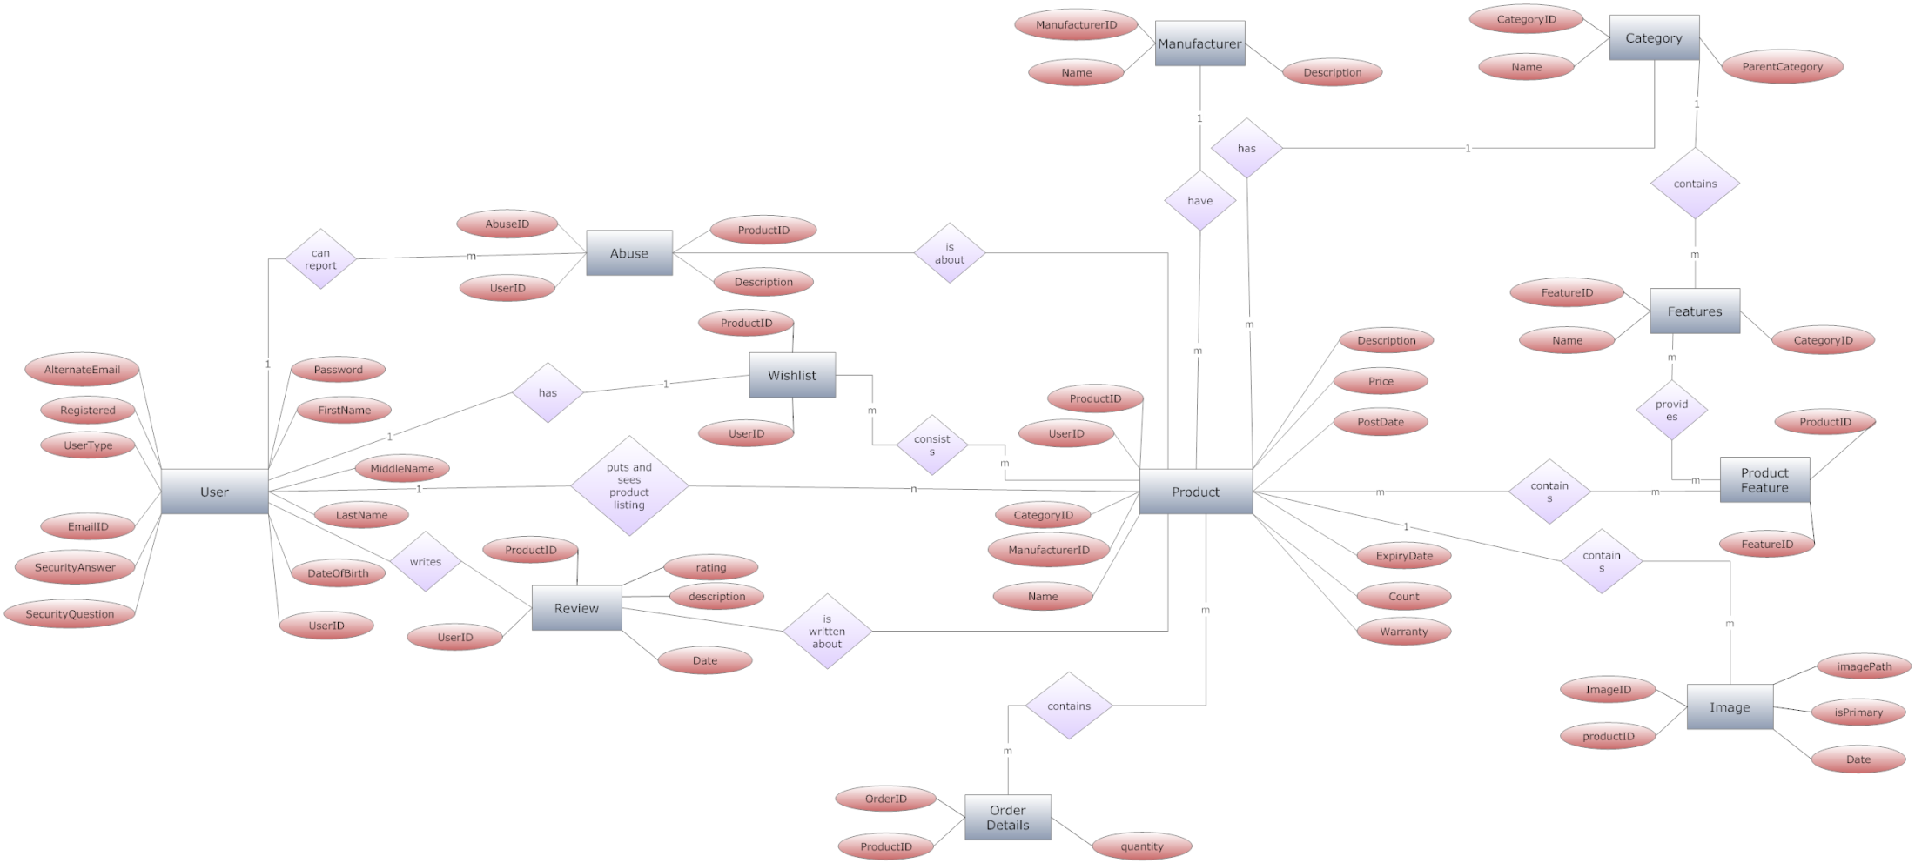
Product and its relations(Chen’s notation)

Slide 62
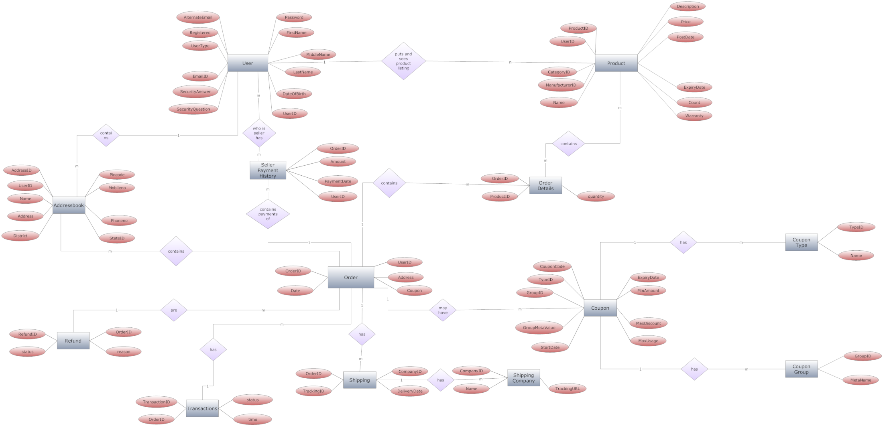
Order and its relations(Chen’s notation)

Slide 63
Full ER-DIAGRAM(Chen’s notation)
Click to see enlarged E.R DIAGRAM

Slide 64
QUERIES

Slide 65
Create
CREATE TABLE IF NOT EXISTS `mydb`.`Manufacturer` (
`manufacturerID` INT NOT NULL AUTO_INCREMENT,
`manufacturerName` VARCHAR(64) NOT NULL
,
`manufacturerDescription` VARCHAR(512) NULL,
PRIMARY KEY (`manufacturerID`));

Slide 66
Create (with foreign key)
CREATE TABLE IF NOT EXISTS `mydb`.`Wishlist` (
`User_userID` INT NOT NULL,
`Products_productID` INT NOT NULL,
INDEX `fk_Wishlist_User1_idx` (`User_userID` ASC),
INDEX `fk_Wishlist_Products1_idx` (`Products_productID` ASC),
CONSTRAINT `fk_Wishlist_User1`
FOREIGN KEY (`User_userID`)
REFERENCES `mydb`.`User` (`userID`)
ON DELETE NO ACTION
ON UPDATE NO ACTION,
CONSTRAINT `fk_Wishlist_Products1`
FOREIGN KEY (`Products_productID`)
REFERENCES `mydb`.`Products` (`productID`)
ON DELETE NO ACTION
ON UPDATE NO ACTION);

Slide 67
Insert
INSERT INTO user (`userID` , `userFirstName` , `userMiddleName` , `userLastName` , `userDateOfBirth` , `userEmail` , `userPassword` , `userRegistered` , `usertypeID` , `userAlternateEmail` , `userSecurityQuestion` , `userSecurityAnswer`
) VALUES (‘3’ , 'Ramankit', NULL , 'Singh', '1991-04-30', 'ramankit.singh@gmail.com', 'testpass', '2013-10-28 04:11:09', '1', 'demo@demo.com','first pet', 'rosi'
);

Slide 68
Insert
INSERT INTO `userType` (`typeID`,`userTypeName`,`userTypeDescription`) VALUES (0,'Admin','This id is associted with the role of Administrator');
INSERT INTO `userType` (`typeID`,`userTypeName`,`userTypeDescription`) VALUES (1,'User','This id is associated with the role of Buyer');
INSERT INTO `userType` (`typeID`,`userTypeName`,`userTypeDescription`) VALUES (2,'Seller','This id is associated with the role of Seller');

Slide 69
Update
UPDATE user SET `userID` = '4', `userAlternateEmail` = 'test@test.com', `userSecurityAnswer` = 'pucchu' WHERE `user`.`userID` =3;

Slide 70
Future Scope
A front end based on client server architecture
Trigger addition
Fully detailed payment module addition

Slide 71
Future Scope
A front end based on client server architecture
Trigger addition
Fully detailed payment module addition

Slide 72
Thank you ☺

