Slide 1
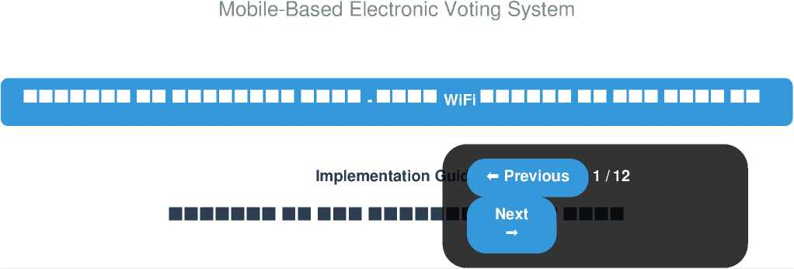
Children's Parliament Election System

