Slide 1

OPERATING SYSTEMS AND SYSTEMS PROGRAMMING (25CS2104E)
Alarm Clock
A Linux command-line alarm built with signals, timers and threads
Section 13 | Team 17
S Udayasri (2520090003)
B Akshitha (2520090014)
R Bhanu Priya (2520090171)
Faculty: S Alekhya

Slide 2
Problem Statement
The gap
Desktop and mobile alarms use high-level GUI frameworks that hide how the OS tracks and triggers time-based events.
Timers, signals and background processes stay a black box.
Our approach
A simple Linux alarm utility that calls OS-level APIs and system calls directly.
Shows process management, signal handling and system programming in practice.

Slide 3
Objectives
Design a Linux command-line alarm clock in C using POSIX system calls
Schedule and trigger alarms with timers and SIGALRM signal handling
1
2
Store and retrieve alarm settings persistently using file handling
Use multithreading for continuous background monitoring of alarm times
3
4

Slide 4
Proposed Methodology
1
2
3
4
Set alarm
Store
Monitor
Trigger
User enters time through the command line
>
Alarm saved to a local file for persistence
>
pthread compares system time; nanosleep() avoids busy-waiting
>
SIGALRM fires and a console notification alerts the user
Modular design: alarm-setting, monitoring and notification are separate functions.

Slide 5
OS Concepts and Linux APIs Used
Concept / API | Purpose
Signals (SIGALRM) | Triggers the alarm event at the set time
alarm() / setitimer() | Schedules timed interrupts for the alarm
POSIX threads (pthread_create) | Runs monitoring concurrently with the main program
File I/O (open, read, write) | Stores and retrieves saved alarms
nanosleep() | Precise delays between time checks
sleep() / process scheduling | Keeps monitoring alive at minimal CPU usage

Slide 6
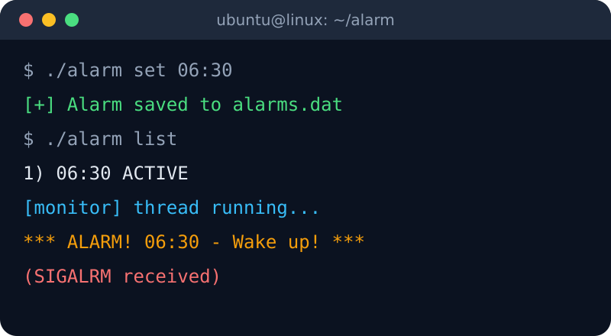
How It Works
Set one or more alarms from the terminal
Alarms persist in a file across runs
Background thread watches the clock
SIGALRM handler prints the alert
Illustrative output of the planned utility

Slide 7
Individual Contributions
SU
BA
BP
S Udayasri
B Akshitha
R Bhanu Priya
2520090003
2520090014
2520090171
Alarm-triggering logic using signals and system calls
Alarm-setting interface and background monitoring thread
Alarm storage/retrieval with file handling, and documentation

Slide 8
Tools and Expected Outcome
Linux / Ubuntu Development and testing
Expected outcome
A working command-line alarm clock that sets, stores and manages multiple alarms, triggers them accurately via signals, and uses CPU efficiently with threads and timers.
C / C++ Timer logic and system calls
GCC / Make Compile and build
pthread library Concurrent monitoring thread
VS Code / gedit Editing and debugging

Slide 9
Thank You

