Slide 1
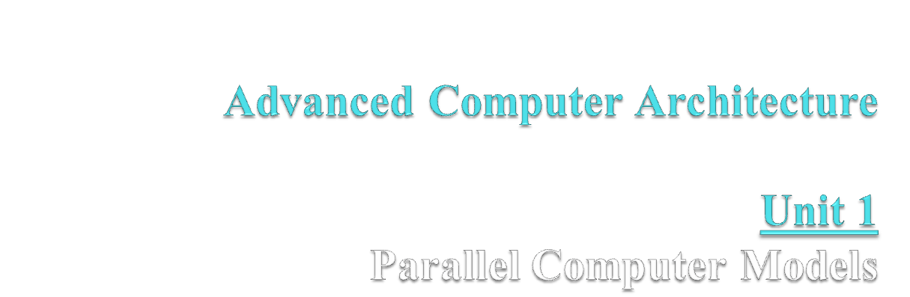
1.1 → The State of Computing
1.2 → Multiprocessors and Multicomputers
1.3 → Multivector and SIMD Computers
1.4 → Architectural Development Tracks

Slide 2
1.1 The State of Computing
Early computing was entirely mechanical:
  abacus (about 500 BC)
  mechanical adder/subtracter (Pascal, 1642)
  difference engine design (Babbage, 1827)
  binary mechanical computer (Zuse, 1941)
  electromechanical decimal machine (Aiken, 1944)
Mechanical and electromechanical machines have limited speed and reliability because of the many moving parts. Modern machines use electronics for most information transmission.

Slide 3
Computing Generations
Computing is normally thought of as being divided into generations.
Each successive generation is marked by sharp changes in hardware and software technologies.
With some exceptions, most of the advances introduced in one generation are carried through to later generations.
We are currently in the fifth generation.

Slide 4
First Generation (1945 to 1954)
Technology and Architecture
  Vacuum tubes and relay memories
  CPU driven by a program counter (PC) and accumulator
  Machines had only fixed-point arithmetic
Software and Applications
  Machine and assembly language
  Single user at a time
  No subroutine linkage mechanisms
  Programmed I/O required continuous use of CPU
Representative systems: ENIAC, Princeton IAS, IBM 701

Slide 5
Second Generation (1955 to 1964)
Technology and Architecture
  Discrete transistors and core memories
  I/O processors, multiplexed memory access
  Floating-point arithmetic available
  Register Transfer Language (RTL) developed
Software and Applications
  High-level languages (HLL): FORTRAN, COBOL, ALGOL with compilers and subroutine libraries
  Still mostly single user at a time, but in batch mode
Representative systems: CDC 1604, UNIVAC LARC, IBM 7090

Slide 6
Third Generation (1965 to 1974)
Technology and Architecture
  Integrated circuits (SSI/MSI)
  Microprogramming
  Pipelining, cache memories, lookahead processing
Software and Applications
  Multiprogramming and time-sharing operating systems
  Multi-user applications
Representative systems: IBM 360/370, CDC 6600, TI ASC, DEC PDP-8

Slide 7
Fourth Generation (1975 to 1990)
Technology and Architecture
  LSI/VLSI circuits, semiconductor memory
  Multiprocessors, vector supercomputers, multicomputers
  Shared or distributed memory
  Vector processors
Software and Applications
  Multprocessor operating systems, languages, compilers, and parallel software tools
Representative systems: VAX 9000, Cray X-MP, IBM 3090, BBN TC2000

Slide 8
Fifth Generation (1990 to present)
Technology and Architecture
  ULSI/VHSIC processors, memory, and switches
  High-density packaging
  Scalable architecture
  Vector processors
Software and Applications
  Massively parallel processing
  Grand challenge applications
  Heterogenous processing
Representative systems: Fujitsu VPP500, Cray MPP, TMC CM-5, Intel Paragon

Slide 9
Elements of Modern Computers
The hardware, software, and programming elements of modern computer systems can be characterized by looking at a variety of factors, including:
  Computing problems
  Algorithms and data structures
  Hardware resources
  Operating systems
  System software support
  Compiler support

Slide 10
Computing Problems
Numerical computing
  complex mathematical formulations
  tedious integer or floating-point computation
Transaction processing
  accurate transactions
  large database management
  information retrieval
Logical Reasoning
  logic inferences
  symbolic manipulations

Slide 11
Algorithms and Data Structures
Traditional algorithms and data structures are designed for sequential machines.
New, specialized algorithms and data structures are needed to exploit the capabilities of parallel architectures.
These often require interdisciplinary interactions among theoreticians, experimentalists, and programmers.

Slide 12
Hardware Resources
The architecture of a system is shaped only partly by the hardware resources.
The operating system and applications also significantly influence the overall architecture.
Not only must the processor and memory architectures be considered, but also the architecture of the device interfaces (which often include their advanced processors).

Slide 13
Operating System
Operating systems manage the allocation and deallocation of resources during user program execution.
UNIX, Mach, and OSF/1 provide support for
  multiprocessors and multicomputers
  multithreaded kernel functions
  virtual memory management
  file subsystems
  network communication services
An OS plays a significant role in mapping hardware resources to algorithmic and data structures.

Slide 14
System Software Support
Compilers, assemblers, and loaders are traditional tools for developing programs in high-level languages. With the operating system, these tools determine the bind of resources to applications, and the effectiveness of this determines the efficiency of hardware utilization and the system’s programmability.
Most programmers still employ a sequential mind set, abetted by a lack of popular parallel software support.

Slide 15
System Software Support
Parallel software can be developed using entirely new languages designed specifically with parallel support as its goal, or by using extensions to existing sequential languages.
New languages have obvious advantages (like new constructs specifically for parallelism), but require additional programmer education and system software.
The most common approach is to extend an existing language.

Slide 16
Compiler Support
Preprocessors
  use existing sequential compilers and specialized libraries to implement parallel constructs
Precompilers
  perform some program flow analysis, dependence checking, and limited parallel optimzations
Parallelizing Compilers
  requires full detection of parallelism in source code, and transformation of sequential code into parallel constructs
Compiler directives are often inserted into source code to aid compiler parallelizing efforts

Slide 17
Evolution of Computer Architecture
Architecture has gone through evolutional, rather than revolutional change.
Sustaining features are those that are proven to improve performance.
Starting with the von Neumann architecture (strictly sequential), architectures have evolved to include processing lookahead, parallelism, and pipelining.

Slide 18
Scalar
Sequential
Lookahead
I/E Overlap
Functional Parallelism
Multiple Func. Units
Pipeline
Implicit Vector
Explicit Vector
Memory-to-memory
Register-to-register
Architectural
Evolution
SIMD
MIMD
Associative Processor
Multicomputer
Processor Array
Mutiprocessor

Slide 19
Flynn’s Classification (1972)
Single instruction, single data stream (SISD)
  conventional sequential machines
Single instruction, multiple data streams (SIMD)
  vector computers with scalar and vector hardware
Multiple instructions, multiple data streams (MIMD)
  parallel computers
Multiple instructions, single data stream (MISD)
  systolic arrays
Among parallel machines, MIMD is most popular, followed by SIMD, and finally MISD.

Slide 20
Parallel/Vector Computers
Intrinsic parallel computers execute in MIMD mode.
Two classes:
  Shared-memory multiprocessors
  Message-passing multicomputers
Processor communication
  Shared variables in a common memory (multiprocessor)
  Each node in a multicomputer has a processor and a private local memory, and communicates with other processors through message passing.

Slide 21
Pipelined Vector Processors
SIMD architecture
A single instruction is applied to a vector (one-dimensional array) of operands.
Two families:
  Memory-to-memory: operands flow from memory to vector pipelines and back to memory
  Register-to-register: vector registers used to interface between memory and functional pipelines

Slide 22
SIMD Computers
Provide synchronized vector processing
Utilize spatial parallelism instead of temporal parallelism
Achieved through an array of processing elements (PEs)
Can be implemented using associative memory.

Slide 23
Development Layers (Ni, 1990)
Hardware configurations differ from machine to machine (even with the same Flynn classification)
Address spaces of processors vary among different architectures, and depend on memory organization, and should match target application domain.
The communication model and language environments should ideally be machine-independent, to allow porting to many computers with minimum conversion costs.
Application developers prefer architectural transparency.

Slide 24
System Attributes to Performance
Performance depends on
  hardware technology
  architectural features
  efficient resource management
  algorithm design
  data structures
  language efficiency
  programmer skill
  compiler technology

Slide 25
Performance Indicators
Turnaround time depends on:
  disk and memory accesses
  input and output
  compilation time
  operating system overhead
  CPU time
Since I/O and system overhead frequently overlaps processing by other programs, it is fair to consider only the CPU time used by a program, and the user CPU time is the most important factor.

Slide 26
Clock Rate and CPI
CPU is driven by a clock with a constant cycle time τ (usually measured in nanoseconds).
The inverse of the cycle time is the clock rate (f = 1/τ, measured in megahertz).
The size of a program is determined by its instruction count, I_{c}, the number of machine instructions to be executed by the program.
Different machine instructions require different numbers of clock cycles to execute. CPI (cycles per instruction) is thus an important parameter.

Slide 27
Average CPI
It is easy to determine the average number of cycles per instruction for a particular processor if we know the frequency of occurrence of each instruction type.
Of course, any estimate is valid only for a specific set of programs (which defines the instruction mix), and then only if there are sufficiently large number of instructions.
In general, the term CPI is used with respect to a particular instruction set and a given program mix.

Slide 28
Performance Factors (1)
The time required to execute a program containing I_{c} instructions is just T = I_{c} × CPI × τ.
Each instruction must be fetched from memory, decoded, then operands fetched from memory, the instruction executed, and the results stored.
The time required to access memory is called the memory cycle time, which is usually k times the processor cycle time τ. The value of k depends on the memory technology and the processor-memory interconnection scheme.

Slide 29
Performance Factors (2)
The processor cycles required for each instruction (CPI) can be attributed to
  cycles needed for instruction decode and execution (p), and
  cycles needed for memory references (m × k).
The total time needed to execute a program can then be rewritten as T = I_{c} × (p + m × k)× τ.

Slide 30
System Attributes
The five performance factors (I_{c} , p, m, k, τ) are influenced by four system attributes:
  instruction-set architecture (affects I_{c} and p)
  compiler technology (affects I_{c} and p and m)
  CPU implementation and control (affects p × τ)
  cache and memory hierarchy (affects memory access latency, k × τ)
Total CPU time can be used as a basis in estimating the execution rate of a processor.

Slide 31
MIPS Rate
If C is the total number of clock cycles needed to execute a given program, then total CPU time can be estimated as T = C × τ = C / f.
Other relationships are easily observed:
  CPI = C / I_{c}
  T =I_{c} × CPI × τ
  T =I_{c} × CPI / f
Processor speed is often measured in terms of millions of instructions per second, frequently called the MIPS rate of the processor.

Slide 32
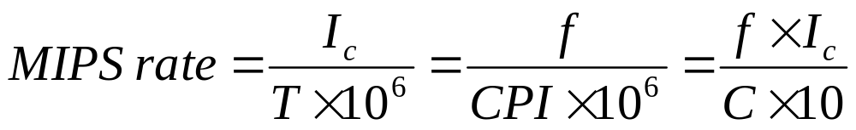
MIPS Rate
The MIPS rate is directly proportional to the clock rate and inversely proportion to the CPI.
All four system attributes (instruction set, compiler, processor, and memory technologies) affect the MIPS rate, which varies also from program to program.

Slide 33
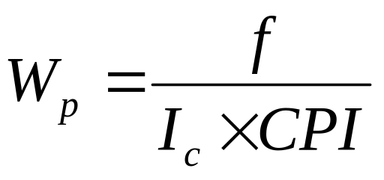
Throughput Rate
The number of programs a system can execute per unit time, W_{s} , in programs per second.
CPU throughput, W_{p}, is defined as
In a multiprogrammed system, the system throughput is often less than the CPU throughput.

Slide 34
Example 1. VAX/780 and IBM RS/6000
Machine Clock Performance CPU Time
VAX 11/780 5 MHz 1 MIPS 12x seconds
IBM RS/6000 25 MHz 18 MIPS x seconds
The instruction count on the RS/6000 is 1.5 times that of the code on the VAX.
Average CPI on the VAX is assumed to be 5.
Average CPI on the RS/6000 is assumed to 1.39.
VAX has typical CISC architecture.
RS/6000 has typical RISC architecture.

Slide 35
Programming Environments
Programmability depends on the programming environment provided to the users.
Conventional computers are used in a sequential programming environment with tools developed for a uniprocessor computer.
Parallel computers need parallel tools that allow specification or easy detection of parallelism and operating systems that can perform parallel scheduling of concurrent events, shared memory allocation, and shared peripheral and communication links.

Slide 36
Implicit Parallelism
Use a conventional language (like C, Fortran, Lisp, or Pascal) to write the program.
Use a parallelizing compiler to translate the source code into parallel code.
The compiler must detect parallelism and assign target machine resources.
Success relies heavily on the quality of the compiler.
Kuck (U. of Illinois) and Kennedy (Rice U.) used this approach.

Slide 37
Explicit Parallelism
Programmer write explicit parallel code using parallel dialects of common languages.
Compiler has reduced need to detect parallelism, but must still preserve existing parallelism and assign target machine resources.
Seitz (Cal Tech) and Daly (MIT) used this approach.

Slide 38
Needed Software Tools
Parallel extensions of conventional high-level languages.
Integrated environments to provide
  different levels of program abstraction
  validation, testing and debugging
  performance prediction and monitoring
  visualization support to aid program development, performance measurement
  graphics display and animation of computational results

Slide 39
Categories of Parallel Computers
Considering their architecture only, there are two main categories of parallel computers:
  systems with shared common memories, and
  systems with unshared distributed memories.

Slide 40
Shared-Memory Multiprocessors
Shared-memory multiprocessor models:
  Uniform-memory-access (UMA)
  Nonuniform-memory-access (NUMA)
  Cache-only memory architecture (COMA)
These systems differ in how the memory and peripheral resources are shared or distributed.

Slide 41
The UMA Model - 1
Physical memory uniformly shared by all processors, with equal access time to all words.
Processors may have local cache memories.
Peripherals also shared in some fashion.
Tightly coupled systems use a common bus, crossbar, or multistage network to connect processors, peripherals, and memories.
Many manufacturers have multiprocessor (MP) extensions of uniprocessor (UP) product lines.

Slide 42
The UMA Model - 2
Synchronization and communication among processors achieved through shared variables in common memory.
Symmetric MP systems – all processors have access to all peripherals, and any processor can run the OS and I/O device drivers.
Asymmetric MP systems – not all peripherals accessible by all processors; kernel runs only on selected processors (master); others are called attached processors (AP).

Slide 43

P₁
P₂
…
P_{n}
System Interconnect
(Bus, Crossbar, Multistage network)
I/O
SM₁
…
SM_{m}

Slide 44
The NUMA Model - 1
Shared memories, but access time depends on the location of the data item.
The shared memory is distributed among the processors as local memories, but each of these is still accessible by all processors (with varying access times).
Memory access is fastest from the locally-connected processor, with the interconnection network adding delays for other processor accesses.
Additionally, there may be global memory in a multiprocessor system, with two separate interconnection networks, one for clusters of processors and their cluster memories, and another for the global shared memories.

Slide 45

LM₁
P₁
Inter-
connection
Network
LM₂
P₂
.
.
.
.
.
.
LM_{n}
P_{n}

Slide 46

GSM
GSM
…
GSM
Global Interconnect Network
P
C
I
N
CSM
P
C
I
N
CSM
P
CSM
P
CSM
…
.
.
.
.
.
.
.
.
.
.
.
.
P
CSM
P
CSM

Slide 47
The COMA Model
In the COMA model, processors only have cache memories; the caches, taken together, form a global address space.
Each cache has an associated directory that aids remote machines in their lookups; hierarchical directories may exist in machines based on this model.
Initial data placement is not critical, as cache blocks will eventually migrate to where they are needed.

Slide 48

Interconnection Network
D
D
D
C
C
…
C
P
P
P

Slide 49
Other Models
There can be other models used for multiprocessor systems, based on a combination of the models just presented. For example:
  cache-coherent non-uniform memory access (each processor has a cache directory, and the system has a distributed shared memory)
  cache-coherent cache-only model (processors have caches, no shared memory, caches must be kept coherent).

Slide 50
Multicomputer Models
Multicomputers consist of multiple computers, or nodes, interconnected by a message-passing network.
Each node is autonomous, with its own processor and local memory, and sometimes local peripherals.
The message-passing network provides point-to-point static connections among the nodes.
Local memories are not shared, so traditional multicomputers are sometimes called no-remote-memory-access (or NORMA) machines.
Inter-node communication is achieved by passing messages through the static connection network.

Slide 51

P
P
…
M
M
M
P
P
M
Message-passing
interconnection network
M
P
P
M
P
P
…
M
M

Slide 52
Multicomputer Generations
Each multicomputer uses routers and channels in its interconnection network, and heterogeneous systems may involved mixed node types and uniform data representation and communication protocols.
First generation: hypercube architecture, software-controlled message switching, processor boards.
Second generation: mesh-connected architecture, hardware message switching, software for medium-grain distributed computing.
Third generation: fine-grained distributed computing, with each VLSI chip containing the processor and communication resources.

Slide 53
Multivector and SIMD Computers
Vector computers often built as a scalar processor with an attached optional vector processor.
All data and instructions are stored in the central memory, all instructions decoded by scalar control unit, and all scalar instructions handled by scalar processor.
When a vector instruction is decoded, it is sent to the vector processor’s control unit which supervises the flow of data and execution of the instruction.

Slide 54
Vector Processor Models
In register-to-register models, a fixed number of possibly reconfigurable registers are used to hold all vector operands, intermediate, and final vector results. All registers are accessible in user instructions.
In a memory-to-memory vector processor, primary memory holds operands and results; a vector stream unit accesses memory for fetches and stores in units of large superwords (e.g. 512 bits).

Slide 55
SIMD Supercomputers
Operational model is a 5-tuple (N, C, I, M, R).
  N = number of processing elements (PEs).
  C = set of instructions (including scalar and flow control)
  I = set of instructions broadcast to all PEs for parallel execution.
  M = set of masking schemes used to partion PEs into enabled/disabled states.
  R = set of data-routing functions to enable inter-PE communication through the interconnection network.

Slide 56

Control Unit
P
P
P
…
M
M
M
Interconnection Network

