Slide 1
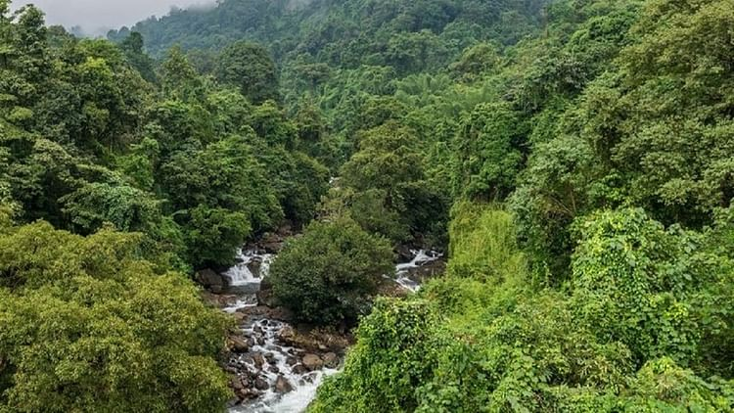
Explore Kansas National Parks
Park 1
Park 2
Park 3
Park 4
Park 5
Park 1 Details
Description
Operating Hours
Address
Activities
Current Weather / Map to the Park

