Slide 1
Virtual Server Verification and kubeconfig

Slide 2
Database Postgres
Setup with statefulset

Slide 3
Notes
Postgres being deployed first as a custom application requires database as dependency and postgres connection details require in application configuration.
Postgres namespace setup and statefulset deployment.
Next screenshot shows all resources created into postgres namespace.
There are multiple resources all details can be found in GitHub repo on this path - kubernetes/1.Postgres-deployment

Slide 4
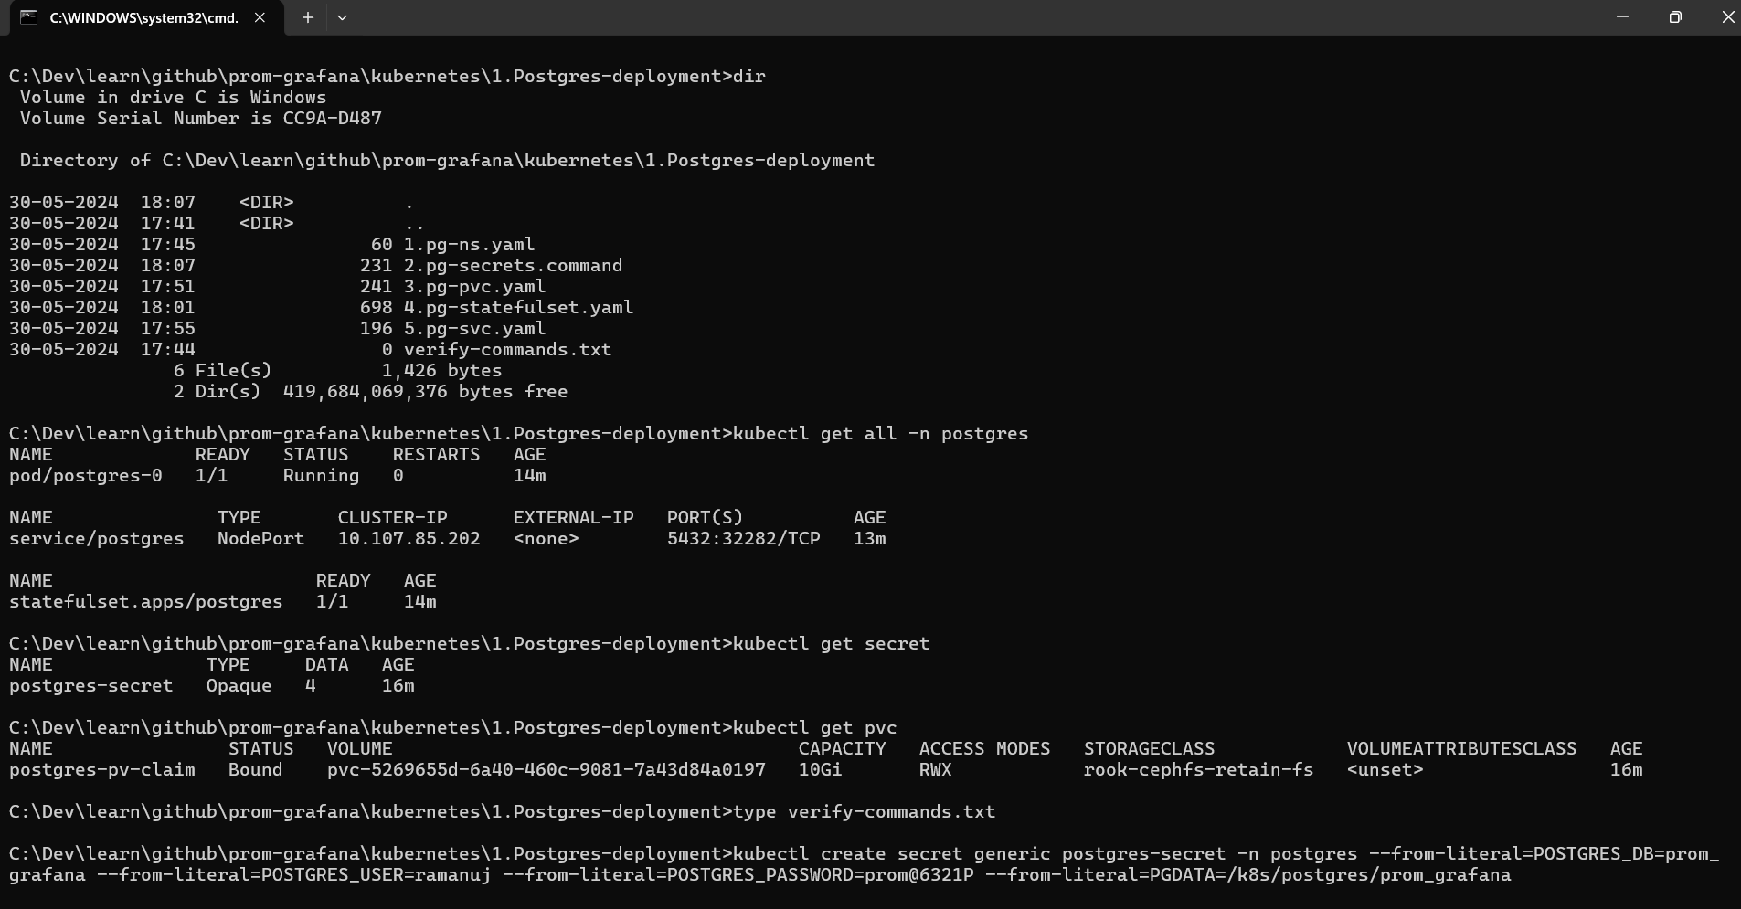

Slide 5
Creating exporter super user

Slide 6
Docker Build and App Run

Slide 7
