Slide 1
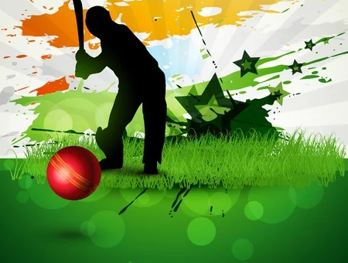
C Player Application
Team Members
Mayank Singhal
Kella Devi Chand
Saurabh Sagare
Mentor-
Ramanuj das

Slide 2
OUTLINE:
Problem Statement
Objective
Microservices
Project Overview
Architecture
Application Flow
Technology and Tools Used
Conclusion

Slide 3
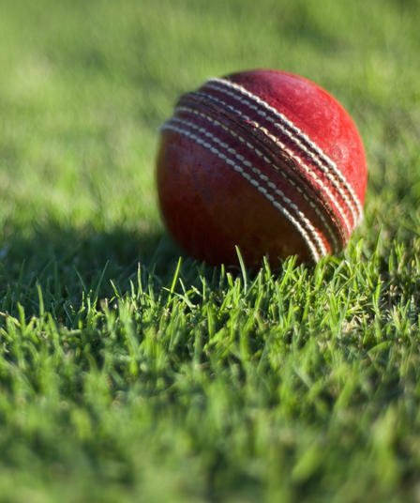
PROBLEM STATEMENT
X is a big cricket fan. He / She is eager to know the cricketer's information and wants to add Cricketers in favorite list.
X wants to access all favorite player's information at same place .

Slide 4
OBJECTIVE
BUILD A CRICKET PLAYER APP TO SEARCH CRICKET PLAYERS AND ADD THEM TO THE FAVOURITE LIST.
CREATE A DASHBOARD VIEW WITH THREE SECTIONS
DISPLAY FAVORITE, PLAYER STATISTICS HTTPS://CRICKETDATA.ORG/ ONE UNDER THE OTHER.
THIS DASHBOARD IS THE DEFAULT VIEW TO BE SHOWN.
THE 3 SECTIONS ARE:
FAVORITE - VIEW ALL FAVORITE PLAYERS UNDER FAVORITE SECTION
PLAYER STATISTICS-DISPLAY ALL PLAYER STATISTICS UNDER PLAYER STATISTICS SECTION

Slide 5
MICROSERVICES
Authentication API
Favorite API

Slide 6
OUR MODEL
Register & Log-in
Search by Name
Save Favourites
View Stats

Slide 7

Register and Log-in
Registered User can access additional features of the platform.

Slide 8

After Logging in
1. User can simply search for A player and he is provided with all the relevant information related to player.
2. User can save his/her favorite player in favorites and can watch it later as well. This feature is made accessible to registered users.
IF A USER ADDS A PLAYER TO A PLAYERS TO HIS/HER FAVORITE LIST MORE THAN FIVE TIMES THEN THAT PLAYER CARD IS ADDED TO RECOMENTATION SECTION
User can view news related to cricket on our application

Slide 9

Project Overview

Slide 10
OVERVIEW
Authentication API
Favorite API
Login
Favorite
HOME
Home
Register
Search
SQL
Server
External API

Slide 11
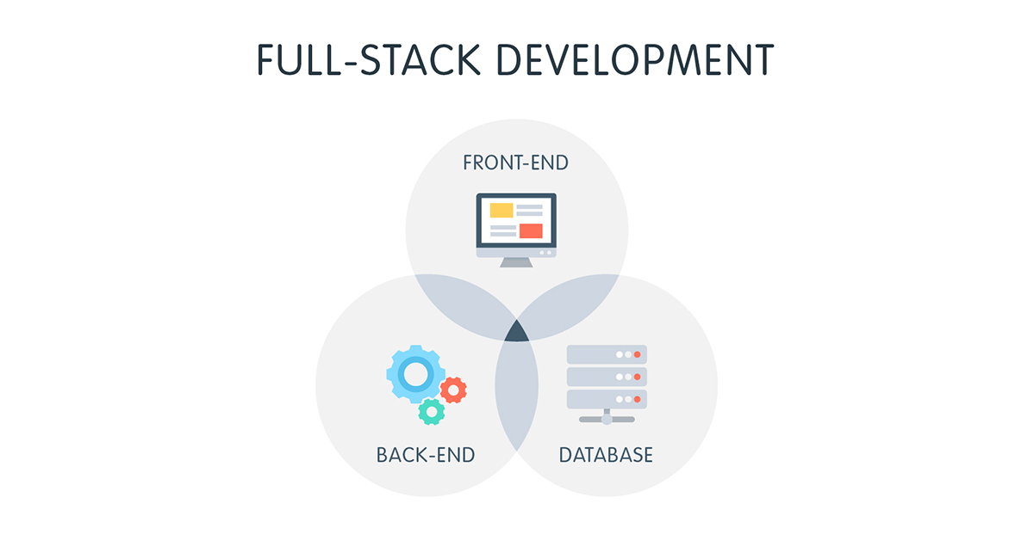

Slide 12
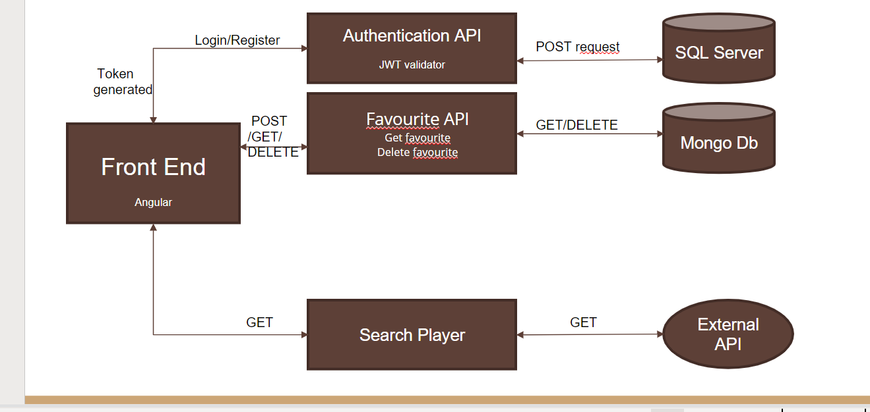
ARCHITECTURE
Api Gateway
SQL Server

Slide 13

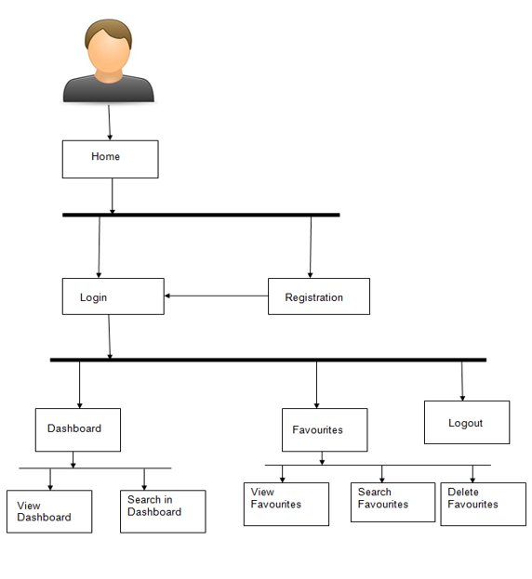

Slide 14
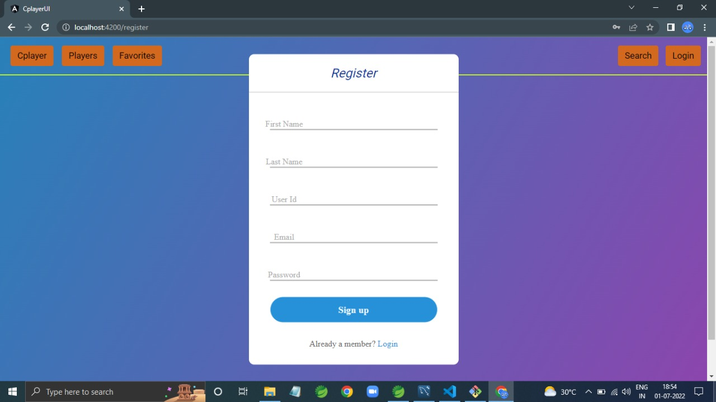
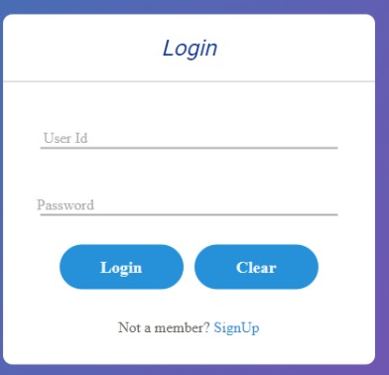
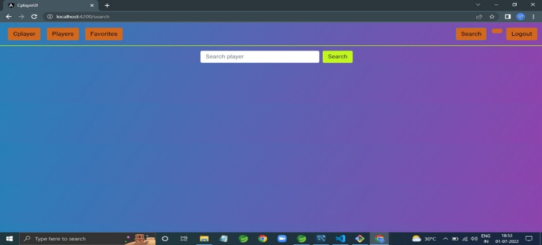
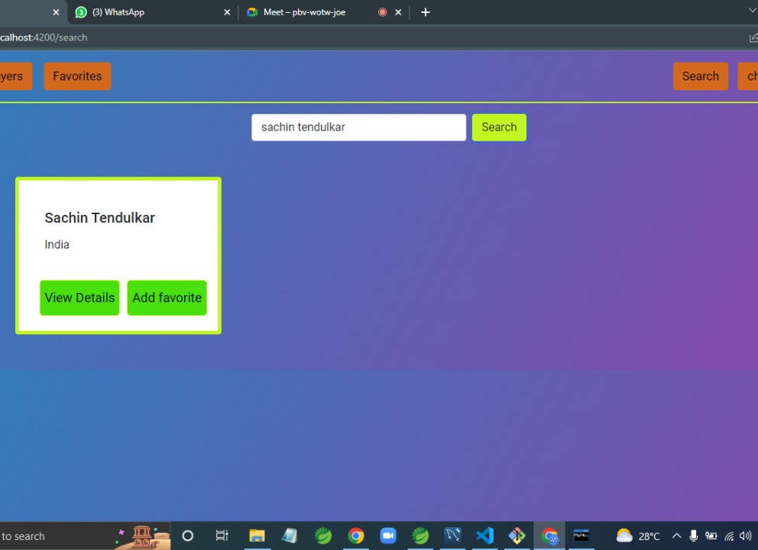
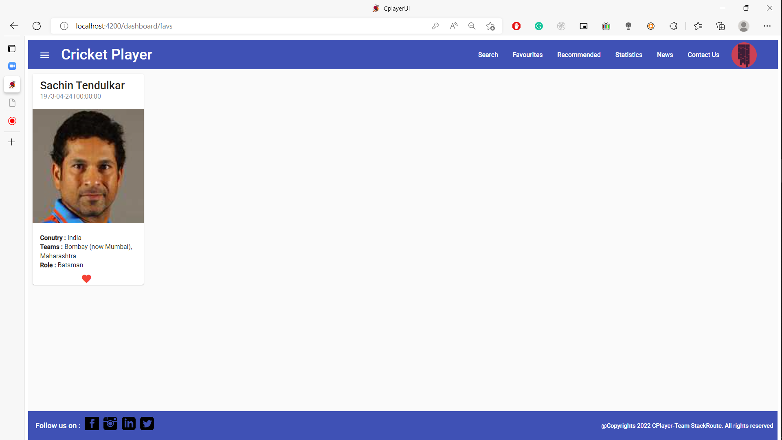
New User
Registered
Login Form
Logged In Dashboard
Searched Player
Favorite Player

Slide 15






Technologies and Tools Used

Slide 16
Conclusion
THE CPLAYER APP HELPS THE USER TO SEARCH CRICKET PLAYERS AND ADD THEM TO THE FAVOURITE LIST.
It also helps user to store the favourite player and delete them afterwards.

Slide 17
IF A USER ADDS A PLAYER TO A PLAYERS TO HIS/HER FAVORITE LIST MORE THAN FIVE TIMES THEN THAT PLAYER CARD IS ADDED TO RECOMENTATION SECTION
ONCE A PLAYER CARD IS ADDED TO RECOMMENDATION SECTION ALL THE USERS ARE ABLE TO SEE IT IN THEIR RECOMMENDATIONS .

Slide 18
THANK YOU
BATCH 27 , Group 10

