Slide 1
E-COMMERCE SHOPING WEBSITE

Slide 2
CONTENTS
Introduction
Aim & Objective
Scope
Importance of Online Shopping
Factors affecting Online Shopping
Technology Used
Overview of Project

Slide 3
Introduction
An E-commerce website requires appropriate strategy of successful design and implementation. Everything is required to plan from scratch to end of website.
The e-commerce sector is seen the exponential growth thus a new option will easily part of this regatta of commercial website.
The e-commerce website will feature the online shopping facility of various fashion products under a single web space.
The proposed web application will allow business personnel to make their total business using it and increase their reachability thousands of times more than today they have over the Internet.

Slide 4
Aim & Objective
The main objective of the study is to develop an online fashion brochure system. The system aims to achieve the following objectives:
To design an online fashion system.
To provides a solution to reduce and optimize the expenses of customer order management
To create an avenue where people can shop for fashion products online.
To develop a database to store information on fashion products and services.

Slide 5
Scope
Every project is done to achieve a set of goals with some conditions keeping in mind that it should be easy to use, feasible and user friendly.
As the goal of this project is to develop an online fashion brochure system, this system will be designed keeping in mind the conditions (easy to use, feasibility and user friendly) stated above.
It may help in effective and efficient order management. In every shot time, the collection will be obvious, simple and sensible.
It is very possible to observe the customer potentials and purchase patterns because all the ordering history is store in the database. It is efficient managing all the operations of an online store within a single platform.
The project aims to automate the business process of this website . The proposed project would cover:

Slide 6
Scope
Customer Side
Customer can view/search products without login.
Customer can also add/remove product to cart without login (if customer try to add same product in cart. It will add only one)
When customer try to purchase product, then he/she must login to system.
After creating account and login to system, he/she can place order.
If customer click on pay button, then their payment will be successful and their order will be placed.
Administrator Side
Admin can provide username, email, password and your admin account will be created.
After login, there is a dashboard where admin can see how many customers is registered, how many products are there for sale, how many orders placed.

Slide 7
Scope
Administrator Side
Admin can add/delete/view/edit the products.
Admin can view/edit/delete customer details.
Admin can view/delete orders
Admin can change status of order (order is pending, confirmed, out for delivery, delivered)
Admin can view the feedbacks sent by customers

Slide 8
Importance of Online Shopping
Ling, said that customers can take enjoy online shopping for 24 hour per day. Consumers can purchase any goods and services anytime at everywhere. Online shopping is user friendly compare to in store shopping because consumers can just complete his requirements just with a click of mouse without leaving their home. Online shopping has some advantages like below
Save the Time of the consumers.
They can purchase any time anywhere
They can compare the price with the others retailers very easily.
Compare the advertising price and actual price

Slide 9
Factors affecting Online Shpooing
There are some factors which affect the online shopping by the Kotler who is a great marketing writer
Convenience (no traffic, crowds,24 hr. access
Product Selection
Delivery Mode
PRIVACY AND SECURITY ISSUES IN ONLINE SHOPPING
Shopping online has never been so easy. With the flourishing numbers of online merchants, people nowadays have various choices to do their shopping. Big companies such as eBay and amazon.com have introduced many values added features to help the customers to decide what to shop for.

Slide 10
Technology Used
HTML: The layout of the website is designed in the html.
CSS: For designing part we used CSS.
JavaScript: All the validation task and animations developed by java script.
Bootstrap is used to make website responsive.
Python: All the business logic implemented in Python.
MySQL: MySQL database is used as database for the whole project.
Django: Django framework has been used for the project.

Slide 11
Overview of Project
Functional Requirements
The following is the desired functionality of the new system. The proposed project would cover:
Customer Module
Customer can view/search products without login.
Customer can also add/remove product to cart without login (if customer try to add same product in cart. It will add only one)
When customer try to purchase product, then he/she must login to system.
After creating account and login to system, he/she can place order.

Slide 12
Overview of Project
Customer Module
If customer click on pay button, then their payment will be successful and their order will be placed.
Customer can check their ordered details by clicking on orders button.
Customer can see the order status (Pending, Confirmed, Delivered) for each order
Customer can Download their order invoice for each order
Customer can send feedback to admin (without login)

Slide 13
Overview of Project
Admin Module
Admin can provide username, email, password and your admin account will be created.
After login, there is a dashboard where admin can see how many customers is registered, how many products are there for sale, how many orders placed.
Admin can add/delete/view/edit the products.
Admin can view/edit/delete customer details.
Admin can view/delete orders.

Slide 14
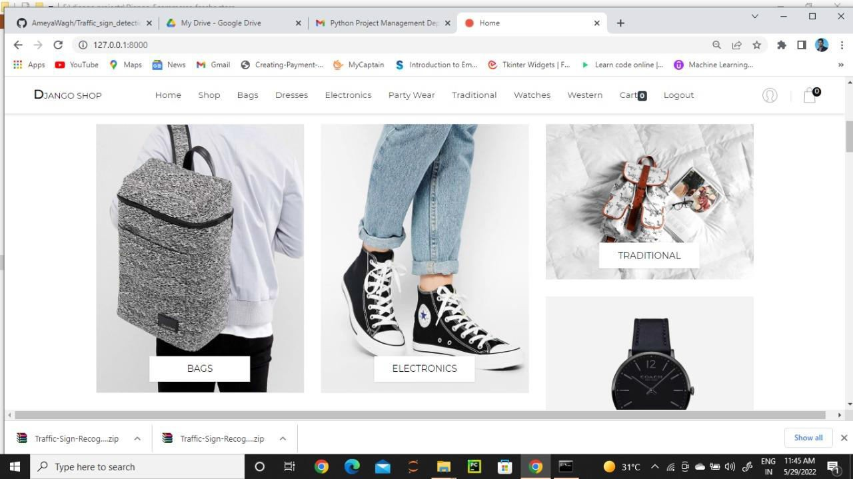
Overview of Project

Slide 15
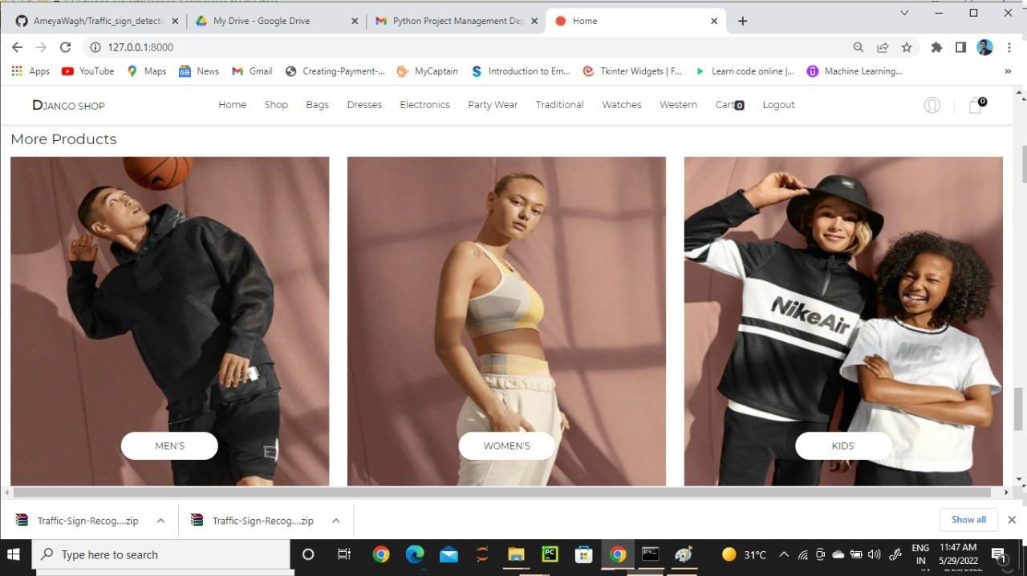
Overview of Project

Slide 16
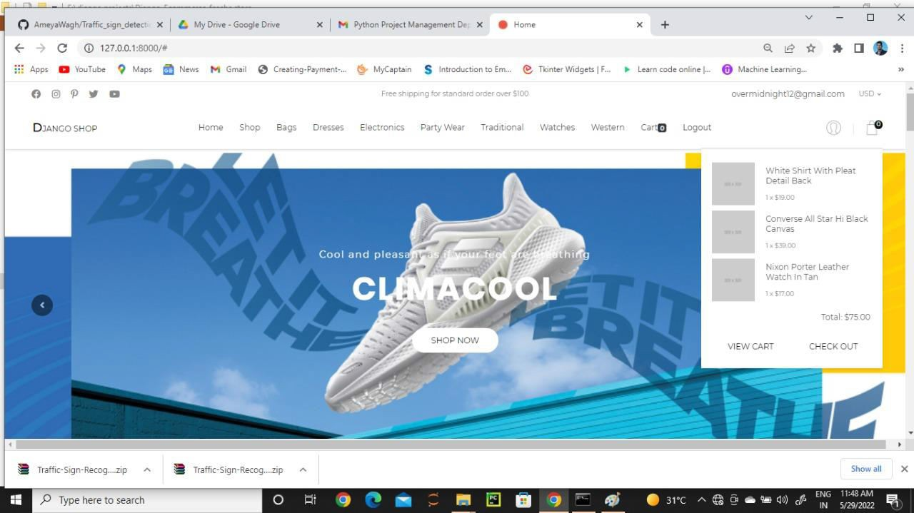
Overview of Project

Slide 17
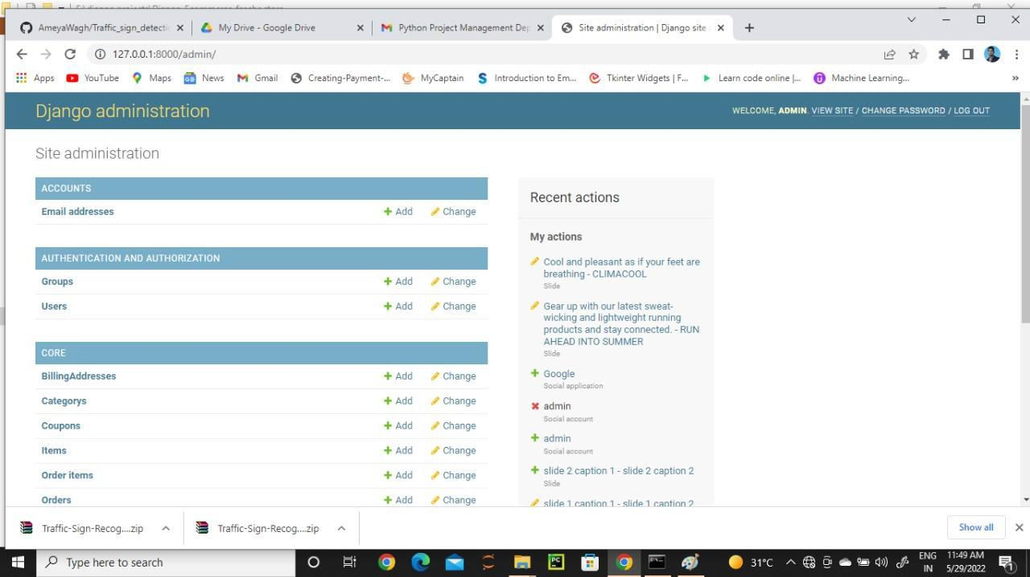
Overview of Project

Slide 18
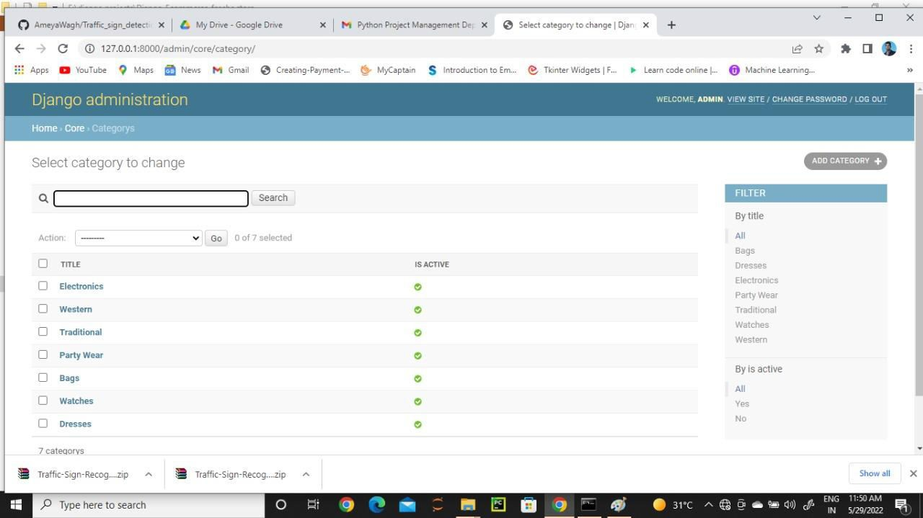
Overview of Project

