Slide 1


Iolchu Ramil, Mameyev Ilyas, Alikulova Svetlana
Data science Homework

Slide 2
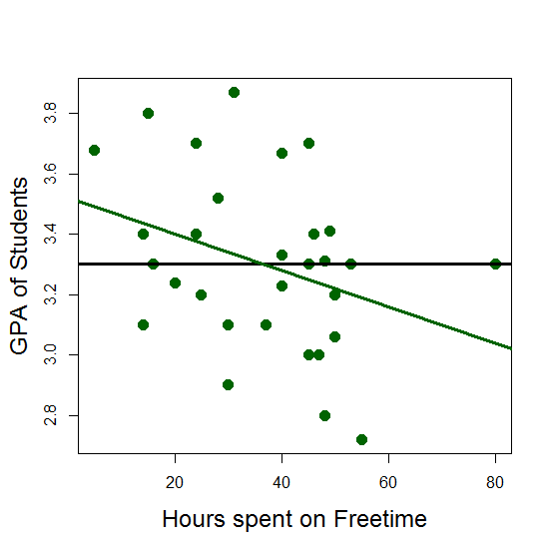
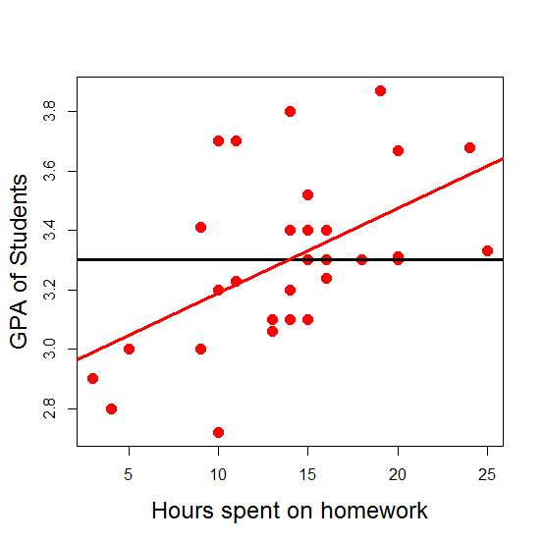


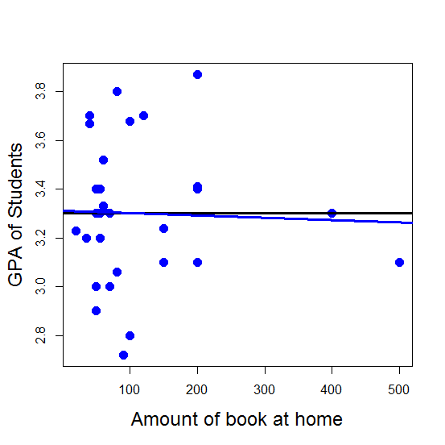
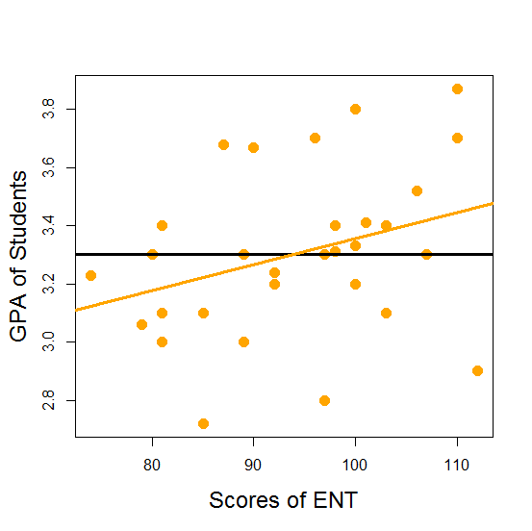
y = 3.78 - 0.013x
y = 2.9 + 0.029x
y = 3.25 - 0.0006x
y = 2.46 + 0.009x

Slide 3
Significance of the data
The table illustrates us that the significance of the time students spent on doing homework is very high, however data that shows us the amount of book they have at home is not significant. Probably, this happens because these numbers do not tell us that a student has read all this books
Coefficients
 | Estimate | Std. Error | t value | Pr(>|t|)
Intercept | 2.4213079 | 0.3495616 | 6.927 | 3.66e-07 | ***
Free time | -0.0074131 | 0.0028221 | -2.627 | 0.014780 | *
Self-development | 0.0148031 | 0.0049433 | 2.995 | 0.006286 | **
Hours | 0.0260977 | 0.0060817 | 4.291 | 0.000252 | ***
ENT | 0.0069319 | 0.0032097 | 2.160 | 0.041005 | *
Books | -0.0005609 | 0.0006586 | -0.852 | 0.402829

Slide 4
Identifying the BEST model
Here we can see the confirmation of the fact that the data, that displays us the amount of book a student has at home, has very low significance. In addition, there is an interesting situation where R² of our Test model notably differs from our basic model.
Variables | Model R² | Test R²
Self-development | 0.3 | 0.76
Self-development, Free time, | 0.44 | 0.69
Self-development, Free time, Homework, | 0.64 | 0.78
Self-development, Free time, Homework, ENT, | 0.7 | 0.62
Self-development, Free time, Homework, ENT, Books | 0.7012 | 0.63

Slide 5
Correlation between the data
The table illustrates us that there is no correlation higher that 0.7 and less than -0.7, therefore there is no multicollinearity
 | GPA | Hours | ENT | Books | Free_time | Self.development
GPA | 1.0000000 | 0.5248504 | 0.3233360 | 0.1125267 | -0.5529054 | 0.5446660
Hours | 0.52485035 | 1.00000000 | -0.04769135 | 0.03350989 | -0.10947783 | 0.06999712
ENT | 0.32333599 | -0.04769135 | 1.00000000 | 0.25030235 | -0.15608103 | 0.18603914
Books | 0.11252667 | 0.03350989 | 0.25030234 | 1.00000000 | 0.00958783 | 0.36674800
Free_time | -0.55290543 | -0.10947783 | -0.15608103 | 0.00958783 | 1.00000000 | -0.36311972
Self.development | 0.5446660 | 0.06999712 | 0.18603914 | 0.36674800 | -0.36311972 | 1.00000000

