Slide 1

“Incident Productivity Tracker”
C. Rama Sai Reddy (15121A0530)
C. Mahammad Akhtar (15121A0527)
C.h. Sandeep Raj (15121A0528)
C. Sreekar (15121A0529)
SREE VIDYANIKETHAN ENGINEERING COLLEGE
(AUTONOMOUS)
(Approved by AICTE, Accredited by NBA and Affiliated to JNTUA, Anantapur)
2018-2019
Guide Head of the Dept
Dr.J.Avanija, Ph.D., Dr.Sunil Kumar , M .Tech.,Ph.D,
Associate Professor, Prof and Head,

Slide 2
CONTENTS
Abstract
Introduction
Implementation
Conclusion

Slide 3
ABSTRACT
Large number of incidents are raised in almost all corporate companies these days. Resolving all such incidents and making a note of all such incidents is a tedious and time consuming task. The aim of this project is to provide a INCIDENT PRODUCTIVITY TRACKER, a web application that is able to manage the creation, updating of incidents and movement of tasks from desk to desk of personnel who work on them. The system is interactive and usable in Corporate Company production operations.

Slide 4
INTRODUCTION
What is an Incident?
An incident is an unplanned interruption or quality reduction of an IT service. The service level agreements (SLA) define the agreed-upon service level between the provider and the customer.
An incident is an unexpected disruption to a service. It disturbs the normal operation thus affecting end user’s productivity

Slide 5
IMPLEMENTATION
Database Creation:
A database is created for the purpose of storing the incidents and their characteristics.
An incident will have many features like the user to whom the incident is assigned to, and the area of the incident along with its priority of closure.
In order to maintain a clear understanding and relationship between all the characteristics of the incidents, we have created a database with some tables.

Slide 6
The tables and the features of the tables in the database used for this project are:
User: This table contains username, password and role.
Role: This table provides information about Roles like administrator and user.
Area: It describes about areas of an incident like Sales, Purchases etc.
Priority : Priority table provides details about the priority of incidents like high,medium,low.
Status: It describes about the status of an incident like open,acknowledged,resolved and completed.
Incident: This table has attributes specific to it and some attributes that are taken from other tables in the database

Slide 7
Model View Controller Creation:
This application is used for operations team for any project to track the incidents raised on the application, its status and know the health of the application.
Functionalities Provided by the Tracker:
Add Incident Report
Update Incident Report
Reports with various filters
Show the different data values considered for the incidents (like areas, priorities, Resources etc)
Download the report capability to Excel.

Slide 8
Technical Implementation of above tracker to achieve above functionalities:
To achieve end to end of each above functionality application would have a UI, Database, business logic which integrates UI and DB and fetch data as needed and some download capabilities to Excel must be supported.
UI Pages and functionalities supported:

Slide 9
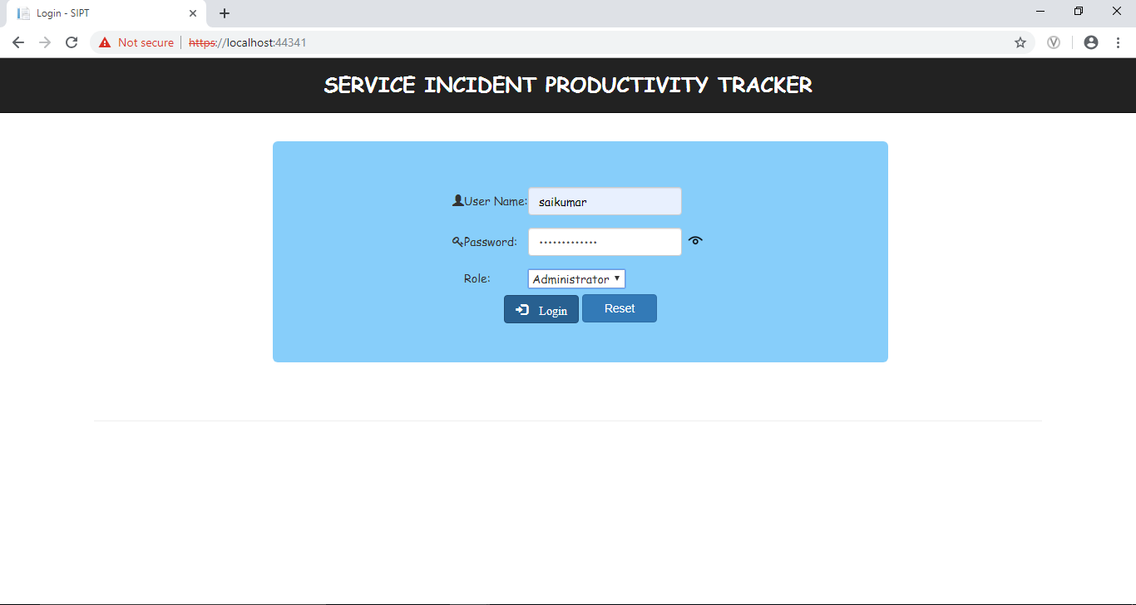
Login Page:
The below is the mock up of the login page in which username, password and role are inputs. Login button click should successfully login and redirect to next page (Incident tracking Page). Cancel should be on same page.
Fig1: Login Page of administrator

Slide 10
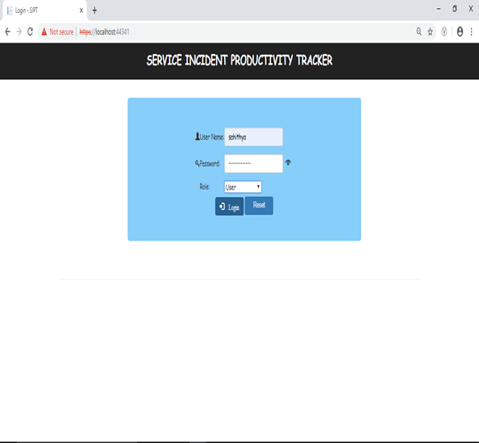
Fig2: Login Page of User

Slide 11
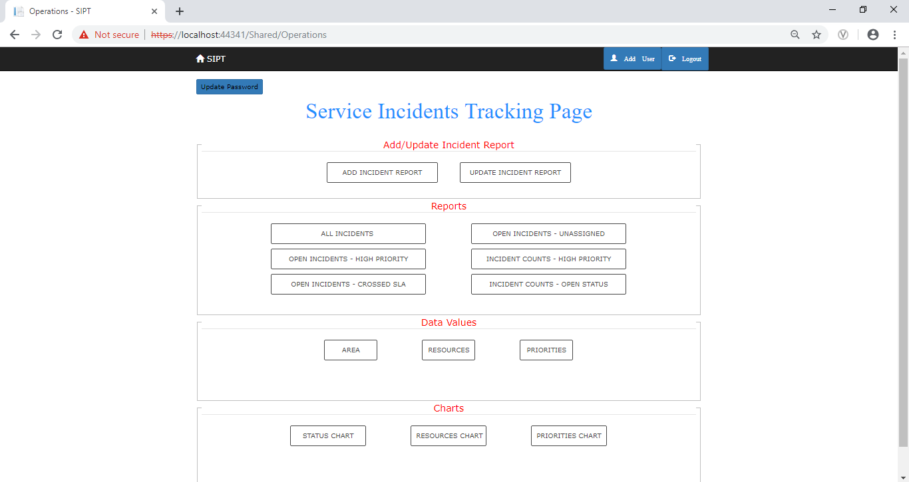
Incident Tracking Page:
Fig3: Incident Tracking Page of Administrator

Slide 12
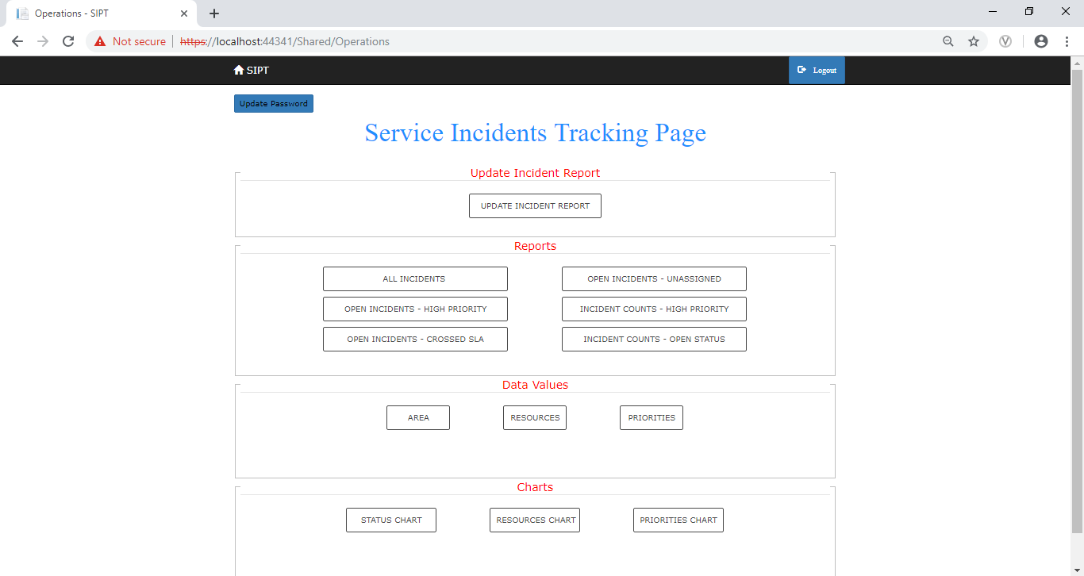
Fig4: Incident Tracking Page of User

Slide 13
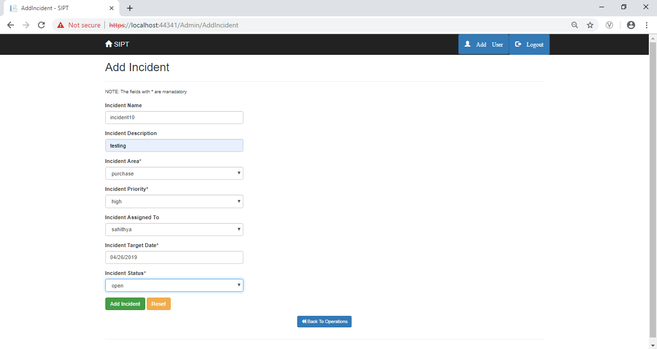
Add Incident Report:
This page must be visible and accessed only to Admins but not for users and Admin must be able to Enter the details and Save the data to DB.
Fig5: Add Incident Page

Slide 14
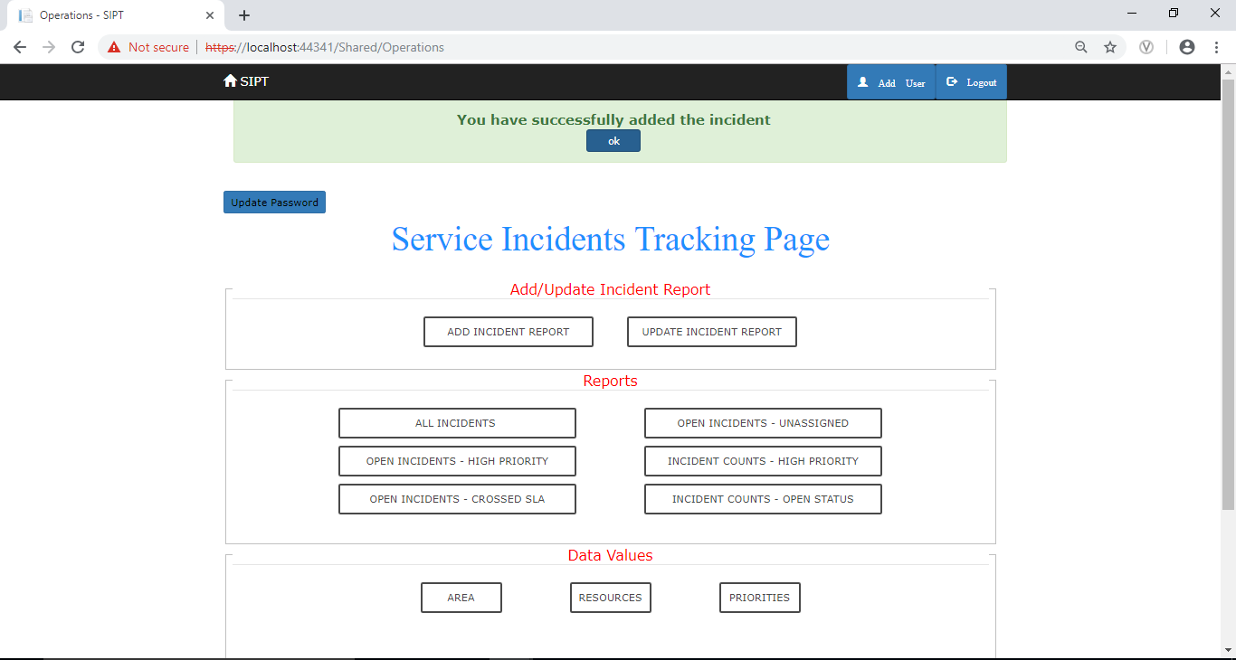
Fig6: Add Incident Page of Success

Slide 15
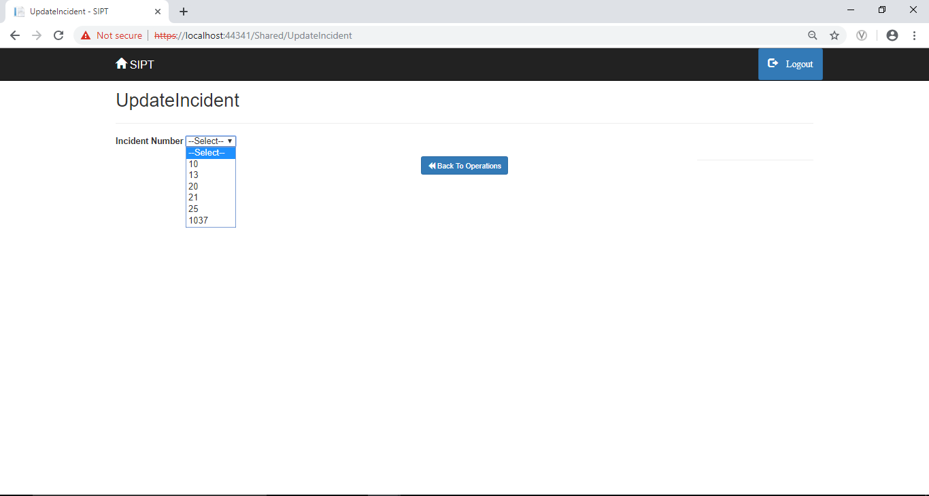
Update Incident Report:
This Page provides capability to search the incident information based on input provided and user must be able to update the details and save the updated information back to DB.
Fig7: Update Incident Page

Slide 16
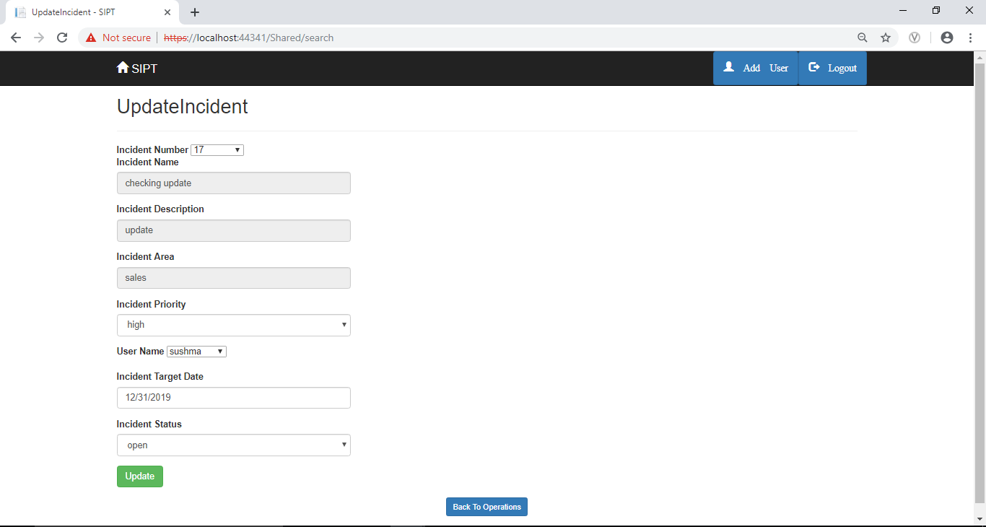
Fig8: Update Incident Page

Slide 17
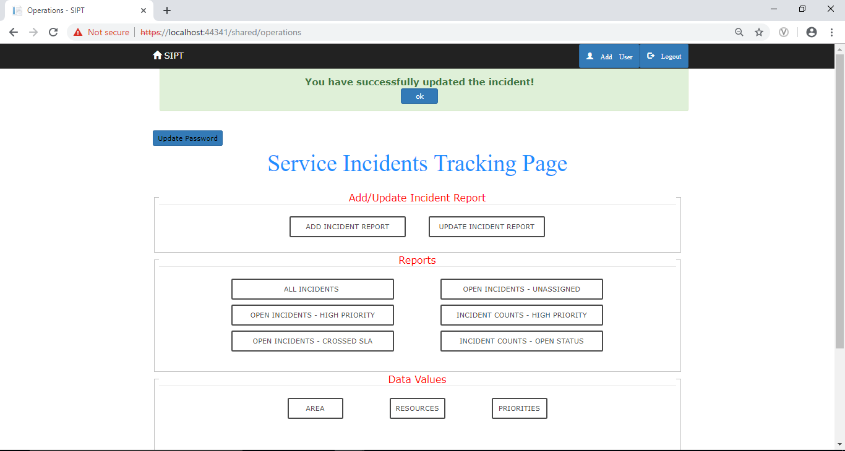
Fig9: Update Incident Page of success

Slide 18
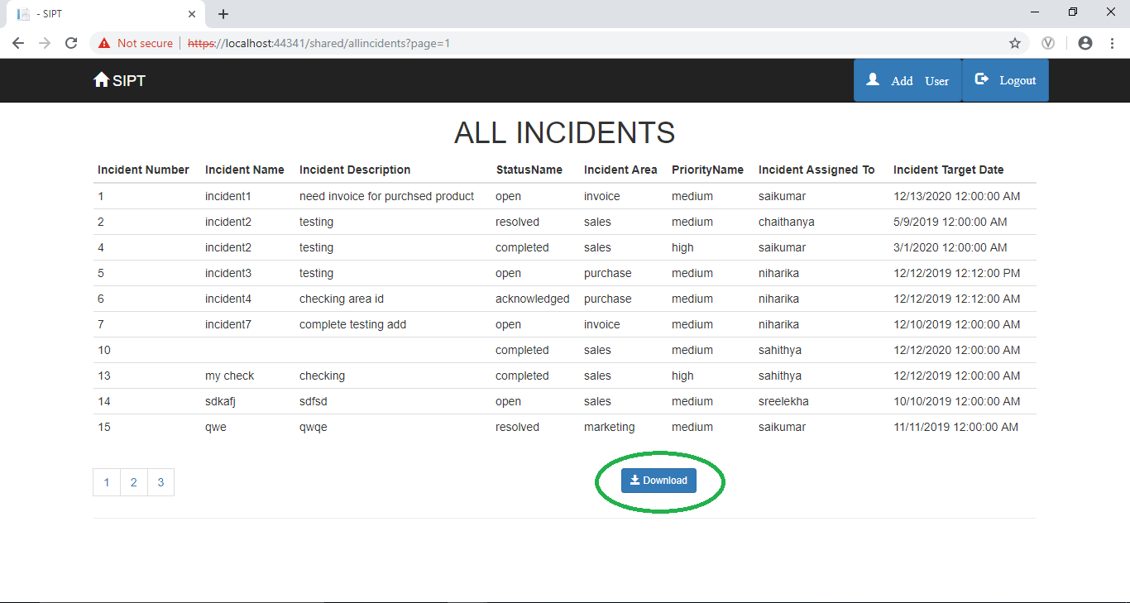
Reports Page:
This page allows to view the incident data based on the report filter we are coming from and the download option must allow to view the data in Excel.
Fig10: Reports Page

Slide 19
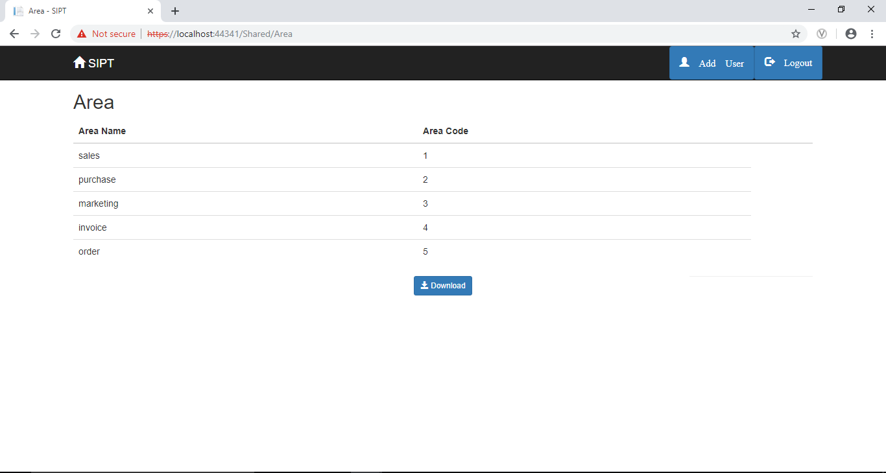
Data Values Page:
This page allows to view the data values of the filter selected (it can be area, resources and priority to know the data values set in the system).
Fig11: Data Values Page

Slide 20
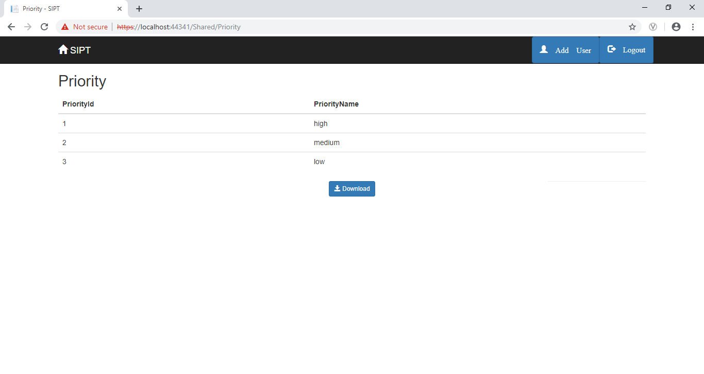
Fig12: Priority Page

Slide 21
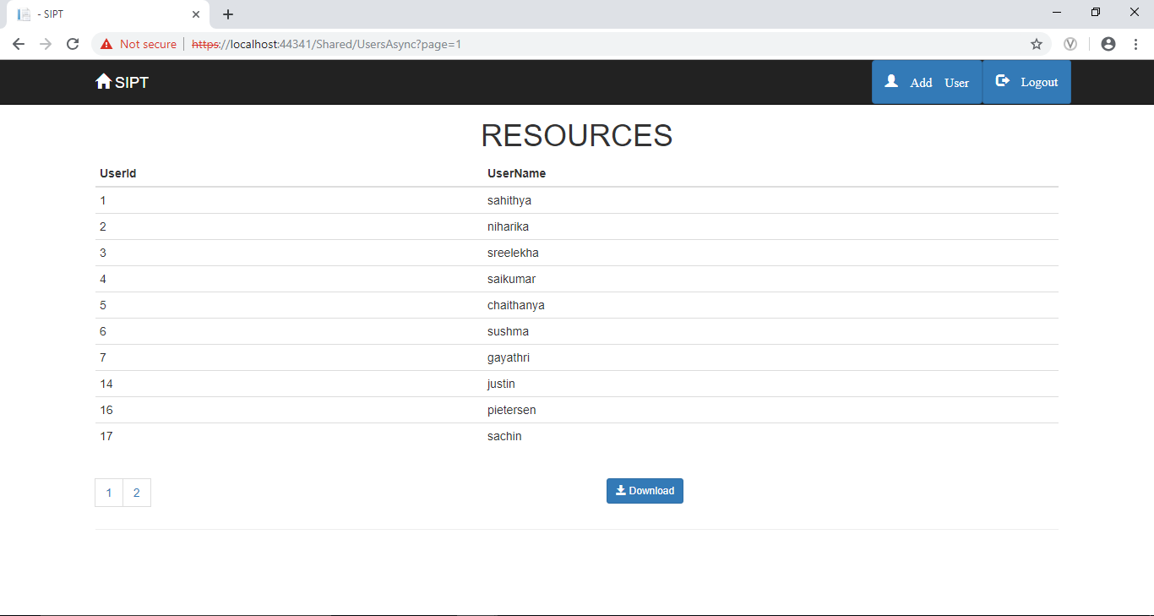
Fig13: Resources Page

Slide 22
CONCLUSION
Incident management follows incidents through the service desk to track trends in incident categories and time in each status.
Employee productivity has a direct impact on your business revenue, There are many reasons for low employee performance, but using innovative methods for monitoring worker activity will let you reveal problems with productivity in the workplace and eliminate them effectively.

Slide 23
Thank You

