Slide 1


TEAM DETAILS · AI BUILDER CUP 2026 · JAPAC · SUSTAINABILITY
Team: Agent Ram · Leader: Ramasamy P · Product: TerraSentinel AI
Satellites leave 1,355 moving points. The engine ranks the few that matter.
Gemini writes the ticket — every number checked. Live on Cloud Run + BigQuery.
Problem: InSAR portals give points, not who goes today. Chatbots invent mm.
Solution: 250 m sites · RPI · honest ETA bands · Gemini number guard.

Slide 2
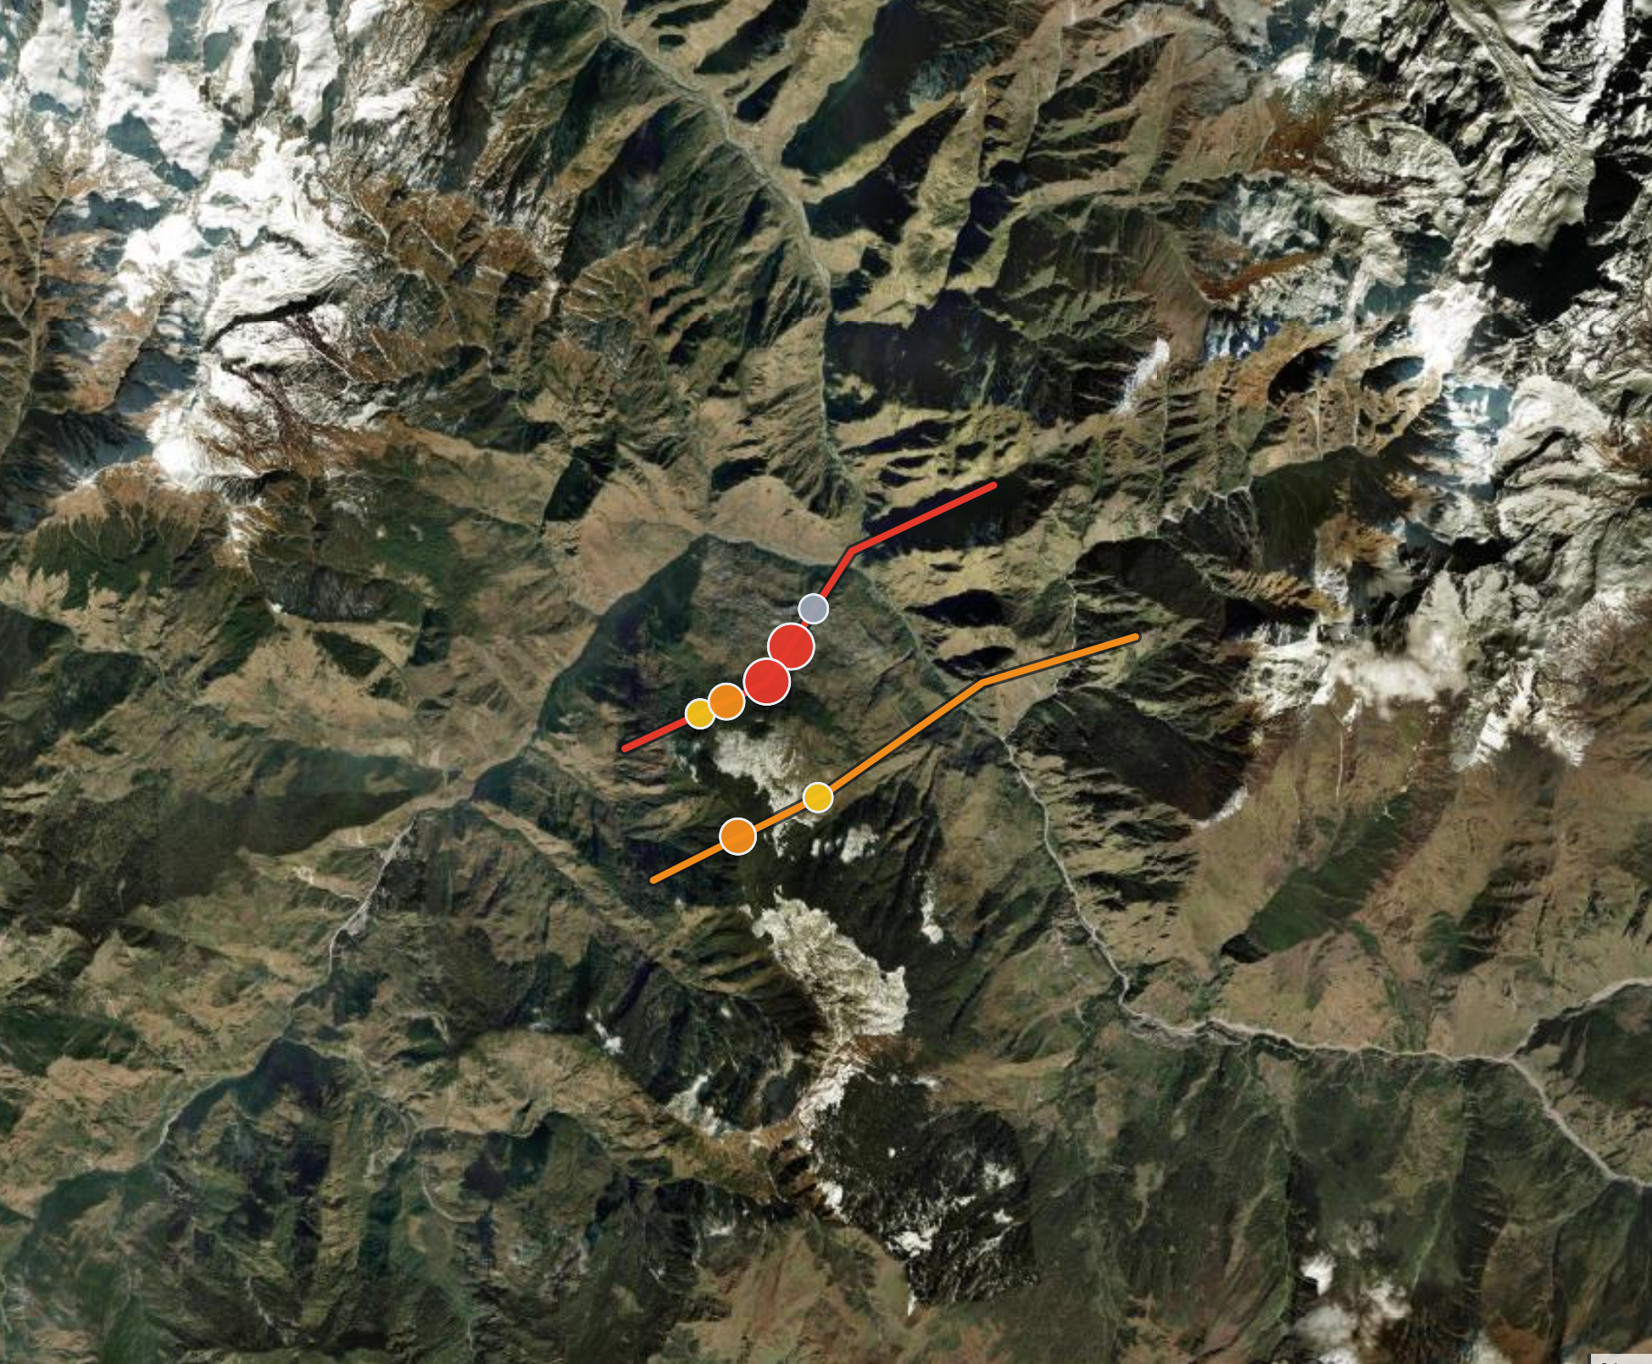

TERRASENTINEL AI
Satellites see the ground move.
Gemini tells engineers where to go first.
62,330 → 4
Observations become act-today sites
RPI 86 · CRITICAL
NH-58 · 35–64 day outlook if trend continues
Gemini · verified
6 tools · 7 numbers checked · 24h dispatch

Slide 3
PROBLEM & DECISION
Ground creeps for months. Nobody ranks which creep matters — crews go to the wrong place.
NH-58 mountain highway
Sole valley access. One slip cuts towns, pilgrims, supply.
Today fails the decision
• Raw InSAR portal — thousands of points, no asset link, no who-goes-today
• Rainfall alarm — treats the trigger as the hazard; fires on stable ground
• Generic AI chatbot — invents mm and failure dates; nothing to audit
• Scheduled walk-over — calendar ignores which segment is accelerating now
Chennai metro tunnels
Settlement under roads & buildings. Tight tolerances.
Dams & tailings
Crest/toe motion · severe downstream consequence.
We do
We refuse
• Progressive creep on linear assets
• Rank · explain · track between passes
• Threshold window + assumptions stated
• Failure / collapse dates
• Sudden events between 6–12 d passes
• Certified safety decisions
The one decision
After this pass: which 250 m, why, and how soon?
One pass · demo data
62,330
observations
1,355
radar points
87
250 m sites
7
CRIT/ELEV
4
Act today

Slide 4
WHY WE WIN
Not another InSAR viewer — a consequence-ranked decision layer with guarded GenAI.
Differentiation
How it solves it
USP · live proof
• 250 m chainage sites on corridor geometry — not a heat-map of every scatterer
• RPI = hazard × consequence × confidence (deterministic Python / BigQuery)
• Act list = today’s state; Alerts = what changed between passes
• Rain amplifies only (+50% cap); USGS quakes never move a score
• Gemini narrates tool results; the engine owns every number
• WEAK radar guard — bad data can never become CRITICAL
• Validate → locate on assets → measure speed / accel / progress
• Classify with data-quality gate; rank Act-today shortlist
• Outlook = [ETA_const, ETA_accel] band ≤ 365 d — never a date
• Work order: summary · hypothesis · urgency · field checklist
• Same maths locally or in BigQuery (TS_DATA_BACKEND flag)
• History is re-run from data — every past score is reproducible
• Honest continuing-regime bands with assumptions spelled out
• Number guard rejects invented mm and “will collapse” language
• Live Cloud Run + BigQuery + Secret Manager + GCS state
• Demo funnel: 62,330 obs → 87 sites → 7 action → 4 Act today
• Gemini live: 6 tool calls · 7 numbers verified · 24h dispatch
• Judge can sign in now — credentials on the login page

Slide 5
PRODUCT SURFACES
Every screen ships a decision an engineer can act on today.
Command Center
Map + KPIs + Act today — ranked by consequence, not raw mm
Site drawer
RPI, speed vs baseline, rain trigger, outlook band, pass trend
Alerts
Pass-to-pass diffs — what changed, not a duplicate Act list
Trends · Portfolio
16 passes recomputed from data; action sites 3→7 tracked
Work Orders
Template-first ticket; Gemini polish; number guard on every figure
Data Hub
Validate-then-import · Open-Meteo rain · provenance · BQ sync
Access & audit
admin/analyst/viewer · CSRF · sessions · full audit log
Methodology
Published formulae — every score auditable by a geotech

Slide 6
STORY & PROCESS FLOW
One satellite pass — from space to a crew at the right 250 metres.
1 · Pass
Every 6–12 days
Sentinel-1 measures mm motion through cloud & night
2 · Map
Onto the corridor
1,355 points matched to highway / metro / dam → 87×250 m sites
3 · Rank
What matters
Fast + accelerating + critical + good data rises; rain alone never alarms
4 · Gemini
Write the ticket
7 tools → reason → JSON → number guard → field checklist
5 · Next
Keep watching
Crew acts; next pass shows calm-down or worse
Demo funnel (labelled synthetic)
Who it serves
62,330
obs
1,355
pts
87
sites
7
action
4
Act today
• Public: find problems while small — keep roads open
• Engineers: short list + ticket (what / where / why)
• Leaders: spend crews where risk is rising

Slide 7
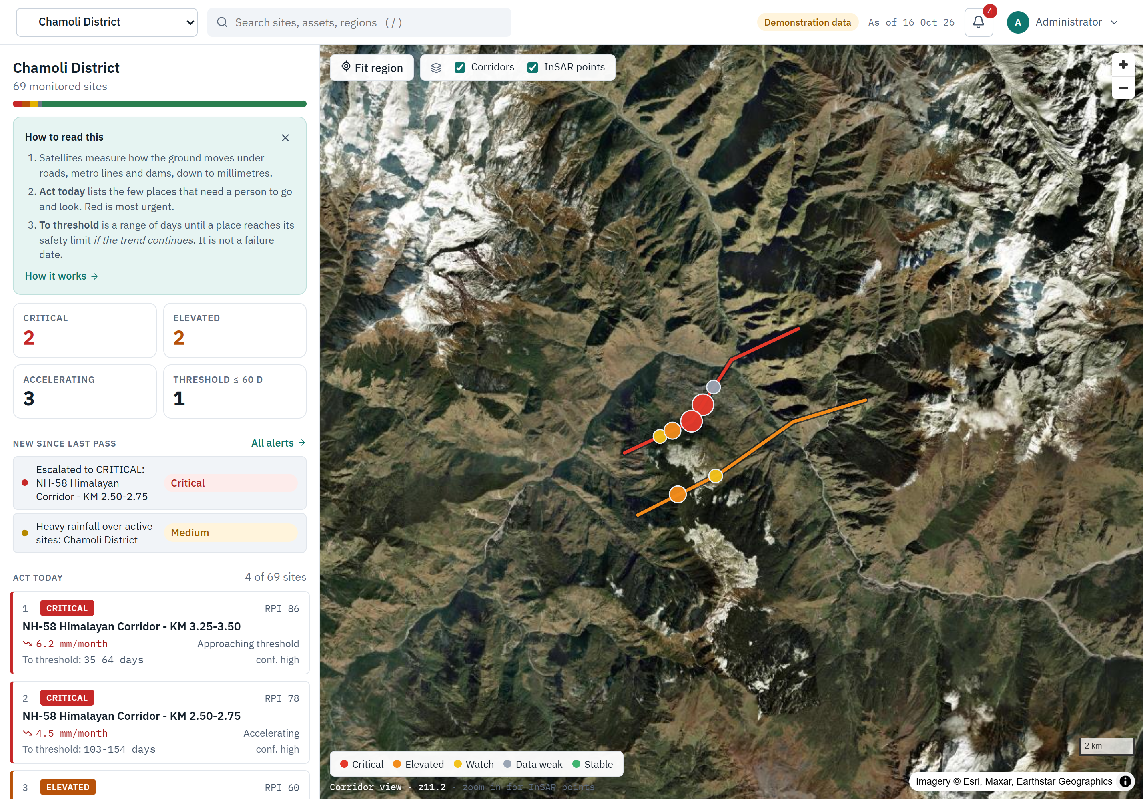
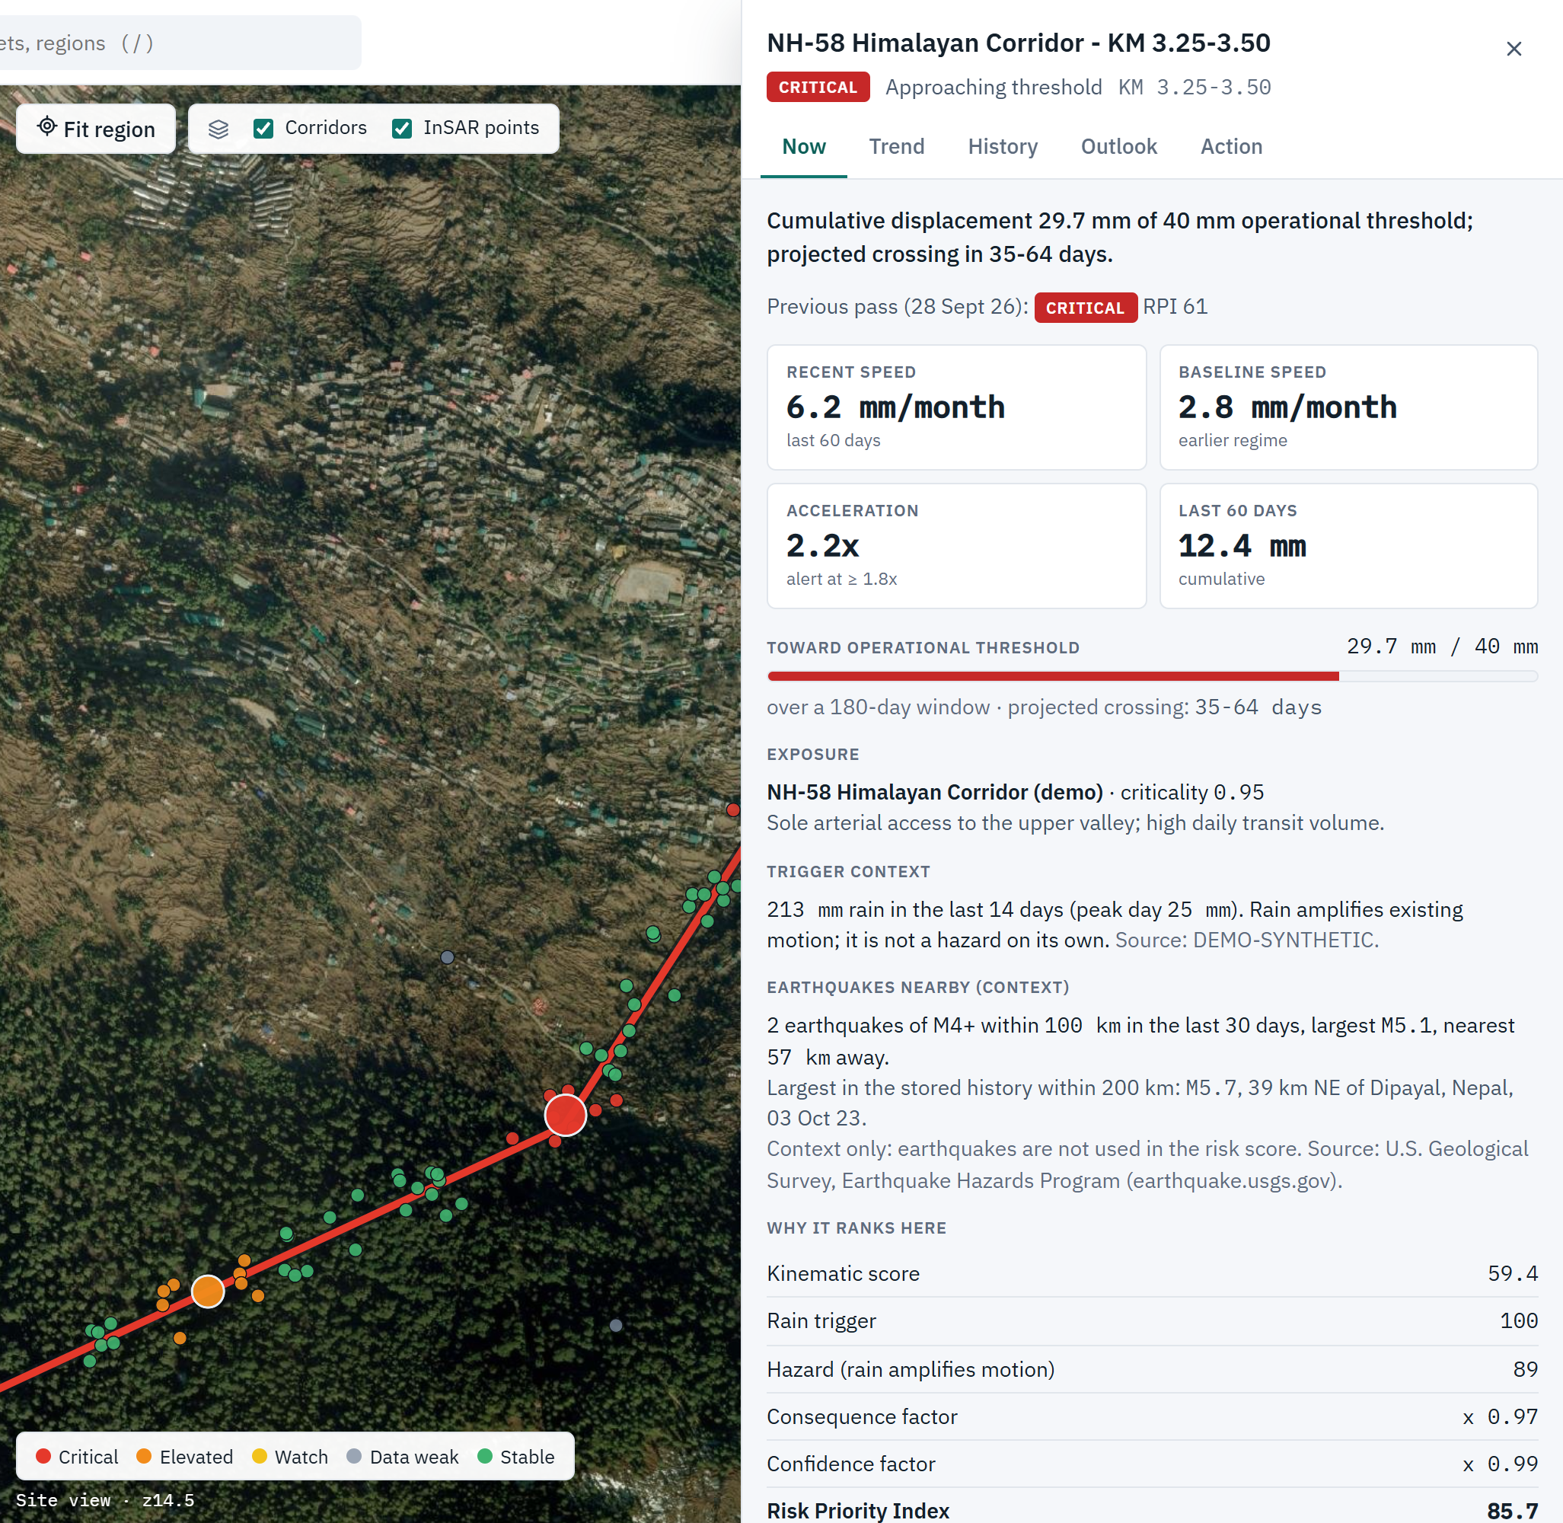
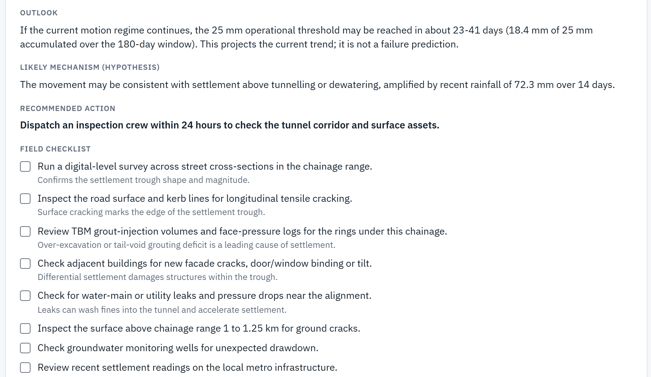
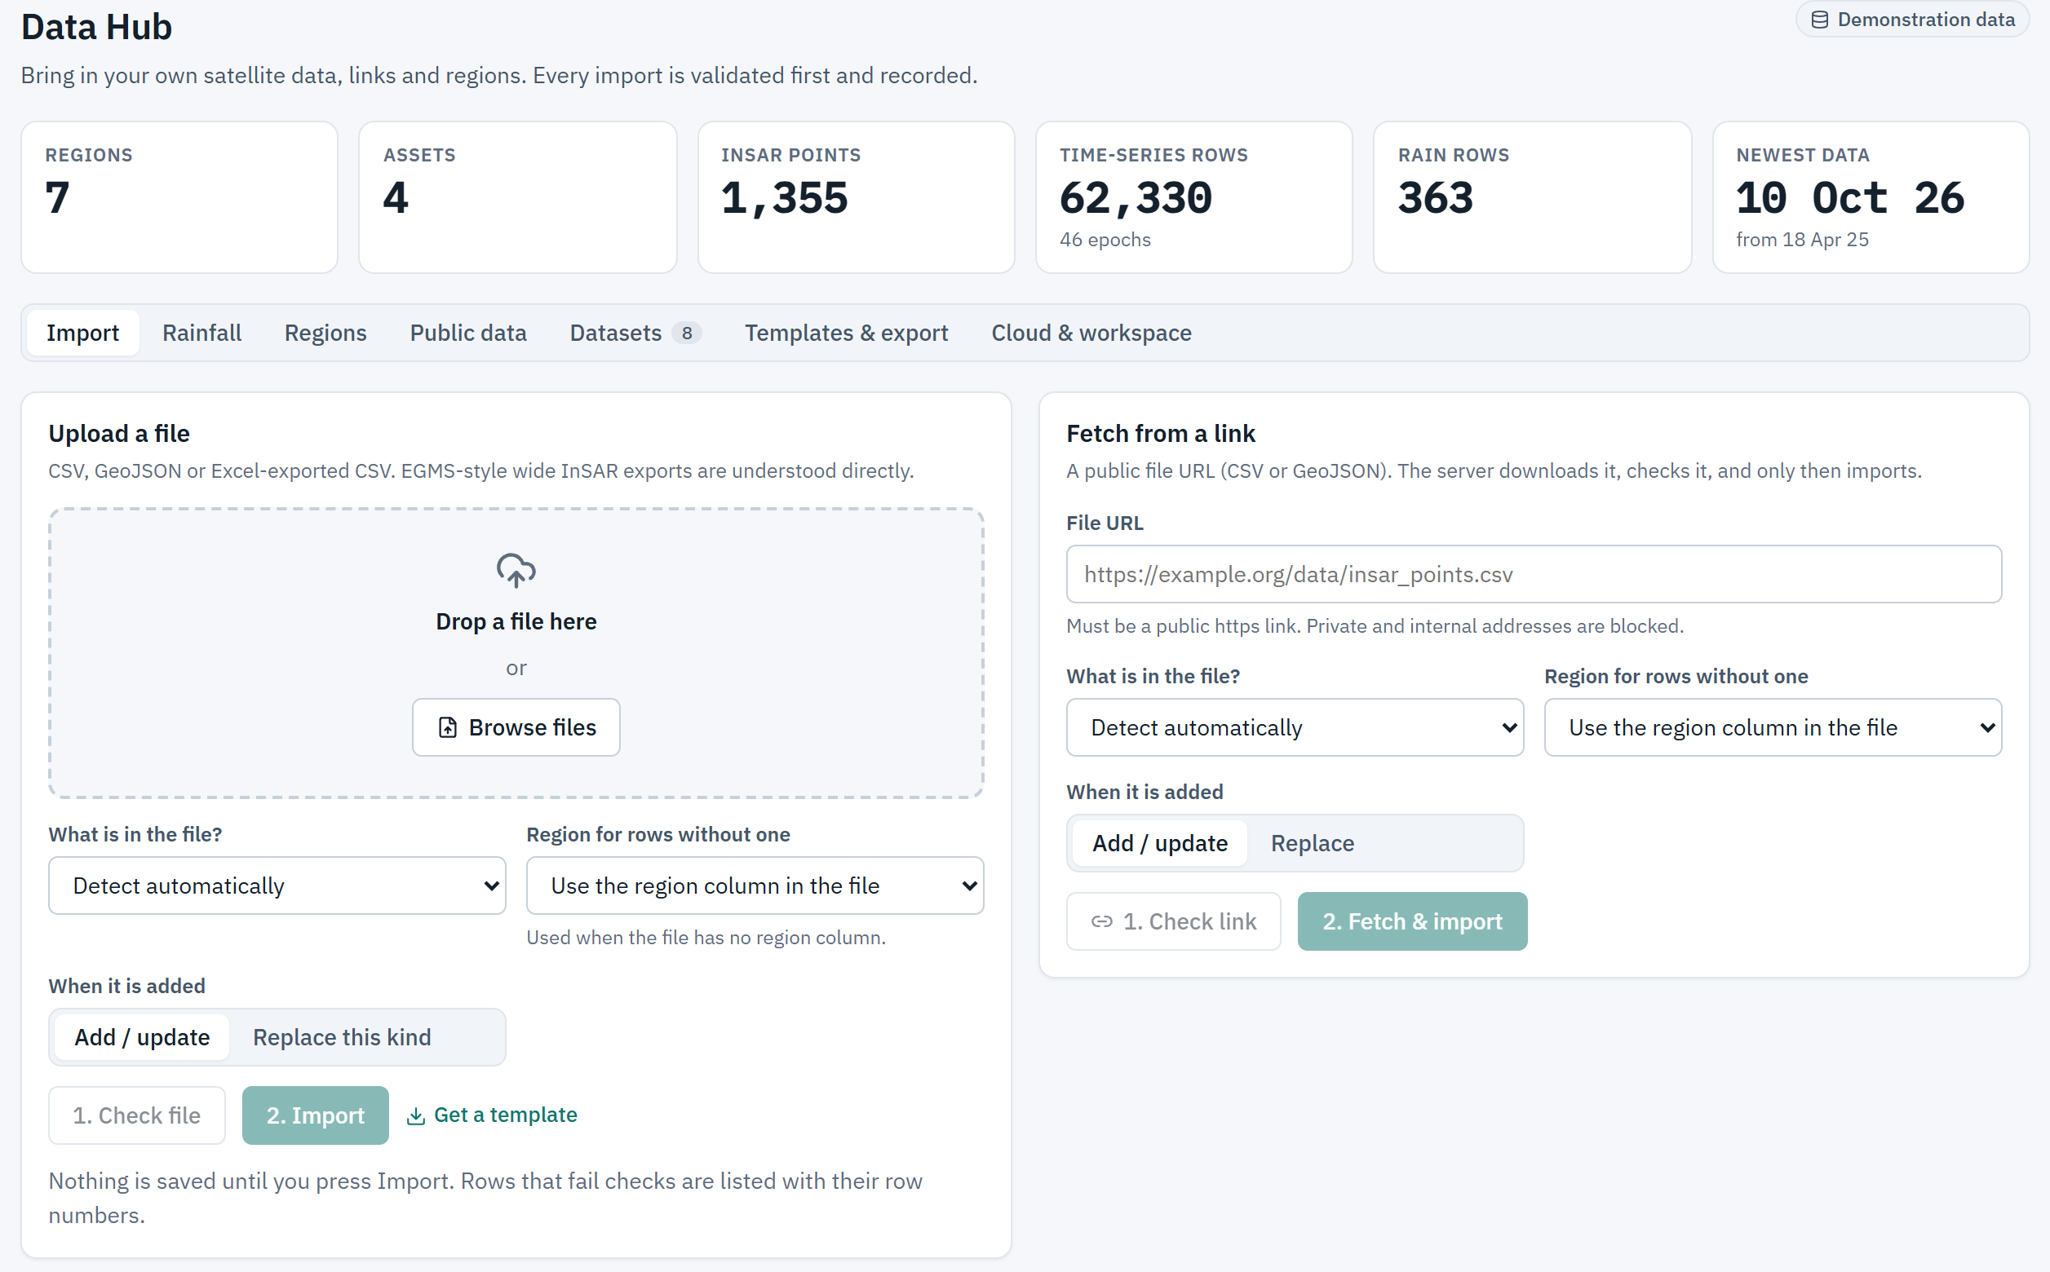
PRODUCT UI (LIVE)
What judges open today — Command Center → site → Gemini ticket → Data Hub.
Command Center · Act list
Site · RPI & outlook
Gemini work order
Data Hub · validate then import

Slide 8
ARCHITECTURE STORY
Ingest → Store → Compute → Snapshot → Serve. One container. GenAI never owns the maths.
Ingest
Data Hub validates
files & HTTPS links
Store
BigQuery or local
GIS join · history
Compute
Detection engine
RPI · tier · band
Snapshot
Pass replay
alerts · trends
Serve
UI + Gemini ticket
audit trail
EDGE
Cloud Run · HTTPS · CSP/HSTS · rate limits · sessions · GCS state
UI + API
React/MapLibre · FastAPI · RBAC · CSRF · SSRF-safe fetch · audit
ENGINE
Deterministic RPI / tiers / ETA bands / alerts — GenAI never computes these
GENAI
Gemini tools → number guard → template fallback (Vertex or AI Studio)
DATA
BigQuery partitions/GEOGRAPHY XOR local · USGS context only · provenance

Slide 9
GENAI ON GOOGLE CLOUD
Without GenAI: a number. With Gemini + guard: a ticket an engineer can trust.
LIVE PROOF: Gemini drafted a Metro Line 4 ticket with 6 tool calls and 7 numbers verified. Recommendation: “Dispatch an inspection crew within 24 hours…” — every millimetre from tools, not free text.
Ingest
Cloud Run
Data Hub
Store
BigQuery
GIS + history
Compute
Engine
RPI · tier · band
Explain
Gemini
+ number guard
Act
Map · ticket
· audit
Gemini loop
Number guard
GCP stack
• 7 tools: metrics, history, outlook, rain, seismic, exposure, quality
• Round 0 MUST call tools → investigate → write JSON
• Temp 0.1 · model fallback on 429/5xx
• Rejects any mm/days/% not in a tool result
• Rejects “will collapse”, “failure date”, “no risk”
• On failure: labelled template still ships
• Cloud Run — SPA + API + engine + agent
• BigQuery — partitions, ST_DWITHIN, bytes cap
• Vertex/AI Studio · Secrets · GCS · ADC

Slide 10
ESTIMATED COST (OPTIONAL)
GenAI only on tickets; ranking stays deterministic CPU.
Cloud Run
1–2 vCPU / 2 GiB · min=1 while judging
low tens USD/mo warm
BigQuery
~62k rows · TTL cache · max bytes billed
pennies–low USD demos
Gemini Flash
Work-order path only · template fallback
per-ticket, optional
Secrets + GCS
Admin/Gemini secrets · state volume
pennies
Scale path
Materialize assignment · raise instances
linear with corridors

Slide 11
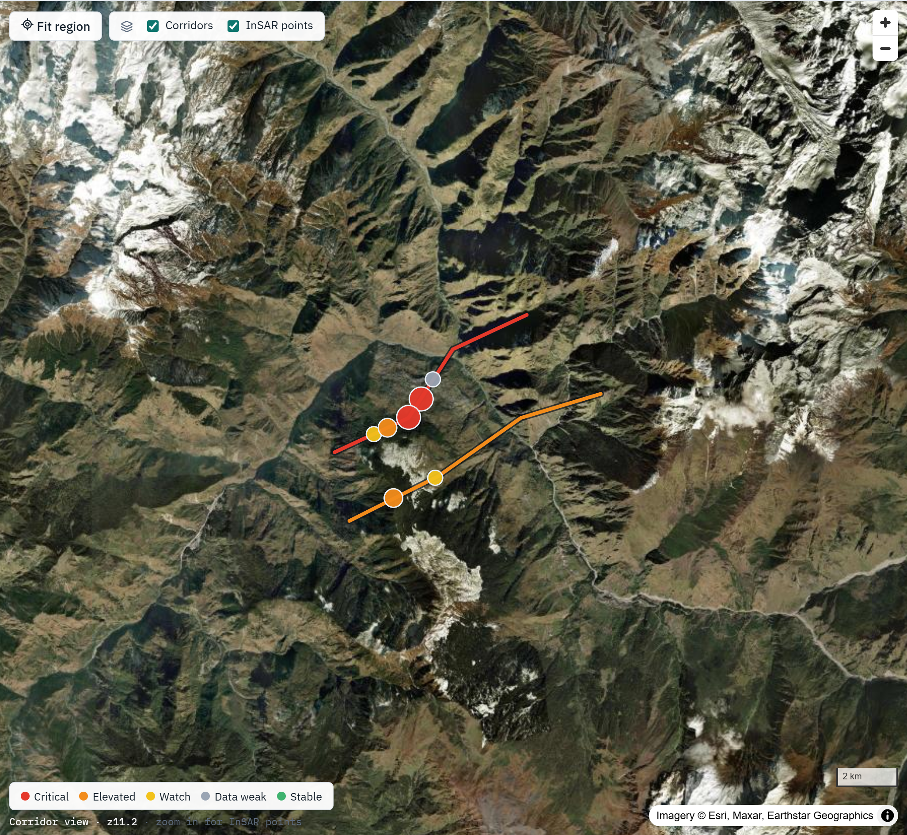
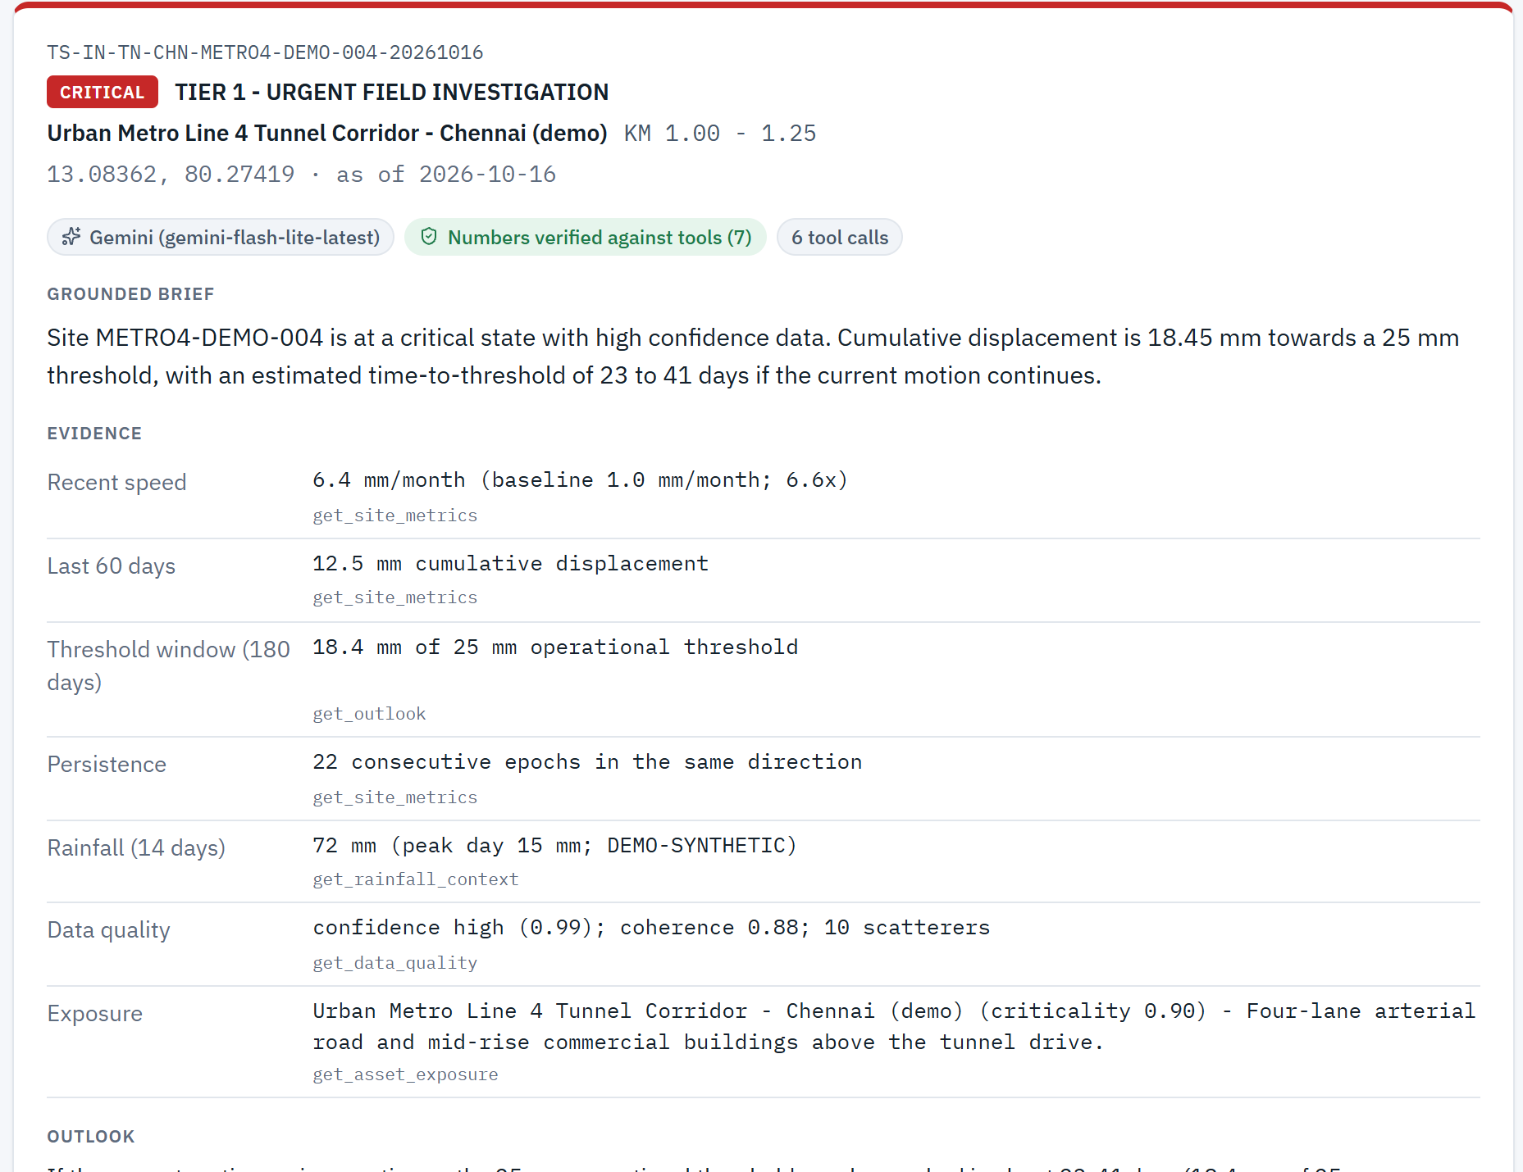
PROTOTYPE SNAPSHOTS
Winning proof on screen — Chamoli Act list, NH-58 CRITICAL, verified Gemini ticket.
Chamoli · 69 sites · 4 act today
Ranked map — not every scatterer
NH-58 · RPI 86 · 35-64 day band
Gemini · numbers verified

Slide 12
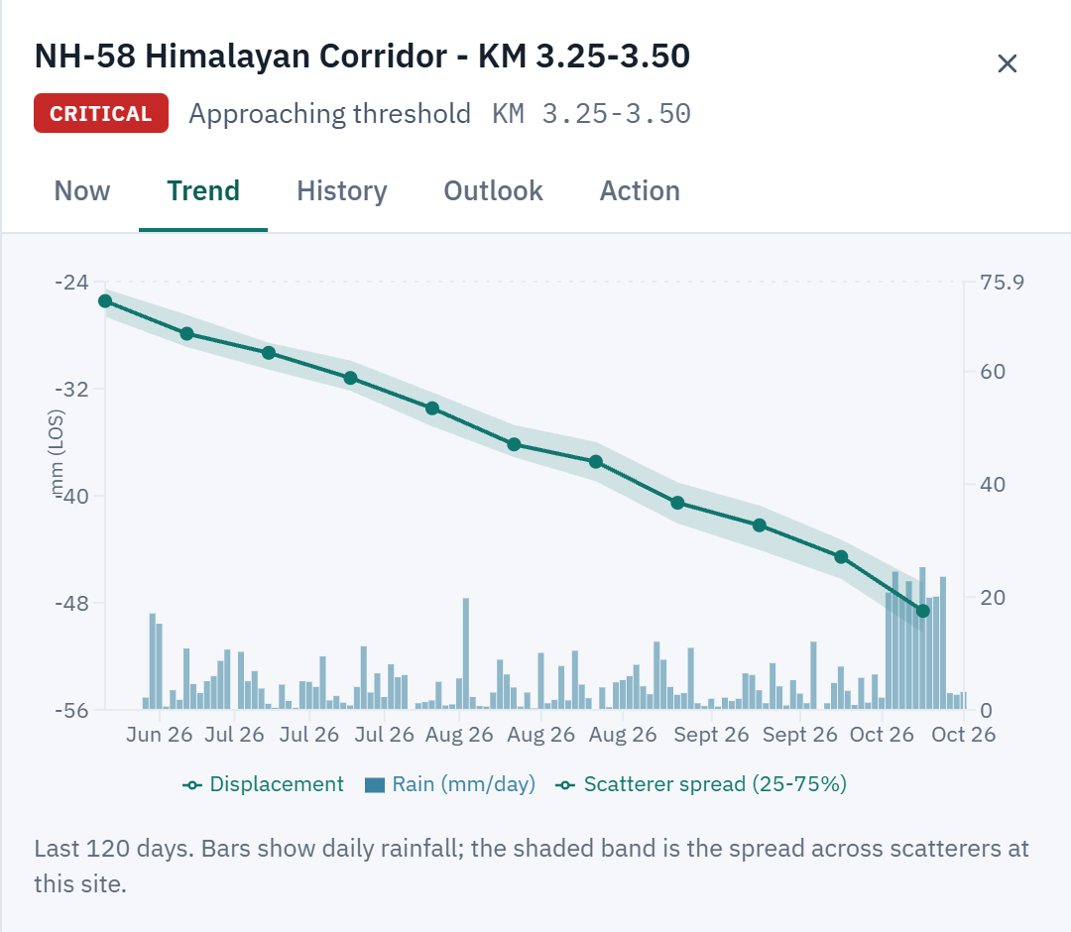
WORKED PROOF
NH-58 KM 3.25–3.50 — same numbers in UI, tools, and Gemini work order.
CRITICAL · RPI 86 · band 35–64 d
• Inputs: 6.2 vs 2.8 mm/mo · 2.2× · 29.7/40 mm · rain 213 mm · crit 0.95 · conf 0.97
• kin = 100×(.4·0.62 + .3·0.40 + .3·0.74) = 59.4
• hazard = 59.4×(1+0.5×1.0) = 89.1 (rain capped)
• RPI = 89.1×0.975×0.985 ≈ 85.7 → CRITICAL (threshold approach)
• Outlook: 51 d const · 44 d accel → widened 35–64 d if trend continues
• History: this site 61→86 · portfolio action sites 3→7 over 16 passes
• What-if: minor road→57 ELEV · weak radar→≤15 WEAK · rain on stable→≈1
• Integrity: GenAI never computes RPI / tier / ETA — tools only
Site trend · displacement + rain
Live Cloud Run + BigQuery (warm)
summary ~0.4s · sites ~0.3s · alerts ~2s
Hot-path prefetch before history warm
Gemini: 6 tool calls · 7 numbers verified

Slide 13
ASK · BUYER · ROADMAP
Sustainability impact today. Scale tomorrow. Honesty rules never move.
THE ASK: Review the live demo, the 3-minute video, and the repository.
Buyer: asset-integrity / geotech teams. They buy engineer attention — 1,355 points become 7 sites.
Roadmap
Non-negotiable honesty
• Production InSAR providers on the same Data Hub schema
• Materialize spatial assignment for national corridors
• HA when session store leaves single-process files
• OIDC / IAP · field offline packet · deeper amplifiers only
• Outlook bands ≠ collapse / failure dates — always
• Gemini narrates tool numbers only — always
• Synthetic demo data labelled in the UI — always
• Secrets in Secret Manager / .env — never in git

Slide 14
JUDGE PATH · LINKS
Sign in → Command Center → NH-58 site → Work Order → Data Hub (5 minutes).
1 · GitHub
https://github.com/ramasamyp-aiengineer/terra-sentinel-ai
2 · Demo video (3 min)
docs/pitch/TerraSentinel-AI-Demo-3min.mp4 — upload to Drive/YouTube for the portal
3 · Live product
https://terrasentinel-598899050820.asia-southeast1.run.app
Credentials are shown on the sign-in page (judge demo hint).
Look for: Act list · outlook band (not a date) · “numbers verified” on the work order.

Slide 15
RISK ENGINE MATHS
Measure → Score → Project. Deterministic, tested, explainable.
1 · Measure
2 · Score
3 · Project
• Recent speed: slope last 60 d
• Baseline: 270 to 90 d ago
• Accel = |recent|/max(|base|,0.5)
• Persistence · seasonal recovery
• Site = median in 250 m bin
• conf mixes coh·epochs·pts·SNR
• Weak data can never be CRITICAL
• kin=100*(.4s+.3a+.3p)
• hazard=kin*(1+0.5*rain/200)
• RPI=hazard*(0.5+0.5*crit)
• *(0.5+0.5*conf)
• Slow/far x0.2 · seasonal x0.35
• WEAK cap 15 · quakes never scored
• CRITICAL / ELEVATED / WATCH
• ETA_const = remaining / speed
• ETA_accel = quadratic root
• band=[min,max] <= 365 d
• Highway 40 mm / 180 d demo
• Metro 25 mm · Dam 30 mm
• ALWAYS a band
• NEVER a failure date

Slide 16


