Slide 1
GTIN
(Global Trade Identification Number)

Slide 2
Table of Contents
What is a GTIN?
GTIN Composition
GTIN Types
GTIN Pool Concept
Trade GTIN Creation in Agile PLM
Case GTIN Creation in Agile PLM
GTIN Formats
Eaches , Cases and Pallets
Product Structure with GTIN
Trade and Case GTIN relationship

Slide 3
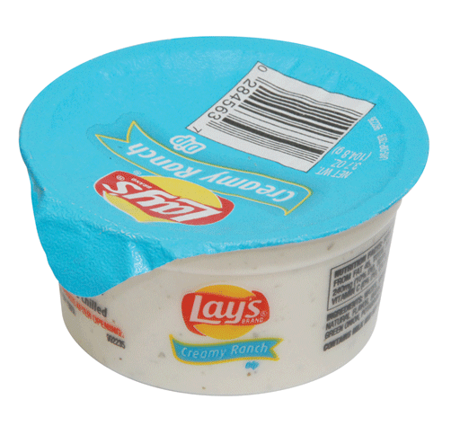
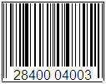
What is a GTIN?
GTIN is the abbreviation for Global Trade Identification Number
The Global Trade Identification Number(GTIN) is an industry standard for identification of products. It is the bar-coded number customers use to scan the item when it is sold.
This was developed by GS1, which is an international non-profit organization
GTINs may be 8, 12, 13 or 14 digits long, and each of these 4 numbering structures are constructed in a similar fashion , that is, by combining Packaging indicator, Company Prefix, Item Reference and a calculated Check Digit
GTIN

Slide 4
GTIN Composition
GTIN is made up of 4 parts
- Packaging Indicator (not applicable for 8,12 and 13 formats)
- Manufacturer ID or Company Prefix
- Item Reference Number (short form UPC)
- Check digit
Company Prefix
Check Digit
0-0028400-05804-9
Packaging Indicator
Item Reference Number(UPC)

Slide 5
GTIN Types
Trade GTIN – GTIN which is printed on the bag.
Shipping/Case GTIN – GTIN which is attached to the case/pallet of the product.
International GTIN – GTIN which is reserved for products which are sold internationally. These GTINs will not have any product assignment.

Slide 6
How do we create GTINs in Agile PLM?
(GTIN Pool Concept)
PEPSICO AGILE PLM
SAP
Agile requests for
UPC Numbers
Trade GTIN
(pkg indicator always 0)
GTIN POOL
“creates”
Trade GTIN/Case GTINs
USER
SAP sends UPC numbers to Agile PLM
fetches
GTIN from pool
“creates”
fetches GTIN
from pool
Note *
International GTINs are Trade GTINs that have the “Reserve for International?” field set to “Yes”
Case GTIN
(pkg indicator 0-9)

Slide 7
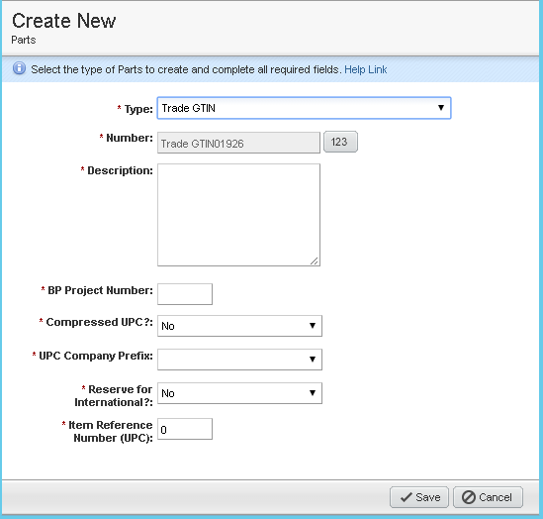
Trade GTIN Creation in Agile PLM
Main inputs that decide how a Trade GTIN is fetched from the pool –
UPC Company Prefix – specifies which manufacturer’s product this GTIN is for.
Compressed UPC? – If this is yes, then the system picks a GTIN from pool that has a UPC between 0-99 (for FLNA of FLUS)
Item Reference Number(UPC)
If 0, system picks the next available GTIN number from the Pool . This is referred to as System Generated UPC
If non-zero, system will retrieve this UPC value, if it exists for the company prefix. Else, it will create a new Trade GTIN with this number . The 9 variations of GTIN is added to the GTIN pool

Slide 8
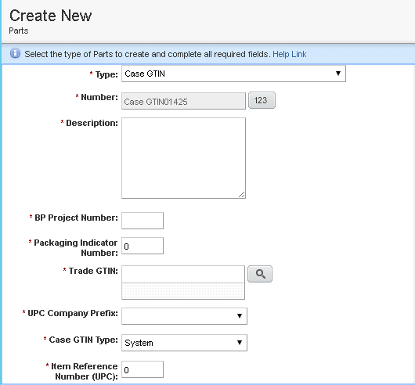
Case GTIN Creation in Agile PLM
The Case GTIN Type field determines how the GTIN is fetched from the Pool
There are 3 modes –
System – based on combination of Packaging indicator, Company Prefix ,next available GTIN is fetched from the pool
Default – fetches the GTIN from pool based on the Company Prefix and Item Reference Number (UPC) of the Trade GTIN number chosen during creation
Manual –Creates the Case GTIN with the non-zero item reference number entered by user, packaging indicator and Company prefix combination even if the number is not present in pool

Slide 9
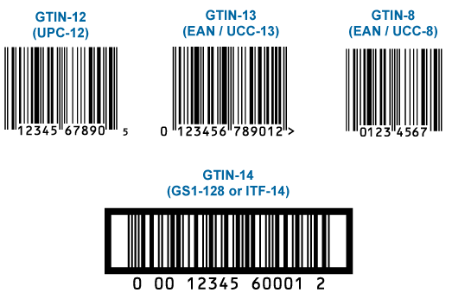
GTIN Formats
UPC A or GTIN-12 - This is a 12-digit number format used primarily in North America
UPC E or Zero suppressed UPC -. This is an 8 digit format that is used on products that are too small to hold a regular UPC-A barcode. It is a compressed barcode which is intended for use on small items.
ITF14 - This is a 14-digit number used to identify trade items at various packaging levels. (This is the main format of GTINs we use in PepsiCo Agile PLM)

Slide 10
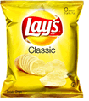
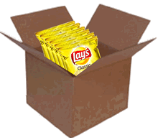
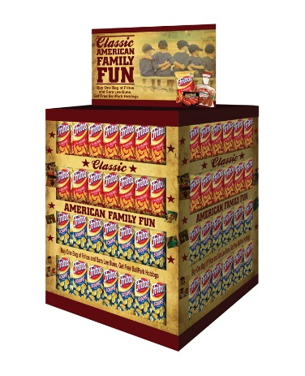
Eaches, Cases and Pallets
Each An individually wrapped unit of product, such as a flex bag of product, such as Lay’s, Tostitos, Frito’s, Doritos, Cheetos, and so forth.
Each : 08022400 Trade GTIN: 0-0028400-32040-5
Case A shipping container for eaches or caddies. A product can be associated with multiple case packs, such as a regular carton which normally represented by a case sequence of -01.
Case : 08022401 Case GTIN: 0-0028400-32040-0
Case Qty: 15
Pallet
A Pallet is a big wooden platform to enable shipment and sales in large quantities. There are saleable and non-saleable(only used for shipments) pallets.
Each : 08228000 Trade GTIN: 0-0028400-47241-8
Case : 08228001 Case GTIN: 0-0028400-58258-2
Case Qty: 1

Slide 11
Product Structure with GTIN
PALLET OF CASES: 08022401
CASE GTIN: 0-0028400-57410-5
contains
PALLET OF PRODUCT: 08023402
CASE GTIN: 0-0028400-41450-0
CASE: 08022401
contains
contains
EACH: 08022400
TRADE GTIN: 0-0028400-32040-5

Slide 12
Trade and Case GTIN relationship
Trade and Shipping UPC has same number.
If the items within a carton have the same product numbers , the Packaging Indicator will be a non-zero number indicating the packaging level and the same Product Number (Item reference (UPC) ) will be used
0-0836093-40118-5 – Trade GTIN
1-0836093-40118-2 – Shipping GTIN
Trade and Shipping UPC has different numbers.
If the items within a carton have different product numbers (i.e. mixed pack), the Packaging Indicator should be a “0” and a brand new unique Product Number must be used to represent this unique assortment.
0-0028400-05804-9 – Trade GTIN
0-0028400-58115-8 – Shipping GTIN

Slide 13
Thank You

