Slide 1
Free Internet
By,
Ramaseshan
Engineering Team
Fractalio Data
Notes:
Free Internet is not about zero pricing internet, it is about having freedom over the internet we use. It is about our privacy, liberty and basic democratic human rights.

Slide 2
How many of you use these ??
GOOGLE
WHATSAPP
FACEBOOK
YOUTUBE
At what value are these companies valued at ??
Notes:
Whatsapp is valued at about $19 billion, Facebook at $100Bn and Youtube at $34 Bn.
What makes a free of cost application like this, to be valued at so much cost ??
Good Read
http://www.theguardian.com/technology/2013/aug/27/facebook-stock-price-record-high

Slide 3
MAIN SOURCES OF INCOME
ADS
ADS
ADS
ADS
USER DATA
Notes:
https://www.facebook.com/advertising/ (Read Step 2)
How does step 2 work ??
https://www.facebook.com/business/a/online-sales/ad-targeting-details
http://www.nytimes.com/2014/06/13/technology/facebook-to-let-users-alter-their-ad-profiles.html
By now you would have probably realised, how fb is already using you likes, comments, messages, posts (You postand you dont post) to target to share an advt.
Lets talk about google.
Google.com/dashboard, history.google.com
http://www.theguardian.com/world/2014/feb/03/microsoft-facebook-google-yahoo-fisa-surveillance-requests
Are we a product ??

Slide 4
HOW DOES ADS WORK ??
https://www.youtube.com/watch?v=bqWuioPHhz0

Slide 5
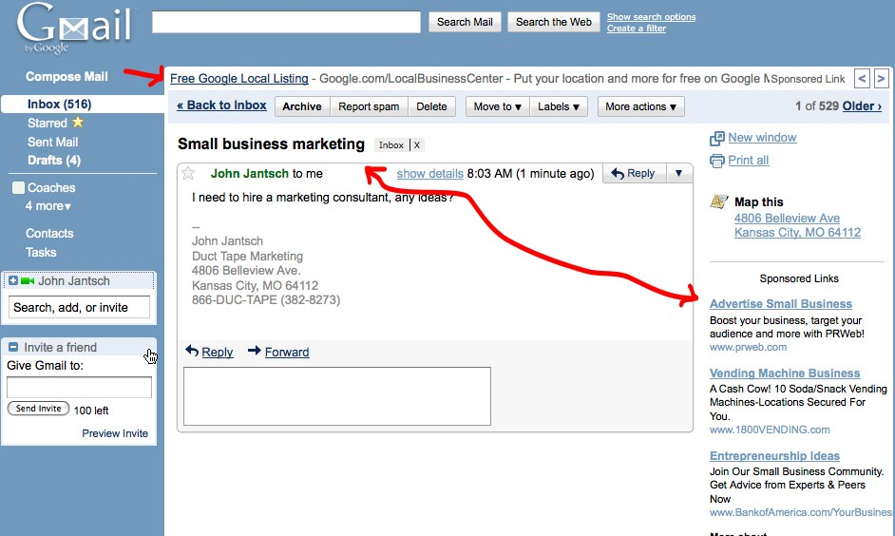
USER BUBBLE – LETS BUBBLE IT
Notes:
http://dontbubble.us
http://donttrack.us/

Slide 6
Free Your Data.
"Data is the new Oil"
http://freeyourdata.org/

Slide 7
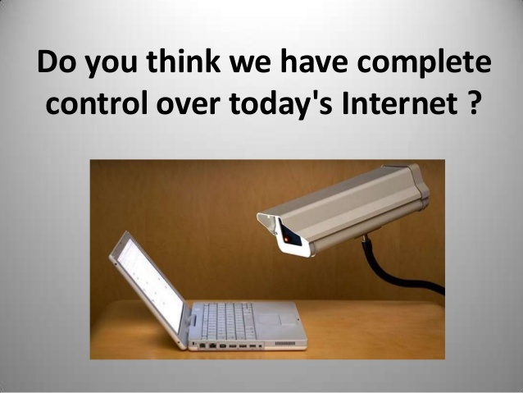
Notes:
http://dashes.com/anil/2012/12/the-web-we-lost.html
http://ducknetweb.blogspot.in/2014/03/60-minutes-blasts-data-sellers-ftc.html

Slide 8
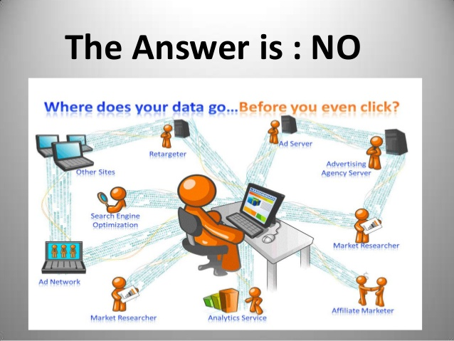

Slide 9
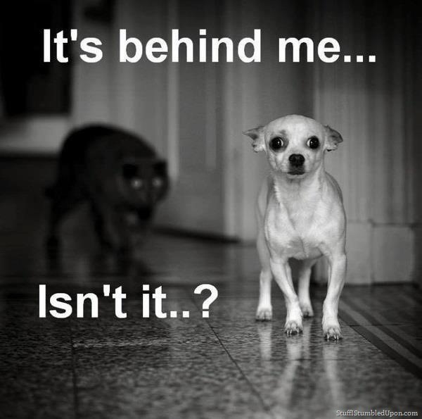

Slide 10
Lets watch a movie. Shall we ?
https://www.youtube.com/watch?v=BPP3aXvKkXg

Slide 11
TAKE YOUR PRIVACY BACK
Facebook Diaspora(www.diasporafoundation.org), Ello(ello.co)
Google DuckDuckgo (www.duckduckgo.com)
Whatsapp Telegram (http://telegram.org/)
Browser Mozilla Firefox (www.firefox.com)
Email Client Mozilla Thunderbird
Google Playstore Fdroid (http://www.f-droid.org)
Android,IOS Firefox (https://www.mozilla.org/en-US/firefox/os/)
Facebook Chat CryptoCat (firefox) or ChatSecure(Android)
SMS TextSecure (https://whispersystems.org/)
uTorrent Transmission or Deluge (http://deluge-torrent.org/)
Google Maps OpenStreetMap(https://www.openstreetmap.org/)
Google Drive OwnCloud (https://owncloud.org/)

Slide 12
Free Internet and Free Software are not about technology, it is about Freedom, Liberty and Human Rights.
Notes:
To a corporation , it is more about control over information and Internet than the user wants to have his privacy.

Slide 13


