Slide 1
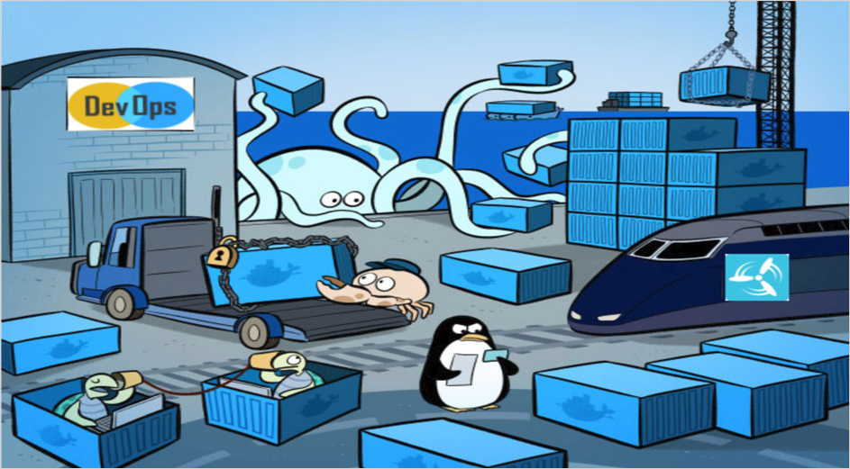
Docker
Rama Shanker

Slide 2
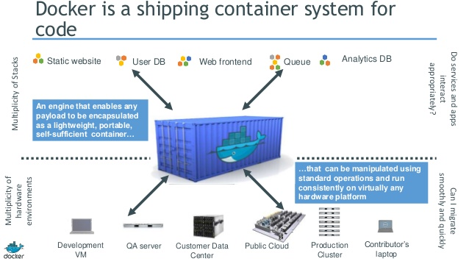
Container
docker exec -it -u root 28cdd9cc7f28 bash

Slide 3
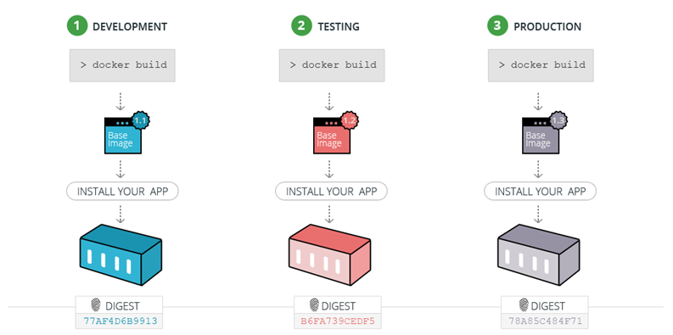
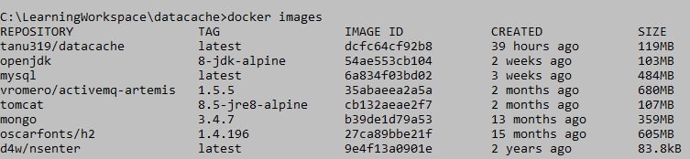
Image
An image is an executable package that includes everything needed to run an application--the code, a runtime, libraries, environment variables, and configuration files.

Slide 4
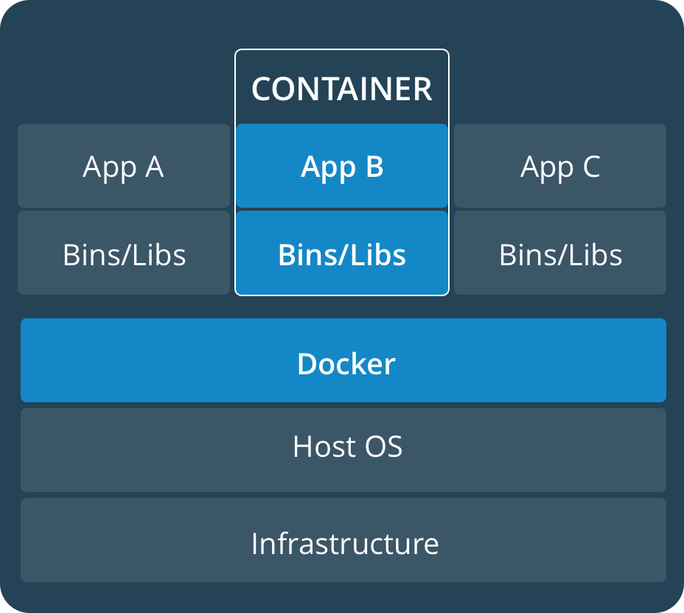
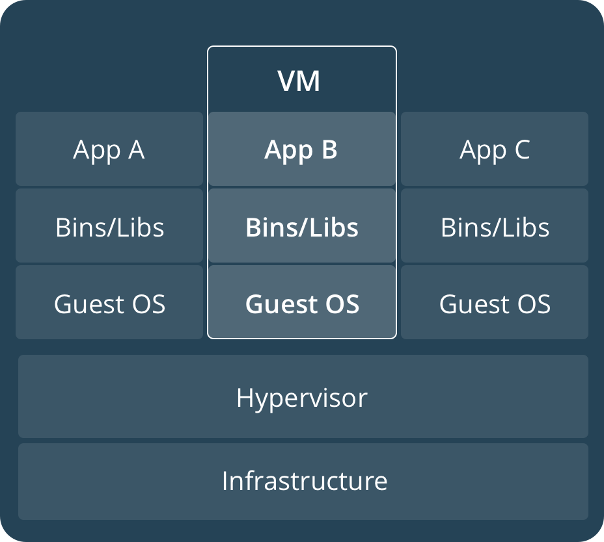
Container Vs VM

Slide 5
Steps To Start
Create an account in docker hub.
https://hub.docker.com/
Build Image using any Plugins.
Ex: Maven, gradle
Push an image
Pull image from docker hub.
Start an application
Understand docker docker-compose

Slide 6
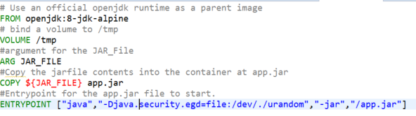
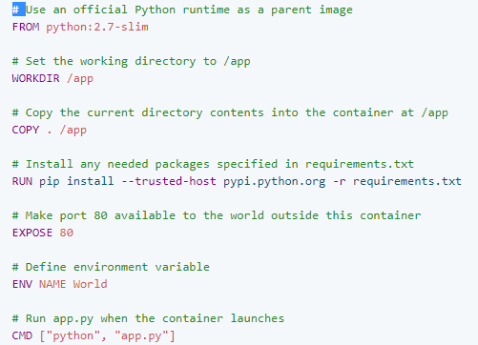
Dockerfile
For Java:
For Python:

Slide 7
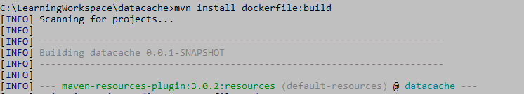
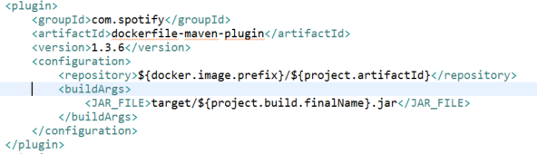
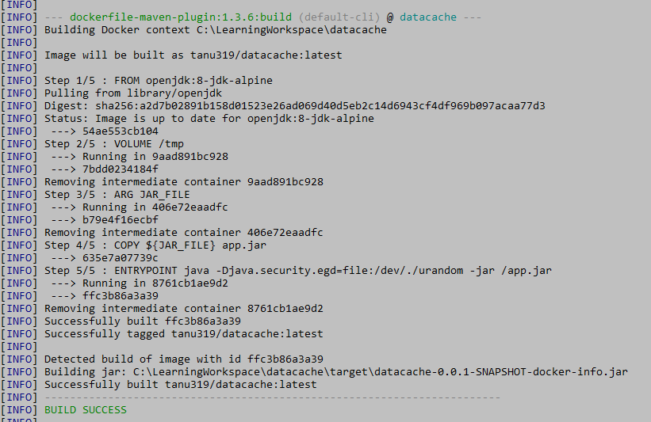
Build a Docker image
Ex: Using maven plugin.

Slide 8
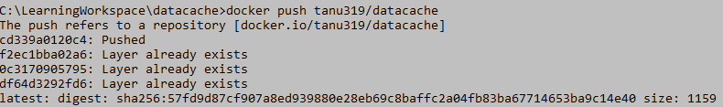
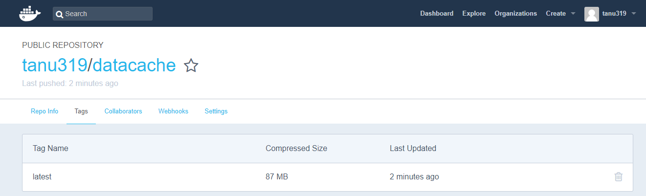
Push Image
Login to docker hub using command
Push image to docker hub
View Image in docker hub.

Slide 9
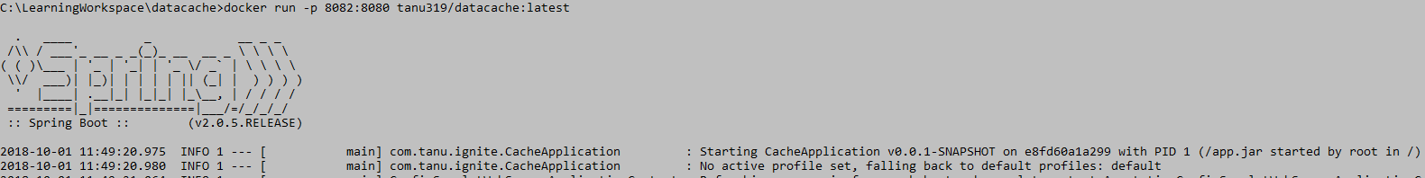
Start application:
docker run -p exposed_port:running_port username/repository:tag

Slide 10
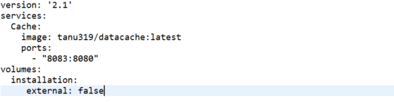
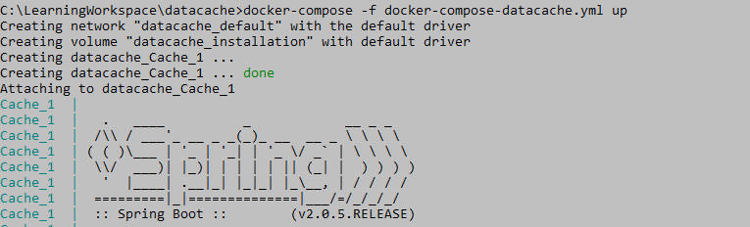

Docker Compose
Docker compose
Compose is a tool for defining and running multi-container Docker applications. With Compose, you use a YAML file to configure your application’s services.
Then, with a single command, you create and start all the services from your configuration.

