Slide 1
SetUpUser and AwsCli

Slide 2
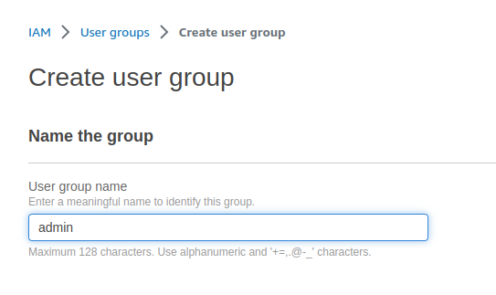
Create User Groups:

Slide 3
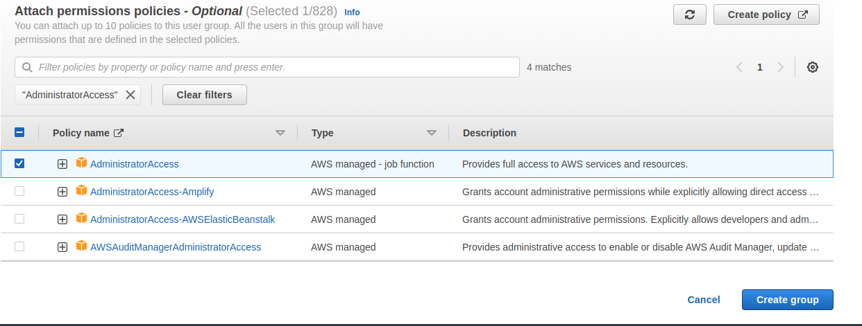
Attach permission policies

Slide 4
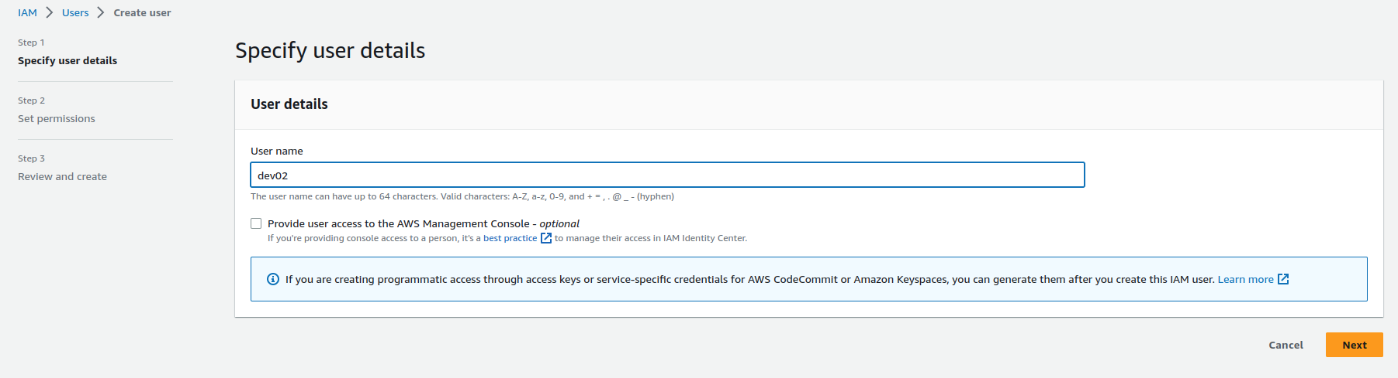
Create IAM User

Slide 5
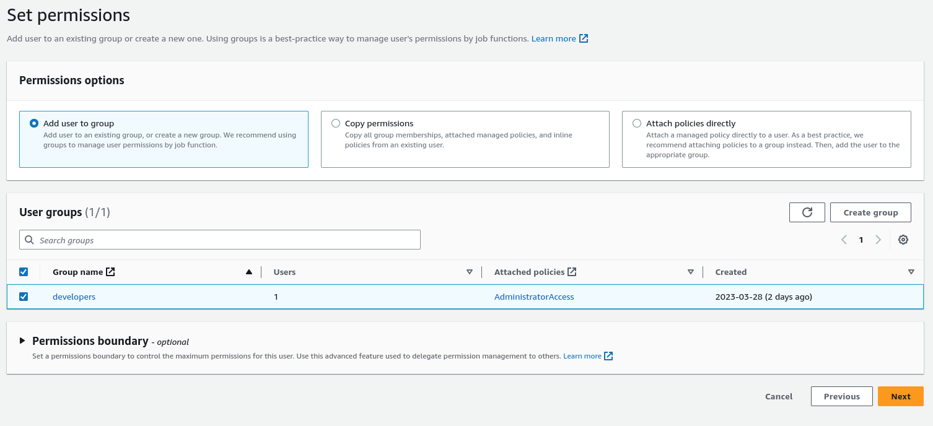

Slide 6
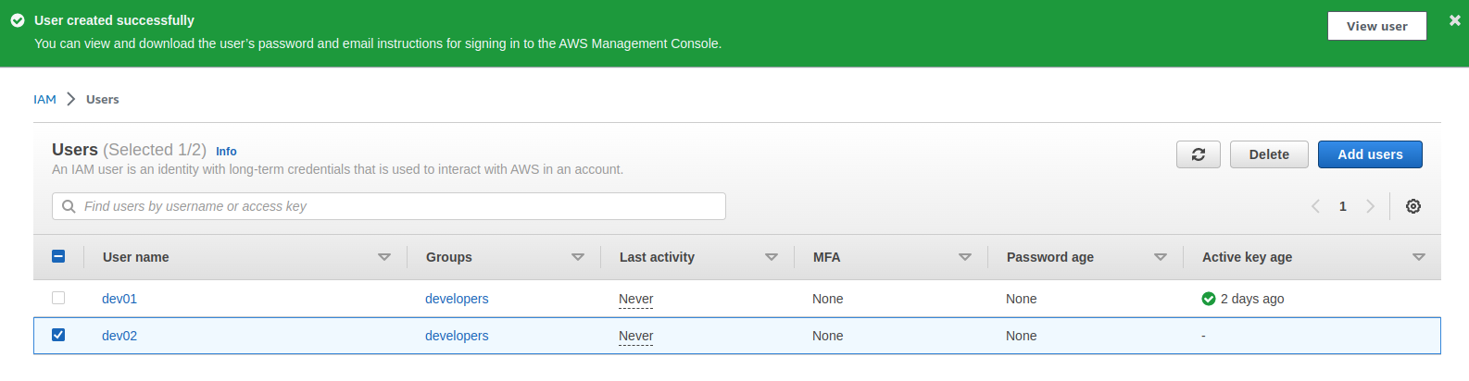

Slide 7
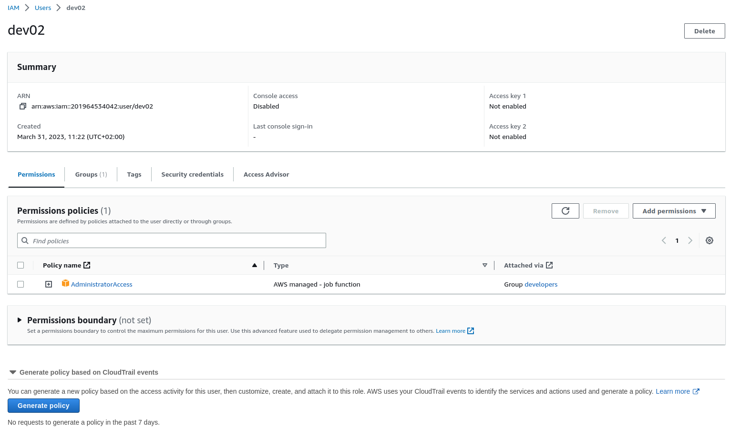

Slide 8
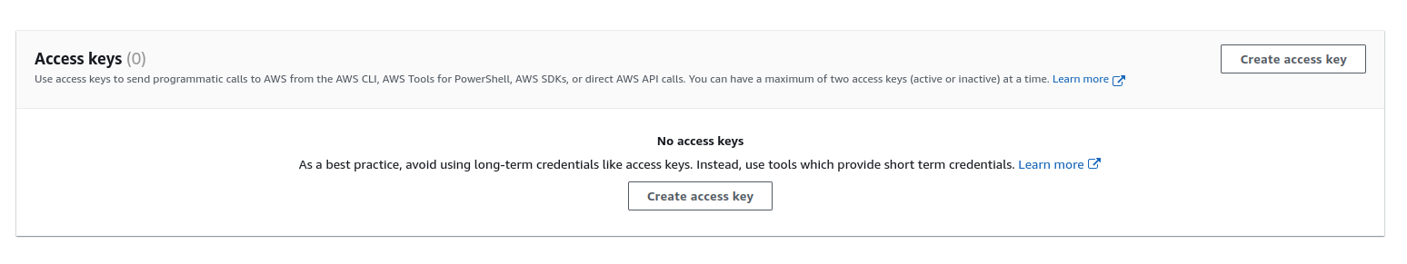
Create Access Key

Slide 9
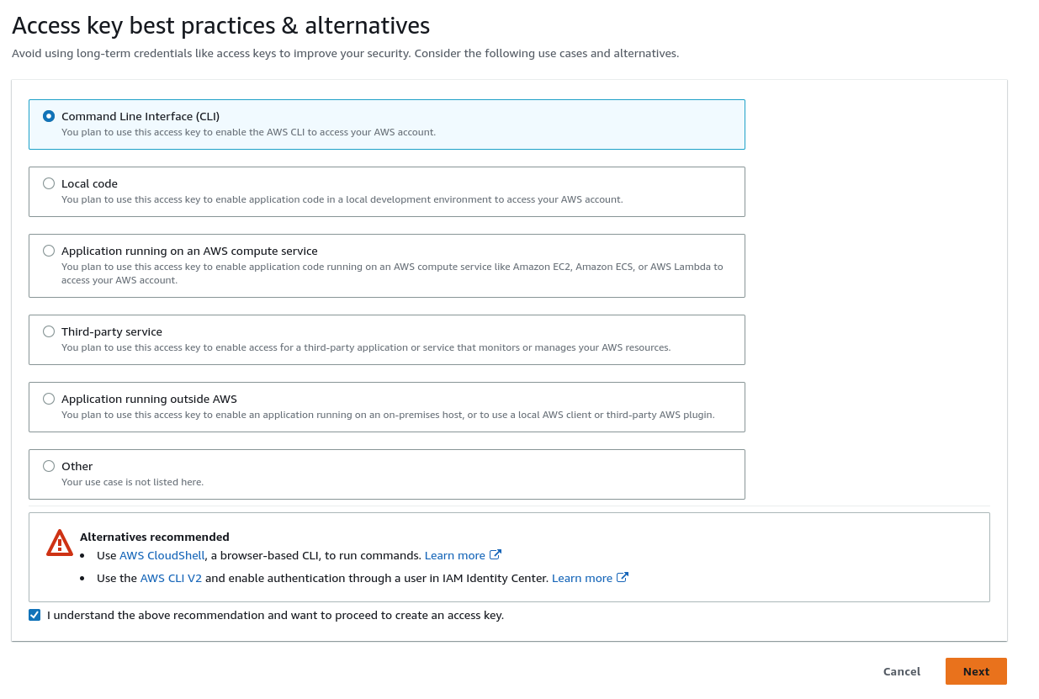

Slide 10
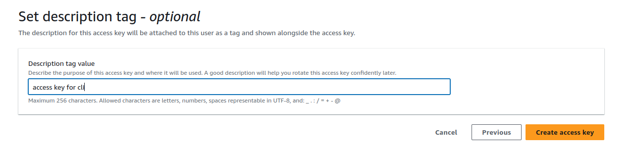

Slide 11
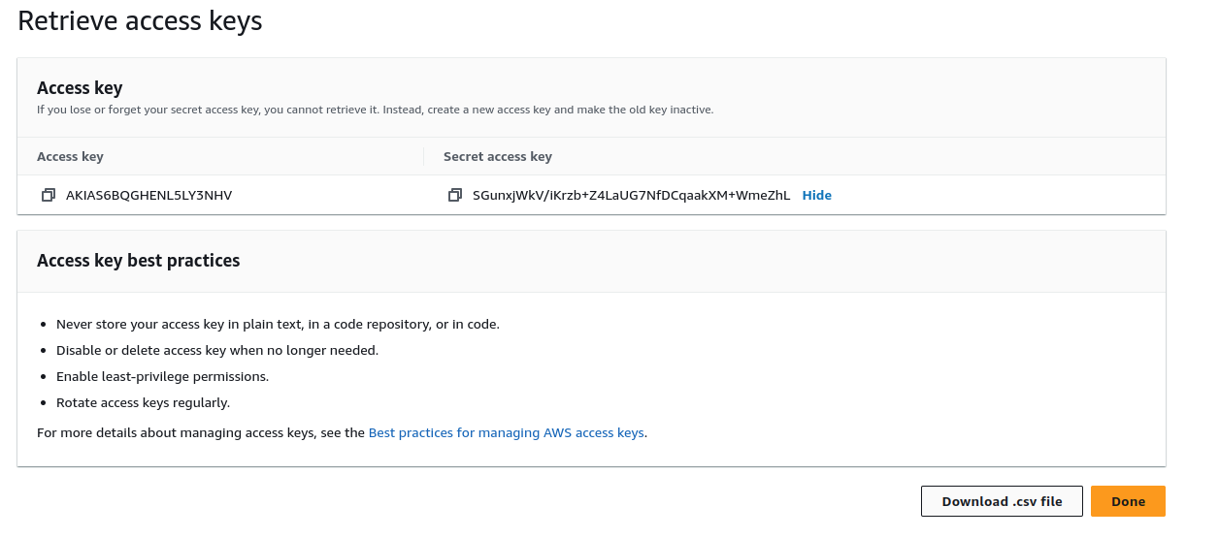
Download the csk and keep for future reference

Slide 12
SetUp AWS cli terminal.
https://docs.aws.amazon.com/cli/latest/userguide/getting-started-install.html
curl "https://awscli.amazonaws.com/awscli-exe-linux-x86_64.zip" -o "awscliv2.zip"
unzip awscliv2.zip
sudo ./aws/install

Slide 13
~$ aws ecr get-login-password --region us-east-1
Unable to locate credentials. You can configure credentials by running "aws configure".
~$ aws configure
AWS Access Key ID [None]: ***************
AWS Secret Access Key [None]: *******************
Default region name [eu-west-1]: us-east-1
Default output format [json]:
~$ aws ecr get-login-password --region us-east-1
eyJwYXlsb2FkIjoiQi9EM0NDL1pMRnpSYmY5QWJXRER2MWx1eGJDMkRnUlVlTnlsa0dORVIweS8vb1ZZcTRyZ2llalMrMjg0d1RudnlJR0syU3JwMUxJcVpyZ**************************************************************************************************************************************************************************************************1CRUVER0VqRHRoOVA5cUlNKzhkMVFJQkVJQTcxK3B0ZkJyWE9Lb2g3Ujg4TFZnR2w1cjlIUWVHT3RKbHlKMUQyOUU5enNNTzB3S2lrd2Ftc05rNTlzQnROWk5JNGQrNmFkK0dNVTRSL1Z3PSIsInZlcnNpb24iOiIyIiwidHlwZSI6IkRBVEFfS0VZIiwiZXhwa*************

Slide 14
Validate access
~$ aws s3api list-buckets --query "Buckets[].Name"
[
"elasticbeanstalk-us-east-1-201964534042"
]

