Slide 1
Inbound traffic vs. outbound traffic

Slide 2
InBound Traffic
Enterprise networks have inbound traffic and outbound traffic. The inbound requests originate from outside parties, such as a user with a web browser, an email client, a server or application making service requests, like FTP and SSH, or API calls to web services.

Slide 3
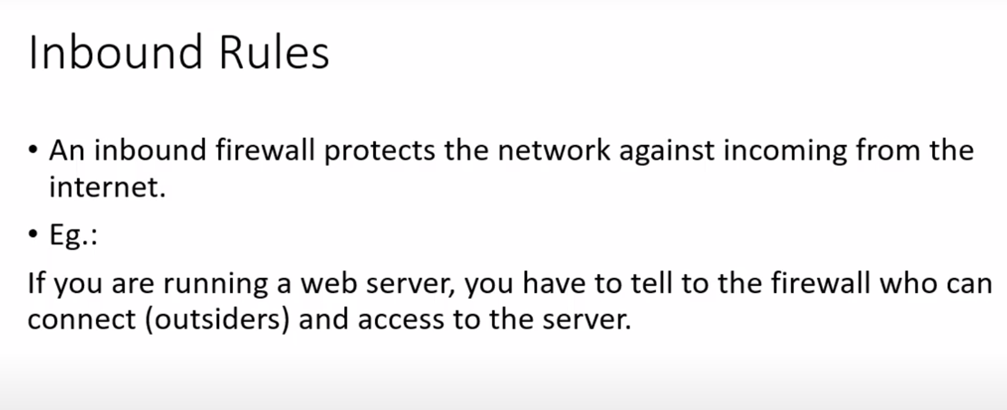

Slide 4
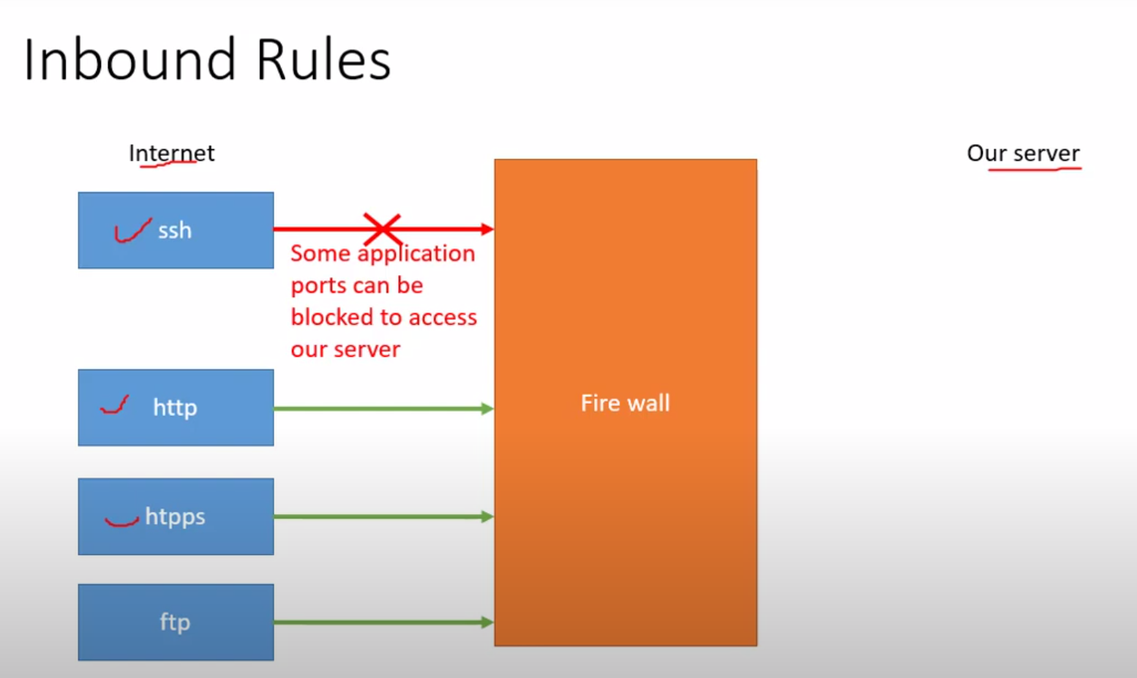

Slide 5
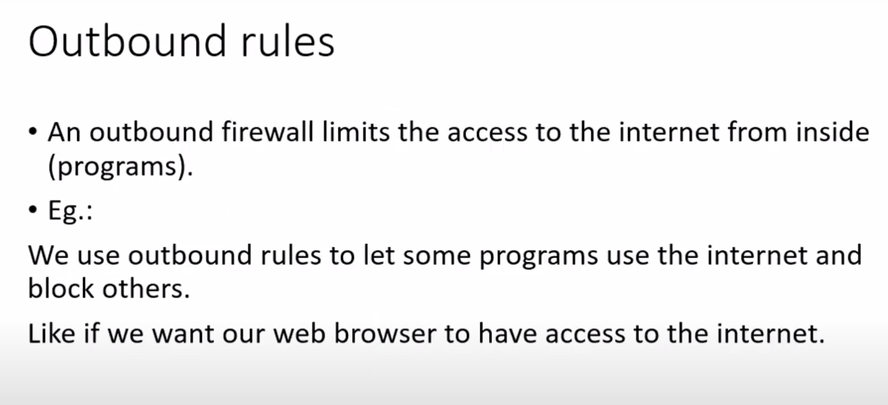

Slide 6
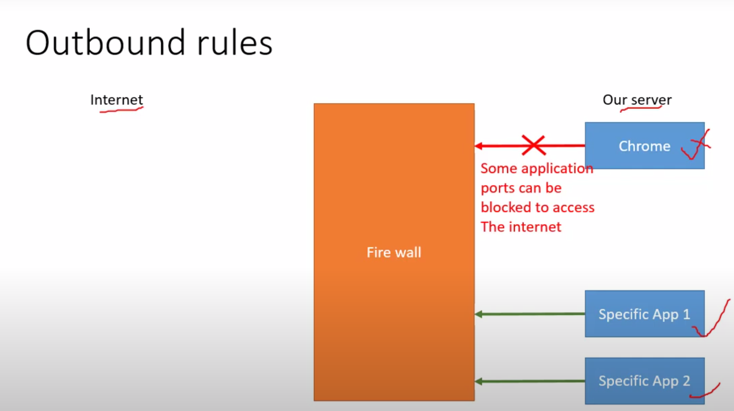

Slide 7
Aws Inbound and Outbound

Slide 8
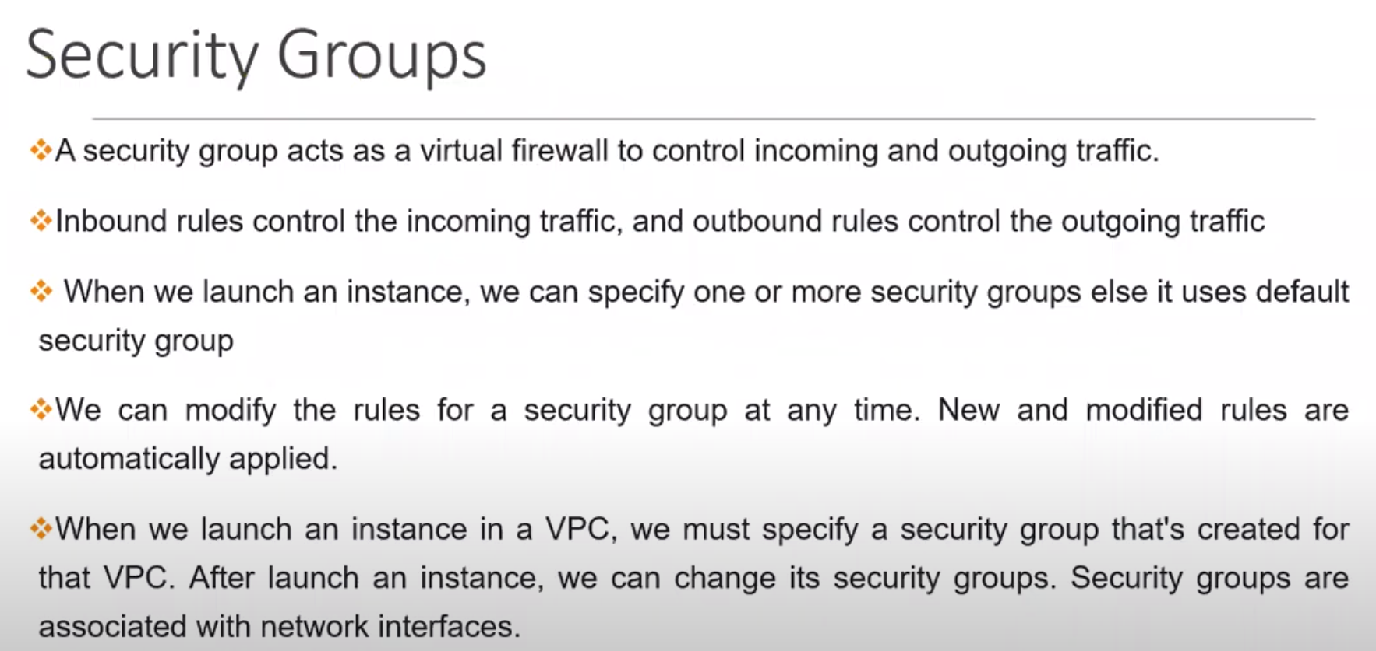

Slide 9
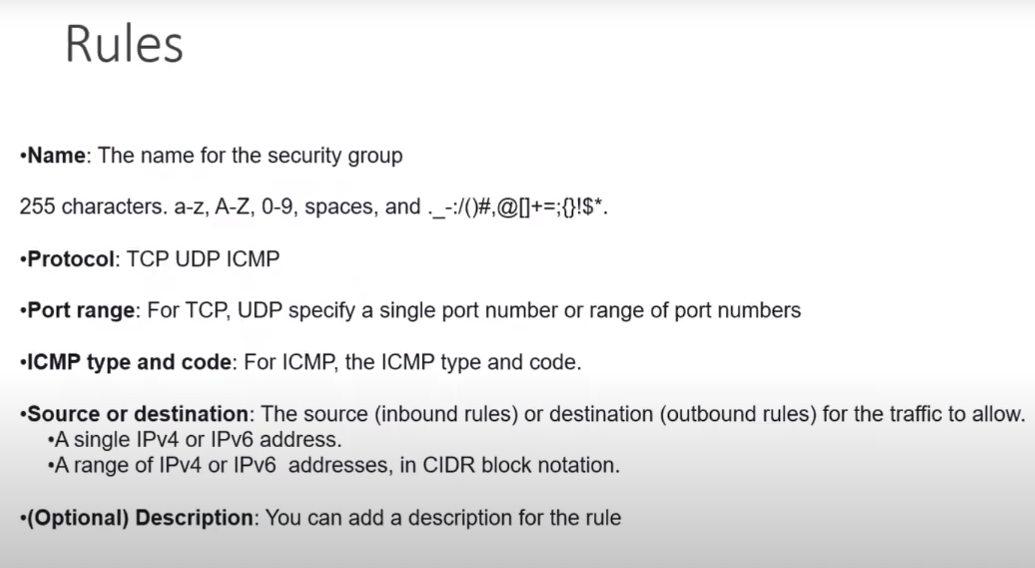

Slide 10
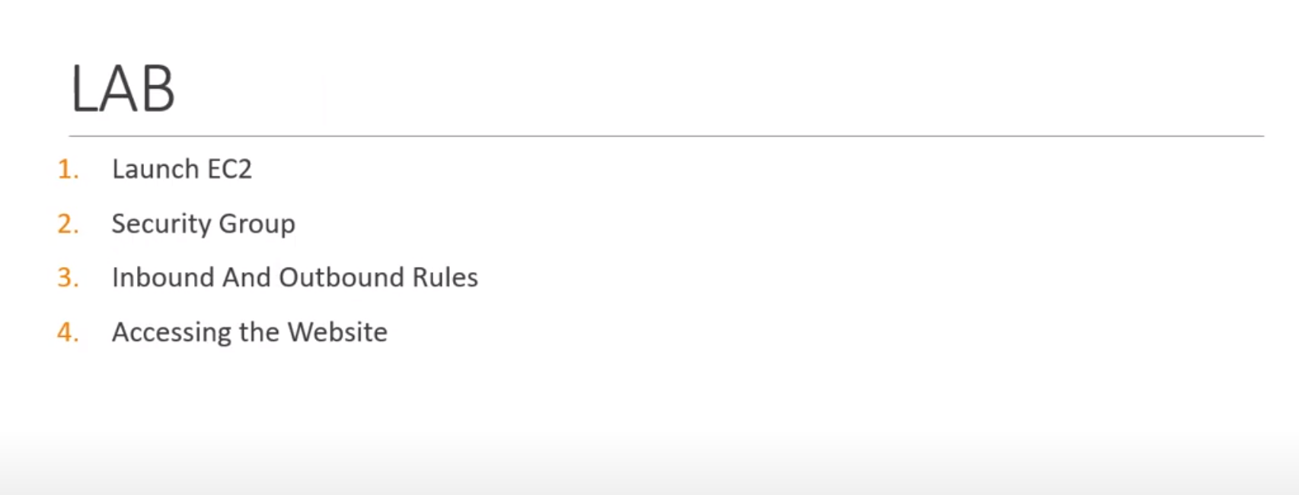

Slide 11
