Slide 1
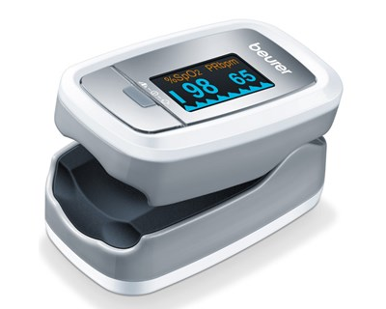
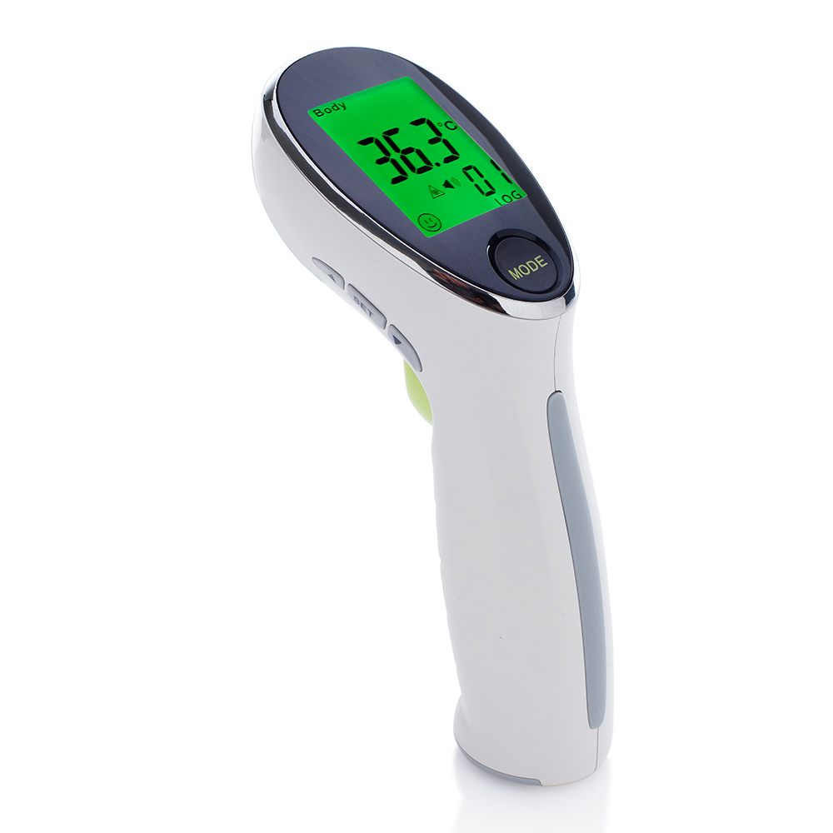
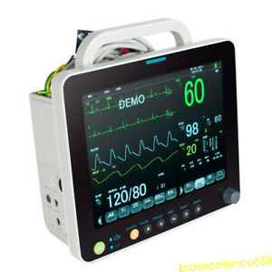
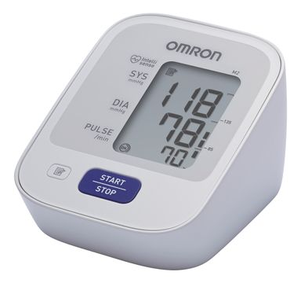
Remote Health Monitoring
Vitals Monitoring

Slide 2
Problem Statement
As the number of patient increase will face lack of medical staff (increasing exponentially)(Centralize monitoring system)
Virus Spread mainly due to close contact then remote monitoring play big role to stop spreading the virus to medical staff.
Due to common symptoms fever cough and shortness of breath.continuous Vital monition play big roles
Hospital infrastructure (Quickly set up for diagnosis)

Slide 3
Solution
Centralize monitoring system(help medical staff to monitor multiple patient)
Continuous vital monitoring(identify priority for care)
Remote monitoring(stop spreading virus to medical staff)
Easy to set up the infrastructure

Slide 4
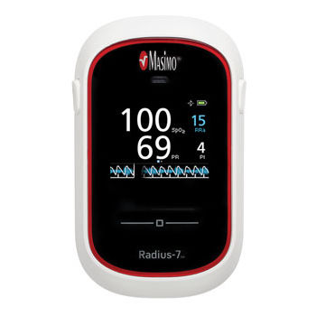
Vitals
Spo2:
Blood pressure:
Body temprature:
Resp Rate:

Slide 5




Design infra structure
websocket

Slide 6
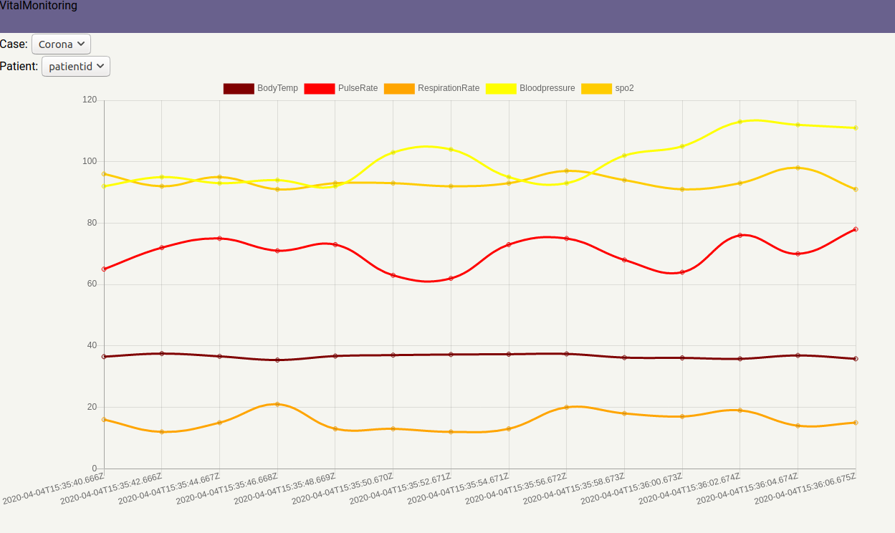
Visualization

