Slide 1
Eureka

Slide 2
Definition
Eureka Server is an application that holds the information about all client-service applications. Every Micro service will register into the Eureka server and Eureka server knows all the client applications running on each port and IP address. Eureka Server is also known as Discovery Server.

Slide 3
Server
<dependencies> <dependency> <groupId>org.springframework.cloud</groupId> <artifactId>spring-cloud-starter-netflix-eureka-server</artifactId> </dependency> </dependencies>
@SpringBootApplication @EnableEurekaServer public class EurekaServerApplication { public static void main(String[] args) { SpringApplication.run(EurekaServerApplication.class, args); } }
server: port: 8761 eureka: client: registerWithEureka: false fetchRegistry: false
Here we're configuring an application port – 8761 is the default one for Eureka servers. We are telling the built-in Eureka Client not to register with ‘itself' because our application should be acting as a server.

Slide 4
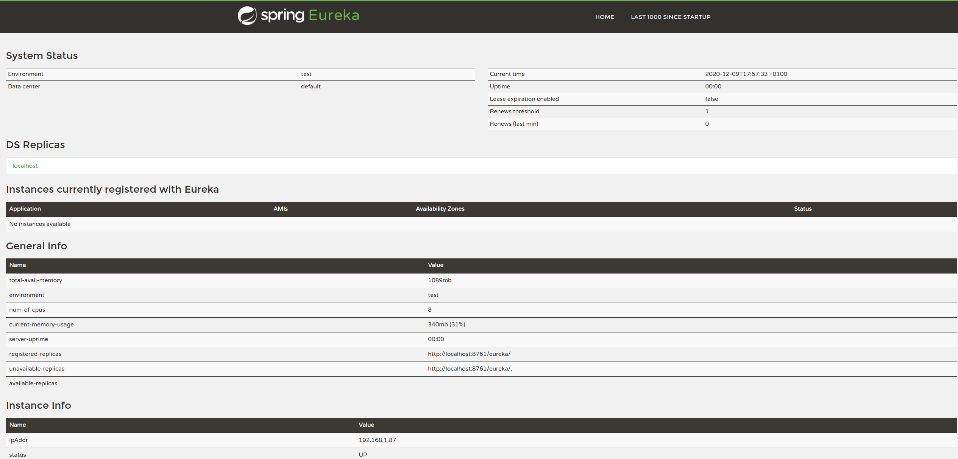

Slide 5
Eureka Client
<dependency> <groupId>org.springframework.cloud</groupId> <artifactId>spring-cloud-starter-netflix-eureka-client</artifactId> </dependency> <dependency> <groupId>org.springframework.boot</groupId> <artifactId>spring-boot-starter-web</artifactId> </dependency>
private EurekaClient eurekaClient;
spring: application: name: spring-cloud-eureka-client server: port: 0 eureka: client: serviceUrl: defaultZone: ${EUREKA_URI:http://localhost:8761/eureka} instance: preferIpAddress: true

Slide 6
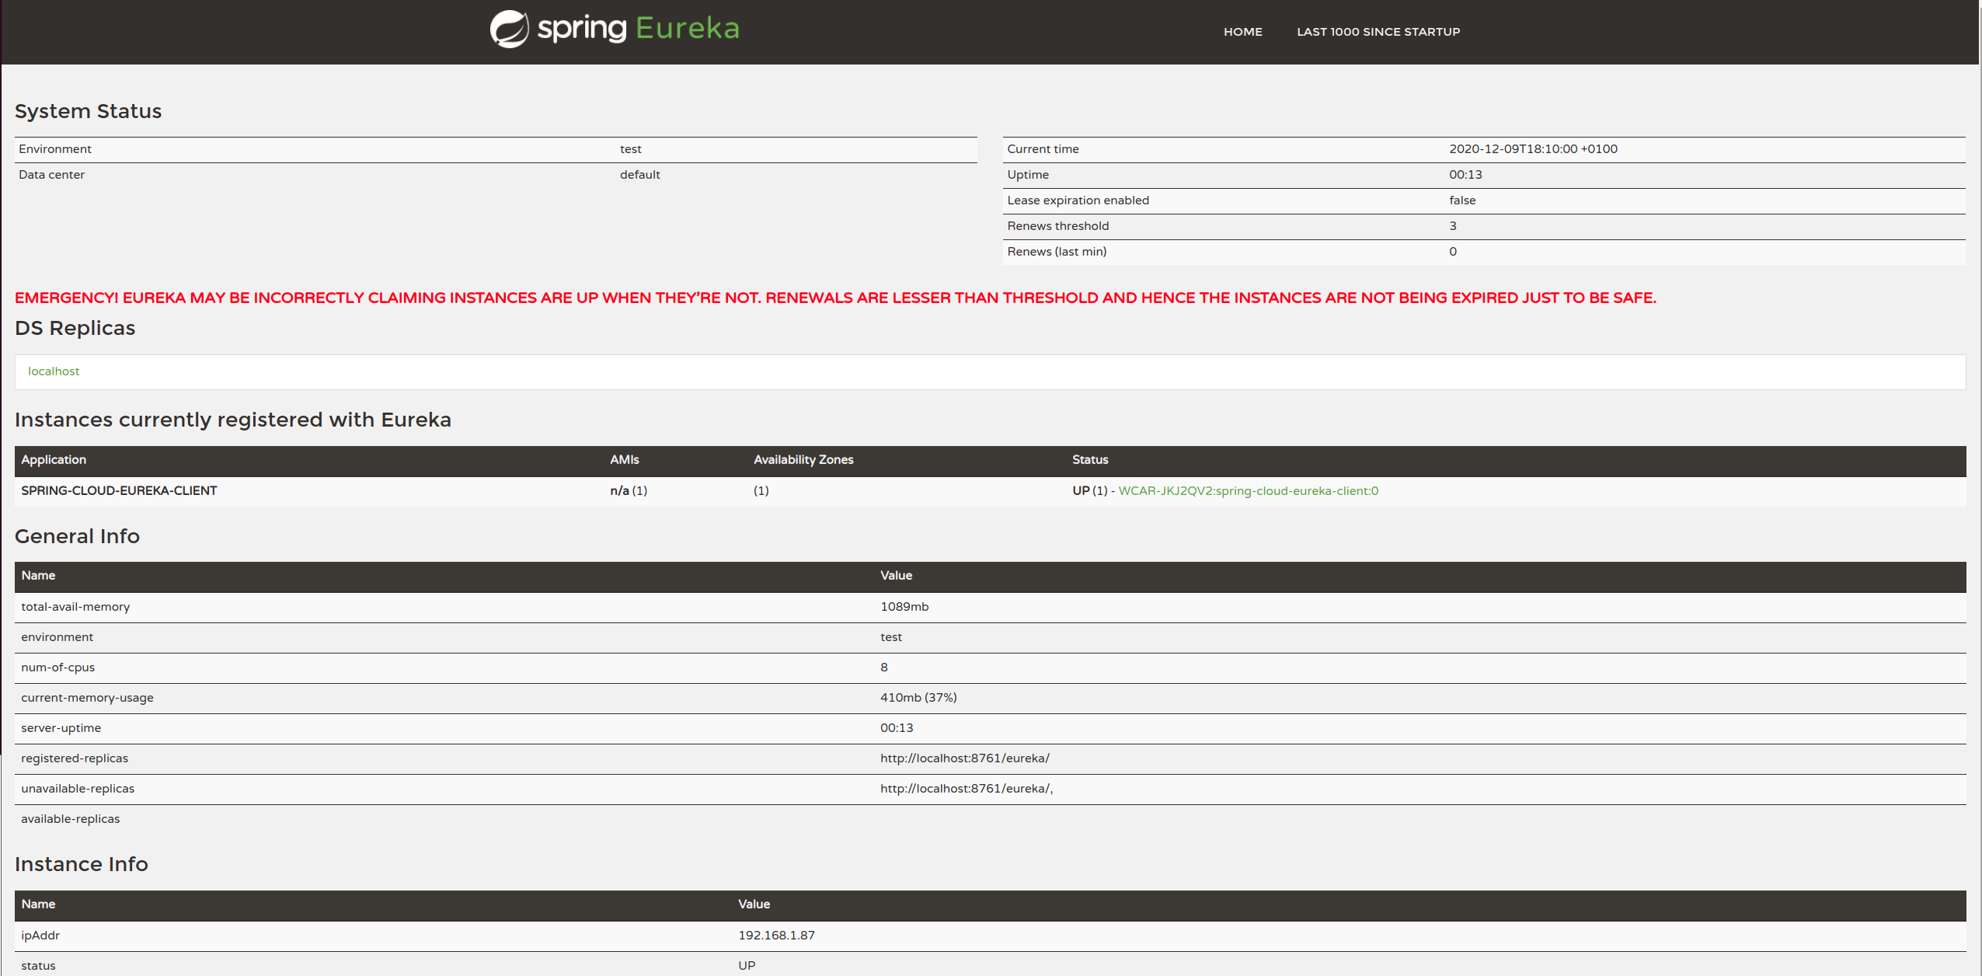

Slide 7
Eureka Feign Client
<dependency> <groupId>org.springframework.cloud</groupId> <artifactId>spring-cloud-starter-netflix-eureka-client</artifactId> </dependency>
<dependency> <groupId>org.springframework.cloud</groupId> <artifactId>spring-cloud-starter-openfeign</artifactId> </dependency>
spring: application: name: spring-cloud-eureka-feign-client server: port: 8080 eureka: client: serviceUrl: defaultZone: ${EUREKA_URI:http://localhost:8761/eureka}
@FeignClient("spring-cloud-eureka-client")
@SpringBootApplication @EnableFeignClients @Controller public class FeignClientApplication { @Autowired private GreetingClient greetingClient; public static void main(String[] args) { SpringApplication.run(FeignClientApplication.class, args); } @RequestMapping("/get-greeting") public String greeting(Model model) { model.addAttribute("greeting", greetingClient.greeting()); return "greeting-view"; } }

Slide 8
