Slide 1
Programm Overview
This one-day program will give strong foundation knowledge on docker deployment in single server and operations on containers, images and networking
Docker
Virtualization
Docker container
Docker image
Docker Networking
Docker Volumes
Docker Compose

Slide 2
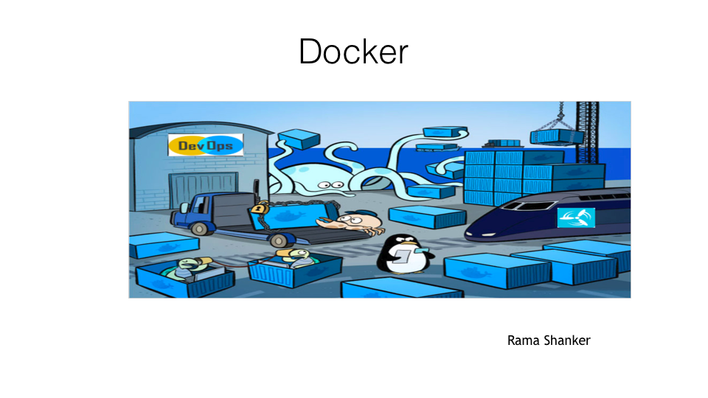

Slide 3
Understanding Docker
Docker is a platform for developers and sys admins to develop, deploy, and run applications with containers. The use of Linux containers to deploy applications is called containerization. Containers are not new, but their use for easily deploying applications is.
Containerization is increasingly popular because containers are:
Flexible: Even the most complex applications can be containerized.
Lightweight: Containers leverage and share the host kernel.
Interchangeable: You can deploy updates and upgrades on-the-fly.
Portable: You can build locally, deploy to the cloud, and run anywhere.
Scalable: You can increase and automatically distribute container replicas.
Stackable: You can stack services vertically and on-the-fly.
https://docs.docker.com/get-started/

Slide 4
Containers and virtual machines
A container runs natively on Linux and shares the kernel of the host machine with other containers. It runs a discrete process, taking no more memory than any other executable, making it lightweight.
By contrast, a virtual machine (VM) runs a full-blown “guest” operating system with virtual access to host resources through a hypervisor. In general, VMs provide an environment with more resources than most applications need.

Slide 5
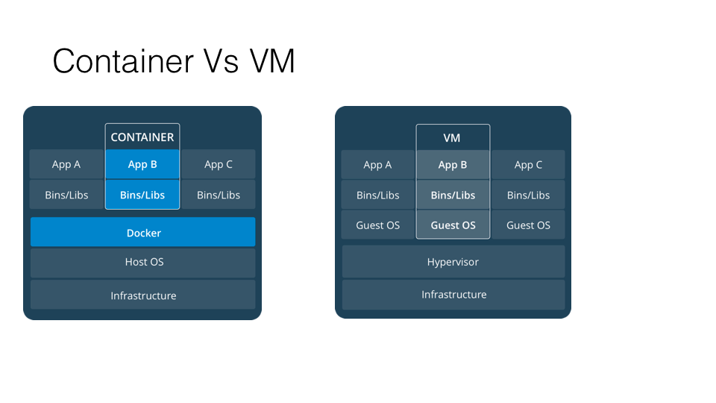
Container And VM

Slide 6
Installing Docker
Installing docker on Windows:
https://docs.docker.com/docker-for-windows/install/

Slide 7
Installing docker on ubuntu
https://tecadmin.net/install-docker-on-ubuntu/
https://docs.docker.com/install/linux/docker-ce/ubuntu/

Slide 8
Installing docker on mac
https://docs.docker.com/docker-for-mac/install/

Slide 9
Container
https://www.docker.com/resources/what-container
A container is a standard unit of software that packages up code and all its dependencies so the application runs quickly and reliably from one computing environment to another.

Slide 10
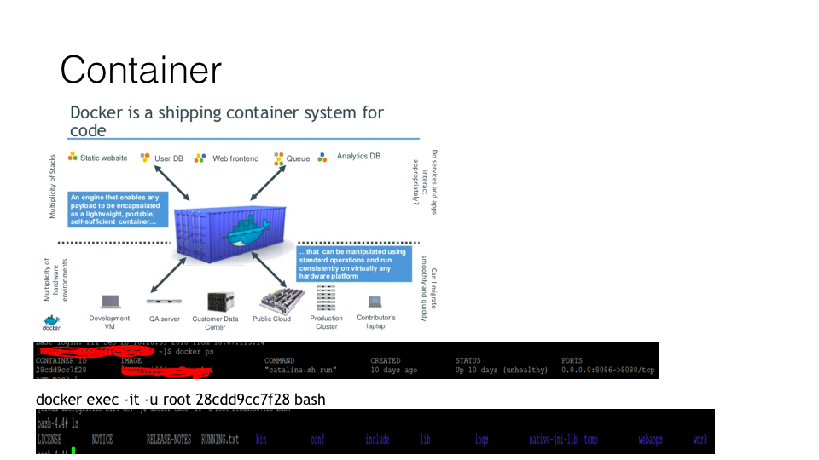

Slide 11
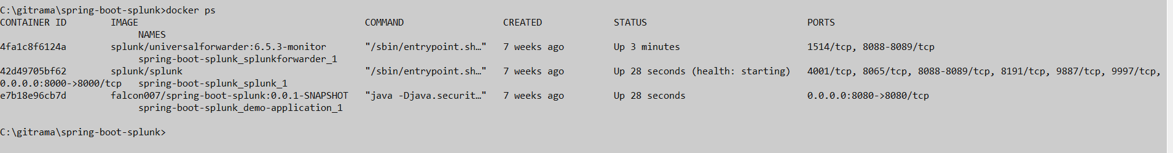
A Docker container image is a lightweight, standalone, executable package of software that includes everything needed to run an application: code, runtime, system tools, system libraries and settings

Slide 12
Docker Image
A Docker image is a file, comprised of multiple layers, used to execute code in a Docker container. An imageis essentially built from the instructions for a complete and executable version of an application, which relies on the host OS kernel.

Slide 13
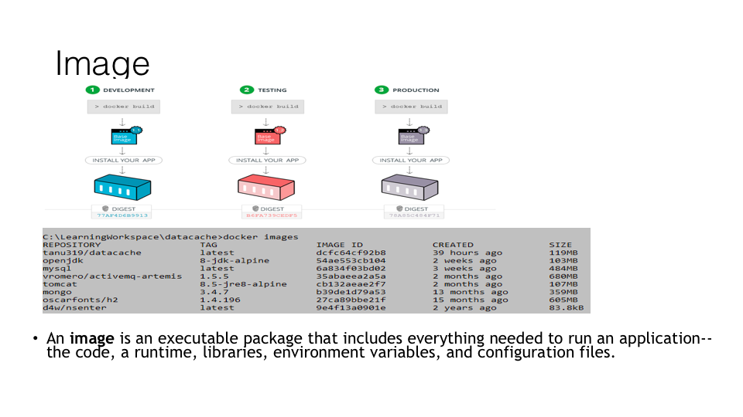
Image

Slide 14
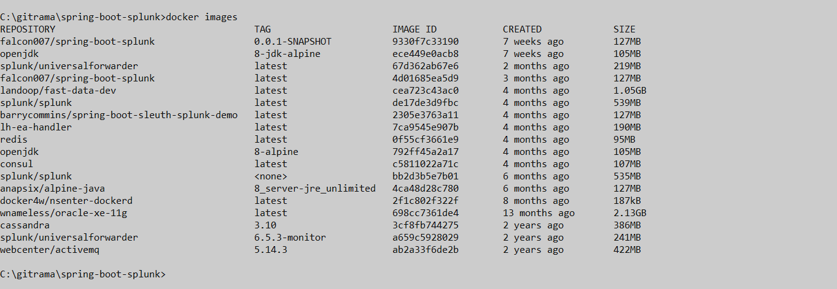
Docker images

Slide 15
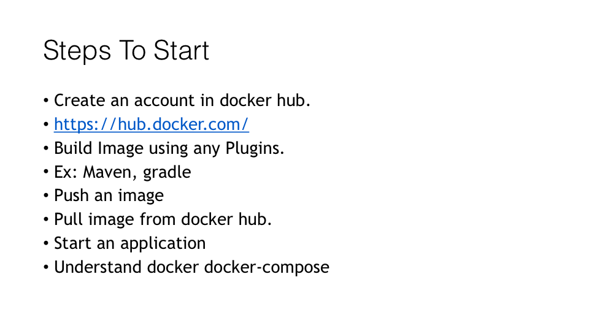
Lab

Slide 16
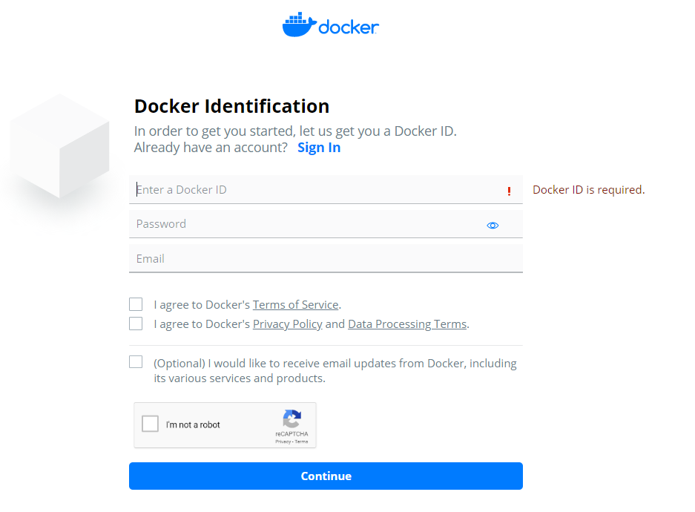
Docker Hub Signup
https://hub.docker.com/

Slide 17
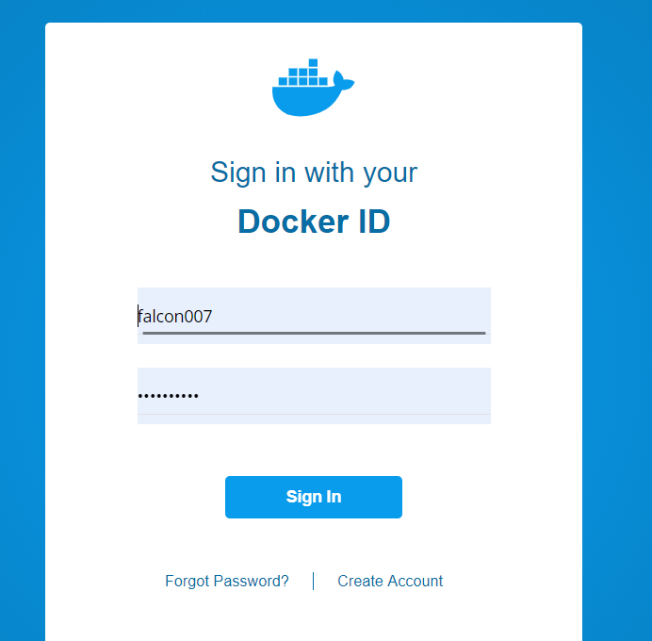
Docker Hub Sign In

Slide 18
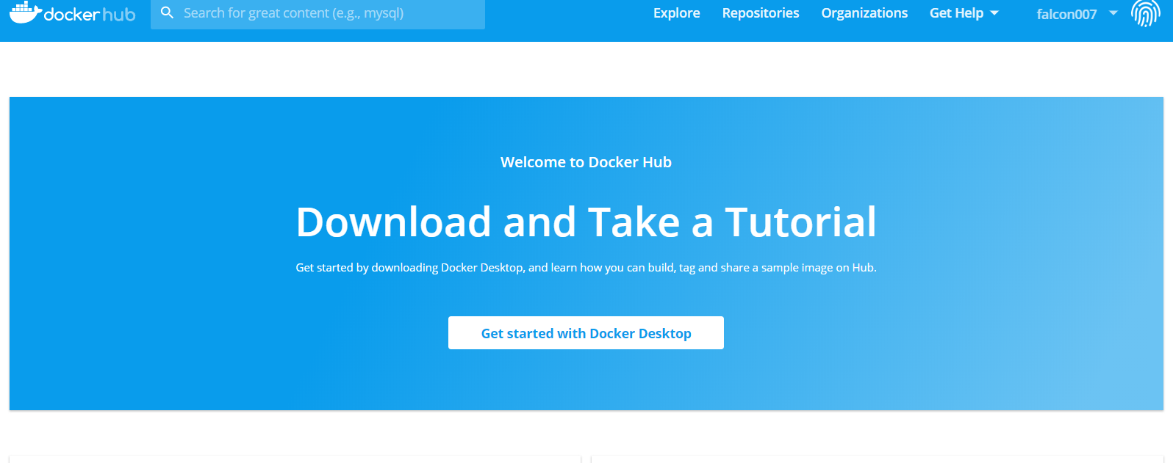
Login Screen

Slide 19
Application:
Create simple spring-boot Application
https://github.com/ramashanker/training/tree/master/simple-spring-boot

Slide 20
Tools Need to install
Maven
Eclipse
JDK
C:\Program Files\Java\jdk1.8.0_191

Slide 21
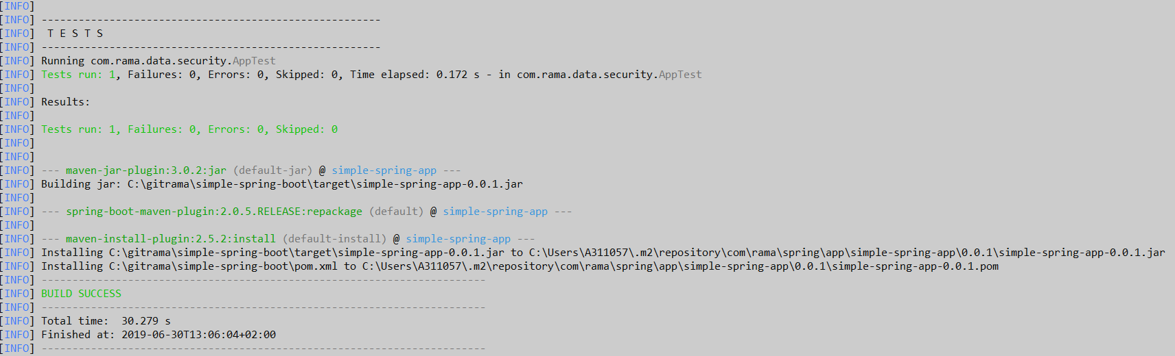
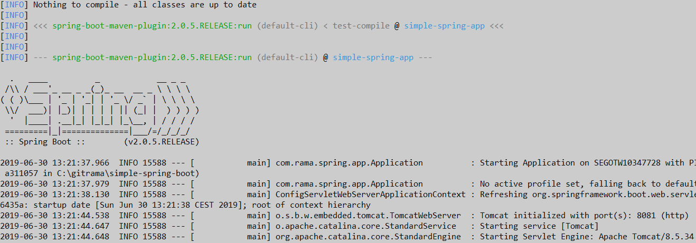
Compile the code: mvn clean install
Run the application: mvn spring-boot:run

Slide 22
Creating Docker Image
FROM openjdk:8-jdk-alpine
VOLUME /tmp
ARG JAR_FILE
COPY ${JAR_FILE} app.jar
ENTRYPOINT ["java","-Djava.security.egd=file:/dev/./urandom","-jar","/app.jar"]

Slide 23
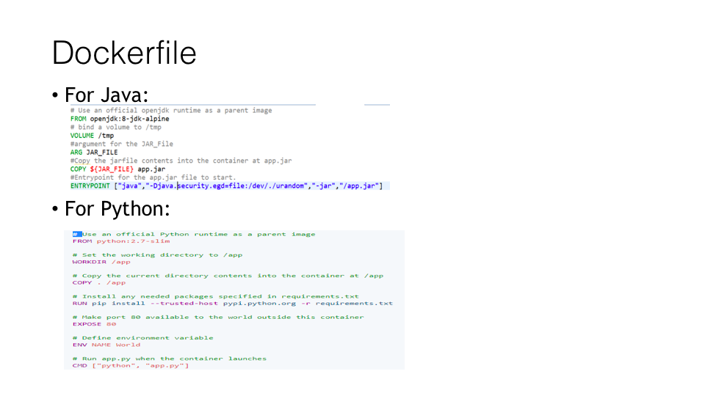

Slide 24
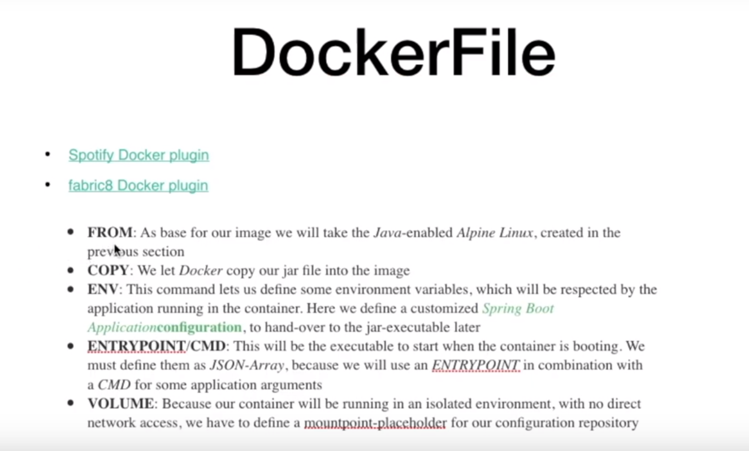

Slide 25
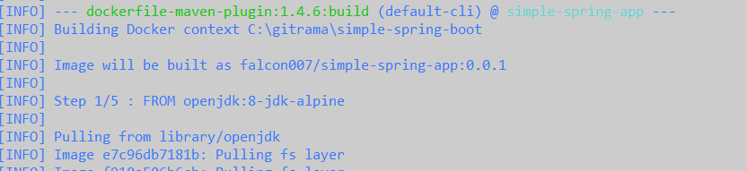
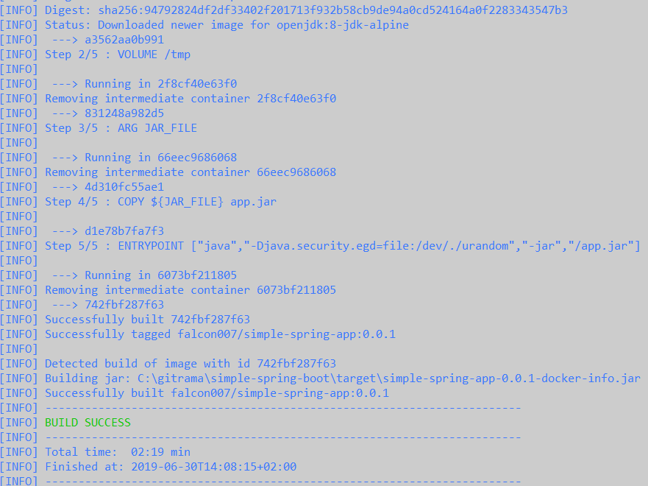
Creating Docker Image
Creating With Maven
mvn install dockerfile:build

Slide 26
Creating With gradle
gradle build docker

Slide 27
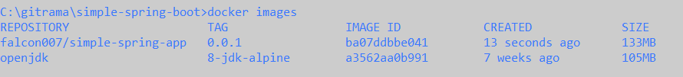
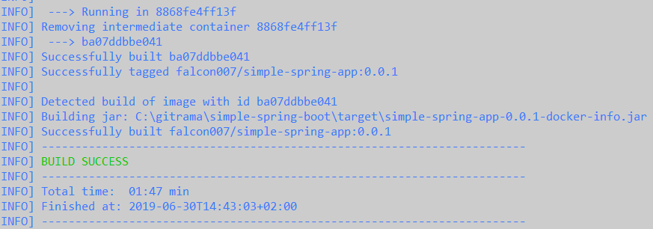
Docker image

Slide 28
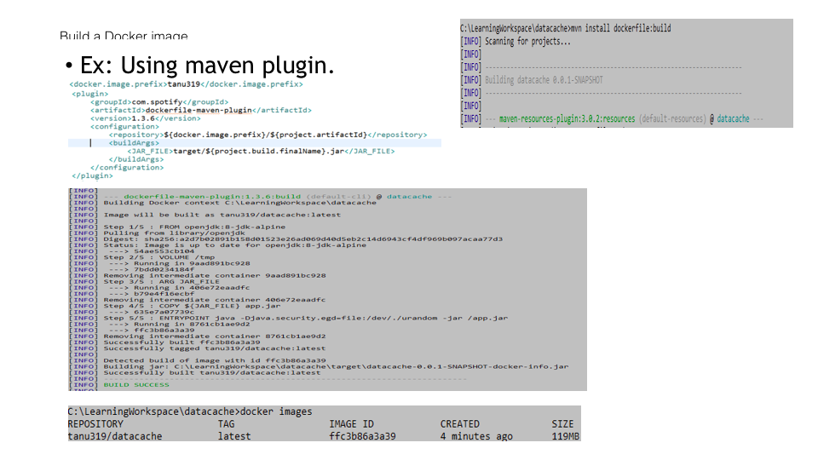
Simple Flow:

Slide 29
Understand More Detail:
https://www.youtube.com/watch?v=q7ERqUOE1Bw&t=1045s

Slide 30
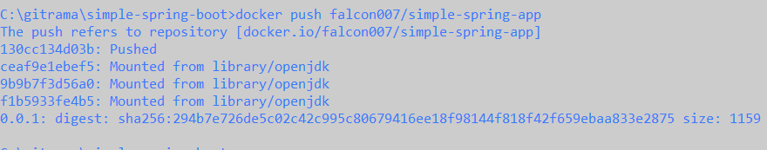
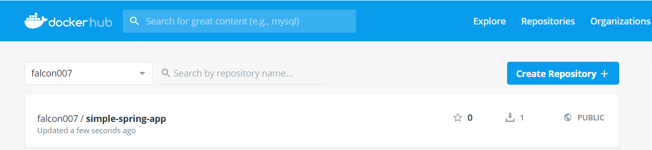
Push docker image
docker login
Docker push
docker push falcon007/simple-spring-app

Slide 31
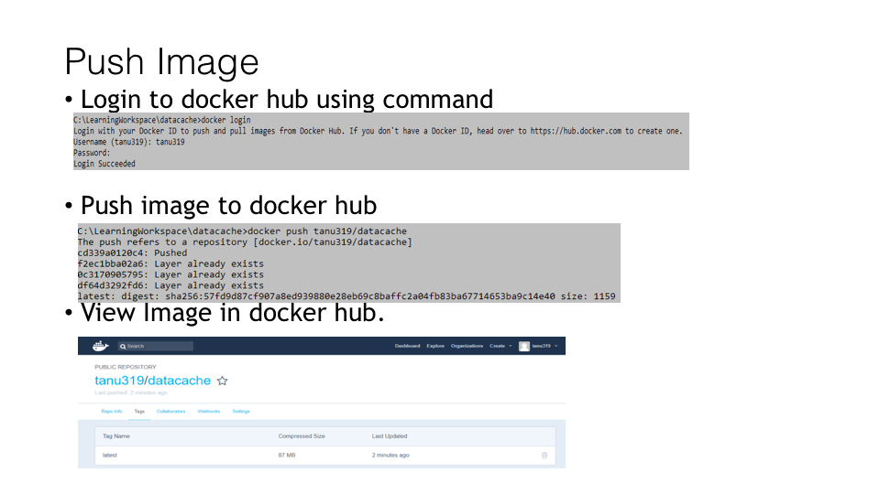
Push Docker image

Slide 32
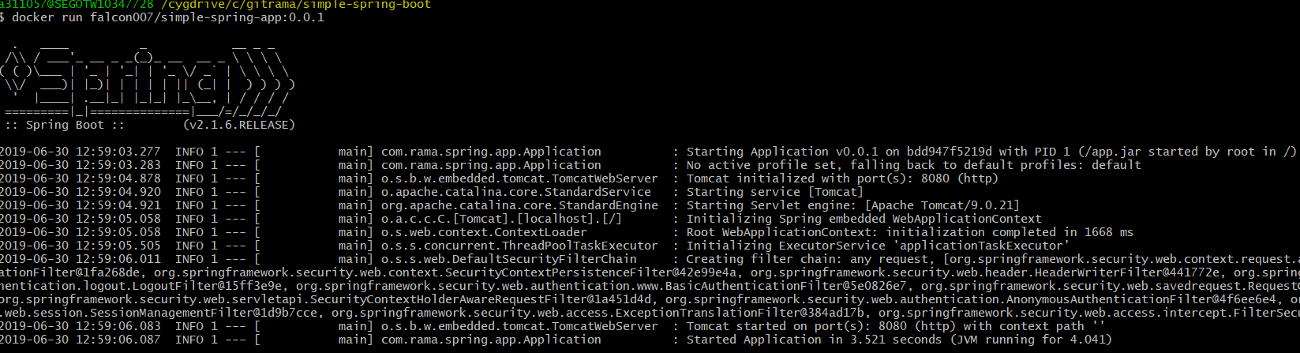
Docker Run:failed
docker run falcon007/simple-spring-app:0.0.1

Slide 33
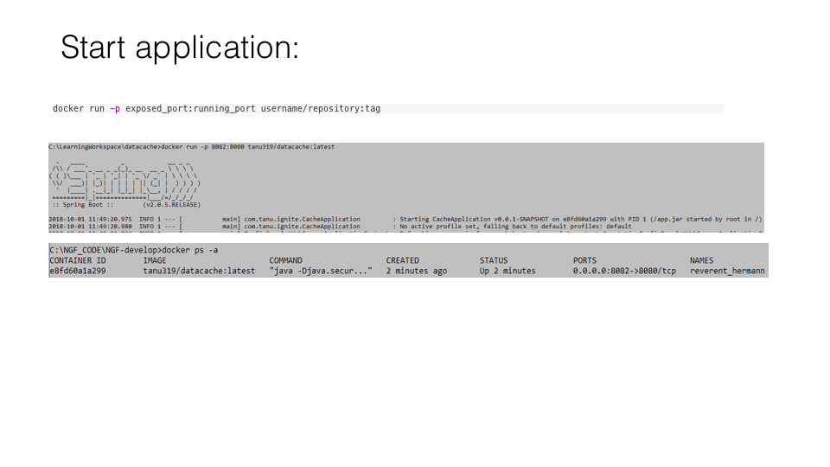
Docker Run With Port

Slide 34
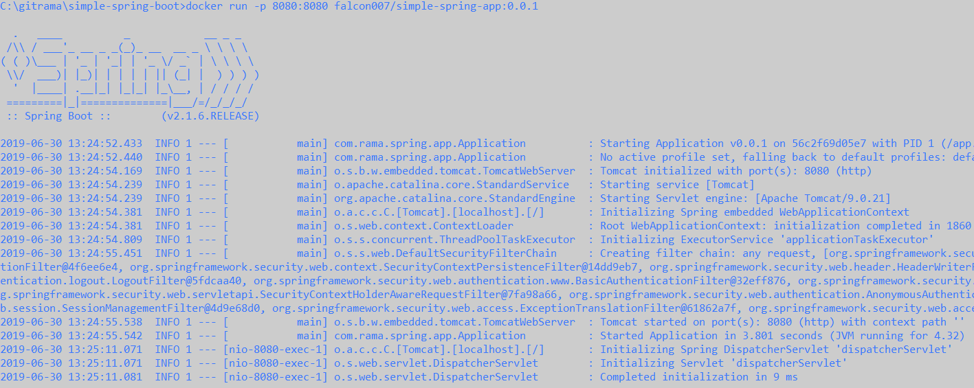
docker run –p exposed_port:running_port repository:tag
docker run -p 8080:8080 falcon007/simple-spring-app:0.0.1

Slide 35
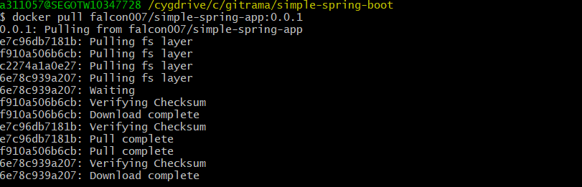
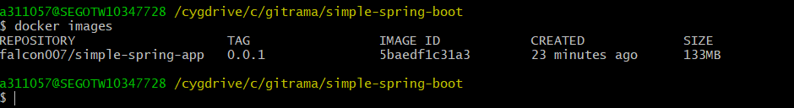
Docker pull
docker pull falcon007/simple-spring-app:0.0.1

Slide 36
Docker Network
https://docs.docker.com/network/
One of the reasons Docker containers and services are so powerful is that you can connect them together, or connect them to non-Docker workloads. Docker containers and services do not even need to be aware that they are deployed on Docker, or whether their peers are also Docker workloads or not. Whether your Docker hosts run Linux, Windows, or a mix of the two, you can use Docker to manage them in a platform-agnostic way.

Slide 37
Network drivers:
Docker’s networking subsystem is pluggable, using drivers. Several drivers exist by default, and provide core networking functionality:
bridge: The default network driver. If you don’t specify a driver, this is the type of network you are creating. Bridge networks are usually used when your applications run in standalone containers that need to communicate.
host: For standalone containers, remove network isolation between the container and the Docker host, and use the host’s networking directly. host is only available for swarm services on Docker 17.06 and higher.
overlay: Overlay networks connect multiple Docker daemons together and enable swarm services to communicate with each other. You can also use overlay networks to facilitate communication between a swarm service and a standalone container, or between two standalone containers on different Docker daemons. This strategy removes the need to do OS-level routing between these containers.
macvlan: Macvlan networks allow you to assign a MAC address to a container, making it appear as a physical device on your network. The Docker daemon routes traffic to containers by their MAC addresses. Using the macvlan driver is sometimes the best choice when dealing with legacy applications that expect to be directly connected to the physical network, rather than routed through the Docker host’s network stack.
none: For this container, disable all networking. Usually used in conjunction with a custom network driver. none is not available for swarm services. See disable container networking.
Network plugins: You can install and use third-party network plugins with Docker. These plugins are available from Docker Hub or from third-party vendors. See the vendor’s documentation for installing and using a given network plugin.

Slide 38
Commands
Command | Description
docker network connect | Connect a container to a network
docker network create | Create a network
docker network disconnect | Disconnect a container from a network
docker network inspect | Display detailed information on one or more networks
docker network ls | List networks
docker network prune | Remove all unused networks
docker network rm | Remove one or more networks

Slide 39
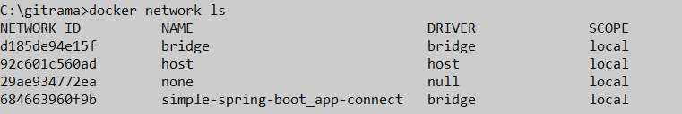
Docker network List

Slide 40
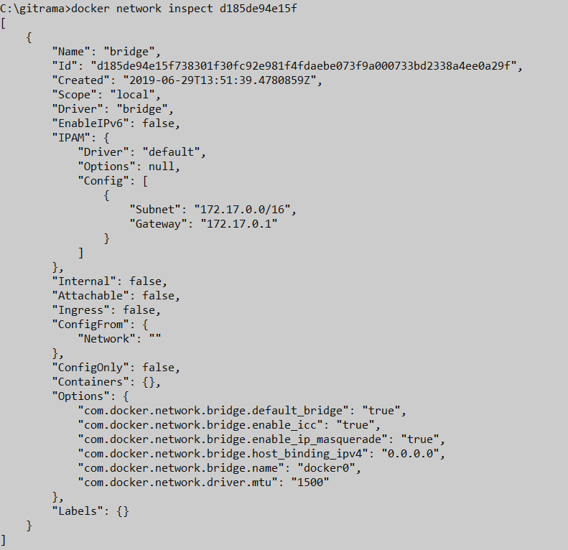
Network Inspect:bridge
https://docs.docker.com/network/bridge/

Slide 41
Bridge networks apply to containers running on the same Docker daemon host. For communication among containers running on different Docker daemon hosts, you can either manage routing at the OS level, or you can use an overlay network.
When you start Docker, a default bridge network (also called bridge) is created automatically, and newly-started containers connect to it unless otherwise specified. You can also create user-defined custom bridge networks. User-defined bridge networks are superior to the default bridge network.

Slide 42
Port Mapping
By default, when you create a container, it does not publish any of its ports to the outside world. To make a port available to services outside of Docker, or to Docker containers which are not connected to the container’s network, use the --publish or -p flag. This creates a firewall rule which maps a container port to a port on the Docker host. Here are some examples.
Flag value | Description
-p 8080:80 | Map TCP port 80 in the container to port 8080 on the Docker host.
-p 192.168.1.100:8080:80 | Map TCP port 80 in the container to port 8080 on the Docker host for connections to host IP 192.168.1.100.
-p 8080:80/udp | Map UDP port 80 in the container to port 8080 on the Docker host.
-p 8080:80/tcp -p 8080:80/udp | Map TCP port 80 in the container to TCP port 8080 on the Docker host, and map UDP port 80 in the container to UDP port 8080 on the Docker host.

Slide 43

Container Inspection:
docker exec -ti 66a149d1ffd4 /bin/sh

Slide 44
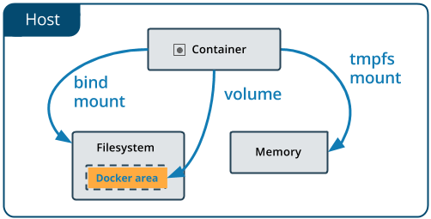
Docker Volume:
Docker volumes are very useful when we need to persist data in Docker containers or share data between containers.
Docker volumes are important because when a Docker container is destroyed, it’s entire file system is destroyed too. So if we want to keep this data, it is necessary that we use Docker volumes.
Docker volumes are attached to containers during a docker run command by using the -v flag

Slide 45
Bind mounts
A bind mount is just mapping a directory on the host machine to a directory in the container. However, when the container is removed, it does not affect the directory.
If the -v or --volume flag’s value is a path, then it is assumed to be a bind mount. If the directory does not exist, then it will be created. When we do this, the directory /path/to/app/directory will contain the same files as /var/www in the container.
Ex:docker run -d --name rama_app -v /path/to/app/directory:/var/www falcon007/simple-spring-app:0.0.1

Slide 46
Docker Volume:
Volumes are the preferred mechanism for persisting data generated by and used by Docker containers. While bind mounts are dependent on the directory structure of the host machine, volumes are completely managed by Docker. Volumes have several advantages over bind mounts:
Volumes are easier to back up or migrate than bind mounts.
You can manage volumes using Docker CLI commands or the Docker API.
Volumes work on both Linux and Windows containers.
Volumes can be more safely shared among multiple containers.
Volume drivers allow you to store volumes on remote hosts or cloud providers, to encrypt the contents of volumes, or to add other functionality.
A new volume’s contents can be pre-populated by a container.
In addition, volumes are often a better choice than persisting data in a container’s writable layer, because using a volume does not increase the size of containers using it, and the volume’s contents exist outside the lifecycle of a given container.

Slide 47
Attaching Volume:
https://stephenafamo.com/blog/docker-volumes-introduction/

Slide 48
Docker cheet sheet
docker rmi -f $(docker images -a -q)
docker start $(docker ps -a -q --filter "status=exited")
docker restart $(docker ps -a -q)

Slide 49
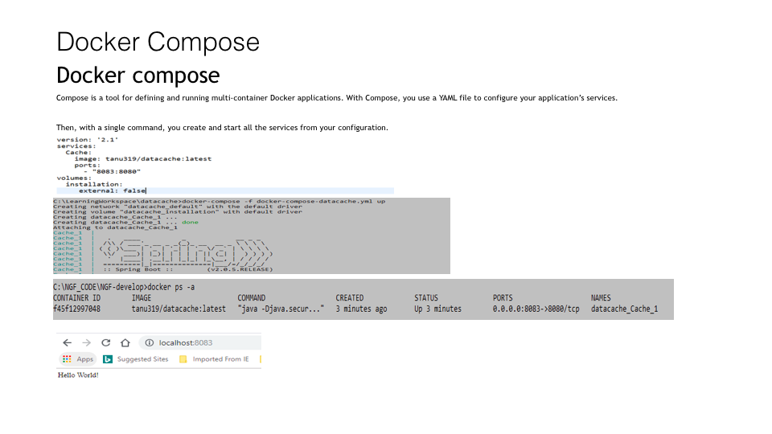
Docker composer

Slide 50
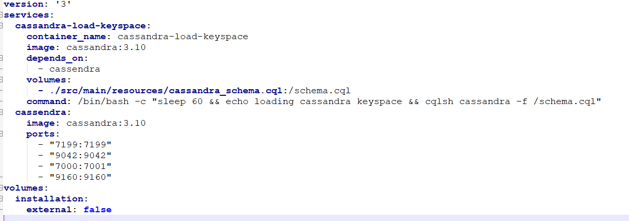
Composer

