Slide 1

Vendor Performance Analysis
An in-depth validation of vendor performance, supply chain liquidity, and pricing mechanisms — spanning 10,692 operational rows across 18 key metrics to identify margin optimization, freight containment, and supplier dependency risks.
Unified Schema
Four legacy tables — Sales, Purchases, Purchase Prices, and Vendor Invoices — were consolidated into a single robust grid.

Slide 2
DATA QUALITY
Key Observations & Operational Anomalies
1
2
Negative Gross Profit
Price Outliers
Minimum of –$52,002.78 exposes mispriced stock or aggressive markdowns. ProfitMargin floor of –23,730% reflects overhead accrual with zero sales.
Max PurchasePrice ($5,681.81) and ActualPrice ($7,499.99) vastly exceed means ($24.39 & $35.64) — a mix of commodities and elite luxury SKUs.
3
4
Freight Variance
Stock Velocity Paradox
FreightCost spans $0.09 to $257,032.07 — highlighting unoptimized pipelines, emergency surcharges, or erratic vendor distribution.
StockTurnover ranges 0–274.5 with weak negative correlation to GrossProfit (–0.038). Faster velocity does not guarantee higher profitability.

Slide 3

STRATEGIC INSIGHT #1
High-Margin, Low-Velocity Brands
Analysis isolated brands with premium profit margins but weak sales volumes — ideal candidates for promotional positioning or strategic price adjustments to drive purchase frequency without damaging profitability.
Promotional Positioning
Creative marketing campaigns to increase visibility
Strategic Pricing
Adjust price points to stimulate purchase frequency
Volume Bundling
Bundle high-margin SKUs to move capital while protecting earnings

Slide 4
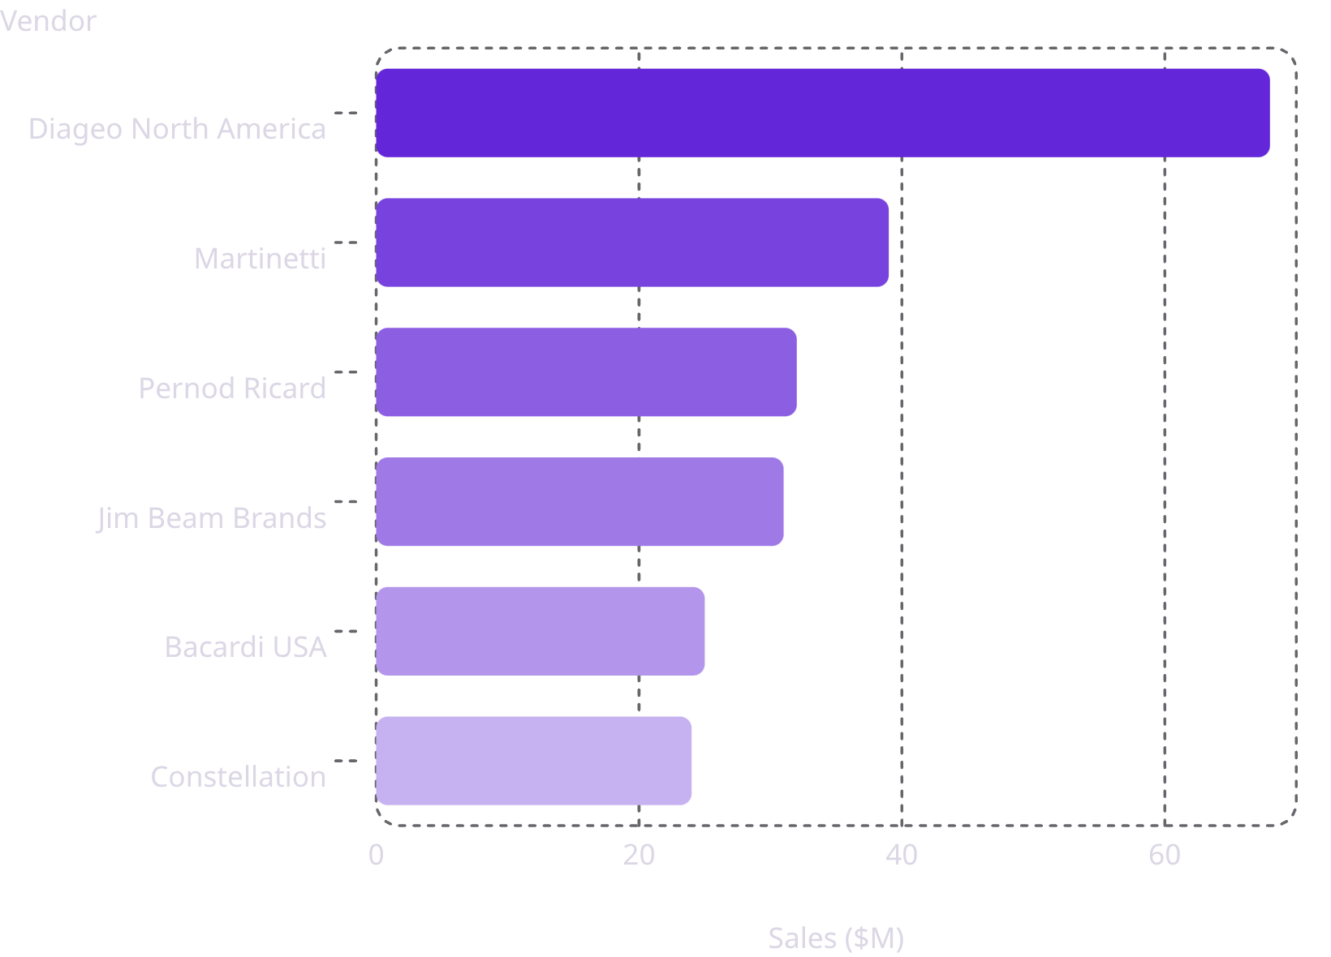
STRATEGIC INSIGHTS #2 & #3
Top Performers & Supplier Dependency
Highest Sales Performance
A concentrated segment of major vendors commands maximum share of TotalSalesDollars — stable, brand-loyal product lines guaranteeing consistent top-line revenue.
Procurement Concentration Risk
Top vendors handle a substantial percentage of total procurement spending. High dependency warrants proactive SLAs and supplier diversification to shield against localized bottlenecks.

Slide 5
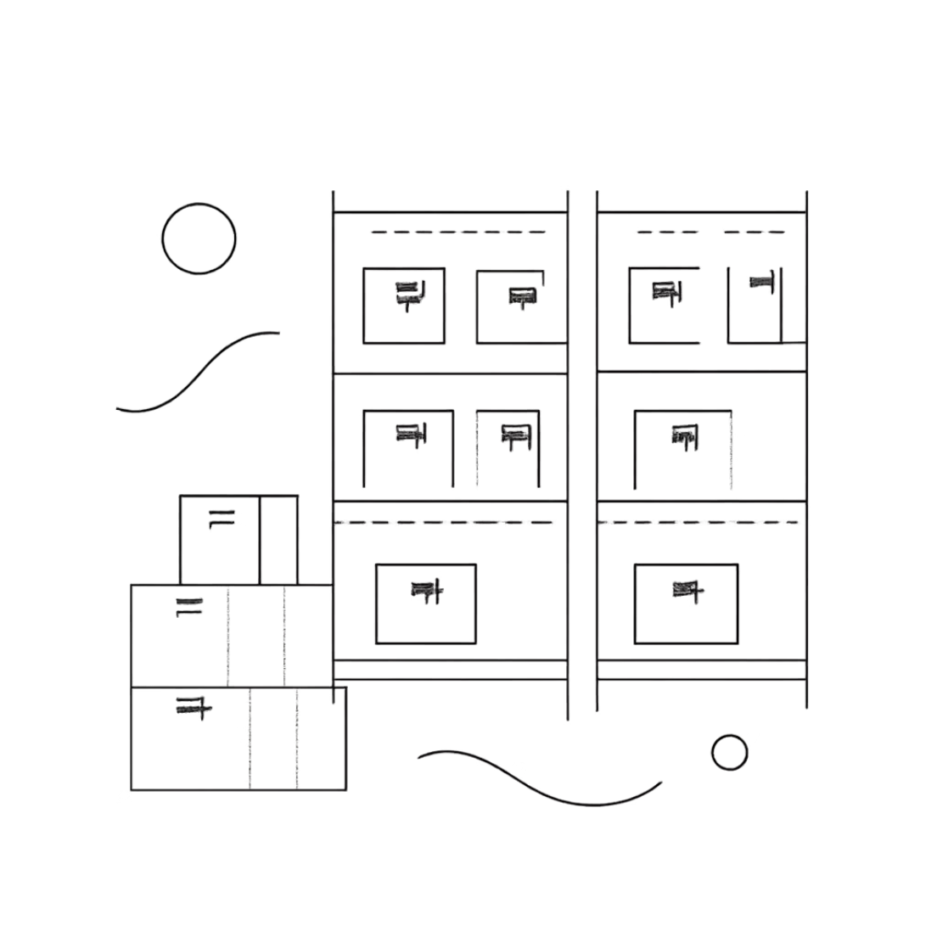
STRATEGIC INSIGHTS #4 & #5
Bulk Pricing & Inventory Turnover
Bulk Purchase Paradox
PurchasePrice has near-zero correlation with TotalSalesDollars (–0.012) and GrossProfit (–0.016). Price fluctuations do not inherently dictate revenue or profit scale. Volumetric mapping reveals optimal discount tiers balancing bulk savings against holding costs.
Dead Stock Identification
Suppliers with StockTurnover approaching 0 signal stagnant lines incurring holding costs. Cross-referencing TotalPurchaseQuantity vs. TotalSalesQuantity isolates vendors holding $2.71M in locked capital.

Slide 6

STATISTICAL VALIDATION
Hypothesis Testing: Vendor Margin Differences
Test Framework
Independent two-sample t-test to determine if margin variations between high and low-performing vendors are structural or random noise.
Results
Metric
Value
Decision
T-Statistic
–10.7137
Highly Significant
P-Value
0.0000
Reject H₀
p < 0.05 confirms superior outcomes are tied to systematic vendor-level traits — not accidental variance.
H₀
No significant difference in mean profit margin (μ_top = μ_low)
Hₐ
Mean profit margins are significantly different (μ_top ≠ μ_low)

Slide 7
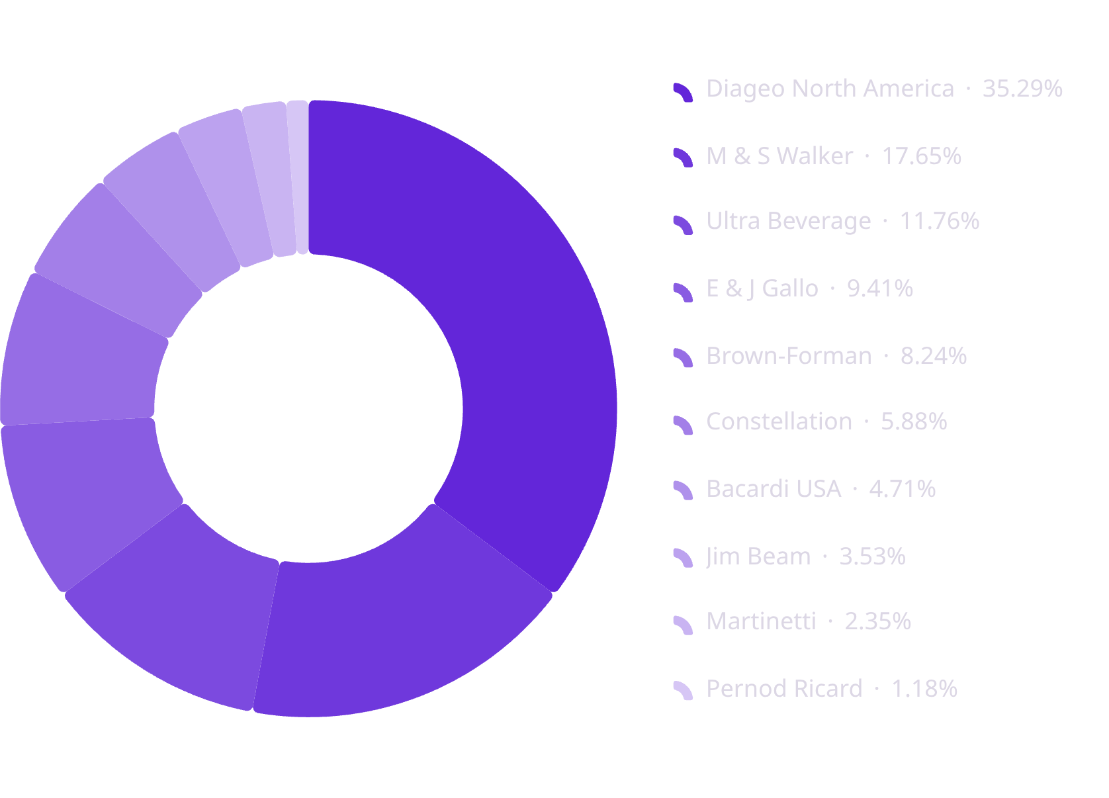
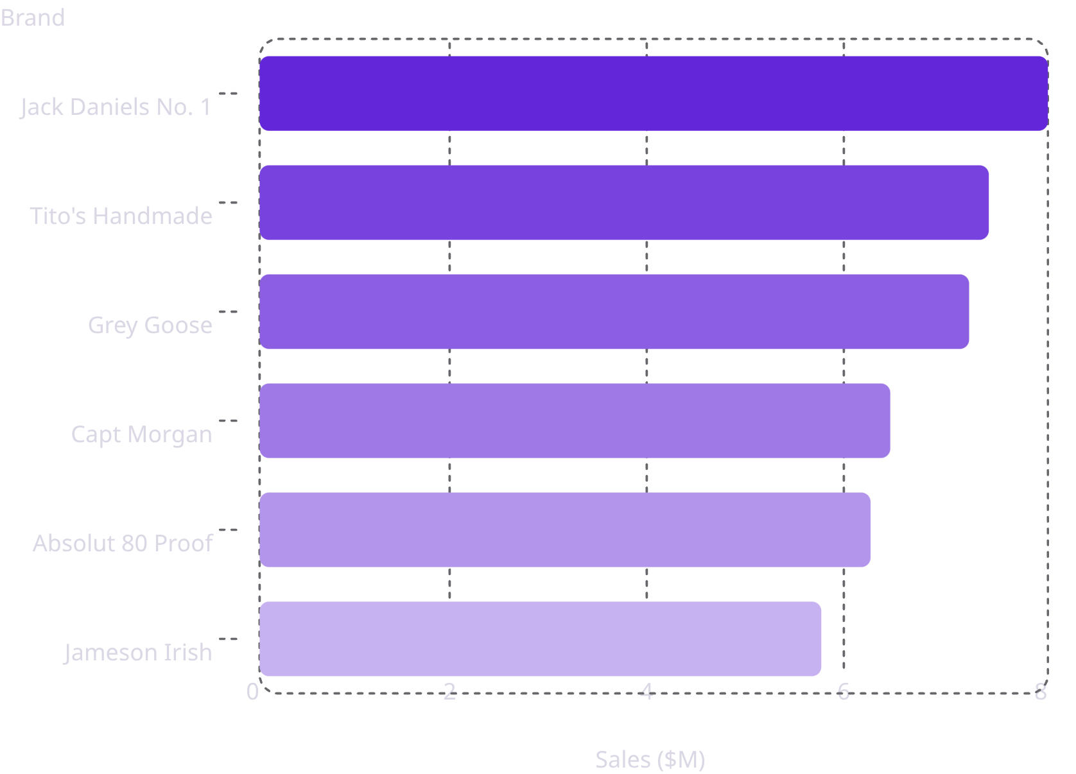
POWER BI DASHBOARD
Vendor Performance Dashboard
$441.41M
$307.34M
$134.07M
Total Sales
Total Purchase
Gross Profit
38.72
$2.71M
Profit Margin
Unsold Capital
Purchase Contribution %
Top Brands by Sales ($M)

Slide 8

RECOMMENDATIONS
Strategic Recommendations
Audit Freight Surcharges
Investigate $257K FreightCost outliers; transition to consistent contractual freight agreements to stabilize distribution lanes.
High-Margin Volume Bundling
Design promotional campaigns for high-margin, low-volume brands to free capital while locking in healthy earnings.
Systematic SKU Clearances
Implement markdown schedules or RTV protocols for suppliers with StockTurnover of 0 to stop capital lock-up in dead stock.

