Slide 1
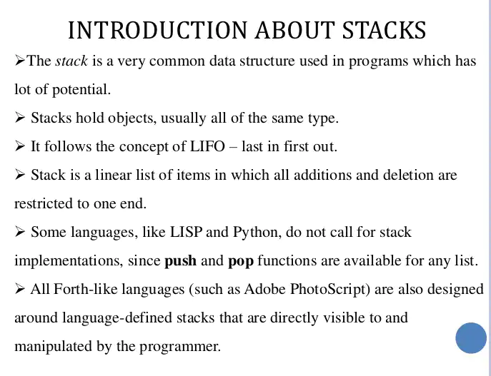
Stack

Slide 2
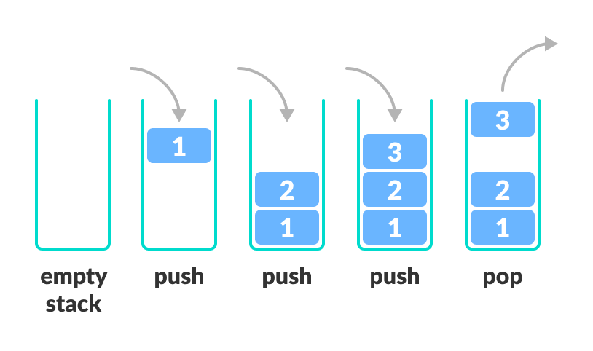
Push and pop operation

Slide 3
