Slide 1


ADVANCED TECHNOLOGIES RESHAPING INDIAN AGRICULTURE

Slide 2
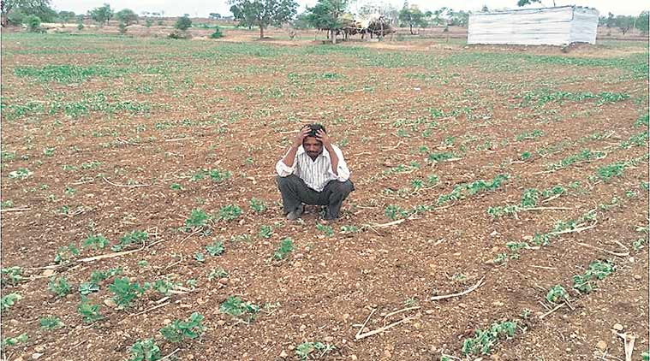


CROP HEALTH
Team members
Raja Bhaskhi
Ankila
Deepika
Ramakrishnan P
Vanthana M

Slide 3
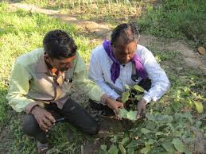


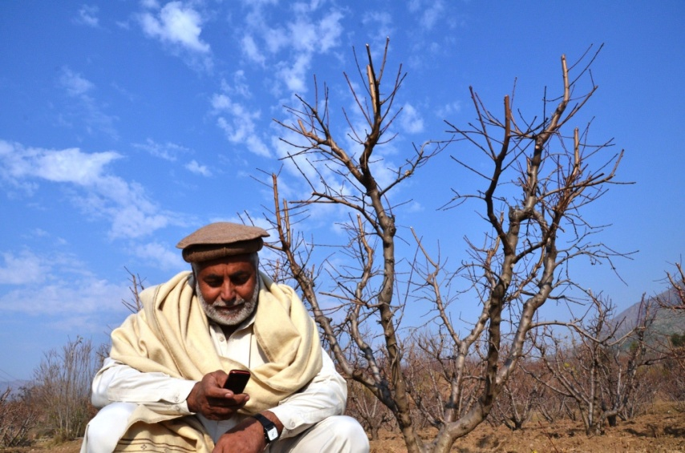

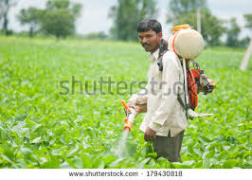
Problems / Opportunity
Phytophilic Scanner

Slide 4


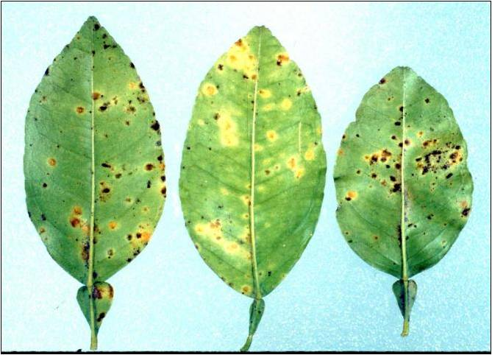
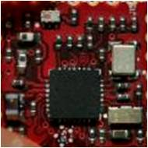
Crop
Symptom
Pathogen
Remedy
Phytophilic Scanner
Crop
Symptom
Pathogen
Remedy
On/Off
On/Off

Slide 5

LABORATORIES
INSURANCE COMPANIES
CONSULTANCY STARTUPS
NGOs
GOVERNMENT
(PLANT HEALTH CARD)
FARMERS
FARMERS

Slide 7
REVENUE GENERATION
PESTICIDE COMPANIES TIE UPS
FARMERS
LABORATORIES
INSURANCE COMPANIES
CONSULTANCY STARTUPS
AGRICULTURE UNIVERSITIES(STUDENTS)
NGOs
Cost effective
one time investment- solution for years

Slide 8

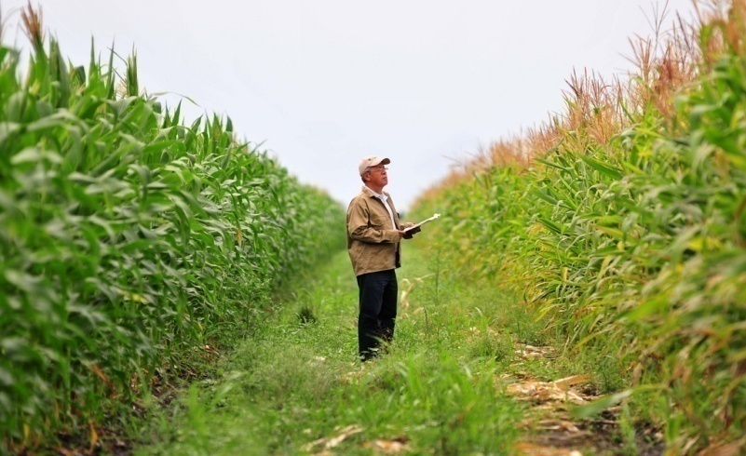
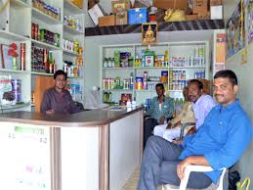



USP
OFF LINE
ON-SPOT SOLUTION
DEALERS
PORTABLE AND HANDY DEVICE

Slide 9
MARKETING STRATEGY
PROGRESSIVE FARMERS
DEMONSTATIONS IN VILLIAGE
ADVERTISMENTS
NGOs
REACHING CUSTOMERS
AGRI INPUT SHOPS
ELECTRONIC SHOPS
KISAN MELAS
SPECIAL SHOPS AT DEMONSTATION PLACE
SERVICE AND CUSTOMER OUTLET

Slide 10

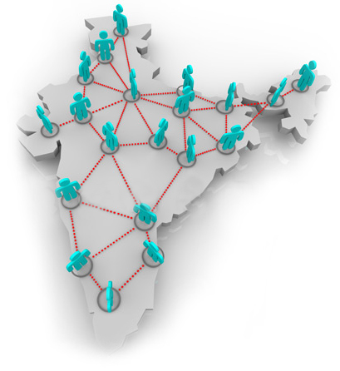
SCALING UP

Slide 11
THANK YOU

