Slide 1

CL 630 Composite Materials (3 0 0 6)
1. Introduction—10 hours
2. Theory of Reinforcement— 4 Hours
3. Polymer nanocomposite (CNT) —6 Hours
4. Lamination Theory—5 Hours
5. Mechanical behavior of composite materials—9 Hours
6. Composite fabrication—6 Hours
Tentative Grading
1. Assignment: 40%
2. Surprise Quiz: 10%
3. Attendance/interaction: 10%
4. MCQ: 40%
By
Dr. Chandan Das
Department of Chemical Engineering
Indian Institute of Technology Guwahati
TAs
Mr. Nagendraprasad (g.nagendra@iitg.ac.in )
Mr. Anil Kumar (anilkumar@iitg.ac.in)
Manoj Yadav (manojyadav@iitg.ac.in)

Slide 2
CL 630 Composite Materials (3 0 0 6)
Chapter 1
Introduction
By
Dr. Chandan Das
Department of Chemical Engineering
Indian Institute of Technology Guwahati, Assam

Slide 3
Background
The importance of a composite material is that two or more distinctly different materials combine together to form a composite which possesses properties that are superior to the properties of the individual components.
The composites industry has usually been perceived as providing specially parts at premium prices.
Today however, composites are being reclassified from “specially” to “common” industry.
The growth of the composite material development has resulted in lower prices without loss of properties.
As the value of fiber reinforced polymers became apparent and accepted in electrical applications and corrosive environments, these synthetic materials began to penetrate virtually every other market worldwide, from automotive and marine to primary structural elements of aircraft and bridges, medical uses, satellites and launch vehicles, specialized industrial machinery components etc.
CL 630

Slide 4
Background
Composite is still an evolving field of material science.
Surveying the pathways to arrive at the present position, some important development in the field is expected.
These will be associated with new composites, design strategies, materials technology, fabrication processes, resource management etc.
These developments will advance in parallel and with synergy to allow composite to play an increasingly important role in engineering and process industry.
These may become the economic barometer while selecting the material of construction which steel and other alloy are enjoying.
CL 630

Slide 5
Textbooks/References
R.M. Jones, Mechanics of Composite Materials, 2nd Ed., 1st Indian Reprint, Taylor & Francis, 2010.
F. L. Matthews and R. D. Rawlings, Composite Materials: Engineering and Science, CRC Press, Woodhead, 1999.
B.D. Agarwal, and J.D. Broutman, Analysis and Performance of Fiber Composites, John Willey and Sons, New York, 1990.
P.K. Mallick, Fiber-Reinforced Composites: Materials, Manufacturing and Design, 2nd Ed., Marcel and Dekker, New York, 1993.
K.K. Arthur, Mechanics of Composite Materials, CRC Press, 1997.
P.K. Mallick, Composite Engineering Handbook, 2nd Ed., Marcel and Dekker, New York, 1997.
CL 630

Slide 6
Introduction
Composite Material:
Two or more materials combined to form a useful third material
Heterogeneous/distinct constituent phases with distinct interface
Properties significantly different from constituent properties
Some properties that can be improved:
  Strength
  Stiffness
  Corrosion resistance
  Thermal conductivity
  Gas barrier properties
  Membrane performance
CL 630

Slide 7
Introduction
Composite Materials:
Matrix: Continuous Phase
Reinforcement: Discontinuous Phase
Common Examples:
Wood: Cellulose fibres in lignin matrix
Bone: Collagen fibres and hydroxyapatite
Concrete: Gravel/sand/crushed stone (aggregate) in cement
Reinforced Concrete: Steel rods in concrete
Plywood: Thin layers of wood glued together
CL 630

Slide 8
Introduction
Reinforcement:
Discontinuous phase
Usually responsible for property enhancement
Factors that can affect properties of composites:
  Properties of constituent materials
  Reinforcement geometry (shape, size)
  Concentration of reinforcement
  Uniformity in distribution of reinforcement
  Orientation of reinforcement
  Interaction between reinforcement and matrix
CL 630

Slide 9
Introduction
Classification based on Geometry of Reinforcement:
Fibre-reinforced Composites (FRCs)
  Single-layer
    Continuous-fibre-reinforced
      Unidirectional
      Bidirectional
    Discontinuous-fibre-reinforced
      Random orientation
      Preferred orientation
  Multilayered
    Laminate
    Hybrid laminate
Particle-reinforced Composites
  Random orientation
  Preferred orientation
CL 630

Slide 10
Introduction
Particle-reinforced Composites/Particulate Composites:
Reinforcement can be classified as particles
Spherical, cubic, irregular-shaped, platelet but not fibrous
Examples:
  Tungsten-carbide particles in cobalt matrix: high surface hardness
  Chromium-carbide particles in cobalt matrix: high corrosion and abrasion resistance
  Carbon black particles in rubber: improve strength
  Copper particle in epoxy (polymer): increases electrical conductivity
  Mica flakes in glassy matrix: good insulation properties
  Polymer-clay nanocomposites (clay platelets dispersed in polymer matrix): improve mechanical, gas barrier and flame retardant properties
CL 630

Slide 11
Introduction
Fibre-reinforced Composites/Fibrous Composites:
Discontinuous-fibre-reinforced composites: Short fibres, fibre length affects composite properties
  Orientation cannot be controlled easily
  Composite properties can be isotropic
  If injection moulding is used for fabrication, fibre orientation can occur in flow direction; not isotropic.
CL 630

Slide 12
Introduction
Fibre-reinforced Composites/Fibrous Composites:
Reinforcement are fibres (high aspect ratio, length much longer than cross sectional dimensions)
Flaws are minimized due to small cross sectional dimensions
Continuous-fibre-reinforced composites: Long fibres.
  Unidirectional composites are very strong in fibre direction but weaker in direction perpendicular to the fibre orientation. Multiple layers may be stacked in various orientations to form laminates.
  Bidirectional reinforcement: reinforcement with woven fabric instead of linear fibres.
CL 630

Slide 13
Introduction
Mechanical Properties of Some Fibres:
Material | Tensile Modulus (GPa) | Tensile Strength (GPa) | Density (g/cm³) | Specific Modulus (GPa.cm³/g) | Specific Strength (GPa.cm³/g)
Fibres
E-glass | 72.4 | 3.5 | 2.54 | 28.5 | 1.38
S-glass | 85.5 | 4.6 | 2.48 | 34.5 | 1.85
Graphite | 390 | 2.1 | 1.90 | 205.0 | 1.1
Boron | 385 | 2.8 | 2.63 | 146.0 | 1.1
Tungsten | 414 | 4.2 | 19.3 | 21.0 | 0.22
Kevlar | 130 | 2.8 | 1.50 | 87.0 | 1.87
Conventional Materials
Steel | 210 | 0.34-2.1 | 7.8 | 26.9 | 0.043-0.27
Glass | 70 | 0.7-2.1 | 2.5 | 28.0 | 0.28-0.84
Tungsten | 350 | 1.1-4.1 | 19.3 | 18.1 | 0.057-0.21
CL 630

Slide 14
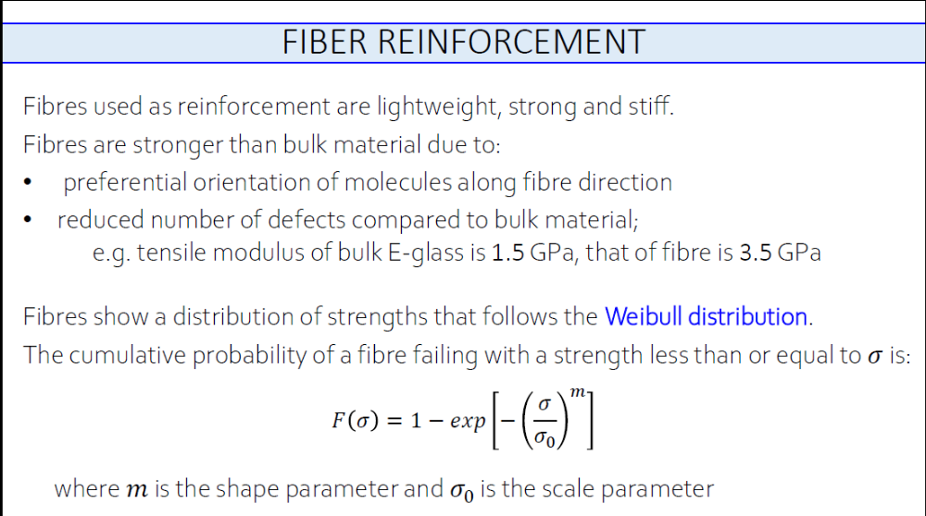


Slide 15
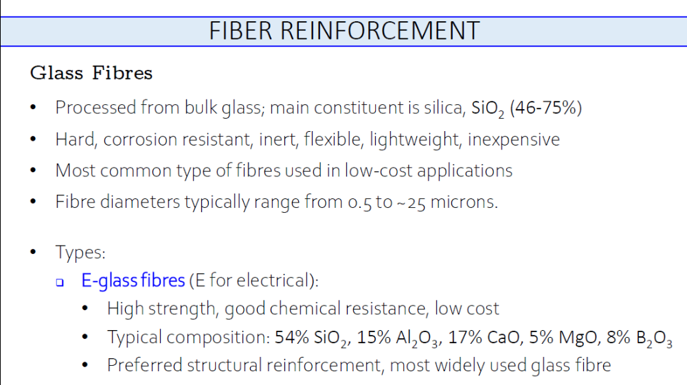

Slide 16
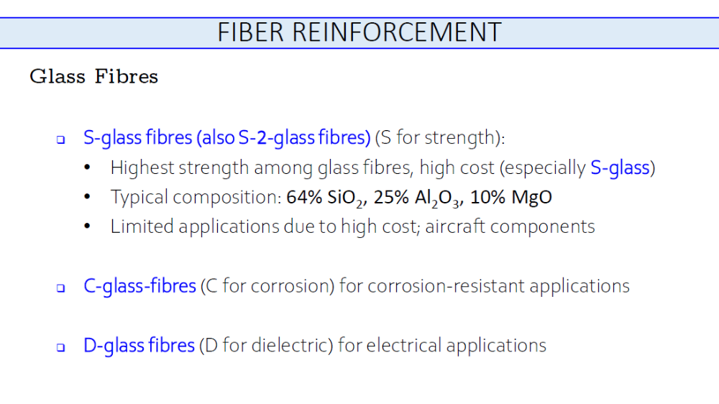

Slide 17
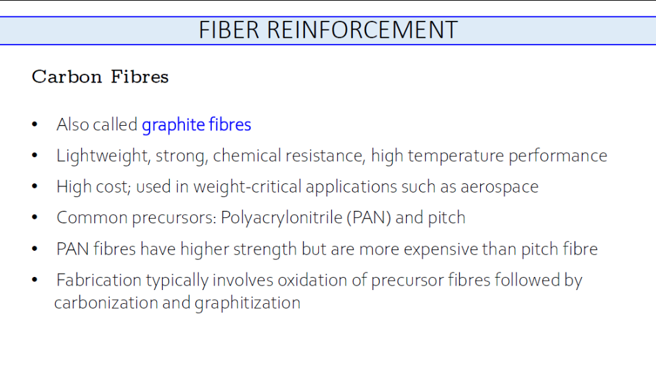

Slide 18
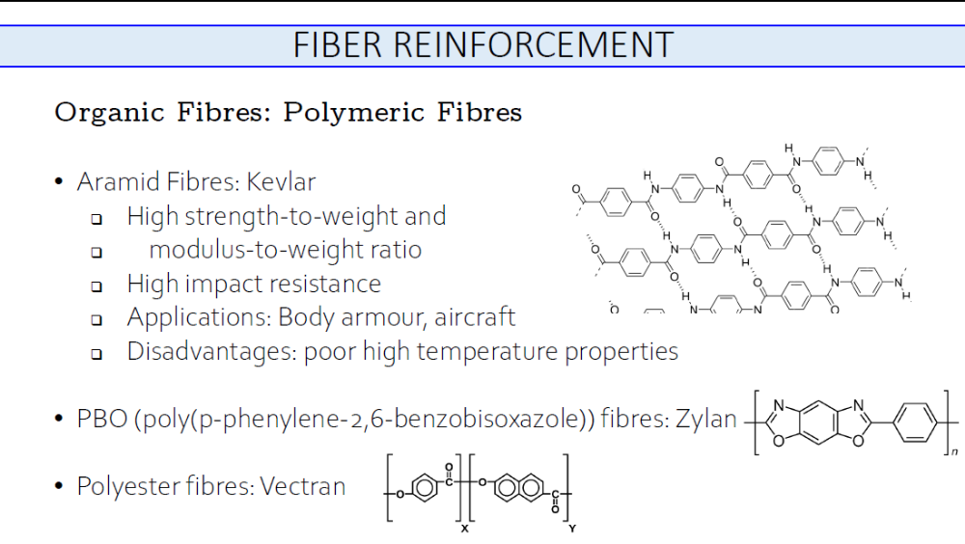

Slide 19
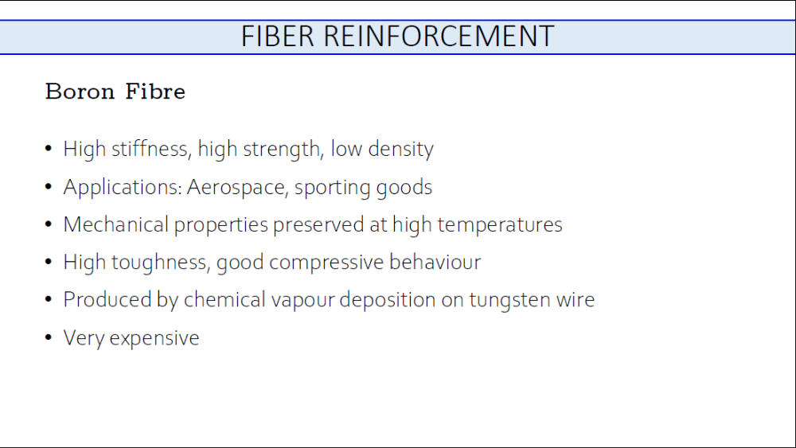

Slide 20
Introduction
1. Definition, properties, classification
2. Use of composite materials over metals, ceramics and polymers
3. Structural applications
4. Materials
Structural materials:
(a) Metals; (b) Polymers; (c) Ceramics and (d) Composite materials
1 (a) Definition: Two or more structural materials, namely, metals, polymers and ceramics, are combined in a structural unit on a macroscopic scale to form a new useful material is called composite material.
Composite materials have two distinct phases; (a) continuous, generally in a greater quantity—matrix (metals, polymers and ceramics) and (b) reinforcing phase for reinforcement of matrix—fibrous or particulate materials.
In general, properties of a matrix are enhanced by incorporating reinforcing phases.
CL 630

Slide 21
1 (b) Properties: The following properties can be improved by forming a composite material as:
(i) Strength (ii) Stiffness
(iii) Corrosion resistance (iv) Wear resistance
(v) Attractiveness (vi) Weight
(vii) Fatigue life (viii) Temperature dependent behavior
(ix) Thermal insulation (x) Thermal conductivity
(xi) Acoustical insulation
NATURAL COMPOSITES:
(A) Wood-fibrous cellulose in lignin matrix
(B) Bone-layered and oriented collagen fibrils in protein-Ca₃(PO₄)₂ matrix
Fiber-reinforced, resin matrix composite materials have high strength/weight and stiffness/weight for weight sensitive applications, like, aircraft and space vehicles.
CL 630

Slide 22
1 (c) Classification
Composite Materials
Fiber-reinforced Composites
Particle reinforced Composites
Single-layered Composites
Multilayered Composites
Random orientation
Preferred orientation
Continuous FRC
Discontinuous FRC
Laminates
Hybrids
Uni-
directional
Multi-directional
Random orientation
Unidirectional orientation
Bi-directional
CL 630

