Slide 1
Continuous filtration
CL206, IITG

Slide 2
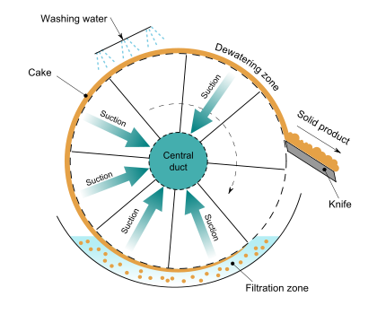
Rotary vacuum filter

Slide 3
Rotary vacuum filter
http://www.solidliquid-separation.com/VacuumFilters/Drum/drum.htm

Slide 4
Rotary vacuum filter
A rotary vacuum filter with an area of 10 m^2 produces a certain filtrate
flowrate at a drum speed of 1.2 rpm. An alternative filter is made
available that has an area of 15 m^2.
At what speed should this be operated to give the same flowrate ?

