Slide 1

CL 630 Composite Materials (3 0 0 6)
1. Introduction—10 hours
2. Theory of Reinforcement— 4 Hours
3. Polymer nanocomposite (CNT) —6 Hours
4. Lamination Theory—5 Hours
5. Mechanical behavior of composite materials—9 Hours
6. Composite fabrication—6 Hours
Tentative Grading
1. Assignment: 40%
2. Surprise Quiz: 10%
3. Attendance/interaction: 10%
4. MCQ: 40%
By
Dr. Chandan Das
Department of Chemical Engineering
Indian Institute of Technology Guwahati

Slide 2
CL 630 Composite Materials (3 0 0 6)
Chapter 1
Introduction
By
Dr. Chandan Das
Department of Chemical Engineering
Indian Institute of Technology Guwahati, Assam

Slide 3
Recap
BORON FIBERS-CVD
CERAMIC FIBERS- SiC and Al₂O₃
SiC: (1) Monofilament; (2) Multifilament and (3) Whisker
Al₂O₃ : (1) Fiber FP; (2) Nextel 610; (3) Nextel 720; (4) Fiberfrax and (5) Saffil
Particles: (Whiskers→ small single crystal) SiC
Matrix: Polymer; Metal; Ceramics
CL 630

Slide 4
C. Matrix: Polymer; Metal; Ceramics
The roles of the matrix in a fiber-reinforced composite are:
(1) to keep the fibers in place,
(2) to transfer stresses between the fibers,
(3) to provide a barrier against an adverse environment, such as chemicals and moisture, and
(4) to protect the surface of the fibers from mechanical degradation (e.g., by abrasion).
The matrix plays a minor role in the tensile load carrying capacity of a composite structure.
However, selection of a matrix has a major influence on the compressive; inter laminar shear.
CL 630

Slide 5
C. Matrix: Polymer; Metal; Ceramics
The matrix provides lateral support against the possibility of fiber buckling under compressive loading, compressive strength of the composite material.
The inter-laminar shear strength is an important design consideration for structures under bending loads, whereas the in-plane shear strength is important under torsional loads.
The interaction between fibers and matrix is also important in designing damage-tolerant structures.
Finally, the processing and defects in a composite material depend strongly on the processing characteristics of the matrix.
For example, for epoxy polymers used as matrix in many aerospace composites, the processing characteristics include the liquid viscosity, the curing temperature, and the curing time.
CL 630

Slide 6
Table: Matrix Materials
Matrix | Category |  | Application
Polymer | Thermoset | Epoxides | In aerospace and aircraft applications
 |  | Polyesters, vinyl esters | Commonly in automotive, marine, chemical, and electrical applications
 |  | Phenolics | In bulk molding compounds
 |  | Polyimides, polybenzimidazoles (PBI), polyphenylquinoxaline (PPQ) | For high-temperature aerospace applications (temperature range: 250°C–400ºC)
 |  | Cyanate ester | Electronics, printed circuit boards, satellite and aerospace structural composites, and low-dielectric and radar applications
 | Thermoplastic | Nylon 6, nylon 6,6, PET, PBT), polycarbonate (PC), polyacetals | With discontinuous fibers in injection-molded articles
 |  | Polyamide-imide (PAI), polyether ether ketone (PEEK), polysulfone (PSUL), polyphenylene sulfide (PPS), polyetherimide (PEI) | Suitable for moderately high temperature applications with continuous fibers
Metallic | Aluminum and its alloys, titanium alloys, magnesium alloys, copper-based alloys, nickel-based superalloys, stainless steel |  | Suitable for high-temperature applications (temperature range:300°C–500ºC)
Ceramic | Aluminum oxide (Al₂O₃), carbon, silicon carbide (SiC), silicon nitride (Si₃N₄) |  | Suitable for high-temperature applications
CL 630

Slide 7
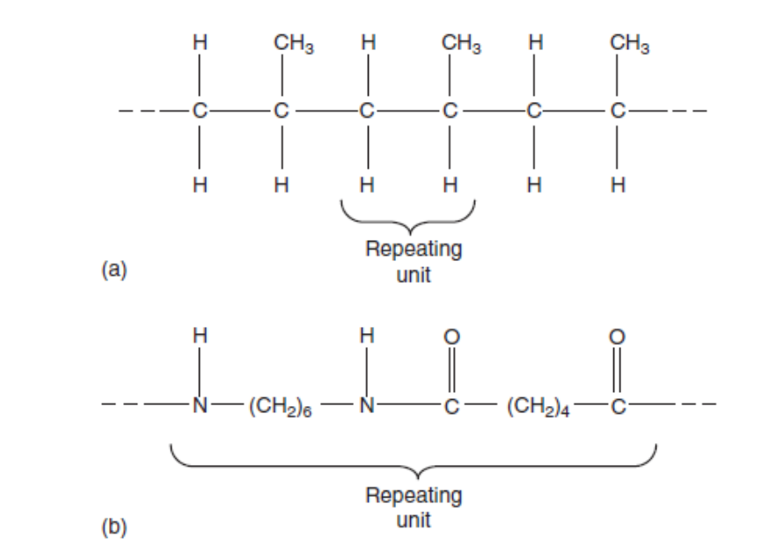
POLYMER MATRIX
Polymer Matrix
A polymer is defined as a long-chain molecule containing one or more repeating units of atoms, joined together by strong covalent bonds.
A polymeric material (commonly called a plastic) is a collection of a large number of polymer molecules of similar chemical structure (but not of equal length).
Figure: Examples of repeating units in polymer molecules. (a) A polypropylene molecule, (b) A nylon 6,6 molecule.
On a submicroscopic scale, various segments in a polymer molecule may be in a state of random excitation.
CL 630

Slide 8
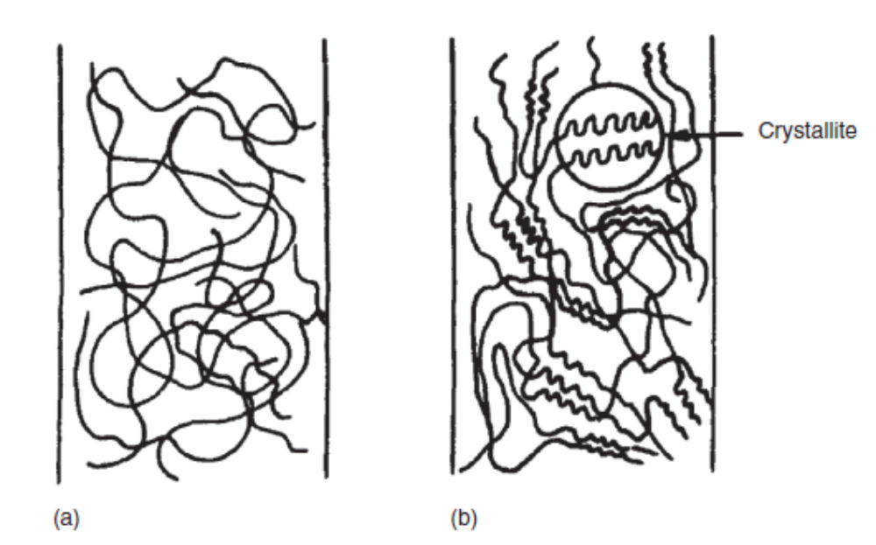
In the solid state, these molecules are frozen in space, either in a random fashion in amorphous polymers or in a mixture of random fashion and orderly fashion (folded chains) in semi-crystalline polymers.
Figure: Arrangement of molecules in (a) amorphous polymers and (b) semi-crystalline polymers.
The frequency, intensity, and number of these segmental motions increase with increasing temperature, giving rise to the temperature-dependent properties of a polymeric solid.
CL 630

Slide 9
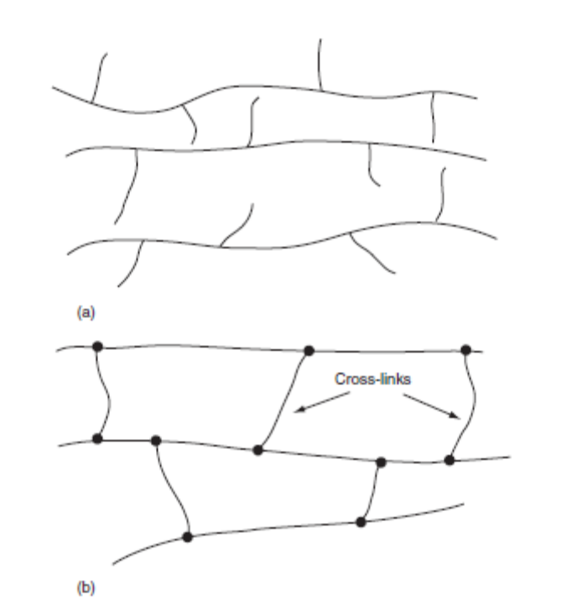
Polymer categorization: Thermoplastics and Thermosets
Polymers are divided into two broad categories:. thermoplastics and thermosets
In a thermoplastic polymer, individual molecules are not chemically joined together.
They are held in place by weak secondary bonds or intermolecular forces, such as van der Waals bonds and hydrogen bonds.
With the application of heat, these secondary bonds in a solid thermoplastic polymer can be temporarily broken and the molecules can now be moved relative to each other or flow to a new configuration if pressure is applied on them.
Figure: Schematic representation
of (a) thermoplastic and
(b) thermoset polymer.
CL 630

Slide 10
Polymer categorization: Thermoplastics and Thermosets
On cooling, the molecules can be frozen in their new configuration and the secondary bonds are restored, resulting in a new solid shape.
Thus, a thermoplastic polymer can be heat-softened, melted, and reshaped (or postformed) as many times as desired.
In a thermoset polymer, on the other hand, the molecules are chemically joined together by cross-links, forming a rigid, three-dimensional network structure. Once these cross-links are formed during the polymerization reaction (also called the curing reaction), the thermoset polymer cannot be melted by the application of heat.
However, if the number of cross links is low, it may still be possible to soften them at elevated temperatures.
CL 630

Slide 11
Selection of Matrix: Thermosets vs. Thermoplastics
The primary consideration in the selection of a matrix is its basic mechanical properties. For high-performance composites, the most desirable mechanical properties of a matrix are
1. High tensile modulus, which influences the compressive strength of the composite
2. High tensile strength, which controls the intraply cracking in a composite laminate
3. High fracture toughness, which controls ply delamination and crack growth
For a polymer matrix composite, there may be other considerations, such as good dimensional stability at elevated temperatures and resistance to moisture or solvents.
The former usually means that the polymer must have a high glass transition temperature T_{g}.
In practice, the glass transition temperature should be higher than the maximum use temperature.
CL 630

Slide 12
Selection of Matrix: Thermosets vs. Thermoplastics
Resistance to moisture and solvent means that the polymer should not dissolve, swell, crack (craze), or otherwise degrade in hot–wet environments or when exposed to solvents, namely, jet fuels, deicing fluids, and paint strippers.
Traditionally, thermoset polymers (also called resins) have been used as a matrix material for fiber-reinforced composites.
The starting materials used in the polymerization of a thermoset polymer are usually low-molecular-weight liquid chemicals with very low viscosities.
Fibers are either pulled through or immersed in these chemicals before the polymerization reaction begins.
Since the viscosity of the polymer at the time of fiber incorporation is very low, it is possible to achieve a good wet-out between the fibers and the matrix without the aid of either high temperature or pressure.
Fiber surface wetting is extremely important in achieving fiber–matrix interaction in the composite, an essential requirement for good mechanical performance.
CL 630

Slide 13
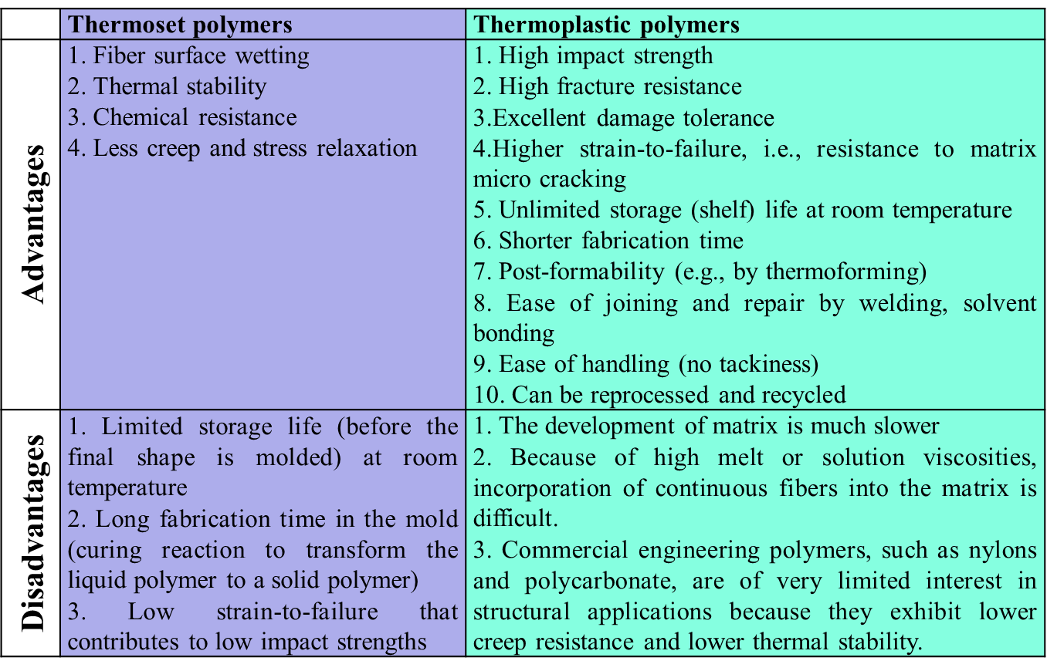
Comparison: Thermosets vs. Thermoplastics
CL 630

Slide 14
Table: Maximum Service Temperature for Selected Polymeric Matrices
Polymer | Tg, °C | Maximum Service Temperature, °C
Thermoset matrix
DGEBA epoxy | 180 | 125
TGDDM epoxy | 240–260 | 190
Bismaleimides (BMI) | 230–290 | 232
Acetylene-terminated polyimide (ACTP) | 320 | 280
PMR-15 | 340 | 316
Thermoplastic matrix
Polyether ether ketone (PEEK) | 143 | 250
Polyphenylene sulfide (PPS) | 85 | 240
Polysulfone | 185 | 160
Polyetherimide (PEI) | 217 | 267
Polyamide-imide (PAI) | 280 | 230
K-III polyimide | 250 | 225
LARC-TPI polyimide | 265 | 300
Recently, a number of thermoplastic polymers have been developed that possess high heat resistance and these are of interest in aerospace applications.
CL 630

Slide 15
Polymer Matrix Composites
Polymer matrix (epoxies, phenolics, polyester etc.) reinforced with fibres (glass, aramids, carbon, boron etc.)
Advantages:
  Low cost
  High specific strength (e.g. graphite/epoxy composite five times stronger than steel per unit weight)
  Simple manufacturing
Disadvantages:
  High melt and solution viscosities
  Low operating temperature
  Susceptible to moisture absorption and dimensional change

Slide 16
Polymer Matrix Composites : Typical Properties
Property | Glass/Epoxy | Graphite/Epoxy | Aluminium | Steel
Specific Gravity | 1.8 | 1.6 | 2.6 | 7.8
Ultimate Tensile Strength (MPa) | 1062 | 1500 | 234 | 648
Young’s Modulus (GPa) | 38.6 | 181 | 69 | 207
Coefficient of Thermal Expansion (μm/m/°C) | 8.6 | 0.02 | 23 | 11.7

Slide 17
Polymer Matrix Composites
Polyesters:
Advantages :
  Low cost
  Can be made translucent
Disadvantages :
  Low service temperatures
  Brittleness
  High shrinkage during curing
Phenolics:
Advantages :
  Low cost
  Good service temperature
Disadvantages :
  High void content

Slide 18
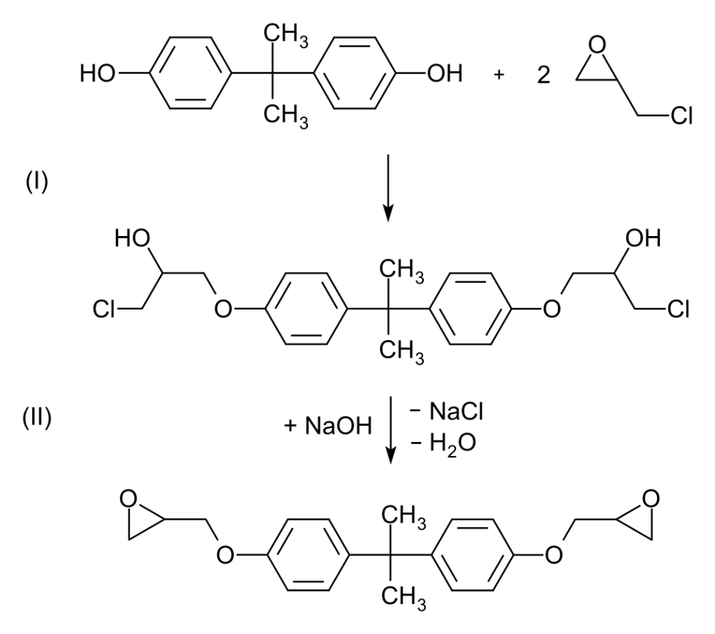
Polymer Matrix Composites
Epoxies: Most commonly used resins
Advantages :
  High mechanical strength
  Good adherence to metals and glasses
  Low shrinkage and volatility during cure
Disadvantages :
  High cost
  Processing more difficult
Bisphenol-based epoxy resin:
+
+ 2NaOH
- 2NaCl
- 2H₂O
Bisphenol-A
Epichlorohydrin
Bisphenol A diglycidyl ether (BADGE or DGEBA)

Slide 19
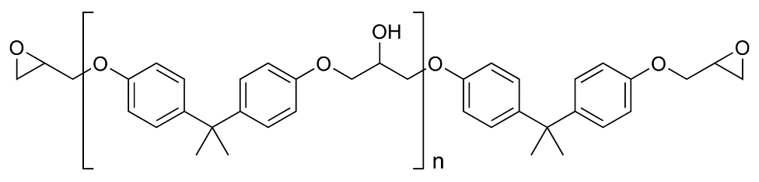
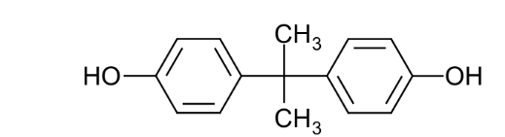
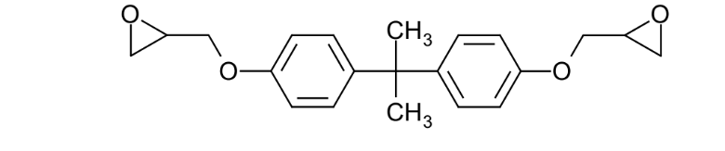
Polymer Matrix Composites: Epoxies
Bisphenol-based epoxy resin:
+
+ 2NaOH
- 2NaCl
- 2H₂O
Bisphenol-A
Epichlorohydrin
Bisphenol A diglycidyl ether (BADGE or DGEBA)
+
Bisphenol-A
DGEBA
Higher molecular weight diglycidyl ethers (n ≥ 1)
Curing Agents or Hardeners: Typically Polyamines

Slide 20
METAL MATRIX
Metal matrix has the advantage over polymeric matrix in applications requiring a long-term resistance to severe environments, such as high temperature.
The yield strength and modulus of most metals are higher than those for polymers, and this is an important consideration for applications requiring high transverse strength and modulus as well as compressive strength for the composite.
Another advantage of using metals is that they can be plastically deformed and strengthened by a variety of thermal and mechanical treatments.
However, metals have a number of disadvantages, namely, they have high densities, high melting points (therefore, high process temperatures), and a tendency toward corrosion at the fiber–matrix interface.
The two most commonly used metal matrices are based on aluminum and titanium.
CL 630

Slide 21
METAL MATRIX
Both of these metals have comparatively low densities and are available in a variety of alloy forms.
Although magnesium is even lighter, its great affinity toward oxygen promotes atmospheric corrosion and makes it less suitable for many applications.
Beryllium is the lightest of all structural metals and has a tensile modulus higher than that of steel.
However, it suffers from extreme brittleness, which is the reason for its exclusion as a potential matrix material.
Nickel and cobalt-based super-alloys have also been used as matrix; however, the alloying elements in these materials tend to bring out the oxidation of fibers at elevated temperatures.
Aluminum and its alloys have attracted the most attention as matrix material in metal matrix composites.
Commercially, pure aluminum has been used for its good corrosion resistance.
CL 630

Slide 22
THANK YOU
Next Class:
Metal Matrix, Ceramic matrix, Fillers
CL 630

