Slide 1

CL 630 Composite Materials (3 0 0 6)
1. Introduction—10 hours
2. Theory of Reinforcement— 4 Hours
3. Polymer nanocomposite (CNT) —6 Hours
4. Lamination Theory—5 Hours
5. Mechanical behavior of composite materials—9 Hours
6. Composite fabrication—6 Hours
Tentative Grading
1. Assignment: 40%
2. Surprise Quiz: 10%
3. Attendance/interaction: 10%
4. MCQ: 40%
By
Dr. Chandan Das
Department of Chemical Engineering
Indian Institute of Technology Guwahati

Slide 2
CL 630 Composite Materials (3 0 0 6)
Chapter 1
Introduction
By
Dr. Chandan Das
Department of Chemical Engineering
Indian Institute of Technology Guwahati, Assam

Slide 3
(A) Fiber-reinforced composites
Definition: Fiber-reinforced composite materials consist of fibers of high strength and modulus embedded in or bonded to a matrix with distinct interfaces (boundaries) between them.
Fiber+Matrix =FRC
Fibrous composite materials: Long fibers are stiffer and stronger than same material in bulk form.
Example: Ordinary plate glass fractures at 2900 psi whereas, commercially available glass fibers have 4,00,000 to 7,00,000 psi and laboratory prepared form glass fibre has 10,00,000 psi tensile strength.
Fibers: Glass; Carbon; Aramid; Extended chain polyethylene; Natural Boron; Ceramic
Matrix: Polymer; Metal; Ceramics
load transfer medium and protection from temperature and humidity
load carrying material
CL 630

Slide 4

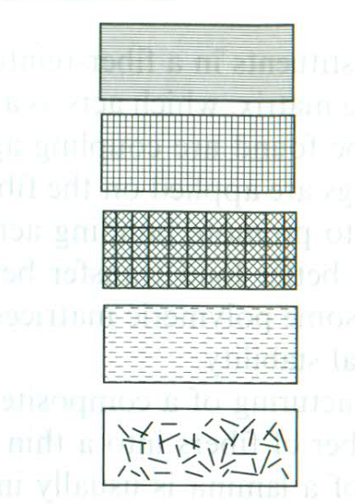
Single-layer composite
Single-layer composite
In single-layer composites, long fiber with high aspect ratio is called continuous FRC, whereas, short fibers with low aspect ratio gives discontinuous FRC.
Continuous FRC
Unidirectional, bidirectional and multidirectional reinforcement
All the fibers in one direction in continuous FRC are called unidirectional.
Fibers are in two directions, usually, normal to each other is termed as bidirectional (woven) reinforcement.
Fibers in more than two directions are multidirectional reinforcement.
(a) (b) (c)
Figure: (a)Unidirectional, (b) bidirectional and (c) multidirectional reinforcement.
CL 630

Slide 5
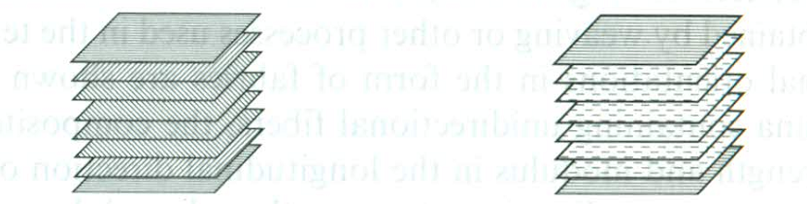
Discontinuous FRC
Random and unidirectional reinforcement
(a) (b)
Figure: (a) Random and (b) unidirectional discontinuous reinforcement.
Multilayered composites
Laminates
The most common form in which fiber-reinforced composites are used in structural applications is called laminate, stack of number of thin layers of fibers (4 to 40) and matrix.
Figure: Consolidated stack of many layers in laminate.
CL 630

Slide 6
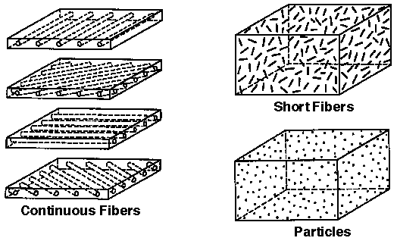
Hybrids
Hybrids are multilayered composites with mixed fibers. The fibers may be mixed in a ply or layer-by-layer and are designed to benefit from different properties of the fibers used.
Example:
Glass+carbon fibers→ polymer matrix→ hybrid FRC (inexpensive, enhanced mechanical properties for stiffness of carbon)
FRC+PRC→ Hybrids
(B) Particle reinforced composites
These composites have approximately equal dimensions in all directions. Shape may be spherical, cubic, platelet or regular/irregular geometry. The arrangement of particulate reinforcement may be either random or preferred orientation. For practical purposes, random orientation is the majority.
Figure: Random and preferred orientation of Particle reinforced composites.
CL 630

Slide 7
2. Use of composite materials over metals, ceramics and polymers
Commercial and industrial applications of composite materials are huge. Structural application includes, aircraft, automotive, sporting goods, marine, electrical, chemical and infrastructure. These are also used in electronics, furniture, building construction, medical industry, power industry, etc.
Salient features
Superior performance and low maintenance cost
Same strength and stiffness as high strength steel and 70% lighter
Compared to Al, three times stronger 60% less weight
Fatigue strength and fatigue damage tolerance are excellent
CL 630

Slide 8

Table: Structural materials and their specific strengths
Category | Material | Tensile or Flexural strength (MPa) | Young’s Modulus (GPa) | Specific Strength
Metal | SAE 1010 steel | 365 | 207 | 46.4
 | 6060-T6 Al Alloy | 310 | 68.9 | 114.4
 | Nickel (20% Cr, 15% Co) | 1200 | 204 | 146.7
 | Titanium (2.5% Sn) | 792 | 112 | 173.7
Ceramic | Alumina | 332 | 382 | 85.8
 | β-Sialon | 945 | 300 | 290.8
 | Zirconia | 900 | 170 | 152
Polymer | Nylon 6.6 | 70 | 2 | 61.4
 | Polystyrene | 50 | 3 | 47.6
 | PVC rigid | 60 | 3 | 35.3
Composite | Carbon fiber-epoxy matrix (unidirectional) | 1550 | 137.8 | 1000
 | Kevlar 49 fiber-epoxy matrix | 1378 | 75.8 | 998.6
CL 630

Slide 9
3. Structural applications of composite materials
(A) Aircraft and military applications
Aircraft | Component | Material | Weight reduction (%) | Commercial/ Military
Boeing 727 | Elevator face sheet | Carbon fiber epoxy | 25 | Commercial
Boeing 737 | Wing spoilers | Carbon fiber epoxy | 37 | Commercial
F-14 (1969) | Skin on horizontal stabilizer box | Boron fiber epoxy | 19 | Military
AV-8B (1982) | Wing skins and substructures, flaps | Carbon fiber epoxy | 25 | Military
CL 630

Slide 10
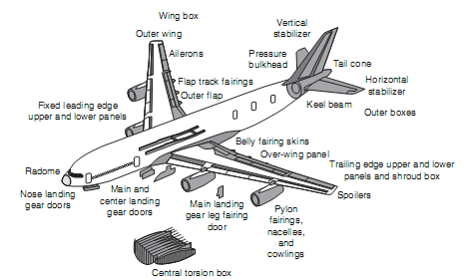
Figure: Use of fiber-reinforced composites in Airbus 380.
CL 630

Slide 11
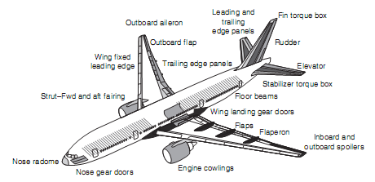
Figure: Use of fiber-reinforced composites in Boeing 777.
CL 630

Slide 12
(B) Space applications
Various FRC are used in space vehicles. These include
mid-fuselage truss structure (Boron fiber reinforced Al tubes)
payload bay door (Sandwich laminate of carbon fiber reinforced epoxy face sheets and Al honeycomb core)
remote manipulator arm (ultrahigh-modulus caqrbon fiber-reinforced epoxy tube)
pressure vessels (Kevlar 49 fiber reinforced epoxy)
support structures for many smaller components
building truss structures of low earth orbit (LEO) satellites (Carbon fiber reinforced epoxy tubes)
Low weight and low coefficient of thermal expansion (TE)
CL 630

Slide 13
(C) Automotive applications
There are three different components in automobiles. These are body components; chassis components and engine components.
Body components: Hood/body panels→high stiffness and dent resistance (damage tolerance)=> E-glass fiber-reinforced sheet molding compound (SMC)
Chassis components: Multileaf steel springs→Unileaf E-glass fiber-reinforced epoxy springs (80% weight reduction)
Engine components: Shafts can be replaced but not cost effective→ non successful;
Fatigue loads at very high temperature pose challenge. High temperature polymer/metal/ceramic matrix will be used.
CL 630

Slide 14
(D) Sporting goods applications
Tennis rackets, athletic shoes, bicycle frames, hockey sticks, base ball bats, archery bows, arrows and helmets are made by composites.
Advantages: Weight reduction; vibration damping; design flexibility
Woods, metals and leathers are replaced by composite materials.
(E) Marine applications
Boats (Sail boats; fishing boats; dinghies; life boats and yachts)
Recreational boats→ Glass FRC or Glass FR vinyl ester resins
Advantages: Weight reduction; higher cruising speed; acceleration; fuel efficiency; maneuverability (controlled change in direction)
CL 630

Slide 15
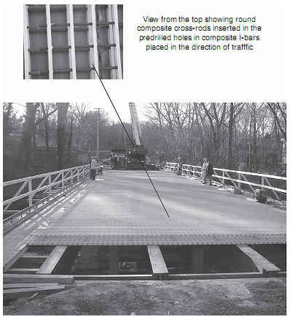
(F) Infrastructure
Reinforced concrete and steels in bridge, building and other civil infra-structures are widely replaced by FRC.
Advantages: Corrosion resistance; longer life; lower maintenance and repairing cost; light weight and hence lower dead weight; easier transportation from production factory to bridge location
(USA and Canada): The Wickwire Run Bridge in West Virginia, USA→ Glass fabric-reinforced polyester (vinyl ester) matrix.
Figure: Glass fiber-reinforced vinyl ester pultruded section in bridge construction.
CL 630

Slide 16
4. Materials
Material selection is one of the most important and critical steps in the mechanical design process. It requires the knowledge of performance requirements of the structure/component under consideration. It also requires the knowledge of
types of loading, e.g., axial, bending, torsion;
mode of loading, e.g., static, fatigue, impact, shock;
service life,
operating/service environment, e.g., temperature, humidity, presence of chemicals;
other structures or components with which the particular design under consideration is required to interact;
manufacturing process that can be used to produce the structure;
cost, manufacturing cost, assembly cost and transportation cost.
A. Fibers: Glass; Carbon; Aramid; Extended chain polyethylene; Natural Boron; Ceramic
B. Particles: (Whiskers→ small single crystal) SiC
C. Matrix: Polymer; Metal; Ceramics
D. Fillers and additives: CaCO₃
CL 630

Slide 17
A. Fibers
These materials occupy the largest volume fraction in a composite and share the major portion of the load acting on a composite structure. Fibers influence the following characteristics:
(a) density
(b) tensile strength and modulus
(c) compressive strength and modulus
(d) fatigue strength and fatigue failure mechanism
(e) electrical and thermal conductivities
(f) cost.
Proper selection of fiber depends on (i) fiber type; (ii) fiber volume fraction; (iii) length and orientation.
A bundle of large number of continuous filaments with small diameter may be untwisted or twisted.
Untwisted: i) Strand/end→ Glass and Kevlar fibers
ii) Tow→ Carbon fibers
Twisted: Yarn
CL 630

Slide 18
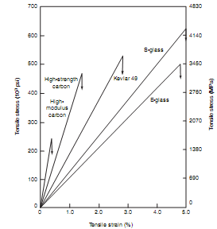
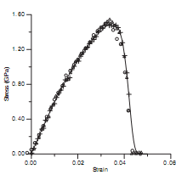
Upto point of failure
Figure: Tensile stress-strain diagram for 300 filaments of untwisted E glass fibers.
Figure: Tensile stress-strain diagram for single filament test.
CL 630

Slide 19


Tensile strength,
where, F_{u}=Force at failure and A_{f}=Average filament cross-sectional area.
Tensile modulus,
where, L_{u}=Gage length and C=True compliance, (speed, loading rate and system compliance).
Both non-linearity and progressive failure occur due to statistical distribution of strength. Weaker filaments fail at low stresses and surviving filaments continue to carry the tensile load.
CL 630

Slide 20
GLASS FIBERS
Glass fibers are the most common of all reinforcing fibers for polymeric matrix composites (PMC).
Advantages: Low cost, high tensile strength, high chemical resistance, excellent insulating resistance
Disadvantages: Low tensile modulus, high density, sensitivity to abraision during handling (decreases tensile strength) low fatigue resistance, high hardness (causes excessive wear on molding dies and cutting tools)
Types: E-glass-lowest cost
S-glass-highest tensile strength (aircraft, missile casing)
C-glass-Chemical applications (corrosion resistant)
S-2-glass-Lower cost version of S-glass to acid resistant
CL 630

Slide 21
Table: Chemical composition of glass fibers
Type | SiO₂ | Al₂O₃ | CaO | MgO | B₂O₃ | Na₂O | Total
E-glass | 54.5 | 14.5 | 17.0 | 4.5 | 8.5 | 0.5 | 100
S-glass | 64.0 | 26.0 | 0 | 10.0 | 0 | 0 | 100
SiO₂→ Principal Ingredient
Al₂O₃ and B₂O₃→Modify network structure of SiO₂
Na₂O→Corrosion resistant, improves workability
Glass fibers are amorphous and isotropic.
CL 630

Slide 22
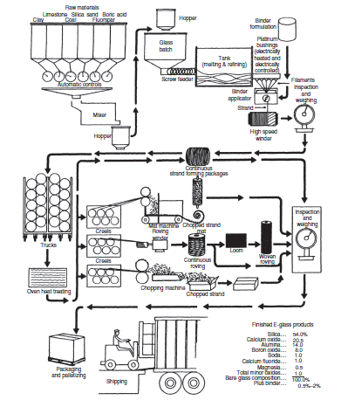
Figure: Flow diagram for glass fiber manufacturing.
CL 630

Slide 23
Manufacturing process
The manufacturing process for glass fibers is presented in above Figure.
Steps:
1. Various ingredients are dried, mixed and melted in a refractory furnace at about 1370⁰C.
2. The molten glass is extruded through a number of orifices and rapidly drawn into filaments of around 10 μm diameter.
3. A protective coating is applied in individual filaments before these are gathered together into a strand and wound on a drum. The coating is a mixture of lubricants (prevent abrasion), antistatic agents (reduce static friction), and a binder. It may contain small percentage of coupling agent to promote adhesion between fiber and polymer matrix.
CL 630

Slide 24
Basic commercial form is strand (bundle of filaments), collection of parallel filaments numbering 204 and above.
Roving is a group of untwisted parallel strands (also called ends) wound on a cylindrical package.
Chopped strands are made by cutting continuous strands into short lengths.
3.2 mm to 12.7 mm lengths chopped strands are used in injection molding operation.
Longer strands upto 50.8 mm are used to form chopped strand mats (CSM).
The tensile strength of glass fibers is reduced in presence of water or under sustainable loads. Water bleaches out the alkali present in the surface. Under sustainable loads, the growth of surface flaws is accelerated owing to stress corrosion by atmospheric moisture.
Tensile strength of glass fibers is decreased with increasing time of load duration.
CL 630

Slide 25
CARBON FIBERS
Carbon fibers are not new technology. These were produced by Thomas Edison as filaments for his electric light bulb.
But in the 1960s carbon fibers were the first “high-strength, high modulus” fibers, developed for structural composites for the space and defense applications.
Since the initial introduction of those fibers, the quality and performance have increased significantly and the price has gone down dramatically.
As a result, carbon fibers are now used in a wide variety of commercial, industrial and consumer applications, such as sporting goods (golf clubs, tennis rackets, bicycle frames, arrows) composite hulls for boats, aircraft brakes, automobile components, industrial rollers and storage tanks, furnace insulation, electronic component shielding, and windmill blades for wind energy systems.
CL 630

Slide 26
Carbon fibers are available with a variety of tensile modulus ranging from 207 GPa to 1035 GPa. In general, low modulus fibers have lower density, lower cost, higher tensile strength, higher compressive strength, and higher tensile strain/failure than high modulus fibers.
Advantages:
i) Exceptionally high tensile strength/weight ratio
ii) High tensile modulus/weight ratio
iii) Zero or negative coefficient of thermal expansion: This is an effect of the graphite crystal structure which is oriented along the axis. The degree of crystallization and orientation directly determines the axial thermal expansion. Carbon fibers with a high degree of crystallinity and alignment have negative axial thermal expansions. The negative axial thermal expansion of the carbon fibers is used in composites to produce low expansion components for use in mirrors and precision alignment devices.
iv) High fatigue strength
v) High thermal conductivity (higher than copper)
Disadvantages:
i) Low tensile strain/failure
ii) Low impact resistance
iii) High electrical conductivity (causes shorting in unprotected electrical machinery)
iv) High cost
CL 630

Slide 27
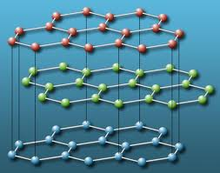
Figure: Orientation of carbon atoms in graphite crystal.
Structure of carbon fibers
Strong covalent bonds present between carbon atoms in a plane but weak van der Waals type force exists between two planes. Hence, anisotropic physical and mechanical properties are observed for carbon fibers (properties depend on direction).
3.35Å
1.415Å
CL 630

Slide 28
Commercial carbon fibers are produced by a two step process - the spinning of an organic precursor and a thermal conversion to carbon.
There are three types of precursors used on a commercial basis to manufacture carbon fibers: rayon, polyacrylonitrile (PAN), and pitch.
Rayon, the raw material used for the first high-performance carbon fibers, was the dominant precursor material in the 1960s and early 1970s.
However, because of its low carbon yield (2~30%), high processing cost, and limited physical properties, today rayon precursor is used for less than 1% of commercial carbon fibers.
Manufacturing process
CL 630

Slide 29
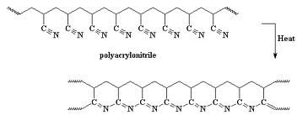
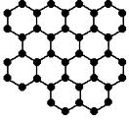

PAN-based Carbon Fibers
PAN-based carbon fibers are derived from polyacrylonitrile or acrylic copolymers. Normally, a solution of the polymer is either wet or dry spun into PAN precursor fibers that are ultimately converted into carbon fibers.
CH₂=CHCN
Polymerization
Chemistry
200-300ºC
Stabilization
PAN filament/precursor fiber
1000-2000ºC and >2000ºC
Carbonization and Graphitization
Graphite like structure
CL 630

Slide 30
Carbon fiber manufacture from PAN
Steps
Polymerization: Acrylonitrile to polyacrylonitrile
Wet spinning: Dilute solution of acrylic polymer is extruded into a coagulation bath
Stabilization of PAN: Heating the fiber in air to temperatures ranging from 200 to 300°C for approximately 1-2 hours
Carbonization: In an inert atmosphere at 1000 to 2000°C for 30 min
Graphitization: Heating above 2000°C with or without stretching upto 3000°C
Surface treatment: Oxidation of the fiber surface to promote adhesion to the matrix resin in the composite
Sizing: Continuous carbon or graphite fiber is coated with sizing agent to promote handleability and wettability of the fiber with the matrix resin
CL 630

Slide 31
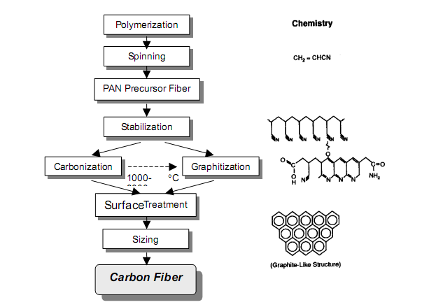
Figure: Flow diagram of PAN-based fiber processing.
CL 630

Slide 32
Pitch-based Carbon Fibers
The production of high-modulus, pitch-based carbon fiber begins by heat treating a petroleum or coal tar pitch feedstock to produce a liquid crystal precursor, termed “mesophase”.
The liquid crystal material is melt spun into a precursor fiber that is converted into a carbon fiber in a process similar to that used for PAN-based carbon fiber.
CL 630

Slide 33
Pitch-based Carbon Fibers
Steps
Pitch purification: By-product of petroleum refining/coal coking is purified
Mesophase formation: Heating the pitch at 300 to 500°C
Melt spinning, drawing followed by heat stabilization: Generation of pitch filaments by passing through spinneret die
Carbonization: In an inert atmosphere at 1000 to 2000°C for 30 min
Graphitization: Heating above 2000°C with or without stretching upto 3000°C
Surface treatment: Oxidation of the fiber surface to promote adhesion to the matrix resin in the composite
Sizing: Continuous carbon or graphite fiber is coated with sizing agent to promote handleability and wettability of the fiber with the matrix resin
CL 630

Slide 34
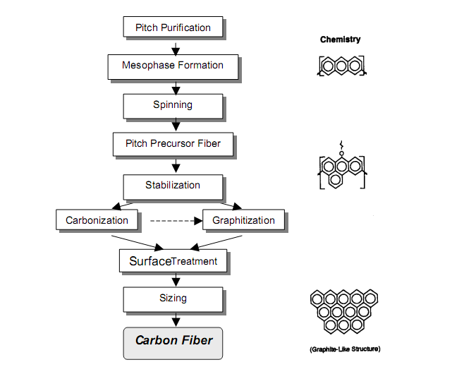
Figure: Pitch-based fiber processing.
CL 630

Slide 35
Table: Comparison between PAN-based and Pitch-based carbon fibers
Properties | PAN carbon fiber | Pitch carbon fiber
Thermal conductivity | Lower | Higher
Electrical conductivity | Lower | Higher
Carbon content (%) | 68 | 93
Cost | Higher | Lower
Specific modulus (tensile modulus/density) | Lower | Higher
Axial coefficient of thermal expansion | Higher | Lower
Tensile strength | 40-50% higher | 40-50% lower
Compressive strength | Higher | One third
CL 630

Slide 36
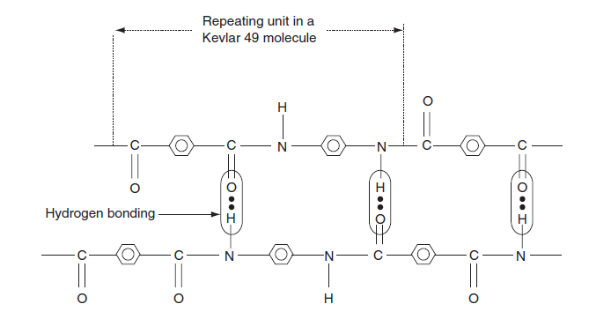
ARAMID FIBERS
Aramid fibers are highly crystalline aromatic polyamide fibers that have the lowest density and the highest tensile strength/weight ratio among the current reinforcing fibers. Kevlar 49 is the trade name of one of the aramid fibers.
Application: Marine and aerospace applications
The aromatic rings give highest chain stiffness as well as better chemical and thermal stability over other fibers or polymers.
Figure: The molecular structure of Kevlar 49.
CL 630

Slide 37
Manufacturing of Kevlar 49
Kevlar 49 filaments are manufactured by extruding an acidic solution of a proprietary precursor (a polycondensation product of terephthaloyol chloride and p-phenylene diamine) from a spinneret.
During the filament drawing process, Kevlar 49 molecules become highly oriented in the direction of the filament axis.
Weak hydrogen bonds between hydrogen and oxygen atoms in adjacent molecules hold them together in the transverse direction.
The resulting filament is highly anisotropic, with much better physical and mechanical properties in the longitudinal direction than in the radial direction.
CL 630

Slide 38
Salient features of Kevlar 49 fiber
Kevlar 49 fibers do not melt or support combustion but will start to carbonize at about 427°C.
The maximum long term use temperature recommended for Kevlar 49 is 160°C. They have very low thermal conductivity, but a very high vibration damping coefficient.
Except for a few strong acids and alkalis, their chemical resistance is good.
However, they are quite sensitive to ultraviolet lights. Prolonged direct exposure to sunlight causes discoloration and significant loss in tensile strength. The problem is less pronounced in composite laminates in which the fibers are covered with a matrix.
Ultraviolet light-absorbing fillers can be added to the matrix to further reduce the problem.
CL 630

Slide 39
Kevlar 49 fibers are hygroscopic and can absorb up to 6% moisture at 100% relative humidity and 23°C.
The equilibrium moisture content is directly proportional to relative humidity and is attained in 16–36 h.
Absorbed moisture seems to have very little effect on the tensile properties of Kevlar 49 fibers.
However, at high moisture content, they tend to crack internally at the preexisting micro-voids and produce longitudinal splitting.
CL 630

Slide 40
Kevlar 149
A second-generation Kevlar fiber is Kevlar 149, which has the highest tensile modulus of all commercially available aramid fibers.
The tensile modulus of Kevlar 149 is 40% higher than that of Kevlar 49; however, its strain-to-failure is lower.
Kevlar 149 has the equilibrium moisture content of 1.2% at 65% relative humidity and 22°C, which is nearly 70% lower than that of Kevlar 49 under similar conditions.
Kevlar 149 also has a lower creep rate than Kevlar 49.
CL 630

Slide 41
EXTENDED CHAIN POLYETHYLENE FIBERS
Extended chain polyethylene fibers, commercially available under the trade name Spectra, are produced by gel spinning a high-molecular-weight polyethylene.
Gel spinning yields a highly oriented fibrous structure with exceptionally high crystallinity (95%–99%) relative to melt spinning used for conventional polyethylene fibers.
Spectra polyethylene fibers have the highest strength-to-weight ratio of all commercial fibers available to date.
Two other outstanding features of Spectra fibers are their low moisture absorption (1% compared with 5%–6% for Kevlar 49) and high abrasion resistance, which make them very useful in marine composites, such as boat hulls and water skis.
CL 630

Slide 42
EXTENDED CHAIN POLYETHYLENE FIBERS
The melting point of Spectra fibers is 147°C; however, since these exhibit a high level of creep above 100°C, the application temperature is limited to 80°C–90°C.
The safe manufacturing temperature for composites containing Spectra fibers is below 125°C, since these exhibit a significant and rapid reduction in strength as well as increase in thermal shrinkage above this temperature.
Spectra fibers have poor adhesion with resin matrices.
Spectra fibers provide high impact resistance for composite laminates even at low temperatures.
However, their use in high-performance aerospace composites is limited, unless they are used in conjunction with stiffer carbon fibers to produce hybrid laminates with improved impact damage tolerance than all-carbon fiber laminates.
CL 630

