Slide 1
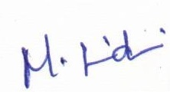
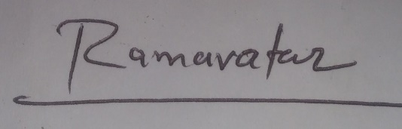
IoT based Smart Agriculture Using Learning Algorithms
Name: Ramavatar Yadav Guided By:
Roll No.: 206121027 Dr. M. Sridevi

Slide 2
INTRODUCTION
Agricultural is a field which is still plagued with inefficient monitoring and alert systems.
The crops in the field should be protected from wild.
Attack of wild animals on the farms leads to poor crop engenderment and consequential financial loss to the owners of the farm.

Slide 3
PROBLEM STATEMENT
The aim of this project is to build a model which is detecting the animals using computer vision technique to protect crops and provide a smart irrigation system which predicts the water requirement for a crop using machine learning algorithm.

Slide 4
OBJECTIVE
To develop a system which will detect animals in entered in the farm.
Using Deep learning Algorithm, the model will predict the object for every image frame received from the Live Camera.
Classify animals to harmful and non-harmful animals and take actions accordingly.
To develop a smart irrigation system which predicts the water requirement for a crop using machine learning algorithm.

Slide 5
Existing work
Currently, IR sensor and Ultrasonic sensors were used to detect the activity of animals in farms. PIR sensor and Ultrasonic will detect any kind of object but Image recognition can be used to classify the wild animals.
There is no remote monitoring of soil moisture for farmers. Thus, an application can be developed which will enable the remote monitoring of the soil moisture values and thus assist the control of the water pump.

Slide 6
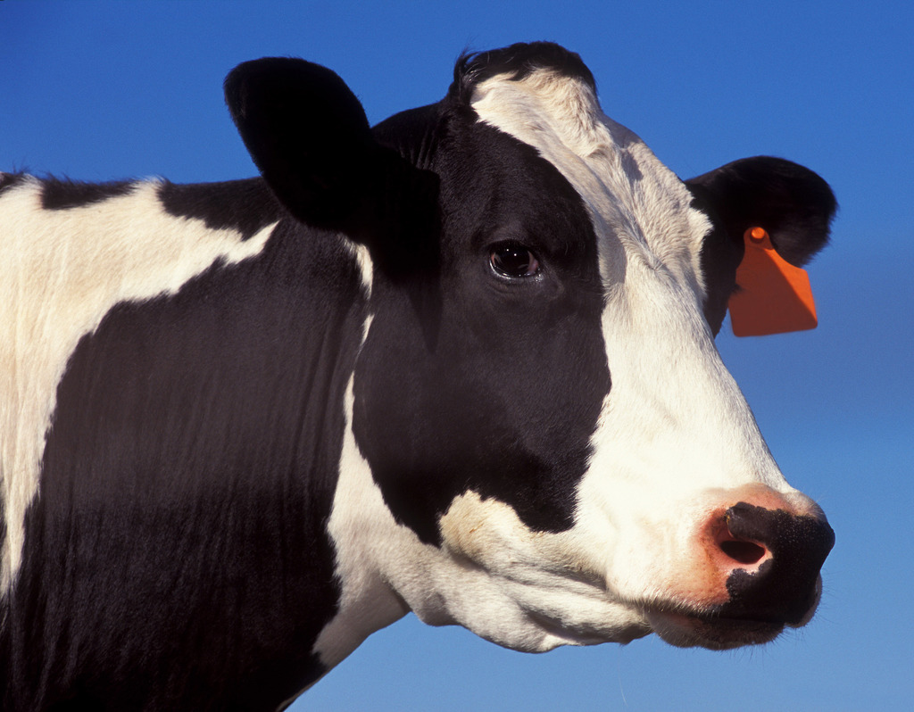
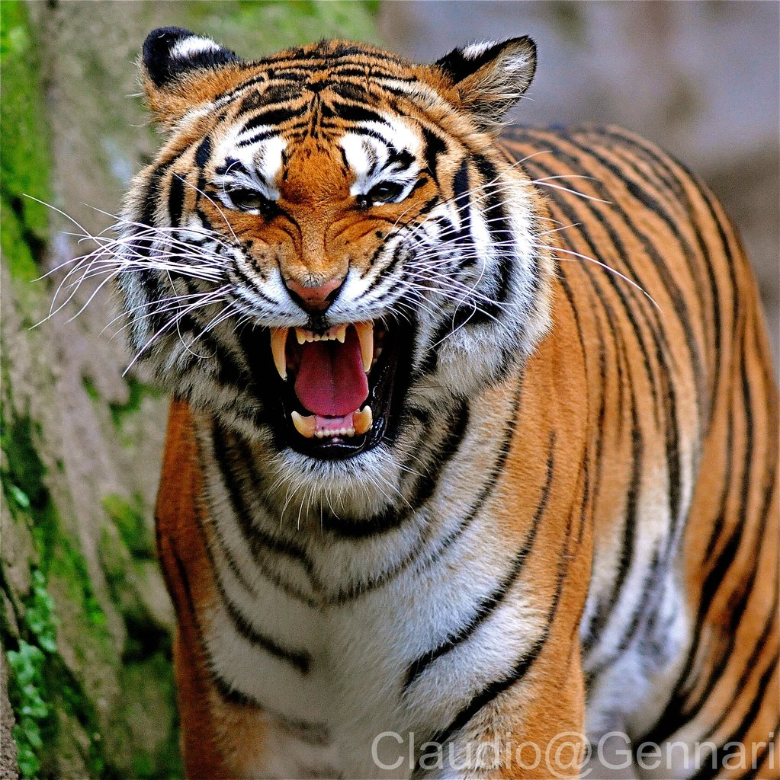
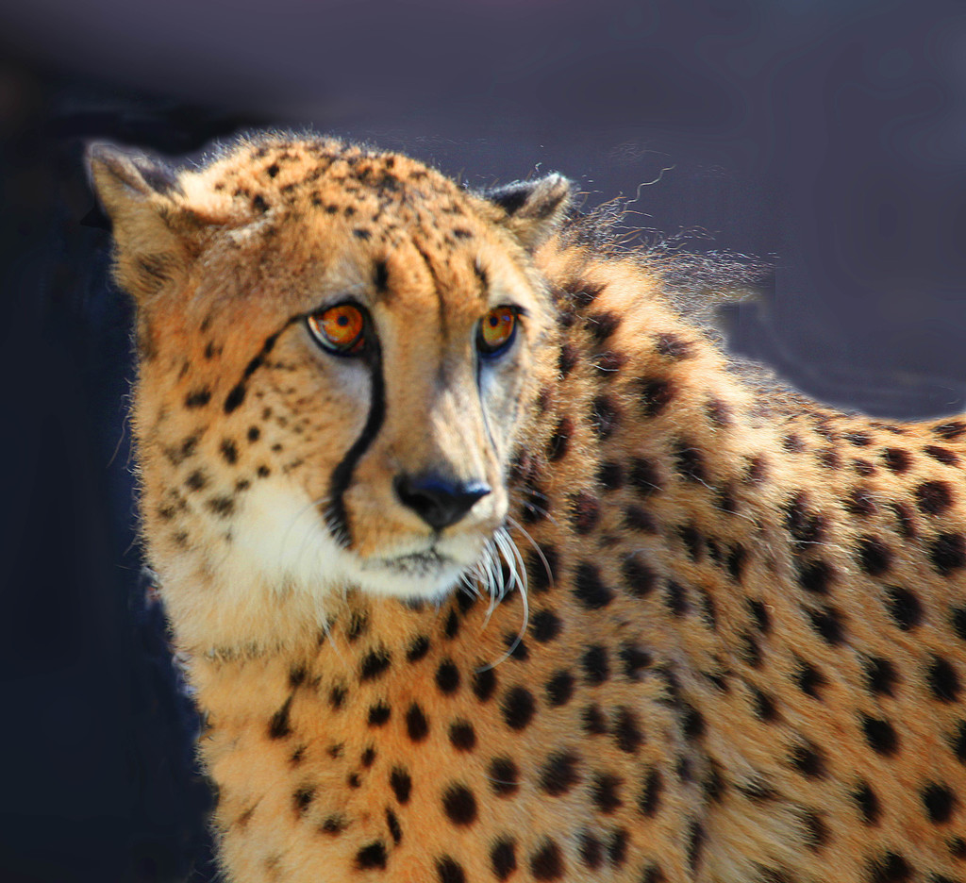
DATASET
The first dataset consists of images of wild Animals.
The dataset was collected from Kaggle.
It consists of 10 type of wild animals.
The dataset consists of around 10000 images.
The dataset is split into test and train sets.

Slide 7
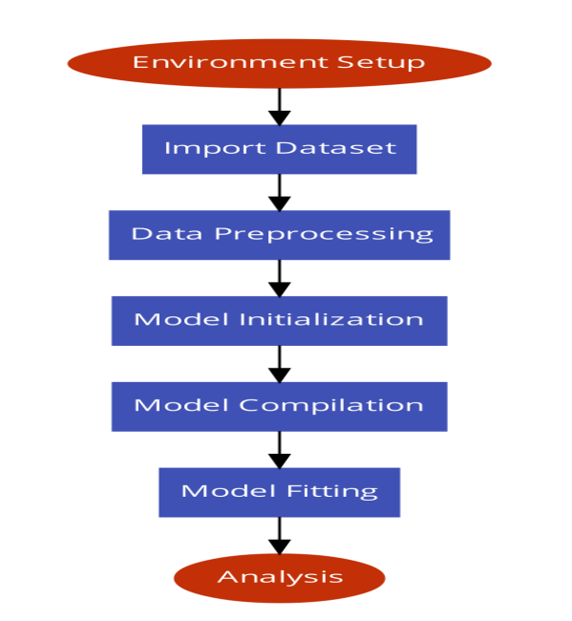
METHODOLOGY

Slide 8
OUTLINE OF THE PROJECT
The steps involved are as follows :
The first step is Dataset Selection which is getting relevant dataset for the project.
The second step is Pre-processing which means cleansing the erroneous and noisy data to convert it into usable format.
The next step is Model Initialization followed by Model Compilation and Model Training which includes using the pre-processed data to train the model for identifying the Animals.

Slide 9
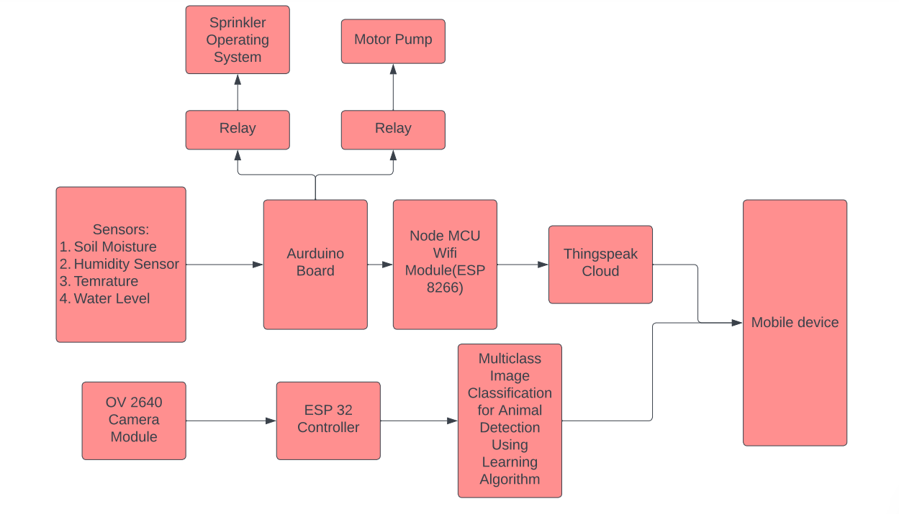
Block Diagram of proposed system :

Slide 10
MODEL
Used VGG16 model.
VGGNet-16 consists of 16 convolutional layers and is very appealing because of its very uniform Architecture.
There are a few convolution layers followed by a pooling layer that reduces the height and the width.
If we look at the number of filters that we can use, around 64 filters are available that we can double to about 128 and then to 256 filters. In the last layers, we can use 512 filters. which reduces the number of parameters and matrix multiplications. This enables much faster training of each layer. It uses a stack of three layers rather than two layers.

Slide 11
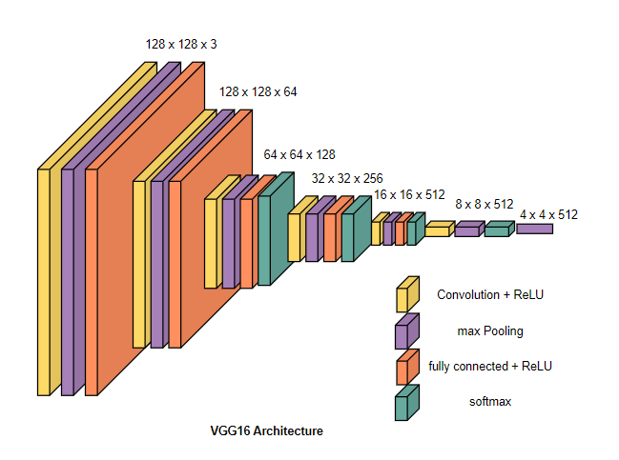

Slide 12
MODEL
The proposed model uses Random Forest classifier for the prediction of water requirement for the crop.
The proposed model uses IoT sensors like temperature, humidity and soil moisture to collect data and send it to think speak cloud. The data from cloud is then send to our machine learning model which predicts the requirement of water for crop.
Random forest model is being proven better than other traditional method for predicting water requirement for crops.

Slide 13
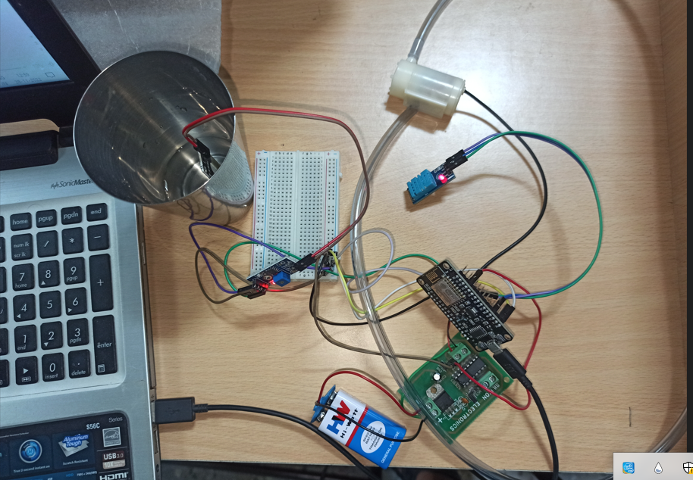
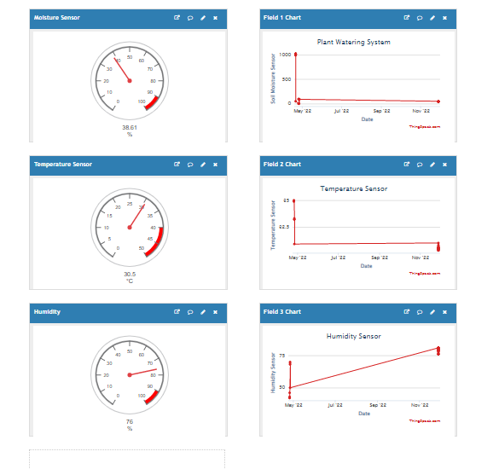
Implementation for Smart Irrigation:

Slide 14
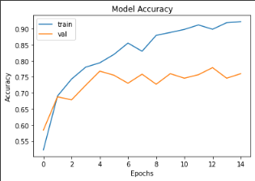
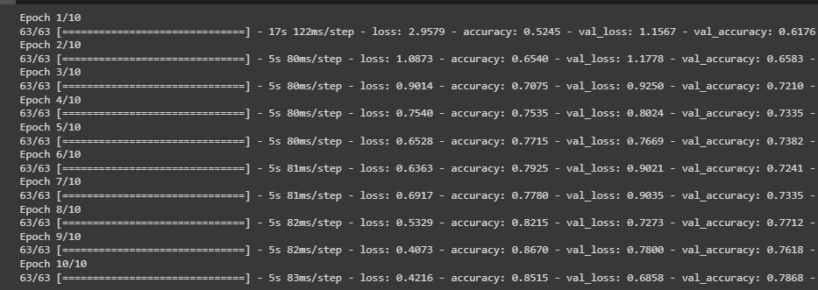
RESULTS AND ANALYSIS
1. VGG16 (Visual Geometry Group) Model
The accuracy score of VGG16 model lies between 74% to 79% and the average accuracy is 78.36%
Fig: Accuracy v/s Num of epochs Curve
Fig: VGG16 Accuracy Score

Slide 15
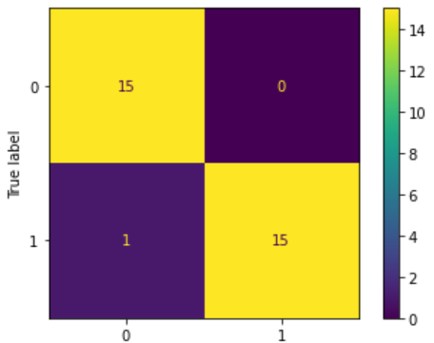
RESULTS AND ANALYSIS
2. Random Forest Classifier Model
The proposed irrigation model is able to perform better than traditional models. Using this model 90% accuracy is achieved.
indicates the true and predicted label on testing data set,15 true positive and 15 true negative, 0 false positive and 1 false negative.
The model gives
precision = 1,
recall = 0.93,
accuracy = 0.97
F1 score = 0.90
Fig: VGG16 Accuracy Score

Slide 16
FUTURE WORK
The future work is to improve the accuracy of wild Animals detection in farms.
Also, to create a model in which we can integrate both the models together.
Furthermore, an app can also be developed which gives better user experience and can enhance our model to much more larger userbase.

Slide 17
References:
[1] E. -T. Bouali, M. R. Abid, E. -M. Boufounas, T. A. Hamed and D. Benhaddou, "Renewable Energy Integration Into Cloud & IoT-Based Smart Agriculture," in IEEE Access, vol. 10, pp. 1175-1191, 2022, doi: 10.1109/ACCESS.2021.3138160.
[2] R. R. Thirrunavukkarasu, T. Meeradevi, S. Ganesh Prabhu, J. Arunachalam, P. Manoj kumar and R. Prasath, "Smart Irrigation And Crop Protection Using Arduino," 2021 7th International Conference on Advanced Computing and Communication Systems (ICACCS), 2021, pp. 639-643, doi: 10.1109/ICACCS51430.2021.9441867.
[3] Kasara Sai Pratyush Reddy , Y Mohana Roopa, Kovvada Rajeev L N , Narra Sai Nandan, ” IoT based Smart Agriculture using Machine Learning,” Proceedings of the Second International Conference on Inventive Research in Computing Applications (ICIRCA-2020) IEEE Xplore.
[4] P. Deotale and P. Lokulwar, "Smart Crop Protection System from Wild Animals Using IoT," 2021 International Conference on Computational Intelligence and Computing Applications (ICCICA), 2021, pp. 1-4, doi: 10.1109/ICCICA52458.2021.9697315.

Slide 18
Thank you!

