Slide 1
ADFORGE AI
HACKATHON PITCH
AdForge AI
Turn product ideas into platform-ready ads.
AI ADVERTISING CREATIVE STUDIO
R. RAMYASREE · J. NEHA · P. CHARISHMA · Y. KOWSHIK
Notes:
AdForge AI is an AI Advertising Creative Studio built to make the path from product idea to advertisement faster.

Slide 2
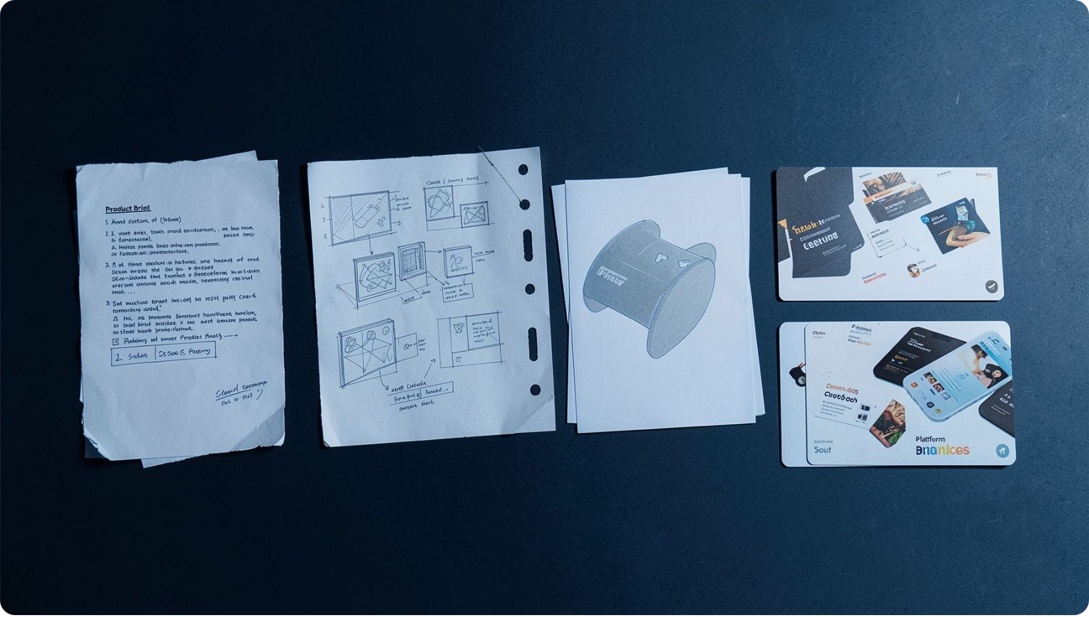
01 · THE PROBLEM
ADFORGE AI
Creating effective ads is still too slow and expensive
Small businesses, startups, e-commerce sellers, marketing teams, and individual creators face repetitive creative work.
Copy, creative design, platform formats, revisions, and brand consistency slow the path from idea to campaign.
Product idea → Copywriter → Designer → Revisions → Platform formatting → Final advertisement
Notes:
The problem is not a lack of ideas. It is the repetitive creative work between the idea and the final advertisement.

Slide 3
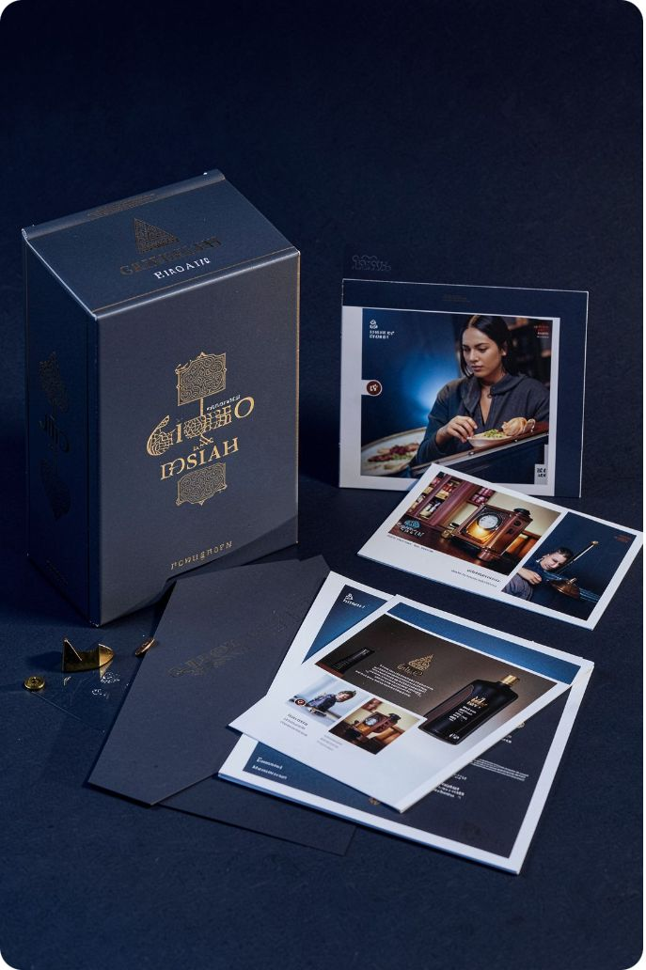

02 · THE SOLUTION
ADFORGE AI
Meet AdForge AI
INPUT
Product + audience + platform + objective + tone
ENGINE
AdForge AI creative workflow
Turn a product brief into advertising copy and platform-ready creative variations.
Headlines
Visual creative
Ad copy · CTAs · hashtags
Platform-specific variations
Notes:
AdForge AI turns a product brief into copy, creative concepts, and platform-specific advertising outputs.

Slide 4
03 · TARGET USERS
ADFORGE AI
Target Users & Use Cases
TARGET USERS
USE CASES
Small businesses and startups
E-commerce sellers
Digital marketers
Social media creators
Marketing teams
Launching a new product
Promotional and discount ads
Social media advertisements
Generating multiple ad variations
Adapting content for different advertising platforms
Notes:
AdForge AI supports the people who need to move from a product brief to campaign-ready advertising: small businesses, sellers, marketers, creators, and marketing teams.

Slide 5
04 · THE EXPERIENCE
CREATE IN FIVE MOVES
From product idea to advertisement
01
02
03
Enter
Select
Generate
Product details: name, description, target audience.
Campaign: platform, objective, tone.
Headlines, ad copy, CTAs, hashtags, and creative concepts.
04
05
Preview
Save & publish
Review platform-specific ad variations.
Download and reuse generated creatives.
Notes:
The experience is intentionally simple: enter the brief, select the campaign, generate, preview, then save and publish.

Slide 6





05 · THE PRODUCT
ADFORGE AI
AdForge AI tools for faster ad creation
Ad creative generation
Multi-platform support
Creative library
Headlines, copy, CTAs, hashtags, and creative variations.
Instagram, Facebook, Google Ads, LinkedIn.
Product image upload and reusable creatives.
Templates
Usage views
Fast starts for new campaigns.
Creative generation and platform usage views.
Notes:
AdForge combines generation, platform support, reusable assets, templates, and analytics in one creative workspace.

Slide 7
06 · CREATIVE INTELLIGENCE
AI PIPELINE
AdForge AI creative pipeline
AdForge AI turns each campaign brief into structured outputs the frontend can render consistently across platforms.
USER INPUT
ADFORGE GENERATION
IMPLEMENTATION
Product information
Audience
Platform
Objective · tone · product image
Content and headline
Ad copy and CTA
Hashtag generation
Visual prompt generation
AI API integration
Structured JSON responses
Fallback mechanism
Platform-specific adaptation
Notes:
The intelligence layer separates user input, generation, and implementation so the frontend receives a consistent structured response for each campaign brief.

Slide 8
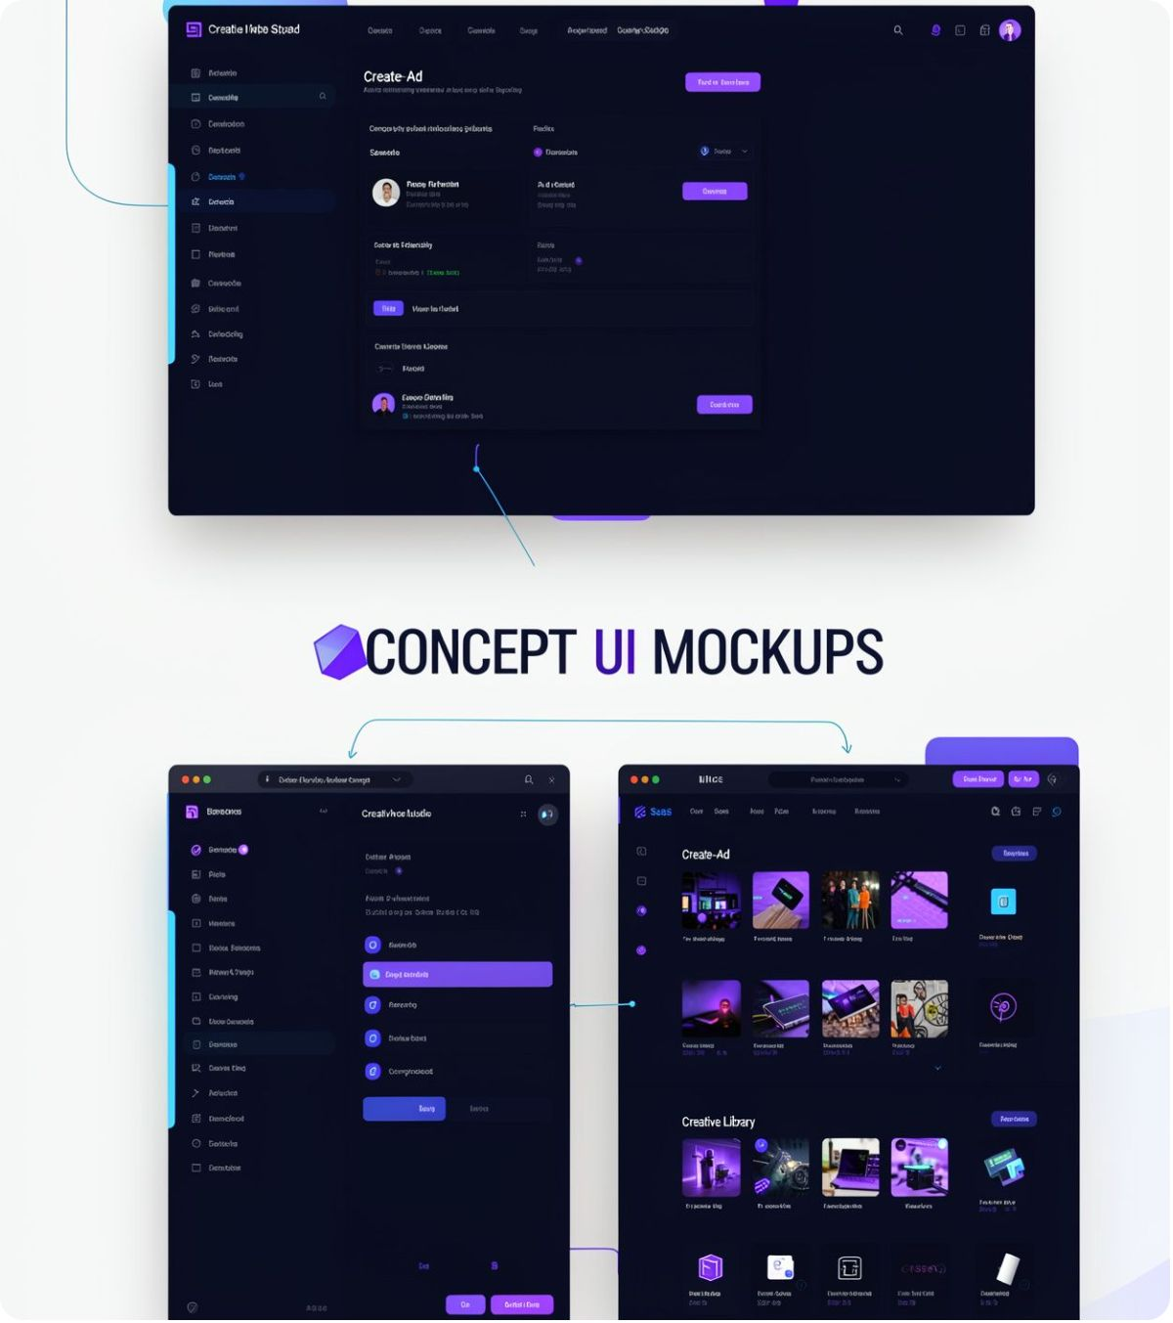
07 · FOUNDATION
FULL-STACK SAAS
The full-stack foundation behind AdForge AI
CONCEPT ARCHITECTURE
User → React + Vite frontend → REST API layer → FastAPI + Python backend
BACKEND BRANCHES
AI service
PostgreSQL
For generation
For persistent user data
AdForge AI sends generated creative data to the ad creative library; PostgreSQL persists product and creative assets.
SEPARATION OF FRONTEND, BACKEND, AI SERVICES, AND PERSISTENT DATA KEEPS THE SAAS ARCHITECTURE CLEAR.
Notes:
The architecture keeps the product legible: React + Vite at the frontend, a REST API layer, FastAPI + Python at the backend, AI service for generation, PostgreSQL for persistent user data, and a creative library for outputs.

Slide 9
08 · PRODUCT EXPERIENCE
CONCEPT UI MOCKUPS
AdForge AI product experience
Dashboard
Create Ad
Campaign creation and usage overview.
Product, audience, platform, objective, and tone inputs.
OVERVIEW · USAGE · RECENT CREATIVES
BRIEF → GENERATE
Creative preview
My Creatives
AdForge AI creative with platform variations.
Library, templates, and analytics views.
INSTAGRAM · FACEBOOK · GOOGLE ADS · LINKEDIN
RESPONSIVE REACT INTERFACE · POSTGRESQL-BACKED PERSISTENCE
PRODUCT CONCEPT MOCKUPS FOR THE ADFORGE AI WORKFLOW, NOT APPLICATION SCREENSHOTS.
Notes:
These are clearly labeled product concept mockups: the dashboard, Create Ad flow, AI-generated preview, and My Creatives library with templates and analytics.

Slide 10
09 · THE HORIZON
ADFORGE AI
THE TAKEAWAY
NEXT HORIZON
From product brief to platform-ready campaign faster
Brand kits, brand voice learning, A/B testing, performance optimization
Social publishing, AI-generated images and videos, multilingual advertising
Campaign analytics, team collaboration, subscription-based SaaS plans
Reduce time required to create ad campaigns.
Help smaller teams create professional advertisements.
Generate ad variations and adapt content across platforms.
Reduce repetitive creative work.
ADFORGE AI · CREATE. GENERATE. ADAPT. · THANK YOU.
Notes:
AdForge AI reduces repetitive creative work, helps smaller teams create professional advertisements, and adapts content across platforms. The next horizon expands brand intelligence, testing, publishing, multilingual advertising, analytics, collaboration, and SaaS plans.

