Slide 1
TRGN 515: Advanced Human Genomic Analysis Methods
Lecture 1 – Week 1:
Administrivia & Expectations & Basics
Bilgenur Baloglu, Ph.D.
Clinical Instructor of Translation Genomics,
USC Keck School of Medicine
Bioinformatics scientist III, Thermo Fisher Scientific
Email: baloglu@usc.edu

Slide 2
Outline for lecture 1
Get to know your instructor
Course things
Homework
Course etiquette
Course outline
Things you should know and you will need
Bioinformatics? Machine learning? Python?
Q&A
Jump into Python crash course

Slide 3









My academic path
BSc in Molecular Biology and Genetics at Istanbul Technical University, Turkey
Exchange year at Munich Technical University, Germany
PhD in biological sciences at the National University of Singapore, Singapore
Postdoc at the Centre for Biodiversity Genomics, University of Guelph, Canada

Slide 4




My industry career
Won the All-Genetics award for industrial applications using DNA barcoding and DNA metabarcoding for environmental DNA study category
Managed to get to the top 5% in the application process of 'Sci-Founder Fellowship' among 371 applicants for start up idea (then got rejected)
Got accepted into Braid Theory’s Celsius: Ocean Synthetic Biology Pre-Accelerator (currently debating)
Bioinformatics lead, Sequential Skin (Feb – August 2021)
Developed bioinformatics pipelines to process MiSeq and ONT 16S data. Products: Python based primer designing algorithm, bash & R based MiSeq ecological analysis tool
Bioinformatics scientist III, Thermo Fisher Scientific (August 2021 – )

Slide 5

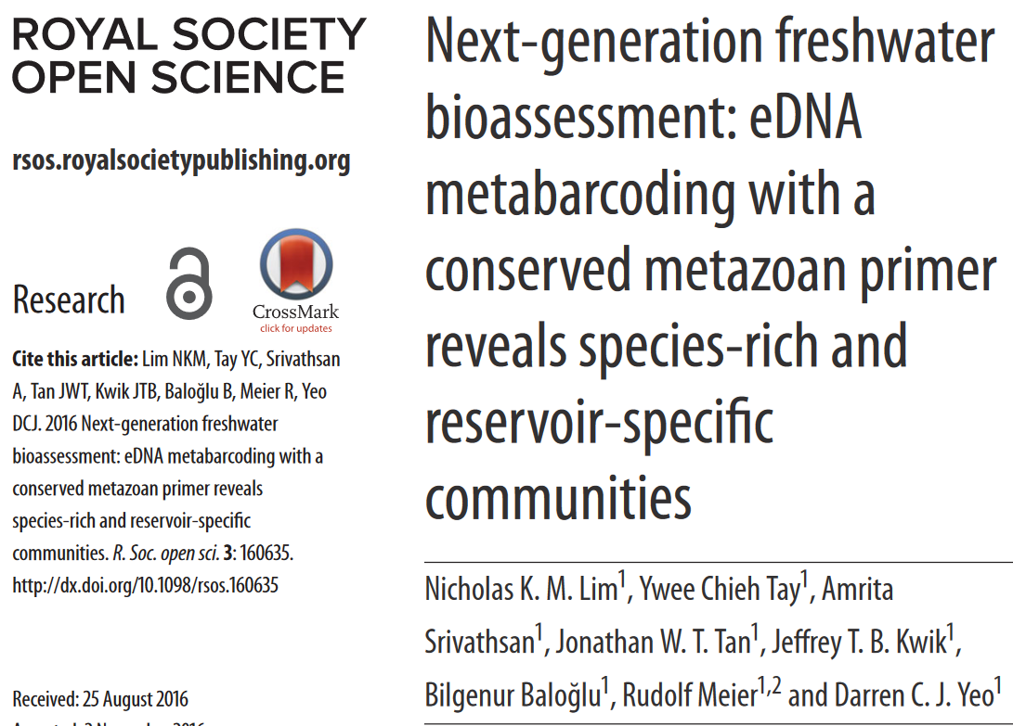
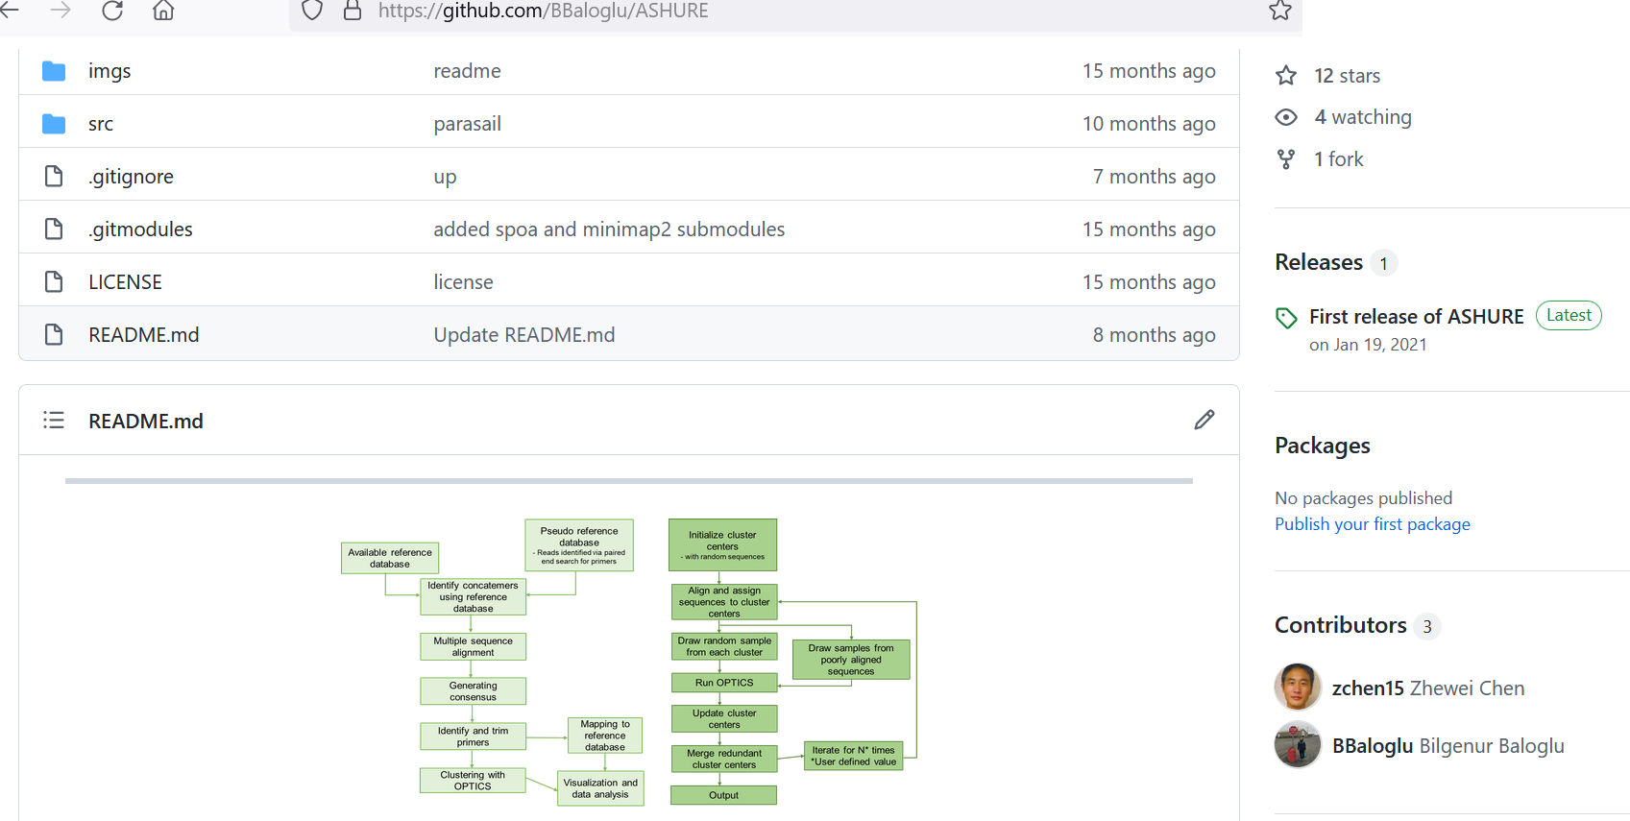
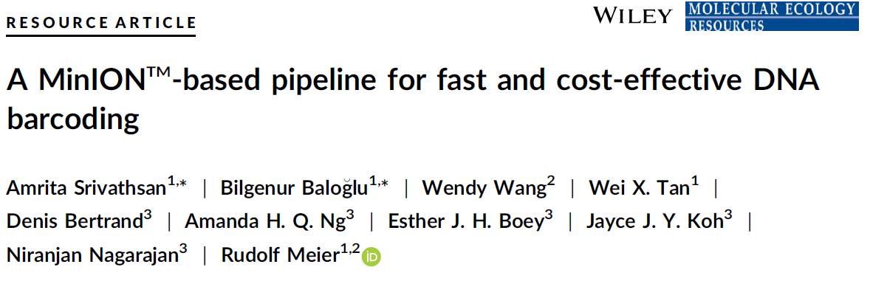
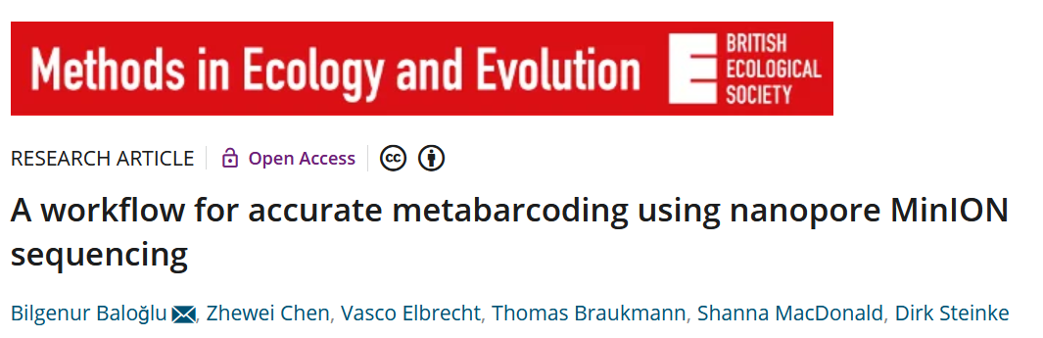
My path from academia to industry

Slide 6
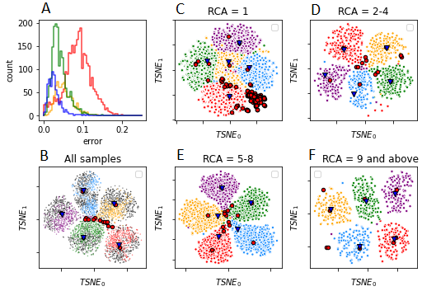
My path from academia to industry
Algorithms
[1] Baloglu, B., Chen, Z. Python-based bioinformatics algorithm for analyzing metabarcoding data obtained with Nanopore sequencing. Github site
[2] Srivathsan, A.*, Baloglu, B.*, Wang, W., Tan, W.X., Bertrand, D., Ng, A.H.Q., Boey, E.J.H., Koh, J.J.Y., Nagarajan, N. and Meier, R. Python-based bioinformatics algorithm for analyzing DNA barcoding data obtained with Nanopore sequencing. Github site

Slide 8
Course info
Lecture (Tue/Thu)
5-7 pm
6 Homeworks, ~20% of final grade
Due on Sunday night (11:59 pm) via Blackboard
Homework 1 is released as of this lecture!
Check /scratch/trgn515/Homework
Due this Sunday
1 Midterm exam, at week 9, 20% of final grade
1 Final project, due week 14, 30% of final grade
Final exam, week 15, 10% of final grade
Plan accordingly w/ trgn515!

Slide 9
Regarding homeworks
If you have prior experience with Python
Should be pretty straightforward (2-3 hours)
If you do not…
Might take a while (3-4 hours?)
But don’t worry, you will catch up as long as you follow the notebooks and run them on your own time

Slide 10
Late submission policy
Up to 24 free late hours
Specify # of late hours used when submitting

Slide 11
Course etiquette
Feel free to ask questions during lecture
Adhere to the academic integrity
Do not copy each other’s solutions

Slide 12
Course website
Link here (but you should create your own repositories and add me as a collaborator):
https://github.com/BBaloglu/TRGN515_USC
Link to my personal website
https://bbaloglu.github.io/
Up-to-date office hours, zoom links, additional reading, etc.:
Check Blackboard

Slide 13
Course outline
Python crash course and Python libraries for data visualization
3 weeks
Introduction to Bioinformatics with Biopython library
2 weeks
Introduction to machine learning
3 weeks
Building machine learning models
4-5 weeks
Final project: Throughout the course with presentation in week 14

Slide 14
What should you know
Pandas, numpy, Scikit
Python
Basic statistics
Basic knowledge of biology and DNA sequencing
Basic competency with UNIX/Linux (can use a terminal)
Familiarity with some ML terminology
Don’t worry. You will get there!

Slide 15
What do you need
Python 3.7
Jupyter notebooks
If you want to access Jupyter on your own PC, then you will also need Anaconda3 installation (version 4.5.12)
GitHub account: This is where you will upload your homeworks and projects, where you will add me as a collaborator in order to share them with me
CRITICAL THINKING!

Slide 16
How you will operate
Make your own directories and subdirectories on the TRGN server in /scratch directory
Copy the lecture and homework notebooks in your own directory
Work on homework in your own directory (not in the shared directory)
Copy or transfer the final homework in your Github repository (ideally keep the same directory system), which should notify me if I am added as a collaborator

Slide 18
What is bioinformatics?
Dealing with biological challenges using computer science tools?
Biggest part of bioinformatics: Dealing with DNA sequencing data
DNA sequencing is the process of reading biological material and translating it into a computer readable data representation.
The sequencing process is complex and introduces many challenges such as gaps between reads, lack of coverage and various other sequencing errors

Slide 19
What is machine learning?
“Machine learning is fitting a function to examples and using that function to generalize and make predictions about new examples.”
Derek Jedamski, GitHub

Slide 20
What is machine learning?
Make a machine (computer) learn a model (hypothesis) with enough data of a given type, so it becomes able to identify one or more patterns within it.
Identified (learned) patterns can then be used for making estimates (predictions) on unseen data of similar type as the data which was used to learn the pattern.
The amount of required data may vary based on the difficulty of the pattern to learn.
The learning process is often referred to as training, while the process of making decisions is called classification

Slide 21
Why use Python for Machine learning
Popular and has large user base, various resources like stack overflow
Python has more machine learning packages than other languages
Easy to learn, easy to use

Slide 22
Should we even use machine learning?
Is this a type of problem that can be solved using machine learning?
Does this problem require a prediction or some type of bucketing into categories?
Do you have all the components needed to build a model?
Do I have data with labels?
Do I have the ability to assess the quality of the model?
Do I know what an acceptable accuracy threshold looks like?
Notes:
Generally speaking, if there's no prediction or segmentation to be made, then machine learning is not needed.
If there are too many additional or outside factors, there'll be too much noise for a model to actually make an accurate prediction about whatever you're interested in. For instance, if you're determining whether a given transaction is fraudulent, that's a very hard problem, but it's relatively self-contained. You can extract when you need to make a prediction from the transaction itself and the past transaction of that card owner. However, if you're determining whether a credit company is going to succeed or fail, that's something that's a little too difficult for a model to determine because there are too many additional factors both internal and external.
You need to teach the model what certain behavior looks like. If you don't have labels for your examples, the model can't learn from that past data.
So if you are applying this at work, there's usually some cost to deploying a model. You should be able to tie the model performance to the cost or savings of some sort. So in other words, do I understand the business impact of this model? What is the breakeven point? What would even be considered a success?

Slide 23
Common challenges with machine learning
Problem scoping
Dealing with the wrong problem
Tolerance threshold (i.e., accuracy %) not determined
Data
Lack of data
Too much data
Lack of labels in the data
Data is noisy, dirty etc.
Infrastructure
Lack skills to automate
Not enough compute power
Inability to test quality of the model
Latency
Model takes too long to train
Model takes too long at inference time

Slide 24
Exploratory data analysis
Why?
Understand the shape of the data
Learn which features of might be useful
Inform the cleaning that will come next
What?
Counts or distribution of all variables
Data types of each feature
Missing data
Correlations
Duplicates

Slide 25
Data cleaning
Why?
No data out there are served clean
Shape data so model can pick the best signal
Remove irrelevant data
Adjust features to be acceptable for a model
What?
Encode categorical variables
Fill missing data
Scale data to account for outliers

