Slide 1
SIRS VS SEPSIS
Ram Ayyala

Slide 2
Introduction: Terms
Sepsis is a not a disease, like many think, but rather is the body’s response to an infection, just in a very extreme manner 1. - There is no singular cause for sepsis, as it is brought on by many heterogeneous pathophysiologies, but it is generally brought on due to an infection 1. - Occurs when the human body’s immune system stops fighting the infection and starts to turn on itself 4. - Levels of Sepsis: - Uncomplicated Sepsis is the early stages of sepsis in which patients typically suffer from chills, elevated heart rate, and elevated breathing rate 8. - Severe Sepsis occurs when there is organ damage due to the inflammatory response 7. - Septic Shock occurs when there is a drastic drop in blood pressure (< 65mm Hg) causing high levels of lactic acid in the blood 6.
Systemic Inflammatory Response Syndrome (SIRS) is an exaggerated defense mechanism similar to sepsis. - Symptoms include low blood pressure, abnormal body temperature, or abnormal white blood cell count 2. - Like Sepsis, there is no singular cause for SIRS. - Unlike sepsis, SIRS is caused by a variety of stressors like infections, surgeries, inflammation, etc 2. .

Slide 3
Introduction: A Priori hypothesis
Hypothesis: The Severe Sepsis samples will be more highly associated with the upregulated platelet aggregation genes than the SIRS samples.

Slide 4
Introduction: Sequencing and Data
Data was acquired via sequencing of peripheral blood RNA from whole blood cells of 129 subjects using an Illumina Genome Analyzer 9.
SIRS: n=23 patients 9.
Sepsis: n=106 patients, of which 78 survived 9.
Used 16 samples of the 129 subjects, 4 from each of the following groups:
SIRS
Severe Sepsis
Septic Shock
Uncomplicated Sepsis
Reads were single ended and not run in multiple lanes nor provided as multiple SRR files

Slide 5
Pre-Alignment Sequencing Metrics:
Subjects were chosen such that they had similar number of reads and belonged to one of the 4 groups.
Preliminary Reads of each sample
Preliminary Reads Descriptive Stats
Names | Reads
Sept_Shock_1 | 29,751,934
Sept_Shock_2 | 18,921,649
Sept_Shock_3 | 20,051,251
Sept_Shock_4 | 19,330,185
Sev_Sepsis_1 | 16,810,341
Sev_Sepsis_2 | 27,113,546
Sev_Sepsis_3 | 18,531,357
Sev_Sepsis_4 | 16,445,943
SIRS_1 | 18,221,614
SIRS_2 | 17,953,067
SIRS_3 | 19,127,377
SIRS_4 | 17,705,087
US_1 | 18,092,887
US_2 | 17,157,220
US_3 | 26,705,705
US_4 | 17,671,305
N | Mean | Median | SD | Min | Max
16 | 19,974,404 | 18,376,486 | 4,064,128 | 16,445,943 | 29,751,934

Slide 6
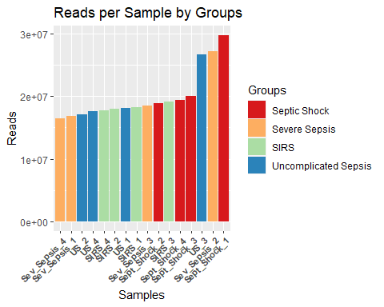

Slide 7
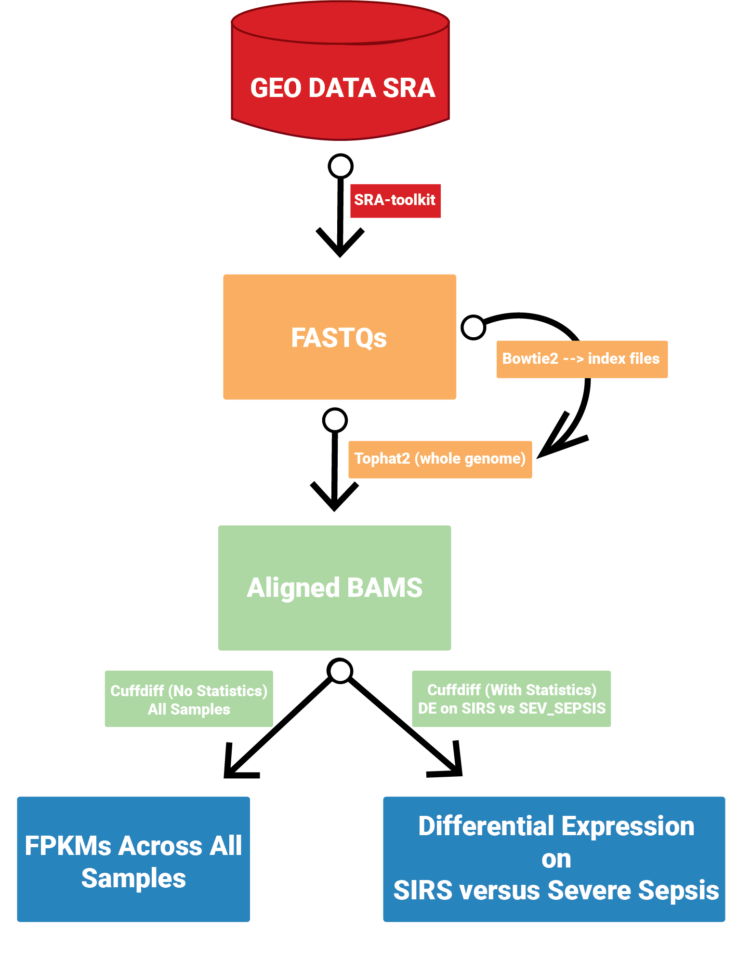
Tophat2 - alignment / counting / stats process description:
TopHat2 Workflow

Slide 8
Tophat2 - alignment metrics and statistics:
Aligned Reads Descriptive Stats
Percent Aligned Descriptive Stats
N | Mean | Median | SD | Min | Max
16 | 13,674,150 | 14,659,450 | 2,521,255 | 6,851,868 | 16,643,179
N | Mean | Median | SD | Min | Max
16 | 71.47079 | 77.80522 | 18.28645 | 23.02999 | 89.8109

Slide 9
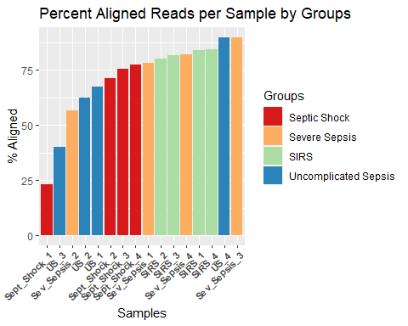

Slide 10
Results:FPKMs Across all Samples
## Warning: Removed 24 rows containing non-finite values (stat_boxplot).

Slide 11
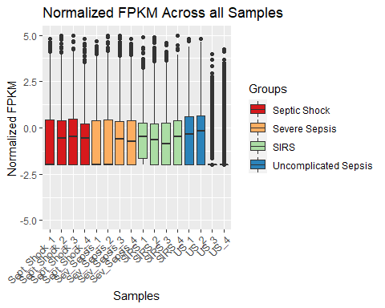

Slide 12
## Results:PCA of FPKMs Across all Samples

Slide 13
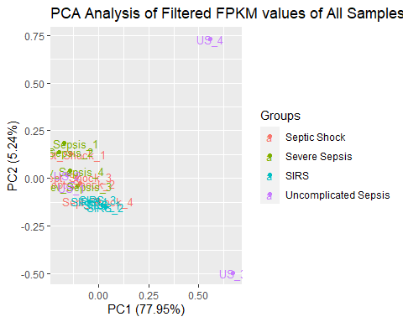
Results: PCA Analysis of Filtered FPKM values of All Samples

Slide 14
## Results: Dendrogram of Filtered FPKM values of All Samples

Slide 15
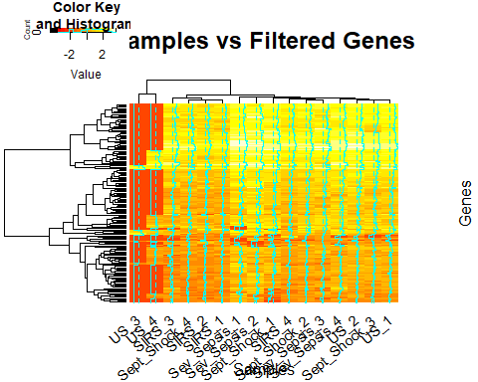
Results: Heatmap of Filtered FPKM values of All Samples VS Filtered Genes

Slide 16
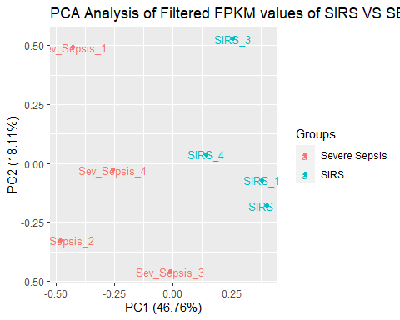
Results: PCA Analysis of Filtered FPKM values of SIRS vs Sepsis

Slide 17
## Results: Dendrogram of Filtered FPKM values of Severe Sepsis vs SIRS ## Results: Heatmap of Filtered FPKM values of SIRS & Severe Sepsis Samples VS Filtered Genes

Slide 18
Pathway Analysis:Upregulated Genes
IPA Upregulated Pathway
Category | Diseases.or.Functions.Annotation | p.value | Molecules | X..Molecules
Cell-To-Cell Signaling and Interaction,Hematological System Development and Function,Inflammatory Response | Aggregation of blood platelets | 0.000313 | ABCC4,DMTN,GNAS,METAP1,P2RX1,PTGER2,STXBP2,UNC13D | 8

Slide 19
Pathway Analysis:Upregulated Platelet Aggregation Genes PCA
## Warning in type.convert.default(X[[i]], ...): 'as.is' should be specified by the ## caller; using TRUE ## Warning in type.convert.default(X[[i]], ...): 'as.is' should be specified by the ## caller; using TRUE ## Warning in type.convert.default(X[[i]], ...): 'as.is' should be specified by the ## caller; using TRUE ## Warning in type.convert.default(X[[i]], ...): 'as.is' should be specified by the ## caller; using TRUE ## Warning in type.convert.default(X[[i]], ...): 'as.is' should be specified by the ## caller; using TRUE ## Warning in type.convert.default(X[[i]], ...): 'as.is' should be specified by the ## caller; using TRUE ## Warning in type.convert.default(X[[i]], ...): 'as.is' should be specified by the ## caller; using TRUE ## Warning in type.convert.default(X[[i]], ...): 'as.is' should be specified by the ## caller; using TRUE

Slide 20
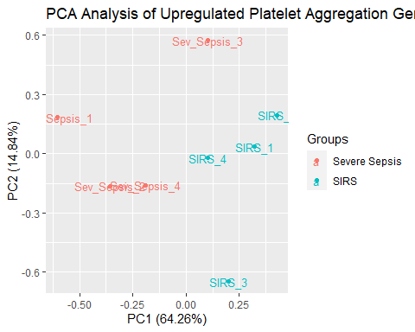

Slide 21
## Pathway Analysis:Upregulated Platelet Aggregation Genes Heatmap ## Pathway Analysis: Findings From the IPA Pathway analysis, we see that there is an upregulation in genes associated with platelet aggregation in patients with severe sepsis. - When a patient is infected, the body will activate its defense mechanisms which can be boiled down to two main mechanisms: - inflammatory response10 - coagulation activation10 - In short, the constant activation of the immune system leads to in an increase in platelet aggregation as that is the natural response - However, it must be noted, that late stage sepsis, such as severe sepsis or septic shock, but mainly septic shock are generally associated with thrombocytopenia or low-platelet-count, but there is previous evidence supporting that there is an increase in thrombocytosis in the earlier stages of sepsis 12.

Slide 22
Pathway Analysis:Downregulated Genes
IPA Downregulated Pathway
Category | Diseases.or.Functions.Annotation | p.value | # Molecules | X..Molecules
Cell Death and Survival,Hematological System Development and Function | Cell viability of B lymphocytes | 0.0281 | FCRL3 | 1
Cell-To-Cell Signaling and Interaction,Hematological System Development and Function,Humoral Immune Response,Immune Cell Trafficking,Inflammatory Response | Activation of B lymphocytes | 0.0388 | FCRL3 | 1

Slide 23
Pathway Analysis: Findings
From the IPA Pathway analysis, we see that there is an downregulation in genes associated with cell viability and activation of B lymphocytes, which can cause lymphopenia. - When a patient has sepsis, it is believed that there is a type of immune suppression that occurs behind the scenes leading to increased morbidity and mortality rates 12. - One key immunosuppression, is the apoptosis of certain immune cells like B-lymphocytes 12. - Septic patients have been found to have a higher rate of lymphopenia which is associated with a higher prevalance for septic shocks and higher mortality rates 12.

Slide 24
Conclusion & Future Studies
Overall, it is plausible to say that there is a difference in the genes expressed between Severe Sepsis and SIRS, despite Sepsis essentially being a derivative of SIRS. Moreover, we see that there is a significant upregulation of genes associated with platelet aggregation in the Severe Sepsis samples in comparison to the SIRS samples. Furthermore, it is not unreasonable to state that their is probably a significant downregulation of genes associated with cell vaibility and activation of B lymphocytes given the evidence presented in previous literature.
In the future:
It is necessary to make sure that all of the samples have a high read alignment percentage as in this study, 2 of the uncomplicated sepsis samples have abysmal levels of alignment percentage, making their contribution to the study practically useless.
Investigate the effects of sepsis on thrombocytopenia and thrombocytosis as it seems to have a significant effect on both diseases.
Investigate more into sepsis’s effects on lymphopenia as it wasn’t feasible to investigate the significance of the downregulation of the FCLR3 gene given that there were barely any downregulated genes to begin with in the IPA analysis.

Slide 25
References:
https://pubmed.ncbi.nlm.nih.gov/25538794/ 2.https://www.cancer.gov/publications/dictionaries/cancer-terms/def/sirs
https://www.ncbi.nlm.nih.gov/books/NBK547669/
https://www.cdc.gov/sepsis/what-is-sepsis.html
https://www.sepsis.org/sepsis-basics/what-is-sepsis/
https://www.mayoclinic.org/diseases-conditions/sepsis/symptoms-causes/syc-20351214
https://www.sepsis.org/sepsis-basics/what-is-sepsis/severe-sepsis/#:~:text=Severe%20sepsis%20occurs%20when%20one,or%20organs%20that%20are%20affected.
https://www.nhsinform.scot/illnesses-and-conditions/blood-and-lymph/septic-shock
https://www.ncbi.nlm.nih.gov/geo/query/acc.cgi?acc=GSE63042
https://www.ncbi.nlm.nih.gov/pmc/articles/PMC6679237/
https://www.ncbi.nlm.nih.gov/pmc/articles/PMC6377227/
https://journals.lww.com/ccmjournal/Abstract/2013/12001/1047___Thrombocytosis_versus_Thrombocytopenia_as.1001.aspx

