Slide 1
RNA SEQ Analysis of Systemic Inflammatory Response Syndrome versus Severe Sepsis
Ram Ayyala

Slide 2
Introduction: Terms
Sepsis is a not a disease, like many think, but rather is the body’s response to an infection, just in a very extreme manner¹.
There is no singular cause for sepsis, as it is brought on by many heterogeneous pathophysiologies, but it is generally brought on due to an infection¹.
Occurs when the human body’s immune system stops fighting the infection and starts to turn on itself ⁴.
Levels of Sepsis:
Uncomplicated Sepsis is the early stages of sepsis in which patients typically suffer from chills, elevated heart rate, and elevated breathing rate⁸.
Severe Sepsis occurs when there is organ damage due to the inflammatory response⁷.
Septic Shock occurs when there is a drastic drop in blood pressure (< 65mm Hg) causing high levels of lactic acid in the blood⁶.
Systemic Inflammatory Response Syndrome (SIRS) is an exaggerated defense mechanism similar to sepsis.
Symptoms include low blood pressure, abnormal body temperature, or abnormal white blood cell count².
Like Sepsis, there is no singular cause for SIRS.
Unlike sepsis, SIRS is caused by a variety of stressors like infections, surgeries, inflammation, etc.²

Slide 3
Introduction: A Priori hypothesis
Hypothesis: The Severe Sepsis samples will be more highly associated with the upregulated platelet aggregation genes than the SIRS samples.

Slide 4
Introduction: Sequencing and Data
Data was acquired via sequencing of peripheral blood RNA from whole blood cells of 132 subjects using an Illumina Genome Analyzer⁹.
SIRS: n=26 patients⁹.
Sepsis: n=106 patients, of which 78 survived⁹.
Used 16 samples of the 132 subjects, 4 from each of the following groups:
SIRS
Severe Sepsis
Septic Shock
Uncomplicated Sepsis
Single or Paired End?
Multiple Lanes/Multiple SRR files?
Reads were single ended and not run in multiple lanes nor provided as multiple SRR files

Slide 5
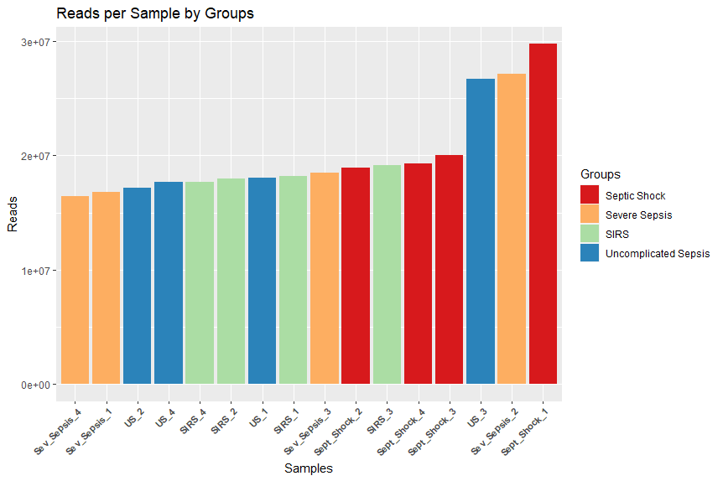
Pre-Alignment Sequencing Metrics:
Subjects were chosen such that they had similar number of reads and belonged to one of the 4 groups.
Preliminary Reads of Each Sample
Preliminary Reads Descriptive Stats
Samples | Reads
Sept_Shock_1 | 29,751,934
Sept_Shock_2 | 18,921,649
Sept_Shock_3 | 20,051,251
Sept_Shock_4 | 19,330,185
Sev_Sepsis_1 | 16,810,341
Sev_Sepsis_2 | 27,113,546
Sev_Sepsis_3 | 18,531,357
Sev_Sepsis_4 | 16,445,943
SIRS_1 | 18,221,614
SIRS_2 | 17,953,067
SIRS_3 | 19,127,377
SIRS_4 | 17,705,087
US_1 | 18,092,887
US_2 | 17,157,220
US_3 | 26,705,705
US_4 | 17,671,305
N | Mean | Median | SD | Min | Max
16 | 19,974,404 | 18,376,486 | 4,064,128 | 16,445,943 | 29,751,934

Slide 6
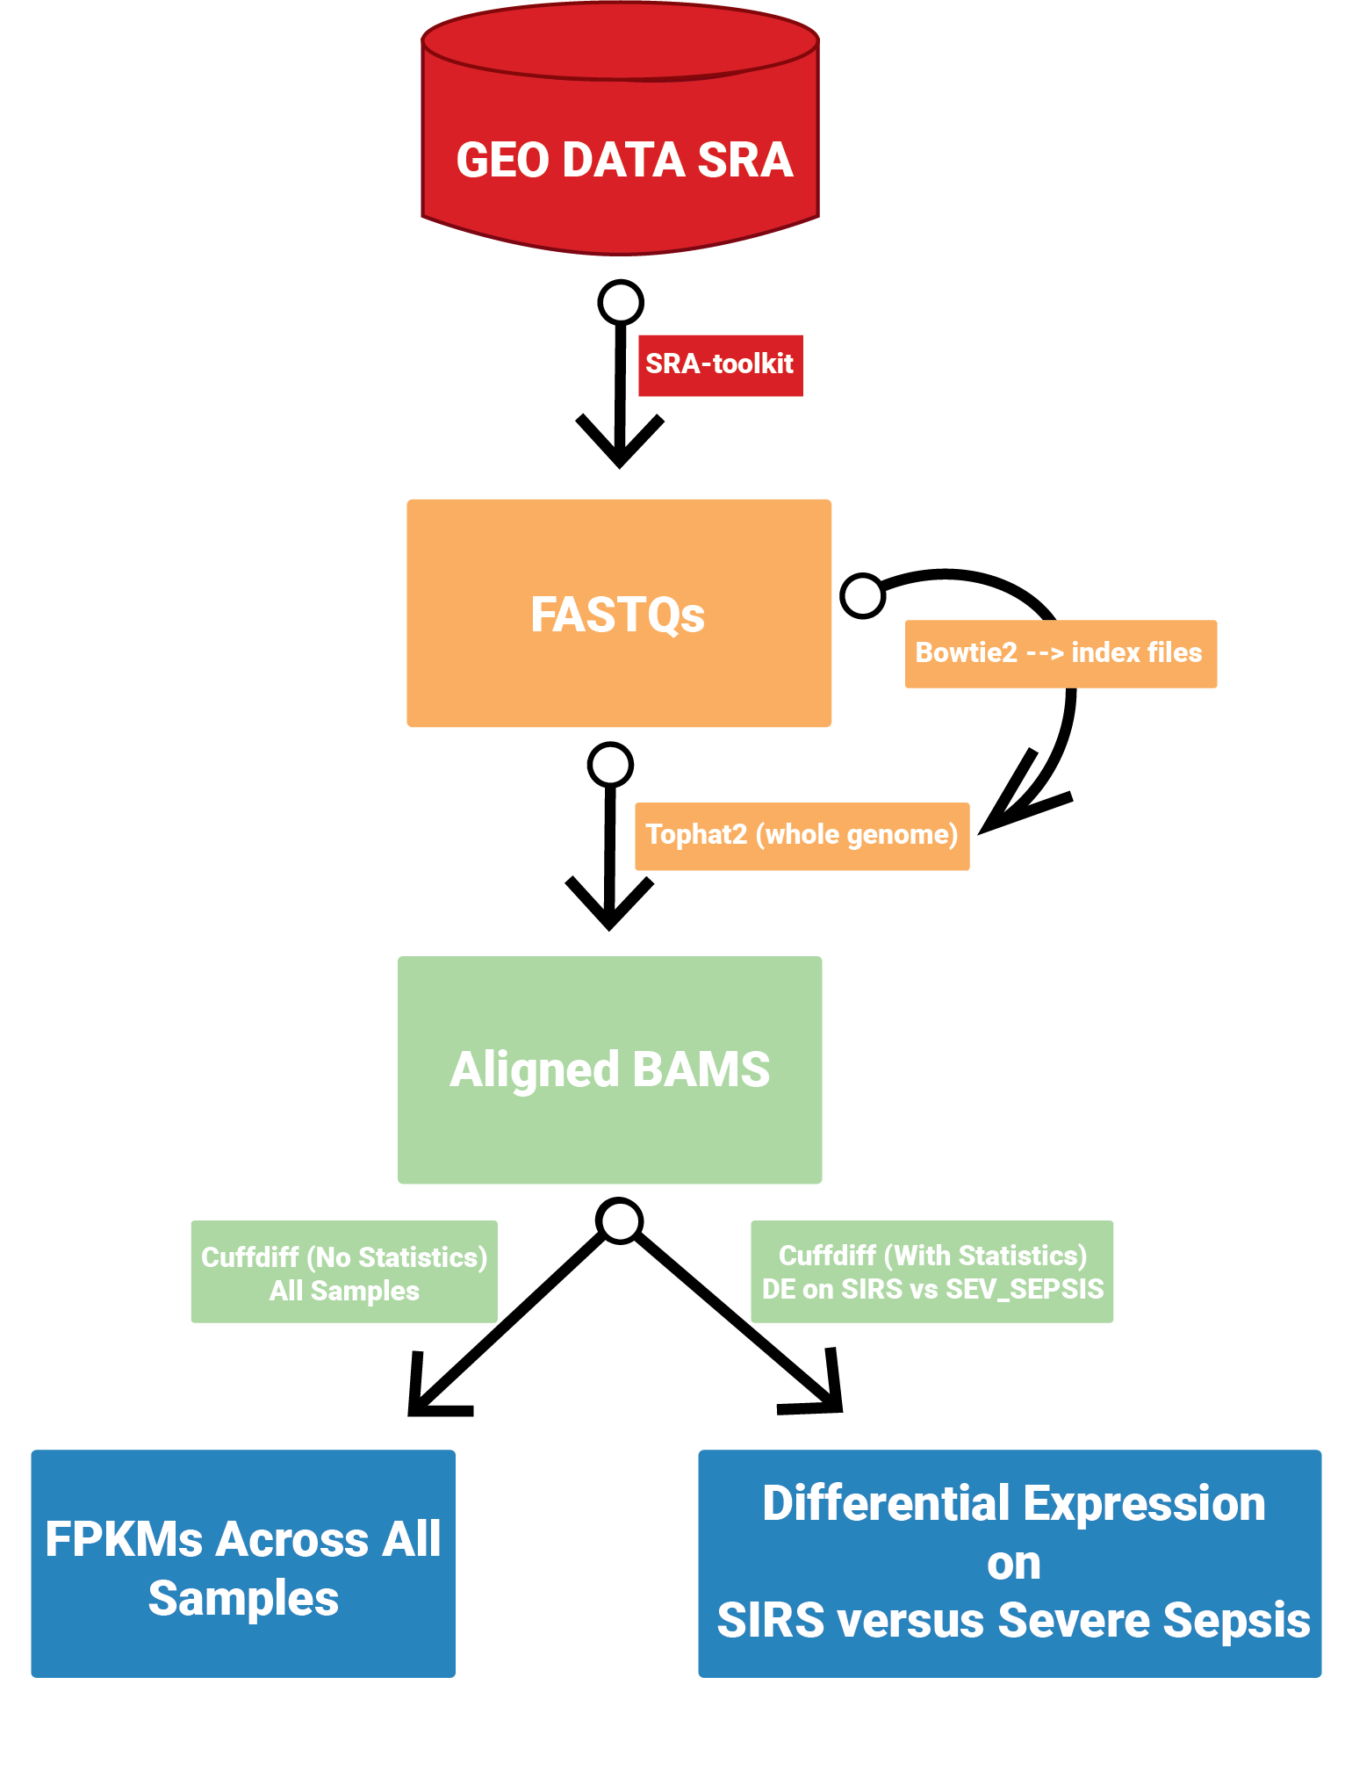
Workflow
Notes:
Tophat2:
-G Homo_sapiens.GRCh38.103.gtf === use this gtf file as a transcriptome guide and to make transcriptome index files (note I gave entire path to where this file is since you are not working in that directory)
-o OUTPUT_DIRECTORY === whatever you want the directory to be called where all of your alignment files to go (This must be unique for each run or else will overwrite the file!!!)
ensembl.GRCh38.103 === prefix used for the FASTA reference and bowtie2 index files (Only give the prefix- do not give file extenstions like .fa or .bt2!!!) (note I gave entire path to where this file is since you are not working in that directory)
File1.fastq === your chosen fastq (if SE)
NAME.nohup.out & === Name of your nohup file (This must be unique for each run or else will overwrite the file!!! This will record all the steps and what happened during the alignment so is a very good things to have recorded)

Slide 7
Tophat2 - alignment metrics and statistics:
Aligned Reads Descriptive Stats
N | Mean | Median | SD | Min | Max
16 | 13,674,150 | 14,659,450 | 2,521,255 | 6,851,868 | 16,643,179
% Aligned Descriptive Stats
N | Mean | Median | SD | Min | Max
16 | 71.47079 | 77.80522 | 18.28645 | 23.02999 | 89.8109

Slide 8
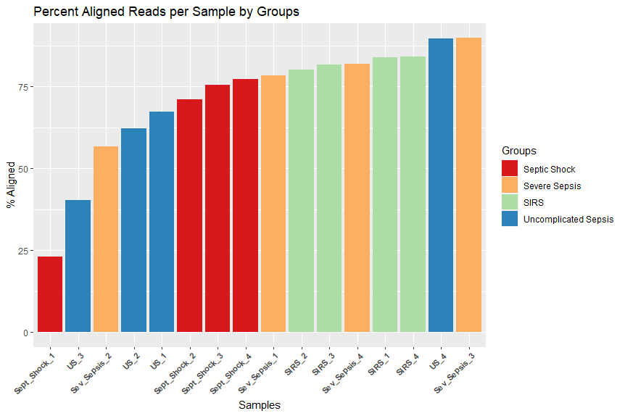
Tophat2 - alignment metrics and statistics:
Notes:
Sept_Shock_1 and US_3 had very low alignment percentages

Slide 9
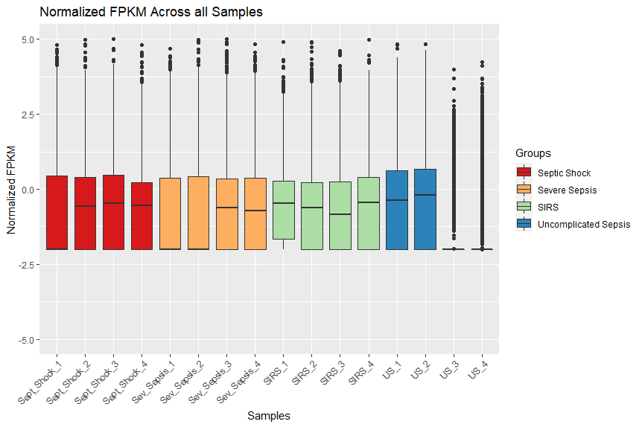
Results: FPKMs Across all Samples
Notes:
Normalized using pseudocount of 0.01 and log 10 scale
US_3 and US_4 had very low FPKM values before normalization, meaning that there is something wrong with these 2 specific samples in terms of how they were sequenced as these samples probably had low sequencing depth

Slide 10
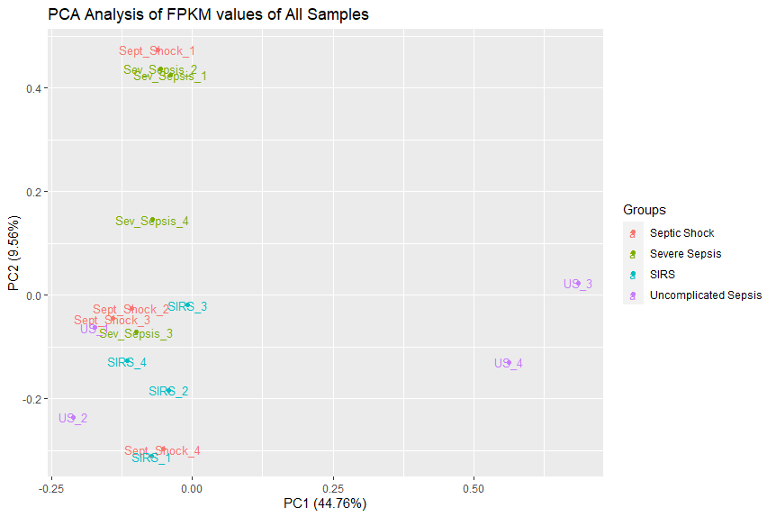
Results: PCA Analysis of FPKM values of All Samples
Notes:
log2FC <= -2
Pvalue < 0.01

Slide 11
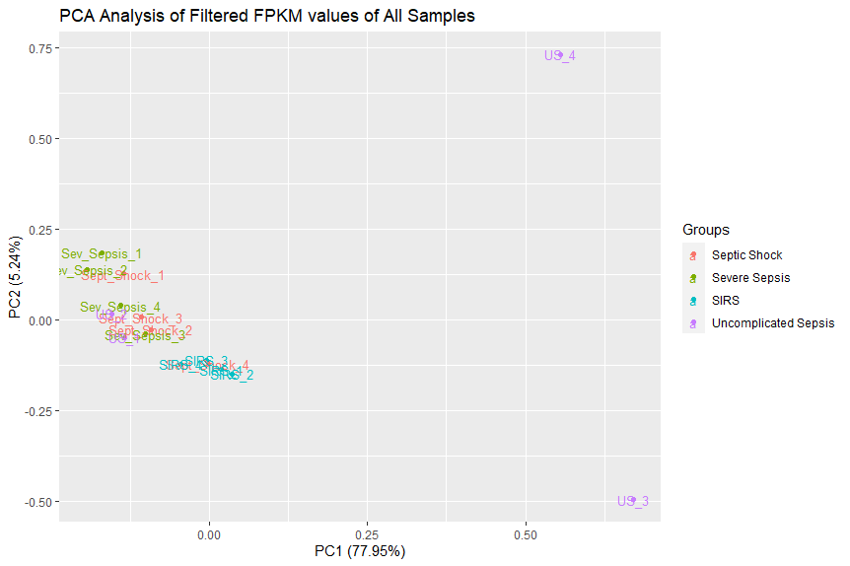
Results: PCA Analysis of Filtered FPKM values of All Samples
Notes:
log2FC <= -2
Pvalue < 0.01
Resulted in 162 genes of interest based off these conditions from the cuffdiff run with stats

Slide 12
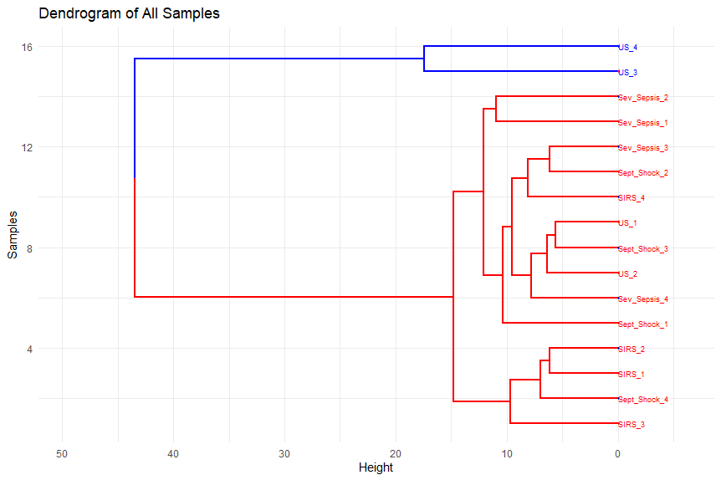
Results: Heatmap of Filtered FPKM values of All Samples VS Filtered Genes

Slide 13
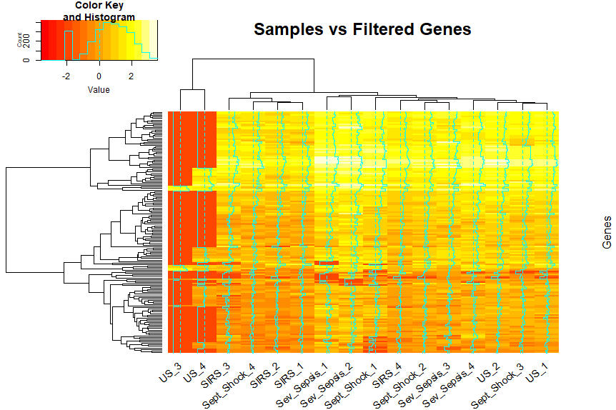
Results: Heatmap of Filtered FPKM values of All Samples VS Filtered Genes

Slide 14
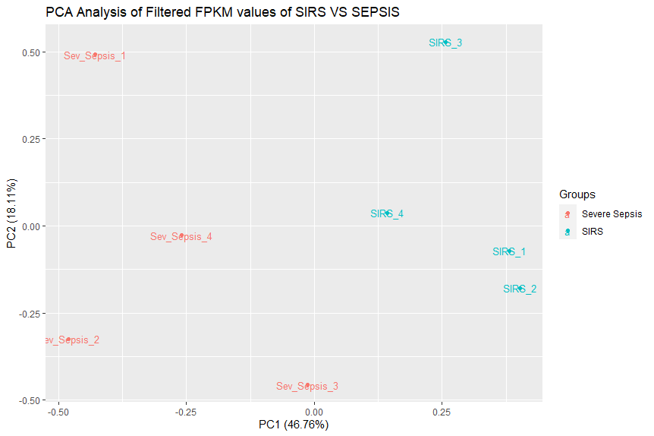
Results: PCA Analysis of Filtered FPKM values of SIRS vs Severe Sepsis

Slide 15
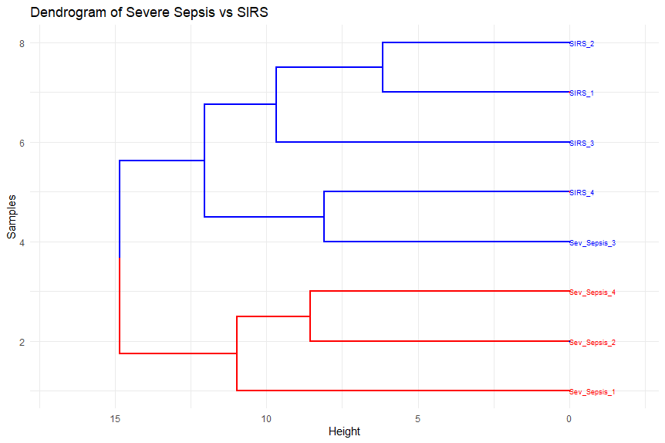
Results: Dendrogram of Filtered FPKM values of Severe Sepsis vs SIRS

Slide 16
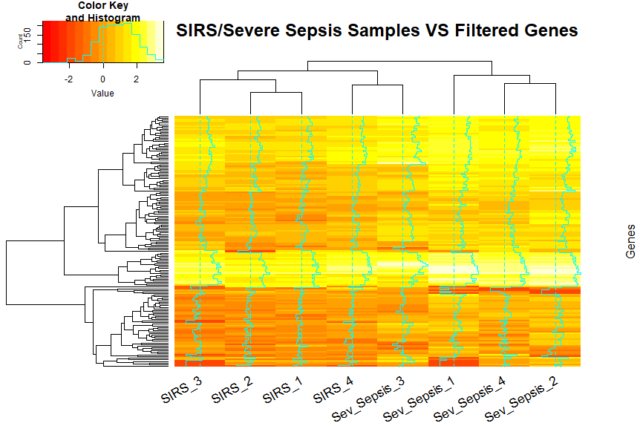
Results: Heatmap of Filtered FPKM values of SIRS & Severe Sepsis Samples VS Filtered Genes

Slide 17
Pathway Analysis:Upregulated Genes
Category | Disease/Function | p.value | Molecules | Molecules
Cell-To-Cell Signaling and Interaction,Hematological System Development and Function,Inflammatory Response | Aggregation of blood platelets | 0.000313 | ABCC4,DMTN,GNAS,METAP1,P2RX1,PTGER2,STXBP2,UNC13D | 8
IPA Upregulated Pathway
Notes:
155 upregulated genes

Slide 18
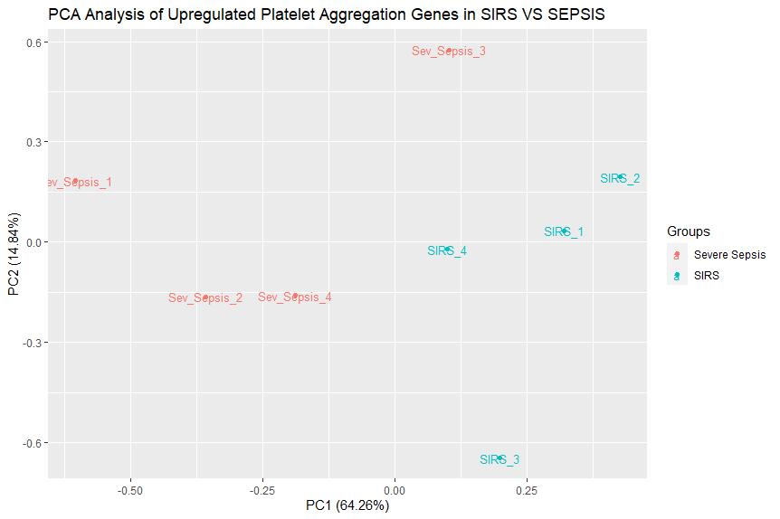
Pathway Analysis: Upregulated Platelet Aggregation Genes PCA

Slide 19
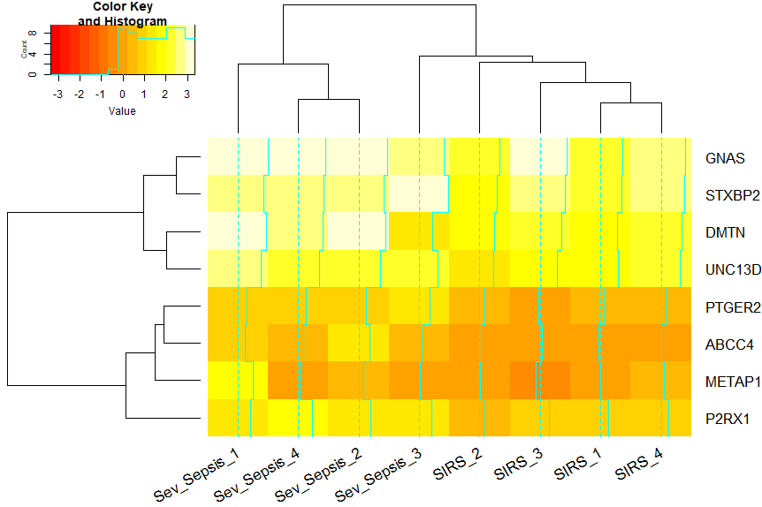
Pathway Analysis: Upregulated Platelet Aggregation Genes Heatmap
Notes:
GNAS is linked to platelet expression https://pubmed.ncbi.nlm.nih.gov/18812479/
STXBP2 required for platelet secretion https://ashpublications.org/blood/article/120/12/2493/30592/Munc18b-STXBP2-is-required-for-platelet-secretion
DMTN affects platelet secretion pathways and aggregation as it acts as a internal calcium mobilizer regulator which affects platelet secretion pathways and aggregation, necessary for platelet motility and migration https://www.genecards.org/cgi-bin/carddisp.pl?gene=DMTN
UNC13D expressed with human platelets https://www.frontiersin.org/articles/10.3389/fimmu.2020.01154/full
PTGER2 is an platelet aggregation inhibitor pathway https://www.genecards.org/cgi-bin/carddisp.pl?gene=PTGER2
ABCC4 modulates platelet aggregation, when inhibited, it causes inhibition of platelet aggregation https://www.ncbi.nlm.nih.gov/pmc/articles/PMC4643005/
METAP1 is predicted to be involved in platelet aggregation https://rgd.mcw.edu/rgdweb/report/gene/main.html?id=1305545
P2RX1 involved in platelet activation during hemostasis or thrombosis https://www.ncbi.nlm.nih.gov/pmc/articles/PMC3360091/

Slide 20
Pathway Analysis: Findings
From the IPA Pathway analysis, we see that there is a higher association of upregulated genes associated with platelet aggregation in patients with severe sepsis samples than in SIRS samples.
- When a patient is infected, the body will activate its defense mechanisms which can be boiled down to two main mechanisms:
- inflammatory response¹⁰
- coagulation activation¹⁰
- In short, the constant activation of the immune system leads to in an increase in platelet aggregation as that is the natural response
- However, it must be noted, that late-stage sepsis, such as severe sepsis or septic shock, but mainly septic shock are generally associated with thrombocytopenia or low-platelet-count, but there is previous evidence supporting that there is an increase in thrombocytosis in the earlier stages of sepsis¹².

Slide 21
Pathway Analysis:Downregulated Genes
Category | Diseases.or.Functions.Annotation | p.value | # Molecules | Molecules
Cell Death and Survival,Hematological System Development and Function | Cell viability of B lymphocytes | 0.0281 | FCRL3 | 1
Cell-To-Cell Signaling and Interaction,Hematological System Development and Function,Humoral Immune Response,Immune Cell Trafficking,Inflammatory Response | Activation of B lymphocytes | 0.0388 | FCRL3 | 1
IPA Downregulated Pathway
Notes:
7 downregulated genes

Slide 22
Pathway Analysis: Findings
From the IPA Pathway analysis, we see that there is a downregulation in genes associated with cell viability and activation of B lymphocytes, which can cause lymphopenia.
When a patient has sepsis, it is believed that there is a type of immune suppression that occurs behind the scenes leading to increased morbidity and mortality rates¹².
One key immunosuppression, is the apoptosis of certain immune cells like B-lymphocytes¹².
Septic patients have been found to have a higher rate of lymphopenia which is associated with a higher prevalence for septic shocks and higher mortality rates¹².

Slide 23
Conclusion & Future Studies
Overall, it is plausible to say that there is a difference in the genes expressed between Severe Sepsis and SIRS, despite Sepsis essentially being a derivative of SIRS. Moreover, we see that there is a significant upregulation of genes associated with platelet aggregation in the Severe Sepsis samples in comparison to the SIRS samples. Furthermore, it is not unreasonable to state that there is probably a significant downregulation of genes associated with cell viability and activation of B lymphocytes given the evidence presented in previous literature.
In the future:
It is necessary to make sure that all of the samples have a high read alignment percentage as in this study, 2 of the samples have very low levels of alignment percentage, making it very hard to determine their impact in the study
Investigate the effects of sepsis on thrombocytopenia and thrombocytosis as it seems to have a significant effect on both diseases.
Investigate more into sepsis’s effects on lymphopenia as it wasn’t feasible to investigate the significance of the downregulation of the FCLR3 gene given that there were barely any downregulated genes to begin with in the IPA analysis.

Slide 24
References:
Tsalik, E. L., Langley, R. J., Dinwiddie, D. L., Miller, N. A., Yoo, B., van Velkinburgh, J. C., Smith, L. D., Thiffault, I., Jaehne, A. K., Valente, A. M., Henao, R., Yuan, X., Glickman, S. W., Rice, B. J., McClain, M. T., Carin, L., Corey, G. R., Ginsburg, G. S., Cairns, C. B., … Kingsmore, S. F. (2014). An integrated transcriptome and expressed variant analysis of sepsis survival and death. Genome Medicine, 6(11). https://doi.org/10.1186/s13073-014-0111-5
NCI Dictionary of Cancer terms. National Cancer Institute. (n.d.). Retrieved November 30, 2021, from https://www.cancer.gov/publications/dictionaries/cancer-terms/def/sirs.
Chakraborty, R. K., & Burns, B. (2021). Systemic Inflammatory Response Syndrome. In Statpearls. essay, StatPearls Publishing.
Centers for Disease Control and Prevention. (2021, August 17). What is sepsis? Centers for Disease Control and Prevention. Retrieved November 30, 2021, from https://www.cdc.gov/sepsis/what-is-sepsis.html.
Sepsis Alliance. (2021, August 4). What is sepsis. Sepsis Alliance. Retrieved November 30, 2021, from https://www.sepsis.org/sepsis-basics/what-is-sepsis/.
Mayo Foundation for Medical Education and Research. (2021, January 19). Sepsis. Mayo Clinic. Retrieved November 30, 2021, from https://www.mayoclinic.org/diseases-conditions/sepsis/symptoms-causes/syc-20351214.
Severe sepsis. Sepsis Alliance. (2021, February 21). Retrieved November 30, 2021, from https://www.sepsis.org/sepsis-basics/what-is-sepsis/severe-sepsis/.
24, N. H. S. (2021, November 1). Septic shock symptoms and treatment. Illnesses & conditions | NHS inform. Retrieved November 30, 2021, from https://www.nhsinform.scot/illnesses-and-conditions/blood-and-lymph/septic-shock.
U.S. National Library of Medicine. (2015, January 1). Geo accession viewer. National Center for Biotechnology Information. Retrieved November 30, 2021, from https://www.ncbi.nlm.nih.gov/geo/query/acc.cgi?acc=GSE63042.
Vardon-Bounes, F., Ruiz, S., Gratacap, M.-P., Garcia, C., Payrastre, B., & Minville, V. (2019). Platelets are critical key players in sepsis. International Journal of Molecular Sciences, 20(14), 3494. https://doi.org/10.3390/ijms20143494
Sheikh Motahar Vahedi, H., Bagheri, A., Jahanshir, A., Seyedhosseini, J., & Vahidi, E. (2019). Association of Lymphopenia with Short Term Outcomes of Sepsis Patients; a Brief Report. Archives of academic emergency medicine, 7(1), e14.
Bakey, S., Karamanos, E., Louwers, L., Kolbe, N., Killu, K., Horst, H., Coba, V., & Rivers, E. (2013). Thrombocytosis versus Thrombocytopenia as Risk Factor for Increased Mortality in Sepsis. Critical Care Medicine, 41. https://doi.org/10.1097/01.ccm.0000440283.47246.33

