Slide 1
Due=March 5,2019
COMP 204 - Programming Studio
Project 1 – OBJECT COUNTING
Counting by Parallel Shrinking
Name=RAMAZAN
Surname= YETİŞMİŞ
Number= 041701013
Field=Computer Engineer

Slide 2



Problem:
In this Project I solved how to count the object of an given image.In this procces I used 2 different shrinking Algorithms such as Levialdi and TSF. We encounter with Levialdi’s Algortihm in 1972 after that in 1990 Hall&Gokmen present us the different solotion which faster than Levaildi’s solotion.
Levialdi Algorithm:
First to perform this algorithm we have to convert the image to binary form My levialdi scans the array from the right-upper side after that it looks either the current index is 0 ar 1.If it is 0 it looks the augmented conditions.If it is 1 it looks for the deletion condition.These conditions are were shown in the code.If the index is an isolted point ,it is counted as an object .
This steps helps us to Labelling procces.After ıt shrunk to a single pixel ,follwed by an expansion phase for each commponent and diseminated in the component.Each pahse takes o(√n).
Isolated
Augmented
Deletion

Slide 3
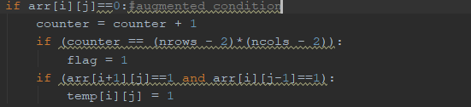
Code analysis:
1.The first if statetment shows that the index is now one and that means it is going to look for augmented conditions
2.The second if is for the termination condition if the number of zeros equals to the number of index termination occures
3.The third if conrols the left and bottom part of the index if they are one then is changes 0 to 1
2.The first if determines whether index is an isolated one or not.
1.The else shows us that index is 1 so deletion condition
3.The else if tells us that bottom,left and bottom_left are 0 so delete1 and write 0 instead.

Slide 4
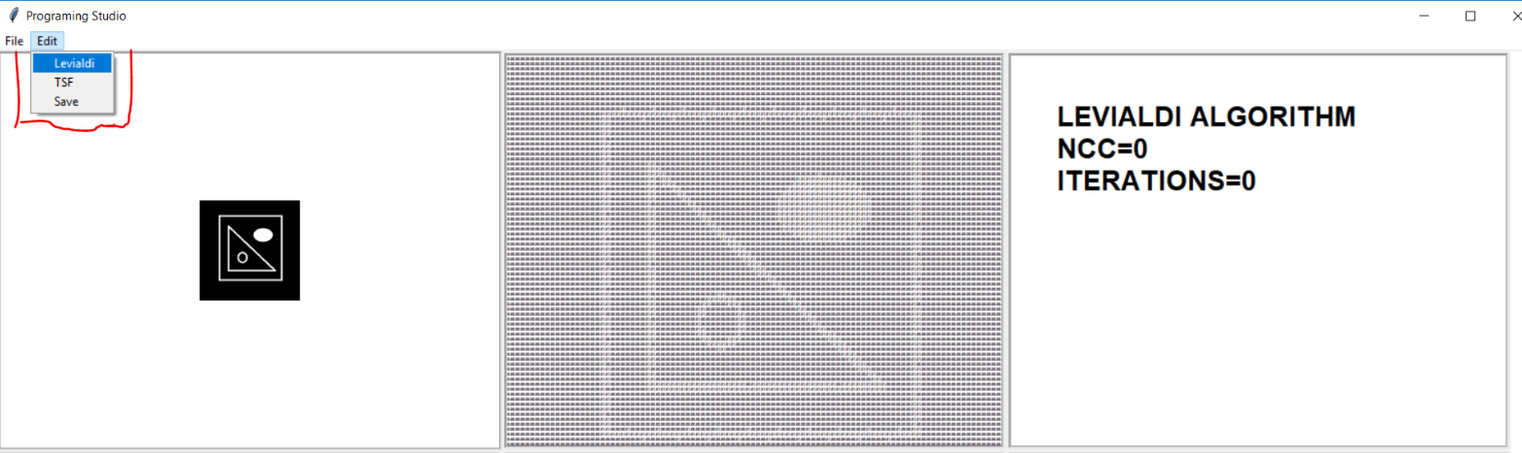
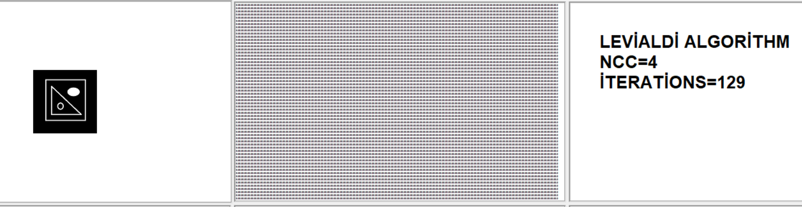
BEFORE
AFTER
After 129 iterations algorithm finds the Correct NCC and terminates itself.
In my GUI instead of button I choose my selections from the menu bar

Slide 5
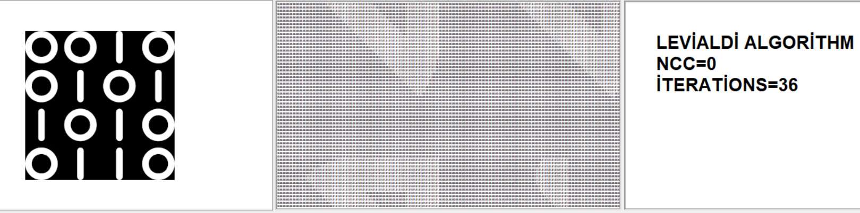
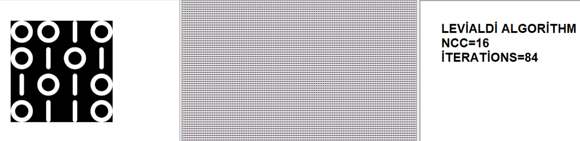
DURING
FINAL
I added DURING part to Show how the algorithm Works.As we can see from the image It scans from upper right side to lower left part.And it finds the correct NCC after 84 iterations.

Slide 6
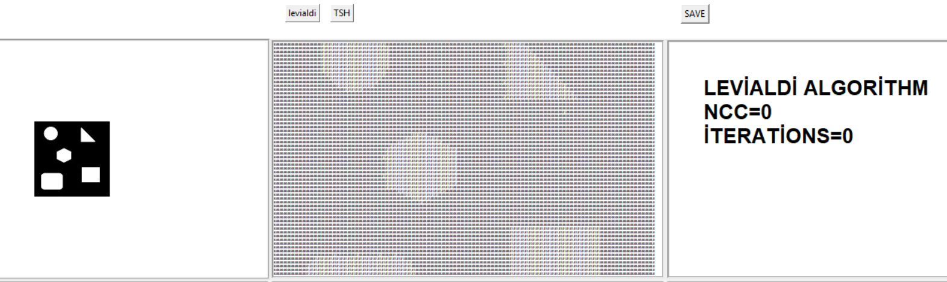
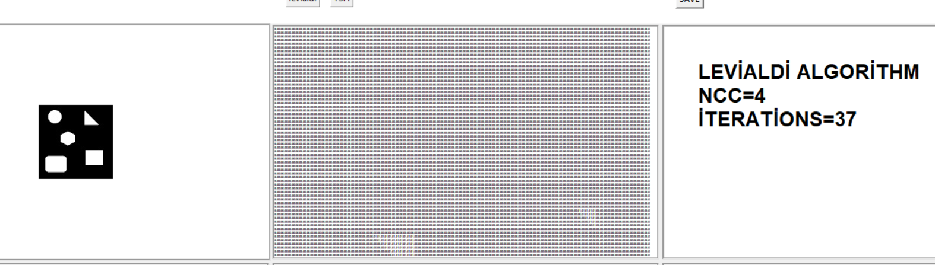
BEFORE
DURING
I give 3 different example and they all are refers to different proccess of the algorithm so we simply follow the algorithm and the illustration of the condition becames more clear

Slide 7
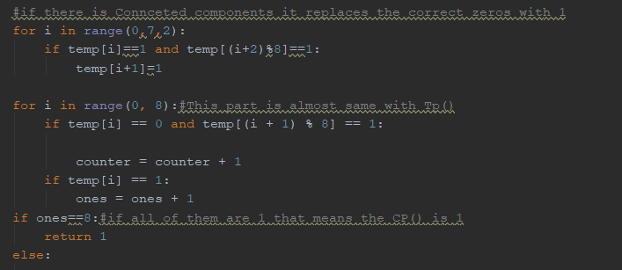
TSF Algorithm
Firstly I write Bp,Cp ,Tp by the help of this functions I implemented the TSF algortihm.In this Algorithm there are 5 loops ,this helps us to divide the array 2 subfields.I implement the whole conditions to the 2 subfields separately.This algortihm may looks like as if it is slow but it is a very fast algorithm
Cp(p) Funct:
In this function I declare a neighbor array.And in that array I realised that amoung 3 squential indexes if the first and last one are 1 we replaces the middle one with 1

Slide 8
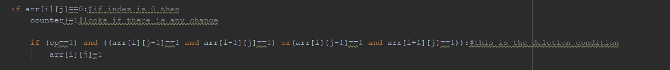

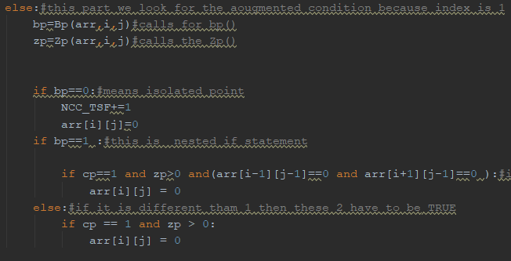
The first if means the index is 0 so condition is augmented one.This condition occurs only when Cp()=1 and P8,P2 or P8,P6 is one.After that it changes 0 to 1
Fianlly if else part occurs that means index is 1 and we are
Going to see the deletion condition.1)first if means the index is isolated so increment NCC.2)The secan one gives us a condition if Bp(p) is 1 we have to control P1 and P7 too.İf not we do not need to look for that condition.

Slide 9
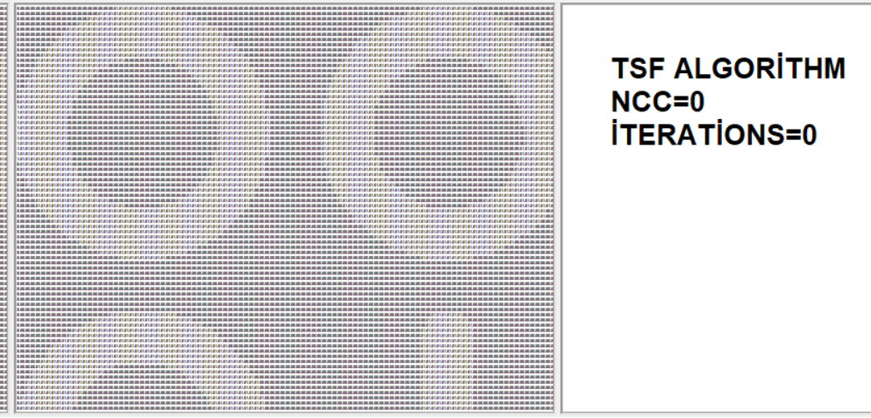

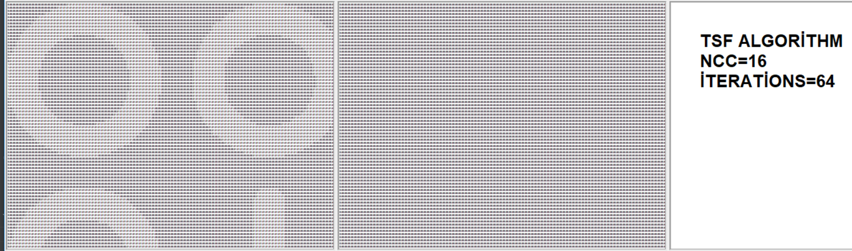
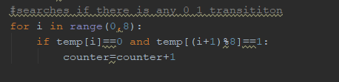
BEFORE
IMAGE
The TSF algortihm fınds correct NCC in 64 iterations and it terminates correctly.
AFTER
Tp(p) fuction:
In this fucntion I looked at the neighbors array so amoung the sequential 2 indexes if there 0 -1 transition increment counter

Slide 10
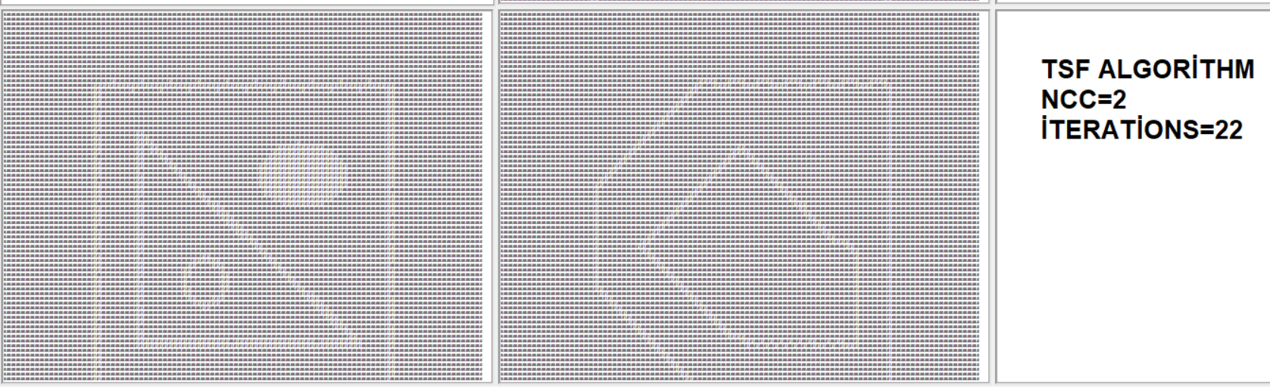
BEFORE
DURING
We can basicly see how TSF Works it divides the image as 2 subfields and after one iteration the 2 sub field becomes 1 again and it carries on until there is no change can be done in the image array.

Slide 11
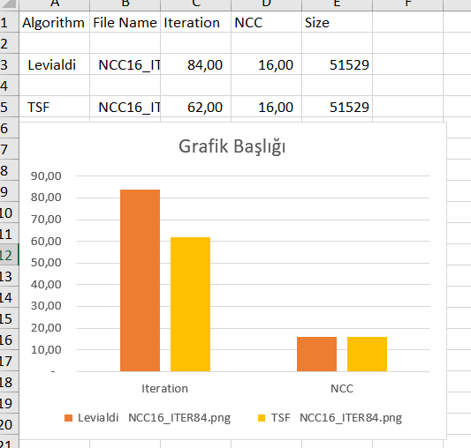
Comparasion
WE can understand from the graph which algorithm is preferable.To illustrate you properly basicly I can say that when The NCCs are equal the number of iteraitons(in TSF I took one iteariton as 2)differs from each other.The TSF algortihm is faster than Levialdi algorithm

