Slide 1
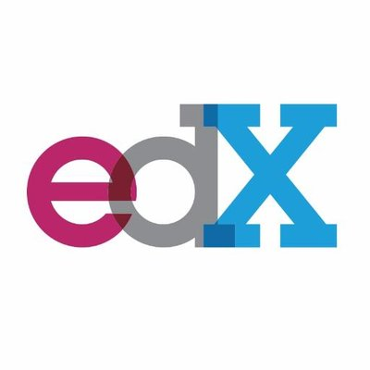
Online Courses from Harvard and MIT
Context
In 2012, the Massachusetts Institute of Technology (MIT) and Harvard University launched open online courses on edX, a non-profit learning platform co-founded by the two institutions. Four years later, what have we learned about these online “classrooms” and the global community of learners who take them?
Content
This report provides data on 290 Harvard and MIT online courses, 250 thousand certifications, 4.5 million participants, and 28 million participant hours on the edX platform since 2012.

Slide 2

Online Learning Platform is edX
We find dataset from kaggle.com
There are 22 Columns and 290 rows according to www.edx.org website of dataset
https://www.kaggle.com/edx/course-study/data

Slide 3
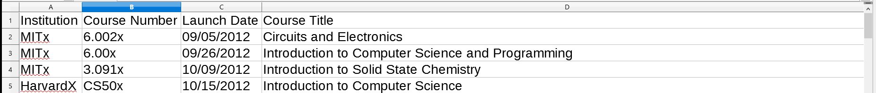
Columns

Slide 4
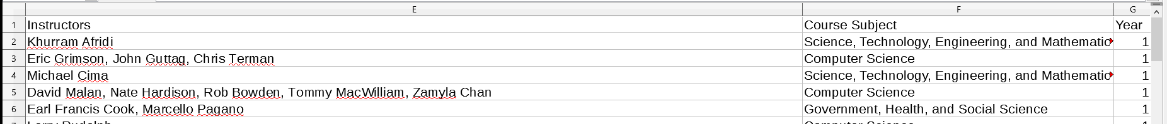
Columns

Slide 5
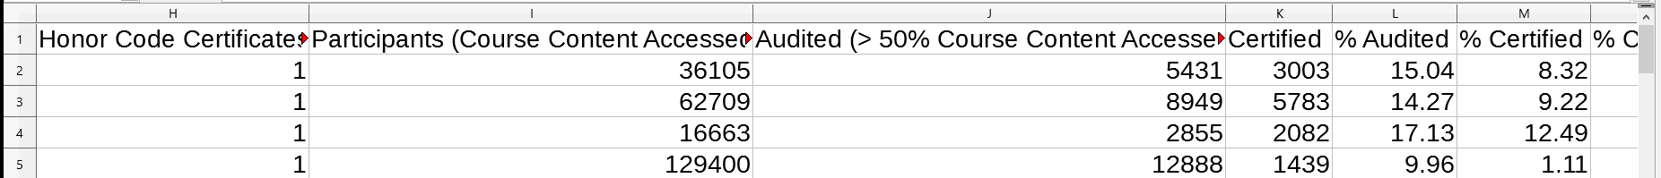
Columns

Slide 6
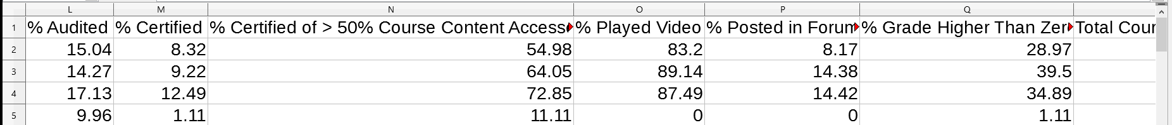
Columns

Slide 7
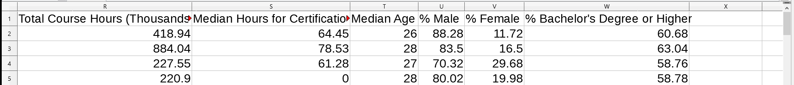
Columns

Slide 8
Our Teams :
DOĞUCAN DENIZ ÇOLPAN
RAMAZAN AYÖZ

