Slide 1
WEEK 5
Spring Boot Security
Authorization & Authentication
JWT Integration
Spring Boot AOP
Microservices Architecture

Slide 2
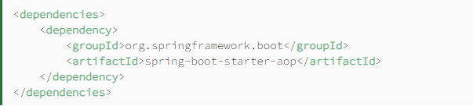
Spring boot AOP
AOP is a programming paradigm that aims to increase modularity by allowing the separation of cross-cutting concerns. It does this by adding additional behavior to existing code without modifying the code itself.
Instead, we can declare the new code and the new behaviors separately.
Spring's AOP framework helps us implement these cross-cutting concerns.

Slide 3
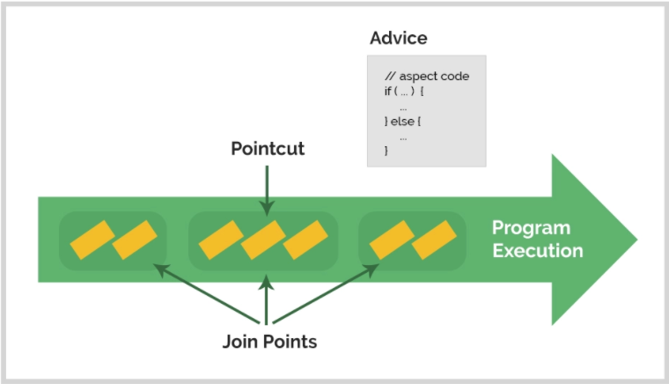
AOP Concepts and Terminology

Slide 4
Terminology
Aspect
An aspect is a modularization of a concern that cuts across multiple classes. Unified logging can be an example of such cross-cutting concern.
Joinpoint
A Joinpoint is a point during the execution of a program, such as the execution of a method or the handling of an exception.
Pointcut
A Pointcut is a predicate that helps match an Advice to be applied by an Aspect at a particular JoinPoint.
We often associate the Advice with a Pointcut expression, and it runs at any Joinpoint matched by the Pointcut.
Advice
An Advice is an action taken by an aspect at a particular Joinpoint. Different types of advice include “around,” “before,” and “after.”

Slide 5
Spring boot actuator
In essence, Actuator brings production-ready features to our application.
Monitoring our app, gathering metrics, understanding traffic, or the state of our database become trivial with this dependency.
The main benefit of this library is that we can get production-grade tools without having to actually implement these features ourselves.
Actuator is mainly used to expose operational information about the running application — health, metrics, info, dump, env, etc. It uses HTTP endpoints or JMX beans to enable us to interact with it.

Slide 6
Actuator Predefined Endpoints
/beans returns all available beans in our BeanFactory. Unlike /auditevents, it doesn't support filtering.
/env returns the current environment properties. Additionally, we can retrieve single properties.
/health summarizes the health status of our application.
/info returns general information. It might be custom data, build information or details about the latest commit.
/logfile returns ordinary application logs.
/metrics details metrics of our application. This might include generic metrics as well as custom ones.
/shutdown performs a graceful shutdown of the application.

Slide 7
MICROSERVICES ARCHITECTURE
Microservice Architecture is a Service Oriented Architecture. In the microservice architecture, there are a large number of microservices. By combining all the microservices, it constructs a big service. In the microservice architecture, all the services communicate with each other.
According to Sam Newman, "Microservices are the small services that work together."
According to James Lewis and Martin Fowler, "The microservice architectural style is an approach to develop a single application as a suite of small services. Each microservice runs its process and communicates with lightweight mechanisms. These services are built around business capabilities and independently developed by fully automated deployment machinery."

Slide 8
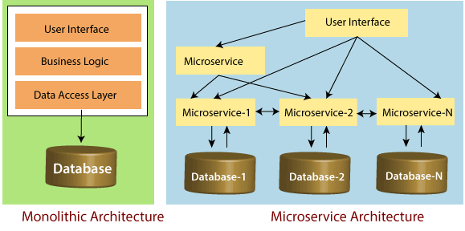
MICROSERVICES ARCHITECTURE
The microservice defines an approach to the architecture that divides an application into a pool of loosely coupled services that implements business requirements. It is next to Service-Oriented Architecture (SOA). The most important feature of the microservice-based architecture is that it can perform continuous delivery of a large and complex application.

Slide 9
Principles of Microservices
Single Responsibility principle
Modelled around business domain
Isolate Failure
Infrastructure automation
Deploy independently

Slide 10
MICROSERVICES ADVANTAGES
Microservices are self-contained, independent deployment module.
The cost of scaling is comparatively less than the monolithic architecture.
Microservices are independently manageable services. It can enable more and more services as the need arises. It minimizes the impact on existing service.
It is possible to change or upgrade each service individually rather than upgrading in the entire application.
Microservices allows us to develop an application which is organic (an application which latterly upgrades by adding more functions or modules) in nature.

Slide 11
MICROSERVICES ADVANTAGES
It enables event streaming technology to enable easy integration in comparison to heavyweight interposes communication.
Microservices follows the single responsibility principle.
The demanding service can be deployed on multiple servers to enhance performance.
Less dependency and easy to test.
Dynamic scaling.
Faster release cycle.

Slide 12
MICROSERVICES DISADVANTAGES
Microservices has all the associated complexities of the distributed system.
There is a higher chance of failure during communication between different services.
Difficult to manage a large number of services.
The developer needs to solve the problem, such as network latency and load balancing.
Complex testing over a distributed environment.

Slide 13
Microservices Challenges
Bounded Context
Dynamic Scale up and Scale Down
Monitoring
Fault Tolerance
Cyclic dependencies
DevOps Culture

Slide 14
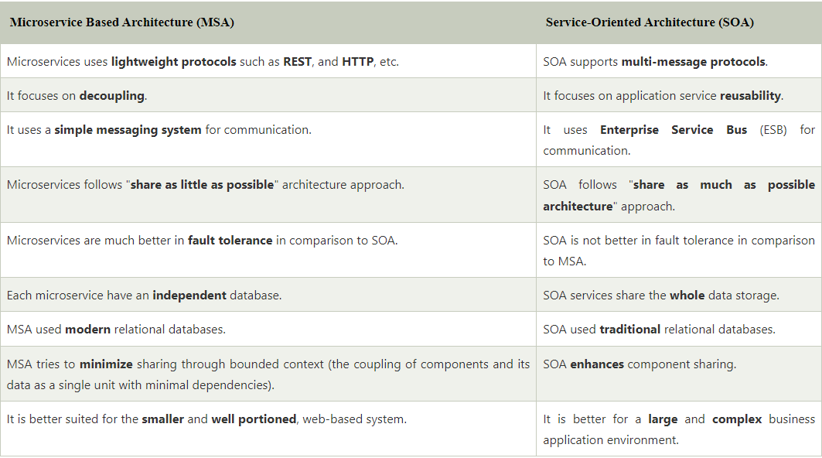
MSA vs SOA

Slide 15
Technical Practise Time
LET’S GET OUR HANDS DIRTY
-------------
Spring Security Integration
Security Configurations
JWT Usage

Slide 16
HW#5
1 – What are Authentication and Authorization ?
2 - What is Hashing in Spring Security ?
3 - What is Salting and why do we use the process of Salting ?
4 - What is “intercept-url” pattern ?
5 - What do you mean by session management in Spring Security ?
6 – Why we need Exception Handling ?
7 - Explain what is AuthenticationManager in Spring security ?
8 - What is Spring Security Filter Chain ?
9 – What are the differences between OAuth2 and JWT ?
10 - What is method security and why do we need it ?
11 – What Proxy means and how and where can be used ?
12 – Waht is Wrapper Class and where can be used ?
13 – What is SSL ? What is TLS ? What is the difference ? How can we use them ?
14 - Why do you need the intercept-url ?

