Slide 1
Week 3
Java8-24 new Features
RESTful Services
SOAP & HTTP
Software Development Processes – TDD

Slide 2
Java8 new Features
forEach() method in Iterable interface
default and static methods in Interfaces
Functional Interfaces and Lambda Expressions
Java Stream API for Bulk Data Operations on Collections
Optional Class Usage
Java Time API
Collection API improvements
Concurrency API improvements
Java IO improvements

Slide 3
forEach() method in Iterable interface
Whenever we need to traverse through a Collection, we need to create an Iterator whose whole purpose is to iterate over, and then we have business logic in a loop for each of the elements in the Collection. We might get ConcurrentModificationException if the iterator is not used properly.
Java 8 has introduced forEach method in java.lang.Iterable interface so that while writing code we focus on business logic. The forEach method takes java.util.function.Consumer object as an argument, so it helps in having our business logic at a separate location that we can reuse.
Let’s see an example!

Slide 4
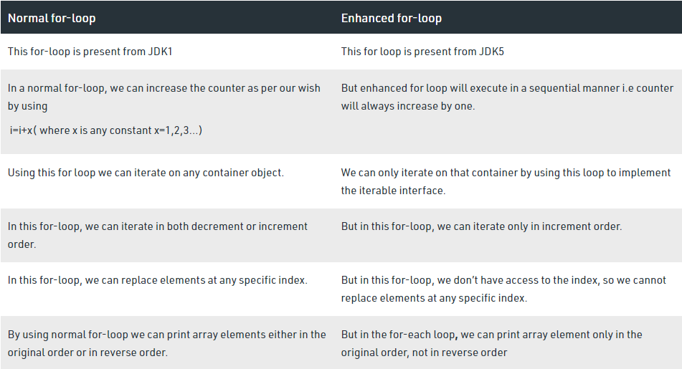
For vs «EnhaNced» For

Slide 5
default & static methods in Interfaces
From Java 8, interfaces are enhanced to have a method with implementation. We can use default and static keyword to create interfaces with method implementation.
Let’s see an example!

Slide 6
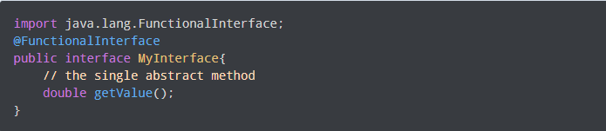
Functional Interfaces
If a Java interface contains one and only one abstract method then it is termed as functional interface. This only one method specifies the intended purpose of the interface.
Sample Usage:
Let’s see an example!

Slide 7
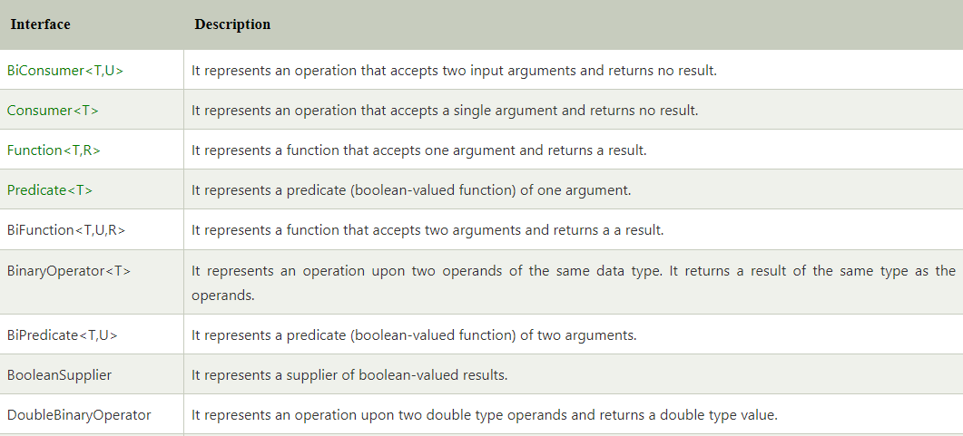
Java Predefined-Functional Interfaces

Slide 8
Java Method References
Java provides a new feature called method reference in Java 8. Method reference is used to refer method of functional interface. It is compact and easy form of lambda expression. Each time when you are using lambda expression to just referring a method, you can replace your lambda expression with method reference. In this tutorial, we are explaining method reference concept in detail.
There are following types of method references in java:
Reference to a static method
Reference to an instance method
Reference to a constructor
Let’s see an example!

Slide 9
Lambda EXPRESSIONS
Lambda expressions are introduced in Java 8 and are touted to be the biggest feature of Java 8. Lambda expression facilitates functional programming, and simplifies the development a lot.
Syntax:
A lambda expression is characterized by the following syntax.
Java normal function:
«Access modifier» «returned type» «method name»( «parameters» ){
// method body
}

Slide 10
Lambda EXPRESSIONS
Following are the important characteristics of a lambda expression:
Optional type declaration − No need to declare the type of a parameter. The compiler can inference the same from the value of the parameter.
Optional parenthesis around parameter − No need to declare a single parameter in parenthesis. For multiple parameters, parentheses are required.
Optional curly braces − No need to use curly braces in expression body if the body contains a single statement.
Optional return keyword − The compiler automatically returns the value if the body has a single expression to return the value. Curly braces are required to indicate that expression returns a value.

Slide 11
Lambda EXPRESSIONS
Java lambda expressions are Java's first step into functional programming. A Java lambda expression is thus a function which can be created without belonging to any class. A Java lambda expression can be passed around as if it was an object and executed on demand.
Java lambda expressions are commonly used to implement simple event listeners / callbacks, or in functional programming with the Java Streams API. Java Lambda Expressions are also often used in functional programming in Java.
Let’s see some sample usages!

Slide 12
Java Optional Class
Java introduced a new class Optional in jdk8. It is a public final class and used to deal with NullPointerException in Java application. You must import java.util package to use this class. It provides methods which are used to check the presence of value for particular variable.
Let’s see some sample usages!

Slide 13
Java StringJoiner
Java added a new final class StringJoiner in java.util package. It is used to construct a sequence of characters separated by a delimiter. Now, you can create string by passing delimiters like comma(,), hyphen(-) etc. You can also pass prefix and suffix to the char sequence.
Let’s see some sample usages!

Slide 14
Streams
Java provides a new additional package in Java 8 called java.util.stream. This package consists of classes, interfaces and enum to allows functional-style operations on the elements. You can use stream by importing java.util.stream package.
Stream provides following features:
Stream does not store elements. It simply conveys elements from a source such as a data structure, an array, or an I/O channel, through a pipeline of computational operations.
Stream is functional in nature. Operations performed on a stream does not modify it's source. For example, filtering a Stream obtained from a collection produces a new Stream without the filtered elements, rather than removing elements from the source collection.
Stream is lazy and evaluates code only when required.
The elements of a stream are only visited once during the life of a stream. Like an Iterator, a new stream must be generated to revisit the same elements of the source.
Let’s see some sample usages!

Slide 15
REST architecture
REST stands for REpresentational State Transfer. REST is web standards based architecture and uses HTTP Protocol. It revolves around resource where every component is a resource and a resource is accessed by a common interface using HTTP standard methods. REST was first introduced by Roy Fielding in 2000.
In REST architecture, a REST Server simply provides access to resources and REST client accesses and modifies the resources. Here each resource is identified by URIs/ global IDs. REST uses various representation to represent a resource like text, JSON, XML. JSON is the most popular one.
HTTP methods
Following four HTTP methods are commonly used in REST based architecture :
GET − Provides a read only access to a resource.
POST − Used to create a new resource.
DELETE − Used to remove a resource.
PUT − Used to update a existing resource or create a new resource.

Slide 16
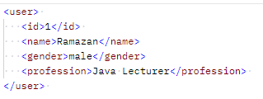
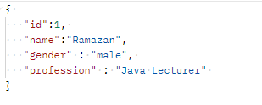
RESTful Web Services - Resources
REST architecture treats every content as a resource. These resources can be Text Files, Html Pages, Images, Videos or Dynamic Business Data. REST Server simply provides access to resources and REST client accesses and modifies the resources. Here each resource is identified by URIs/ Global IDs. REST uses various representations to represent a resource where Text, JSON, XML. The most popular representations of resources are XML and JSON.
For Example, a user is a resource which is represented using the following XML format:
As JSON format:
a

Slide 17
SOAP
SOAP is an acronym for Simple Object Access Protocol. It is an XML-based messaging protocol for exchanging information among computers. SOAP is an application of the XML specification.
SOAP is a communication protocol designed to communicate via Internet.
SOAP can extend HTTP for XML messaging.
SOAP provides data transport for Web services.
SOAP can exchange complete documents or call a remote procedure.
SOAP can be used for broadcasting a message.
SOAP is platform- and language-independent.
SOAP is the XML way of defining what information is sent and how.

Slide 18
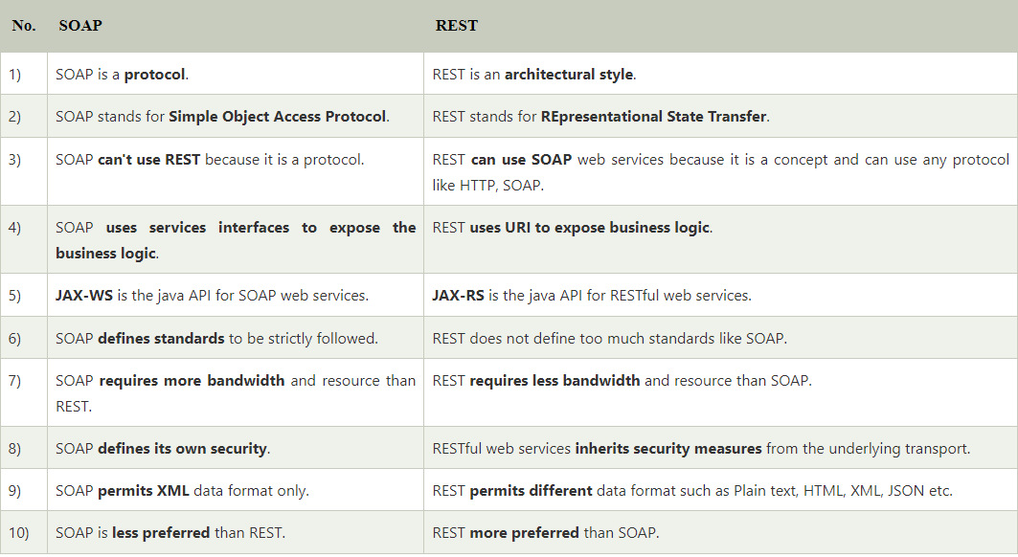
SOAP VS REST

Slide 19
RESTful WEB SERVICES - Messages
RESTful Web Services make use of HTTP protocols as a medium of communication between client and server. A client sends a message in form of a HTTP Request and the server responds in the form of an HTTP Response. This technique is termed as Messaging.

Slide 20
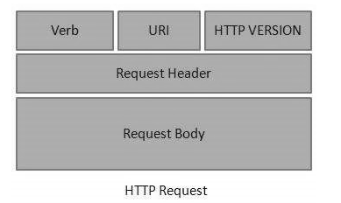
HTTP Request
HTTP Request has five major parts :
Verb − Indicates the HTTP methods such as GET,
POST, DELETE, PUT, etc.
URI − Uniform Resource Identifier (URI) to identify
the resource on the server.
HTTP Version − Indicates the HTTP version. For example, HTTP v1.1.
Request Header − Contains metadata for the HTTP Request message as key-value pairs. For example, client (or browser) type, format supported by the client, format of the message body, cache settings, etc.
Request Body − Message content or Resource representation.

Slide 21
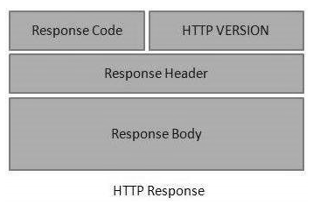
HTTP RESPONSE
An HTTP Response has four major parts −
Status/Response Code − Indicates the Server status
for the requested resource. For example,
404 means resource not found and 200 means response is ok.
HTTP Version − Indicates the HTTP version.
For example HTTP v1.1.
Response Header − Contains metadata for the HTTP Response message as keyvalue pairs. For example, content length, content type, response date, server type, etc.
Response Body − Response message content or Resource representation.

Slide 22
RESTful Web Services - Addressing
Addressing refers to locating a resource or multiple resources lying on the server. It is analogous to locate a postal address of a person.
Each resource in REST architecture is identified by its URI (Uniform Resource Identifier). A URI is of the following format:
Purpose of an URI is to locate a resource(s) on the server hosting the web service. Another important attribute of a request is VERB which identifies the operation to be performed on the resource. For example, in RESTful Web Services - First Application chapter, the URI is
http://localhost:8080/user-management/rest/user-service/users and the VERB is GET.
<protocol>://<hostname>:<port>/<service-name>/<ResourceType>/<ResourceID>

Slide 23
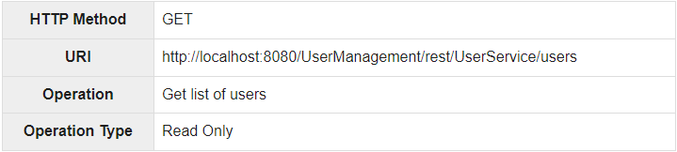
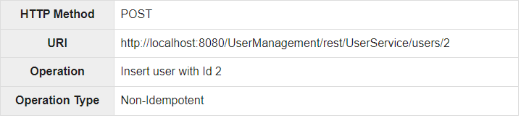
RESTful Web Services – Methods GET & POST

Slide 24
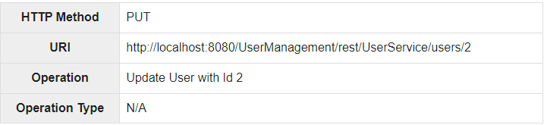
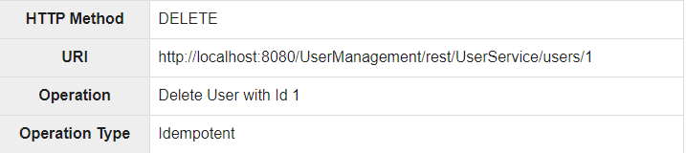
RESTful Web Services – Methods PUT & DELETE

Slide 25
HTTP Entity
The Entity is transferred by the HTTP request and response message if not otherwise restricted by the request method or response status code. An entity is used to consist of entity-header fields and entity-body, although some responses will only include the entity-headers.
Entity Header Fields :
Entity-header fields are used to define the metainformation about the entity-body. If body is not present, the entity-header field defines metainformation about the resource identified by request. Some of this metainformation is OPTIONAL. Some might be REQUIRED by the portion of this specification.

Slide 26
HTTP STATUS CODES
1xx - represents informational responses
2xx - represents successful responses
3xx - represents redirects
4xx - represents client errors
5xx - represents server errors
Most commonly used status codes are:
200 - success/OK
201 - CREATED - used in POST or PUT methods.
304 - NOT MODIFIED - used in conditional GET requests to reduce the bandwidth use of the network. Here, the body of the response sent should be empty.
400 - BAD REQUEST - This can be due to validation errors or missing input data.
401- UNAUTHORIZED - This is returned when there is no valid authentication credentials sent along with the request.
403 - FORBIDDEN - sent when the user does not have access (or is forbidden) to the resource.
404 - NOT FOUND - Resource method is not available.
500 - INTERNAL SERVER ERROR - server threw some exceptions while running the method.
502 - BAD GATEWAY - Server was not able to get the response from another upstream server

Slide 27
Spring Annotations for REST Services
@Controller
@RestController
@RequestMapping
@PathVariable
@RequestParam
@RequestHeader
@Qualifier
@ComponentScan
@Bean
@Transactional
@RequestBody
@ResponseStatus
@Validated
@Value
@Component
@Min / @Max
@Scope
@Service
@Repository

Slide 28
Project Development Lifecycle
RADIT
Requirements -> What do we need for the Project ?
Analysis -> How can I start the Project with requirements ?
Design -> Project Structure – Let’s make a design for our Project!
Implementation -> Development – (Controller-Service-Repo-DB)
Test

Slide 29
Software development processes
Behavior-driven development (BDD)
Design-driven development (D3)
Domain-driven design (DDD)
Test-driven development (TDD)
Value-driven design (VDD)

Slide 30
TEST DRIVEN DEVELOPMENT (TDD)
Test Driven Development (TDD) is software development approach in which test cases are developed to specify and validate what the code will do. In simple terms, test cases for each functionality are created and tested first and if the test fails then the new code is written in order to pass the test and making code simple and bug-free.
Test-Driven Development starts with designing and developing tests for every small functionality of an application. TDD framework instructs developers to write new code only if an automated test has failed. This avoids duplication of code. The TDD full form is Test-driven development.

Slide 31
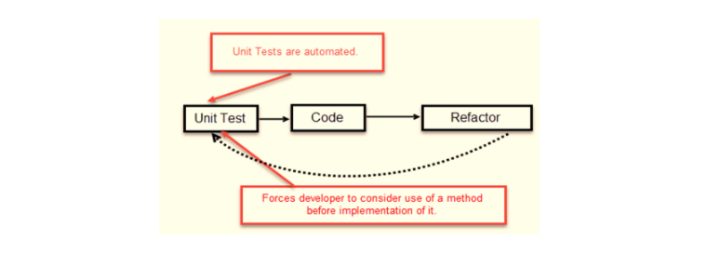
TDD – TEST FIRST DEVELOPMENT

Slide 32
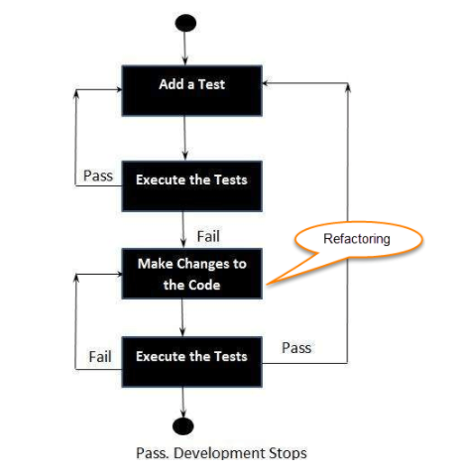
TDD TEST FLOW
Add a test
Run all tests and see if any new test fails
Write some code
Run tests and Refactor code
Repeat
F.e; HackerRank, Coderbyte etc…

Slide 33
TDD –Vs- Traditional Testing
In traditional testing, a successfully executed test discovers one or more than one bugs. The same is in TDD. When a test case fails, there is some development or progress as we know that the problem has to be resolved.
TDD makes sure that the system meets all the specified requirements. It helps build and boost confidence in the system.
TDD emphasizes product code that determines if the testing will be successful or not. While traditional testing focuses on the designing of test cases, and also if the test will execute properly or not to meet the specified requirements.
In TDD, complete coverage of the testing is achieved. Unlike traditional testing, in TDD we test each line of the code.
TDD and traditional testing, when combines, explain why the testing of the system is so important.
In agile modelling, the testing should have a specific purpose. We should be aware of why we are testing and the level of the testing.

Slide 34
Spring boot actuator
In essence, Actuator brings production-ready features to our application.
Monitoring our app, gathering metrics, understanding traffic, or the state of our database become trivial with this dependency.
The main benefit of this library is that we can get production-grade tools without having to actually implement these features ourselves.
Actuator is mainly used to expose operational information about the running application — health, metrics, info, dump, env, etc. It uses HTTP endpoints or JMX beans to enable us to interact with it.

Slide 35
Actuator Predefined Endpoints
/beans returns all available beans in our BeanFactory. Unlike /auditevents, it doesn't support filtering.
/env returns the current environment properties. Additionally, we can retrieve single properties.
/health summarizes the health status of our application.
/info returns general information. It might be custom data, build information or details about the latest commit.
/logfile returns ordinary application logs.
/metrics details metrics of our application. This might include generic metrics as well as custom ones.
/shutdown performs a graceful shutdown of the application.

Slide 36
Technical Practise Time
LET’S GET OUR HANDS DIRTY
-------------
Defining an API
Annotation-based & Java-based Configuration
Setting API Configurations with Annotations
VCS/Git Usage

Slide 37
HW#3
1 – SOAP vs Restful ?
2 - Difference between acceptance test and functional test ?
3 - What is Mocking ?
4 - What is a reasonable code coverage % for unit tests (and why) ?
5 – HTTP/POST vs HTTP/PUT ?
6 - What are the Safe and Unsafe methods of HTTP ?
7 - How does HTTP Basic Authentication work ?
8 - Define RestTemplate in Spring ?
9 – What is the difference between @Controller and @RestController ?
10 – What is DNS Spoofing ? How to prevent ?
11 – What is content negotiation ?
12 – What is statelessness in RESTful Web Services ?
13 - What is CSRF attack? How to prevent ?
14 - What are the core components of the HTTP request and HTTP response ?

