Slide 1
Week 4
SQL
Spring Boot Data
ORM , JPA and Hibernate
RDBMS and NoSQL (PostgreSQL, Mongo, Redis)

Slide 2
SQL
What is SQL?
Stands for Structured Query Language
Used to store, retrieve, and manipulate data in databases
Works with relational database systems like MySQL, PostgreSQL, SQL Server, etc.

Slide 3
Basic SQL Commands
DDL (Data Definition Language)
CREATE TABLE
ALTER TABLE
DROP TABLE
DML (Data Manipulation Language)
SELECT
INSERT
UPDATE
DELETE

Slide 4
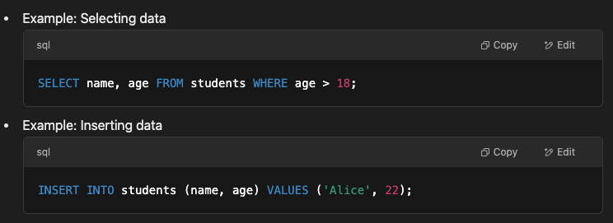
Writing Simple Queries

Slide 5
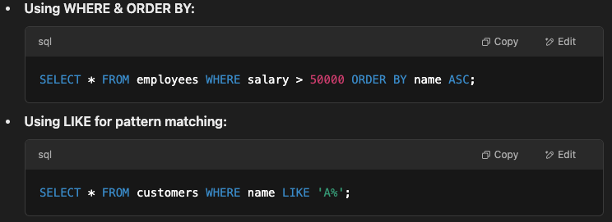
Filtering & Sorting Data

Slide 6
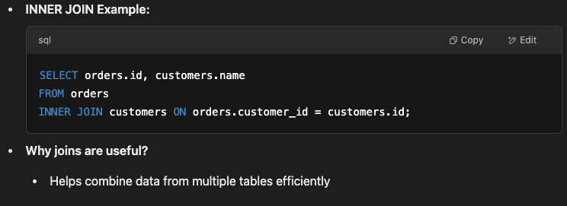
Joins & Relationships

Slide 7
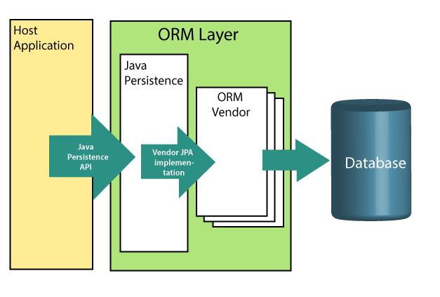
Object-Relation Mapping (ORM)
In ORM, the mapping of Java objects to database tables, and vice-versa is called Object-Relational Mapping. The ORM mapping works as a bridge between a relational database (tables and records) and Java application (classes and objects).
As you can see on the picture, the ORM layer is an adapter layer. It adapts the language of object graphs to the language of SQL and relation tables.

Slide 8
Spring Boot Data JPA
Spring Boot JPA is a Java specification for managing relational data in Java applications. It allows us to access and persist data between Java object/ class and relational database. JPA follows Object-Relation Mapping (ORM). It is a set of interfaces. It also provides a runtime EntityManager API for processing queries and transactions on the objects against the database. It uses a platform-independent object-oriented query language JPQL (Java Persistent Query Language).
In the context of persistence, it covers three areas:
The Java Persistence API
Object-Relational metadata
The API itself, defined in the persistence package
(#) JPA is not a framework. It defines a concept that can be implemented by any framework.

Slide 9
Why to use JPA
JPA avoids writing DDL in a database-specific dialect of SQL. Instead of this, it allows mapping in XML or using Java annotations.
JPA allows us to avoid writing DML in the database-specific dialect of SQL.
JPA allows us to save and load Java objects and graphs without any DML language at all.
When we need to perform queries JPQL, it allows us to express the queries in terms of Java entities rather than the (native) SQL table and columns.

Slide 10
JPA Architecture
Persistence: It is a class that contains static methods to obtain an EntityManagerFactory instance.
EntityManagerFactory: It is a factory class of EntityManager. It creates and manages multiple instances of EntityManager.
EntityManager: It is an interface. It controls the persistence operations on objects. It works for the Query instance.
Entity: The entities are the persistence objects stores as a record in the database.
Persistence Unit: It defines a set of all entity classes. In an application, EntityManager instances manage it. The set of entity classes represents the data contained within a single data store.
EntityTransaction: It has a one-to-one relationship with the EntityManager class. For each EntityManager, operations are maintained by EntityTransaction class.
Query: It is an interface that is implemented by each JPA vendor to obtain relation objects that meet the criteria.

Slide 11
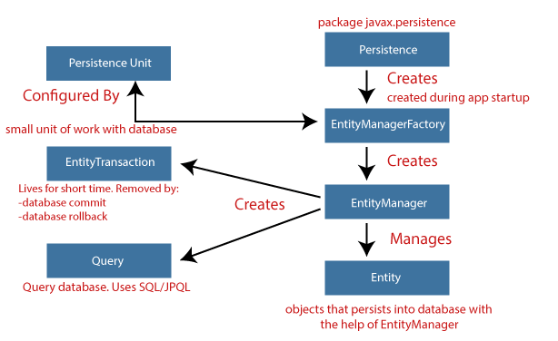
JPA ARCHITECTURE & FLOW

Slide 12
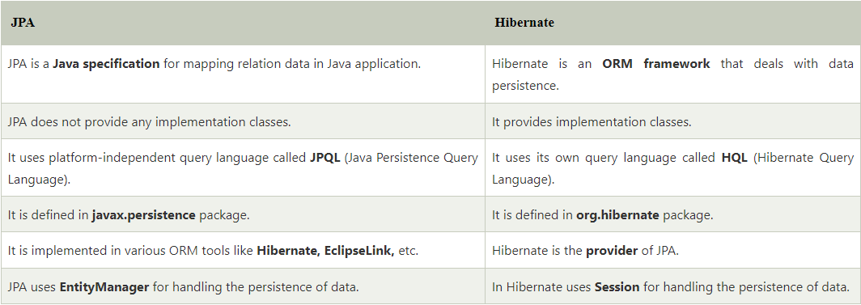
HIBERNATE
It is a lightweight, open-source ORM tool that is used to store Java objects in the relational database system. It is a provider of JPA. It follows a common approach provided by JPA.

Slide 13
HIBERNATE ADVANTAGES
1) Open Source and Lightweight
2) Fast Performance
The performance of hibernate framework is fast because cache is internally used in hibernate framework. There are two types of cache in hibernate framework first level cache and second level cache. First level cache is enabled by default.
3) Database Independent Query
HQL (Hibernate Query Language) is the object-oriented version of SQL. It generates the database independent queries. So you don't need to write database specific queries. Before Hibernate, if database is changed for the project, we need to change the SQL query as well that leads to the maintenance problem.
4) Automatic Table Creation
Hibernate framework provides the facility to create the tables of the database automatically. So there is no need to create tables in the database manually.
5) Simplifies Complex Join
Fetching data from multiple tables is easy in hibernate framework.
6) Provides Query Statistics and Database Status
Hibernate supports Query cache and provide statistics about query and database status.

Slide 14
LOMBOK
Avoid Repetitive & Boilder-plate Code
Constructor creation – @AllArgsConstructor, @NoArgsConstructor, @RequiredArgsConstructor
Getters & Setters - @Getter & @Setter
Equals & HashCode override - @EqualsAndHashCode
toString evveride - @ToString
Builder pattern - @Builder
Data - Generates getters for all fields, a useful toString method, and hashCode and equals implementations that check all non-transient fields. - @Data
Null Check & Avoid NullPointerException - @NonNull

Slide 15
CODE FIRST & DATABASE FIRST
Code First Database
In Code-First approach, entities or classes are created first with the primary focus on the domain of an application. You can start creating classes and required properties, without designing the database that matches the entities. Then the Entity Framework creates the tables and database accordingly and when the code is run, the database is created.
Database First Database
In Database-First approach, database and the related tables are created first. After that, you can create an entity data models using database. It is easier to create a database, as there are multiple options are available by using graphical user interfaces.

Slide 16
CODE-FIRST DATABASE
Advantages
You can create a database and required tables from business entities
It is recommended for small applications that does not involve extensive data processing
You can specify the collections for eager loading and the serialization of data
It provides full access over the code and you can do modifications easily in the code
Disadvantages
You need to write the code related to the creation of database
If there is any change in database after the creation, you need to do it in the business entity class of code and run the application to update the database or by using package manager console
It is difficult to manage the database through code, therefore, it is not recommended in data extensive applications where you need to process large amount of data and have complex logics to builup or maintain the data
Any manual changes will be lost if you update the code from application

Slide 17
Database-First Database
Advantages
Graphical User Interfaces are available to create database and tables, which makes the process easier
It is preferred for the large and extensive data-driven applications
It is easier to create keys and relationships without writing extra code for it
It can use an existing database
Visual Studio provides easy access to configure database via edmx files
Disadvantages
If there is any change in database, model class needs to be extended with the same properties
Creating and managing of keys and relationships requires more coding
It is difficult to maintain or update edmx file if the database is large

Slide 18
Technical Practise Time
LET’S GET OUR HANDS DIRTY
-------------
Hibernate Integration
CRUD operations implementation

Slide 19
HW#4
1 – What is JPA ?
2 - What is the naming convention for finder methods in the Spring data repository interface ?
3 - What is PagingAndSortingRepository ?
4 - Differentiate between findById() and getOne() ?
5 - What is @Query used for ?
6 - What is lazy loading in hibernate ?
7 – What is SQL injection attack ? Is Hibernate open to SQL injection attack ?
8 - What is criteria API in hibernate ?
9 - What Is Erlang? Why Is It Required For Rabbitmq ?
10 – What is the JPQL ?
11 – What are the steps to persist an entity object ?
12 – What are the different types of entity mapping ?
13 - What are the properties of an entity ?
14 - Difference between CrudRepository and JpaRepository in Spring Data JPA?

