Slide 1
Week 2
Spring
Spring Boot
Reactive Programming Approach
Spring WebFlux
GIT – VCS/Version Controlling System

Slide 2
Spring
Spring is a lightweight framework. It can be thought of as a framework of frameworks because it provides support to various frameworks such as Struts, Hibernate, Tapestry, EJB, JSF, etc. The framework, in broader sense, can be defined as a structure where we find solution of the various technical problems.
IOC ( Inversion of Control ) - Specification
DI ( Dependency Injection ) - Implementation

Slide 3
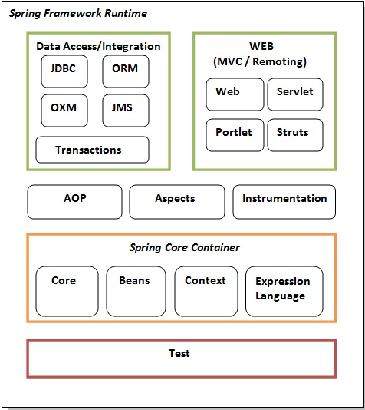
SPRING MODULES

Slide 4
Spring AdvantageS
1) Predefined Templates
Spring framework provides templates for JDBC, Hibernate, JPA etc. technologies. So there is no need to write too much code. It hides the basic steps of these technologies.
Let's take the example of JdbcTemplate, you don't need to write the code for exception handling, creating connection, creating statement, committing transaction, closing connection etc. You need to write the code of executing query only. Thus, it save a lot of JDBC code.
2) Loose Coupling
The Spring applications are loosely coupled because of dependency injection.
3) Easy to test
The Dependency Injection makes easier to test the application. The EJB or Struts application require server to run the application but Spring framework doesn't require server.
4) Lightweight
Spring framework is lightweight because of its POJO implementation. The Spring Framework doesn't force the programmer to inherit any class or implement any interface. That is why it is said non-invasive.
5) Fast Development
The Dependency Injection feature of Spring Framework and it support to various frameworks makes the easy development of JavaEE application.

Slide 5
IOC & DI
The Inversion-of-Control (IoC) pattern, is about providing any kind of callback (which controls reaction), instead of acting ourself directly (in other words, inversion and/or redirecting control to external handler/controller).
The Dependency-Injection (DI) pattern is a more specific version of IoC pattern, and is all about removing dependencies from your code.
Let’s see an example!

Slide 6
SPRING BEAN
In Spring, the objects that form the backbone of your application and that are managed by the Spring IoC container are called beans. A bean is an object that is instantiated, assembled, and otherwise managed by a Spring IoC container.
Some of most used Spring Bean annotations :
@ComponentScan @RequestBody
@Component @PathVariable
@Repository @RequestHeader
@Service
@Controller
@Configuration

Slide 7
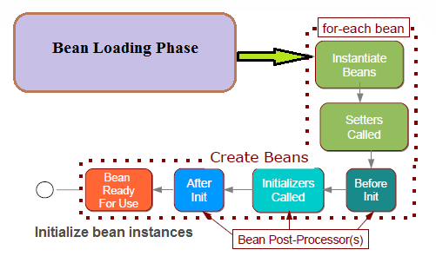
SPRING BEAN LIFE-CYCLE

Slide 8
SPRING BOOT
Spring Boot is a project that is built on the top of the Spring Framework. It provides an easier and faster way to set up, configure, and run both simple and web-based applications.
It is a Spring module that provides the RAD (Rapid Application Development) feature to the Spring Framework. It is used to create a stand-alone Spring-based application that you can just run because it needs minimal Spring configuration.

Slide 9
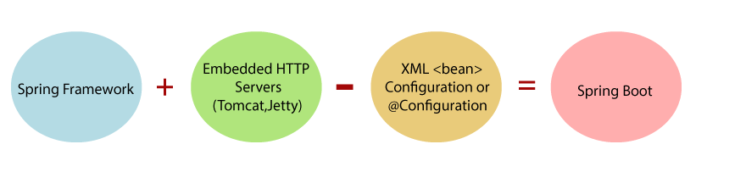
SPRING > to > SPRING BOOT

Slide 10
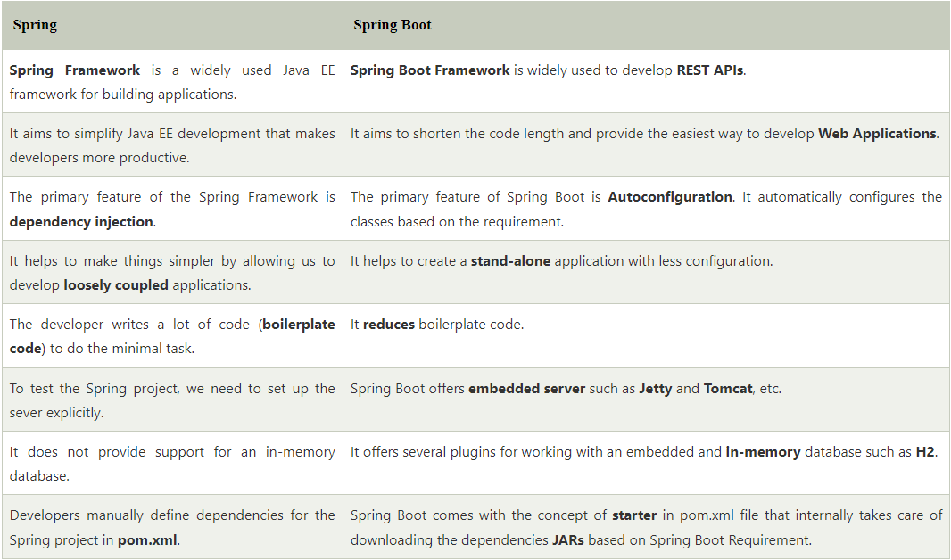
Spring Vs Spring Boot

Slide 11
SPRING BOOT ADVANTAGES
It creates stand-alone Spring applications that can be started using Java -jar.
It tests web applications easily with the help of different Embedded HTTP servers such as Tomcat, Jetty, etc. We don't need to deploy WAR files.
It provides opinionated 'starter' POMs to simplify our Maven configuration.
It provides production-ready features such as metrics, health checks, and externalized configuration.
There is no requirement for XML configuration.
It offers a CLI tool for developing and testing the Spring Boot application.
It offers the number of plug-ins.
It also minimizes writing multiple boilerplate codes (the code that has to be included in many places with little or no alteration), XML configuration, and annotations.
It increases productivity and reduces development time.

Slide 12
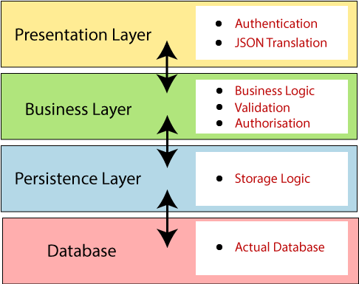
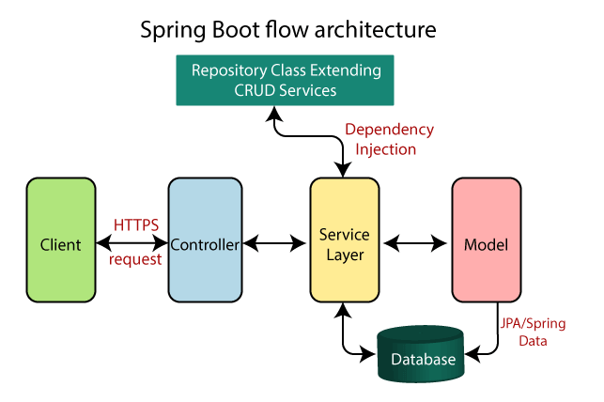
SPRING BOOT ARCHITECTURE

Slide 13
Spring Initializr
Spring Initializr is a web-based tool provided by the Pivotal Web Service. With the help of Spring Initializr, we can easily generate the structure of the Spring Boot Project. It offers extensible API for creating JVM-based projects.
It also provides various options for the project that are expressed in a metadata model. The metadata model allows us to configure the list of dependencies supported by JVM and platform versions, etc. It serves its metadata in a well-known that provides necessary assistance to third-party clients.

Slide 14
Mostly Used Annotations
1. @Bean
2. @Service
3. @Repository
4. @Configuration
5. @Controller
6. @RequestMapping
7. @Autowired
8. @Component
9. @SpringBootApplication
10. @EnableAutoConfiguration
11. @ComponetScan
12. @Required
13. @Qualifier

Slide 15
VCS / GIT
Git is a modern and widely used distributed version control system in the world. It is developed to manage projects with high speed and efficiency. The version control system allows us to monitor and work together with our team members at the same workspace.
Git is an open-source distributed version control system. It is designed to handle minor to major projects with high speed and efficiency. It is developed to co-ordinate the work among the developers. The version control allows us to track and work together with our team members at the same workspace.
Git is foundation of many services like GitHub and GitLab, but we can use Git without using any other Git services. Git can be used privately and publicly.

Slide 16
GIT FEATURES
Open Source
Scalable
Distributed
Security
Speed
Supports non-linear development
Branching and Merging
Data Assurance
Staging Area
Maintain the clean history

Slide 17
GIT BENEFITS
A version control application allows us to keep track of all the changes that we make in the files of our project. Every time we make changes in files of an existing project, we can push those changes to a repository. Other developers are allowed to pull your changes from the repository and continue to work with the updates that you added to the project files.
Some significant benefits of using Git are as follows:
Saves Time
Offline Working
Undo Mistakes
Track the Changes

Slide 18
GITHUB
GitHub is a Git repository hosting service. GitHub also facilitates with many of its features, such as access control and collaboration. It provides a Web-based graphical interface.
GitHub is an American company. It hosts source code of your project in the form of different programming languages and keeps track of the various changes made by programmers.
It offers both distributed version control and source code management (SCM) functionality of Git. It also facilitates with some collaboration features such as bug tracking, feature requests, task management for every project.

Slide 19
Features of GitHub
GitHub is a place where programmers and designers work together. They collaborate, contribute, and fix bugs together. It hosts plenty of open source projects and codes of various programming languages.
Collaboration
Integrated issue and bug tracking
Graphical representation of branches
Git repositories hosting
Project management
Team management
Code hosting
Track and assign tasks
Conversations
Wiki

Slide 20
Benefits of GitHub
GitHub can be separated as the Git and the Hub. GitHub service includes access controls as well as collaboration features like task management, repository hosting, and team management.
The key benefits of GitHub are as follows:
It is easy to contribute to open source projects via GitHub.
It helps to create an excellent document.
You can attract recruiter by showing off your work. If you have a profile on GitHub, you will have a higher chance of being recruited.
It allows your work to get out there in front of the public.
You can track changes in your code across versions.

Slide 21
GIT COMMANDS
https://rogerdudler.github.io/git-guide/

Slide 22
Reactive Programming What is Reactive Programming?
A programming paradigm focused on asynchronous data streams and the propagation of change
Based on the observer pattern: when data changes, all dependent components automatically update
Think of a spreadsheet: change one cell, and formulas using that cell recalculate automatically
Key principle: Instead of pulling data, we react to data as it arrives

Slide 23
Core Concepts of Reactive Programming
Observable Streams: Sources of data that emit values over time
Can be user events, API responses, property changes, etc.
Operators: Functions that transform, filter, or combine streams
Examples: map, filter, merge, combine, debounce
Subscribers/Observers: Components that "listen" to streams and react when new data arrives

Slide 24
Benefits and Use Cases
Benefits:
Naturally handles async operations
Simplifies complex event-handling code
Makes data flow explicit and manageable
Ideal for:
UI development (responding to user events)
Real-time applications (chat, monitoring)
Processing event-based data streams

Slide 25
Spring WebFlux Reactive Programming with Spring
What is Spring WebFlux?
Reactive web framework introduced in Spring 5
Alternative to the traditional Spring MVC
Built on Project Reactor (implements Reactive Streams specification)
Non-blocking, asynchronous programming model
Designed to handle concurrent requests with fewer resources

Slide 26
Core Components of WebFlux
Reactor Types:
Mono<T>: Emits 0 or 1 item
Flux<T>: Emits 0 to N items
RouterFunction & HandlerFunction:
Functional alternative to @Controller annotations
Declarative routing for HTTP requests
WebClient:
Non-blocking, reactive HTTP client
Replaces RestTemplate for reactive applications

Slide 27
Benefits & When to Use WebFlux
Benefits:
Better resource utilization with fewer threads
Improved scalability with high concurrency
Enhanced throughput for I/O-bound applications
Best for:
Microservices with high throughput requirements
Applications with many concurrent connections
Streaming data and real-time updates
Services that call other services (reactive chain)
Not ideal for:
CRUD applications with simple database operations
When your team is unfamiliar with reactive programming

Slide 28
Technical Practise Time
LET’S GET OUR HANDS DIRTY
------------- ------------- -------------
Sample Project initialization with Spring Initializr
Spring Boot Project Init
GIT Usage

Slide 29
HW#2
1 – IOC and DI means ?
2 – Spring Bean Scopes ?
3 – What does @SpringBootApplication do ?
4 – What is Spring AOP ? Where and How to use it ?
5 – What is Singleton and where to use it ?
6 – What is Spring Boot Actuator and Where to use it ?
7 - What is the primary difference between Spring and Spring Boot ?
8 – Why to use VCS ?
9 – What are SOLID Principles ? Give sample usages in Java ?
10 - What is RAD model ?
11 - What is Spring Boot starter ? How is it useful ?
12 – What is Caching ? How can we achive caching in Spring Boot ?
13 – What & How & Where & Why to logging ?
14 - What is Swagger? Have you implemented it using Spring Boot?

