Slide 1
Week 6
TDD
Unit Test / Integration Test
H2 DB Usage for test environment

Slide 2
Software development processes
Behavior-driven development (BDD)
Design-driven development (D3)
Domain-driven design (DDD)
Test-driven development (TDD)
Value-driven design (VDD)

Slide 3
TEST DRIVEN DEVELOPMENT (TDD)
Test Driven Development (TDD) is software development approach in which test cases are developed to specify and validate what the code will do. In simple terms, test cases for each functionality are created and tested first and if the test fails then the new code is written in order to pass the test and making code simple and bug-free.
Test-Driven Development starts with designing and developing tests for every small functionality of an application. TDD framework instructs developers to write new code only if an automated test has failed. This avoids duplication of code.

Slide 4
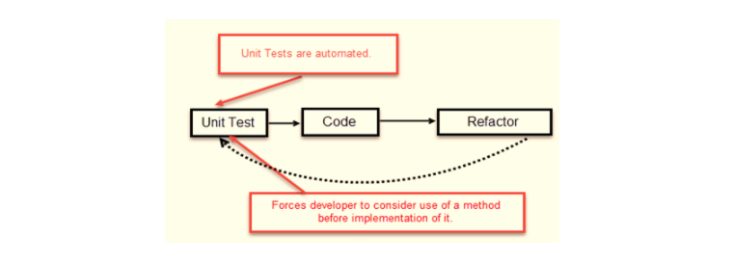
TDD – TEST FIRST DEVELOPMENT

Slide 5
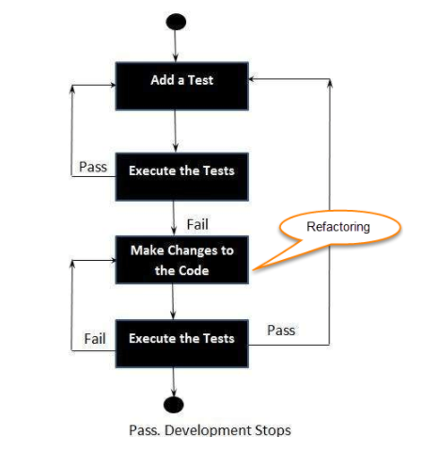
TDD TEST FLOW
Add new test(s)
Run all tests and see if any new test fails
Write some code
Run tests and Refactor code
Repeat
F.e; HackerRank, Coderbyte etc…

Slide 6
TDD –Vs- Traditional Testing
In traditional testing, a successfully executed test discovers one or more than one bugs. The same is in TDD. When a test case fails, there is some development or progress as we know that the problem has to be resolved.
TDD makes sure that the system meets all the specified requirements. It helps build and boost confidence in the system.
TDD emphasizes product code that determines if the testing will be successful or not. While traditional testing focuses on the designing of test cases, and also if the test will execute properly or not to meet the specified requirements.
In TDD, complete coverage of the testing is achieved. Unlike traditional testing, in TDD we test each line of the code.
TDD and traditional testing, when combines, explain why the testing of the system is so important.
In agile modelling, the testing should have a specific purpose. We should be aware of why we are testing and the level of the testing.

Slide 7
Technical Practise Time
LET’S GET OUR HANDS DIRTY
-------------
Spring Boot Test Usages
Unit Test
Integration Test

Slide 8
HW#6
1 – What is the difference between manual testing and automated testing ?
2 – What does Assert class ?
3 - How can be tested 'private' methods ?
4 – What is Monolithic Architecture ?
5 - What are the best practices to write a Unit Test Case ?
6 - Why does JUnit only report the first failure in a single test ?
7 - What are the benefits and drawbacks of Microservices ?
8 - What is the role of actuator in spring boot ?
9 - What are the challenges that one has to face while using Microservices ?
10 - How independent microservices communicate with each other?
11 - What do you mean by Domain driven design ?
12 – What is container in Microservices ?
13 - What are the main components of Microservices architecture ?
14 - How does a Microservice architecture work?

