Slide 1
Week 7
Docker - Docker Compose
Swagger – OpenAPI
CI / CD
Monitoring & Logging

Slide 2
DOCKER
Docker is a container management service. The keywords of Docker are develop, ship and run anywhere. The whole idea of Docker is for developers to easily develop applications, ship them into containers which can then be deployed anywhere.
Features of Docker :
Docker has the ability to reduce the size of development by providing a smaller footprint of the operating system via containers.
With containers, it becomes easier for teams across different units, such as development, QA and Operations to work seamlessly across applications.
You can deploy Docker containers anywhere, on any physical and virtual machines and even on the cloud.
Since Docker containers are pretty lightweight, they are very easily scalable

Slide 3
DOCKER HUB
Docker Hub is a registry service on the cloud that allows you to download Docker images that are built by other communities. You can also upload your own Docker built images to Docker hub. In this chapter, we will see how to download and the use the Jenkins Docker image from Docker hub.

Slide 4

DOCKER IMAGES
In Docker, everything is based on Images. An image is a combination of a file system and parameters. Let’s take an example of the following command in Docker.
The Docker command is specific and tells the Docker program on the Operating System that something needs to be done.
The run command is used to mention that we want to create an instance of an image, which is then called a container.
Finally, "hello-world" represents the image from which the container is made.

Slide 5


Docker Containers
Containers are instances of Docker images that can be run using the Docker run command. The basic purpose of Docker is to run containers. Let’s discuss how to work with containers.
Running a Container:
Running of containers is managed with the Docker run command. To run a container in an interactive mode, first launch the Docker container.
Listing of Containers:
One can list all of the containers on the machine via the docker ps command. This command is used to return the currently running containers.
a

Slide 6
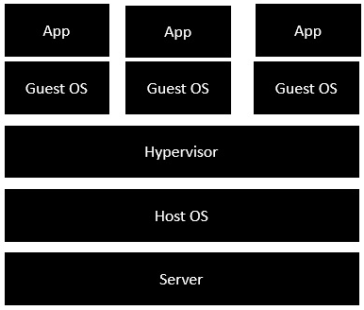
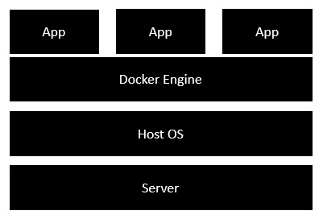
Docker Architecture
Traditional Vertualization
Docker

Slide 7
DOCKER COMPOSE
Docker Compose is used to run multiple containers as a single service. For example, suppose you had an application which required NGNIX and MySQL, you could create one file which would start both the containers as a service without the need to start each one separately.
We can then use the following command to see the compose version :

Slide 8
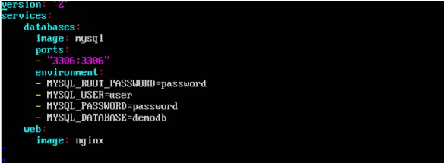
DOCKER COMPOSE
Format of Docker-Compose File:
Now let’s run our Docker Compose file using the following command:
-

Slide 9
CI / CD
CI/CD is a method to frequently deliver apps to customers by introducing automation into the stages of app development. The main concepts attributed to CI/CD are continuous integration, continuous delivery and continuous deployment. CI/CD is a solution to the problems integrating new code can cause for development and operations teams (AKA "integration hell").
Specifically, CI/CD introduces ongoing automation and continuous monitoring throughout the lifecycle of apps, from integration and testing phases to delivery and deployment. Taken together, these connected practices are often referred to as a "CI/CD pipeline" and are supported by development and operations teams working together in an agile way with either a DevOps or site reliability engineering (SRE) approach.

Slide 10
CI –vs- CD
The acronym CI/CD has a few different meanings. The "CI" in CI/CD always refers to continuous integration, which is an automation process for developers. Successful CI means new code changes to an app are regularly built, tested, and merged to a shared repository. It’s a solution to the problem of having too many branches of an app in development at once that might conflict with each other.
The "CD" in CI/CD refers to continuous delivery and/or continuous deployment, which are related concepts that sometimes get used interchangeably. Both are about automating further stages of the pipeline, but they’re sometimes used separately to illustrate just how much automation is happening.
Continuous delivery usually means a developer’s changes to an application are automatically bug tested and uploaded to a repository (like GitHub or a container registry), where they can then be deployed to a live production environment by the operations team. It’s an answer to the problem of poor visibility and communication between dev and business teams. To that end, the purpose of continuous delivery is to ensure that it takes minimal effort to deploy new code.

Slide 11
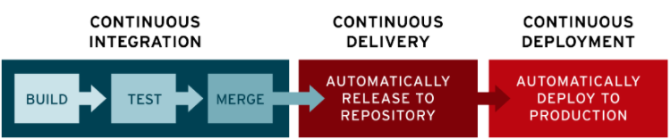
CONTINUOUS DEPLOYMENT
Continuous deployment (the other possible "CD") can refer to automatically releasing a developer’s changes from the repository to production, where it is usable by customers. It addresses the problem of overloading operations teams with manual processes that slow down app delivery. It builds on the benefits of continuous delivery by automating the next stage in the pipeline.

Slide 12
CI / CD Tools
CI/CD tools can help a team automate their development, deployment, and testing. Some tools specifically handle the integration (CI) side, some manage development and deployment (CD), while others specialize in continuous testing or related functions.
Jenkins
GitLab
CircleCI
Travis CI
Atlassian Bamboo

Slide 13
Monitoring & Logging
Why They Matter in Modern Applications
Monitoring and logging are key to understanding system health and diagnosing issues.
Essential for performance optimization, debugging, and security.

Slide 14
What is Monitoring?
Continuous observation of system metrics (CPU, memory, response times, errors, etc.).
Types of Monitoring:
Infrastructure Monitoring(CPU, Memory, Network)
Application Monitoring (Response times, error rates)
User Monitoring (Performance from the end-user perspective)
Popular Tools: Prometheus, Grafana, Datadog, New Relic

Slide 15
What is Logging?
Capturing and storing application events and errors for analysis.
Types of Logs:
Application Logs (Requests, responses, errors)
System Logs (Kernel, OS logs)
Security Logs (Unauthorized access, failed login attempts)
Popular Tools: ELK Stack (Elasticsearch, Logstash, Kibana), Loki, Fluentd

Slide 16
Best Practices
Centralize logs and metrics.
Use structured logging (JSON format).
Set up alerts for critical metrics.
Store logs efficiently with retention policies.
Monitor trends over time to prevent failures.

Slide 17
Technical Practise Time
LET’S GET OUR HANDS DIRTY
-------------
Swagger Documentation
Docker
Docker Compose

