Slide 1


JAVA SPRING WEB DEVELOPMENT BOOTCAMP
Instructor:
Ramazan Sakin
ramazansakin63@gmail.com
linkedin.com/in/ramazan-sakin
github.com/ramazansakin

Slide 2
TABLE OF CONTENTS
Week 1 :
Core Java
OOP Concepts in Java
Clean Code
Maven & Gradle
Technical Environment Setup
- Development IDE ( Intellij Idea , Eclipse, STS etc. )
- API Testing ( Postman )
- GitBash ( VCS )
Week 2 :
Spring
Spring Boot
Reactive Programming Approach (Spring WebFlux)
Version Controlling Systems - GIT
Technical Practise
- Sample Project initialization with Spring Initializr
- GIT Usage
Week 3 :
Restful
SOAP
HTTP
Java 8-24 Overview
Technical Practise
- Java 8-24 sample usages
- Defining an API and configurations
Week 4 :
SQL
Spring Boot Data
ORM , JPA and Hibernate
RDBMS and NoSQL (PostgreSQL, Mongo, Redis)
Technical Practise
- Hibernate Integration with CRUD operations

Slide 3
TABLE OF CONTENTS
Week 5 :
Spring Security
User Authorization & Authentication
JWT Integration
Microservices Architecture
Technical Practise
- Spring Boot Security Integration with JWT
Week 6 :
Spring Boot Test
Unit Test / Integration Test
H2 DB Usage for test environment
Technical Practise
- Spring Boot Test Usages
Week 7 :
Docker, Docker Compose
API Documentation with Swagger, OpenAPI
CI / CD
Monitoring & Logging – NewRelic, DataDog, Prometheus, Kibana

Slide 4
Week 1
Core Java
OOP Concepts in Java
Clean Code
Maven & Gradle
Technical Environment Setup

Slide 5
Java
Java is one of the world's most important and widely used computer languages, and it has held this distinction for many years. Unlike some other computer languages whose influence has weared with passage of time, while Java's has grown.
Java is a high level, robust, object-oriented, secure and stable programming language but it is not a pure object-oriented language because it supports primitive data types like int, char etc.
Java is a platform-independent language because it has runtime environment i.e JRE and API. Here platform means a hardware or software environment in which anapplication runs.
Java codes are compiled into byte code or machine-independent code. This byte code is run on JVM (Java Virtual Machine).
The syntax is Java is almost the same as C/C++. But java does not support low-level programming functions like pointers. The codes in Java is always written in the form of Classes and objects.

Slide 6
Creation of Java
Java was developed by James Ghosling, Patrick Naughton, Mike Sheridan at Sun Microsystems Inc. in 1991. It took 18 months to develop the first working version.
The initial name was Oak but it was renamed to Java in 1995 as OAK was a registered trademark of another Tech company.

Slide 7
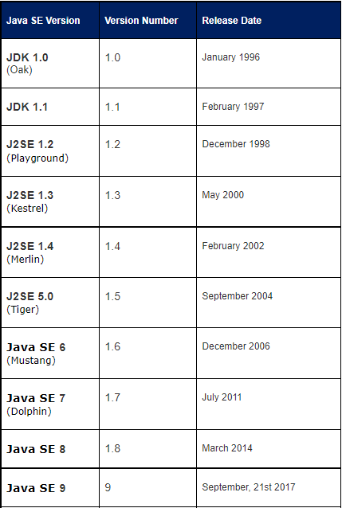

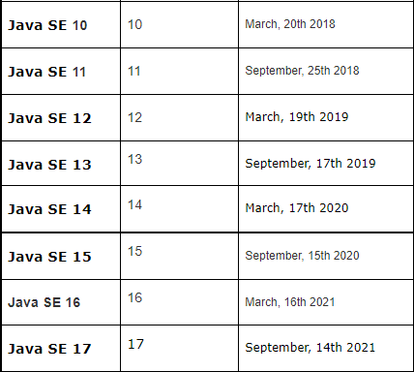
Java Version History
Java SE 18 - March 2022
Java SE 19 - September 2022
Java SE 20 - March 2023
Java SE 21 (LTS) - September 2023
Java SE 22 - March 2024
Java SE 23 - September 2024
Java SE 24 – March 2025
Java SE 25 – September 2025
Notable changes:
Starting with Java SE 9, Oracle switched to a 6-month release cycle
The versioning scheme changed from 1.x to just x starting with Java SE 9
Long-Term Support (LTS) versions are released every 2 years (Java 11, 17, 21)

Slide 8
HOW TO VERSION
[major].[minor].[release].[build]
--------------------------------------------
major: Really a marketing decision. Are you ready to call the version 1.0? Does the company consider this a major version for which customers might have to pay more, or is it an update of the current major version which may be free? Less of an R&D decision and more a product decision.
minor: Starts from 0 whenever major is incremented. +1 for every version that goes public.
release: Every time you hit a development milestone and release the product, even internally (e.g. to QA), increment this. This is especially important for communication between teams in the organization. Needless to say, never release the same 'release' twice (even internally). Reset to 0 upon minor++ or major++.
build: Can be a SVN revision, I find that works best.
F.e : My current chrome version: 96.0.4664.110
In Turkey, generally > [major-version].[minor-version].[bug-fix]

Slide 9
Types of Java Application
Standalone Applications
Web Applications
Enterprise Application
Mobile Application

Slide 10
Features Of Java
Simple
Object Oriented
Robust
Platform Independent
Secure
Multi Threading
Architectural Neutral
Portable
High Performance

Slide 11
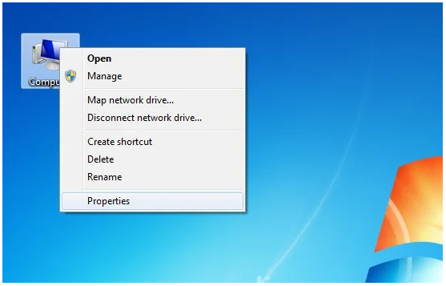
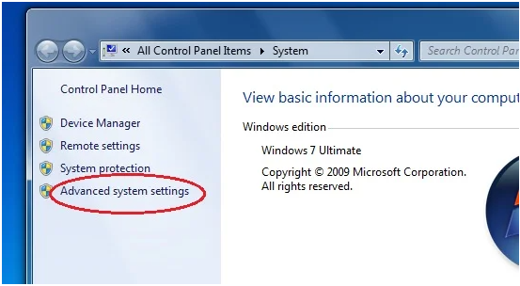
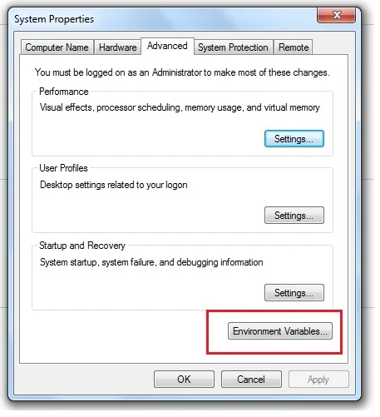
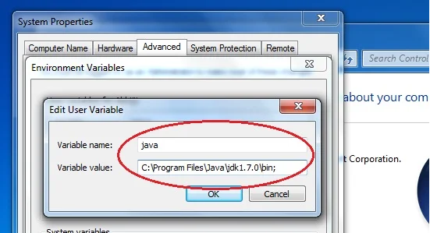
Setting Java Environment and Classpath

Slide 12
Java JVM, JDK and JRE
JDK is a software development environment used for making applets and Java applications. The full form of JDK is Java Development Kit. Java developers can use it on Windows, macOS, Solaris, and Linux. JDK helps them to code and run Java programs. It is possible to install more than one JDK version on the same computer.
JRE is a piece of a software which is designed to run other software. It contains the class libraries, loader class, and JVM. In simple terms, if you want to run Java program you need JRE. If you are not a programmer, you don’t need to install JDK, but just JRE to run Java programs. Though, all JDK versions comes bundled with Java Runtime Environment, so you do not need to download and install the JRE separately in your PC. The full form of JRE is Java Runtime Environment.
JVM is an engine that provides a runtime environment to drive the Java Code or applications. It converts Java bytecode into machine language. JVM is a part of Java Run Environment (JRE). It cannot be separately downloaded and installed. To install JVM, you need to install JRE. The full form of JVM is Java Virtual Machine.

Slide 13

Java - Variable
When we want to store any information, we store it in an address of the computer. Instead of remembering the complex address where we have stored our information, we name that address.The naming of an address is known as variable. Variable is the name of memory location.
Java Programming language defines mainly three kind of variables.
Instance Variables
Static Variables (Class Variables)
Local Variables

Slide 14
Variable Scope
Local variable: Scope of local variable is limited to the block in which it is declared. For example, a variables declared inside a function will be accessible only within this function.
Instance variable: scope of instance variable depends on the access-modifiers (public, private, default). If variable is declared as private then it is accessible within class only.
If variable is declared as public then it is accessible for all and throughout the application.
If variable is declared as default the it is accessible with in the same package.

Slide 15
Java - Data Types
Java language has a rich implementation of data types. Data types specify size and the type of values that can be stored in an identifier.
In java, data types are classified into two catagories :
Primitive Data type
Reference(Non-Primitive) Data type

Slide 16
Initializer BlocK
In Java, the initializer Block is used to initialize instance data members. The initializer block is executed whenever an object is created. The Initializer block is copied into Java compiler and then to every constructor. The initialization block is executed before the code in the constructor.
Let’s see an example!

Slide 17



Java - Type Casting
Casting is a process of changing one type value to another type. In Java, we can cast one type of value to another type. It is known as type casting.
Widening Casting(Implicit)
Narrowing Casting(Explicitly done)
Let’s see an example!

Slide 18
JAVA CORE CONCEPTS
Conditionals(if-else and switch statements)
Loops (for, while, do-while)
Operators
Arrays
Object Creations ways
Detailed tutorials can be found here:
https://www.studytonight.com/java/conditional-statement.php

Slide 19
Programming Paradigms
Imperative
Logical
Functional
Object-Oriented
Detailed describtions can be found here:
http://www.cs.ucf.edu/~leavens/ComS541Fall97/hw-pages/paradigms/major.html

Slide 20
Object Oriented ProgrammIng ParadIgm
Object-oriented programming (OOP) is a programming paradigm based upon objects (having both data and methods) that aims to incorporate the advantages of modularity and reusability. Objects, which are usually instances of classes, are used to interact with one another to design applications and computer programs.

Slide 21
Class
A class is a user defined blueprint or prototype from which objects are created. It represents the set of properties or methods that are common to all objects of one type. In general, class declarations can include these components, in order:
Modifiers: A class can be public or has default access.
class keyword: class keyword is used to create a class.
Class name: The name should begin with an initial letter (capitalized by convention).
Superclass(if any): The name of the class’s parent (superclass), if any, preceded by the keyword extends. A class can only extend (subclass) one parent.
Interfaces(if any): A comma-separated list of interfaces implemented by the class, if any, preceded by the keyword implements. A class can implement more than one interface.
Body: The class body surrounded by braces, { }.

Slide 22
OBJECT
It is a basic unit of Object-Oriented Programming and represents the real life entities. A typical Java program creates many objects, which as you know, interact by invoking methods. An object consists of :
State: It is represented by attributes of an object. It also reflects the properties of an object.
Behavior: It is represented by methods of an object. It also reflects the response of an object with other objects.
Identity: It gives a unique name to an object and enables one object to interact with other objects.

Slide 23
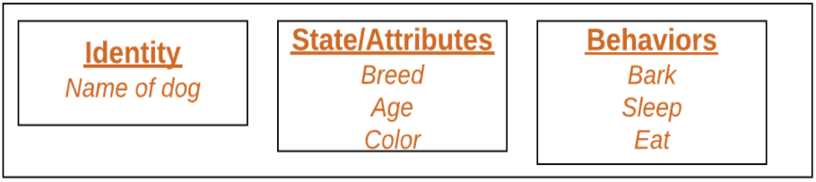
OBJECT
Sample Class detailed usages can be found here:
> https://github.com/ramazansakin/Patika-OOP-Concept-Samples

Slide 24
Encapsulation
Encapsulation is one of our fundemental OOP concepts. The other three are inheritance, polymorphism and abstraction.
Encapsulation is the technique of making the fields in a class private and providing access to the fields via public methods. If a field is decleared as private, it can not be accessed by anyone outside the class, thereby hiding the fields within the class. For this reason, encapsulation is also refered to as data hiding.
Let’s see an example of Class usage!

Slide 25
Abstraction
Abstraction is the process of abstraction in Java is used to hide certain details and only show the essential features of the object. In other words, it details with the outside view of an object(interface).
Abstract class can not be instantiated; the class does not have much use unless it is subclass. This is tipically how abstract classes come about during the design phase. A parent class contains the common functionality of a collection of child classes, but the parent class itself is too abstract to be used on its own.

Slide 26
INTERFACE
An interface in Java is a blueprint of a class. It has static constants and abstract methods.
The interface in Java is a mechanism to achieve abstraction. There can be only abstract methods in the Java interface, not method body. It is used to achieve abstraction and multiple inheritance in Java.
IS-A and HAS-A relationships
Why to use :
It is used to achieve abstraction.
By interface, we can support the functionality of multiple inheritance. – Diamond Problem Solution
It can be used to achieve loose coupling.
Let’s see an example!

Slide 27
Inheritance
Inheritance is an important pillar of OOP(Object-Oriented Programming). It is the mechanism in java by which one class is allowed to inherit the features(fields and methods) of another class.
Super Class: The class whose features are inherited is known as superclass(or a base class or a parent class).
Sub Class: The class that inherits the other class is known as a subclass(or a derived class, extended class, or child class). The subclass can add its own fields and methods in addition to the superclass fields and methods.
Reusability: Inheritance supports the concept of “reusability”, i.e. when we want to create a new class and there is already a class that includes some of the code that we want, we can derive our new class from the existing class. By doing this, we are reusing the fields and methods of the existing class.
Let’s see an example & let’s combine interface and inheritance usage!

Slide 28
POLYMORPHISM
Polymorphism means "many forms", and it occurs when we have many classes that are related to each other by inheritance.
Like we specified in the Inheritance chapter; lets us inherit attributes and methods from another class. Polymorphism uses those methods to perform different tasks. This allows us to perform a single action in different ways.
Method Overriding
Let’s see an example!

Slide 29
INNER CLASSES
In Java, it is also possible to nest classes (a class within a class). The purpose of nested classes is to group classes that belong together, which makes your code more readable and maintainable.
Private Inner Class :
Unlike a ‘regular’ class, an inner class can be private or protected. If you want outside objects to Access class, decleare the class as private.
Let’s see an example!

Slide 30
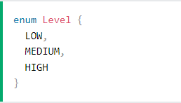
enumerations
An enum is a ‘speicial’ class that represent a group of constants (unchangeable variables, like final variables).
To create an enum, use the ‘enum’ keyword (instead of class or interface), and seperate the constants with a comma. Not that they should be in uppercase letters.
Sample :
Let’s see an example!

Slide 31
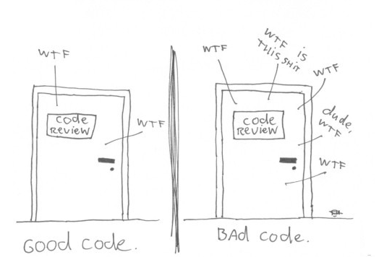
CLEAN CODE

Slide 32
CLEAN CODE
Software engineering principles, from Robert C. Martin's book Clean Code, adapted for Java. This is not a style guide. It's a guide to producing readable, reusable and refactorable software in Java.
Not every principle herein has to be strictly followed, and even fewer will be universally agreed upon. These are guidelines and nothing more, but they are ones codified over many years of collective experience by the authors of Clean Code.

Slide 33
VARIABLES
Use meaningful and pronounceable variable names
> String yyyymmdstr = new SimpleDateFormat("YYYY/MM/DD").format(new Date()); // Bad
> String currentDate = new SimpleDateFormat("YYYY/MM/DD").format(new Date()); // Good
Use the same vocabulary for the same type of variable
// Bad
getUserInfo();
getClientData();
getCustomerRecord();
// Good
getUser();

Slide 34
VARIABLES
Use searchable names
We will read more code than we will ever write. It's important that the code we do write is readable and searchable.
setTimeout(blastOff, 86400000); // Bad
// Declare them as capitalized `const` globals.
public static final int MILLISECONDS_IN_A_DAY = 86400000;
setTimeout(blastOff, MILLISECONDS_IN_A_DAY); // Good

Slide 35
VARIABLES
Use explanatory variables
// Bad
String address = "One Infinite Loop, Cupertino 95014";
String cityZipCodeRegex = "/^[^,\\\\]+[,\\\\\\s]+(.+?)\\s*(\\d{5})?$/";
saveCityZipCode(address.split(cityZipCodeRegex)[0], address.split(cityZipCodeRegex)[1]);
// Good
String address = "One Infinite Loop, Cupertino 95014";
String cityZipCodeRegex = "/^[^,\\\\]+[,\\\\\\s]+(.+?)\\s*(\\d{5})?$/";
String city = address.split(cityZipCodeRegex)[0];
String zipCode = address.split(cityZipCodeRegex)[1];
saveCityZipCode(city, zipCode);

Slide 36
VARIABLES
Avoid Mental Mapping
String [] l = {"Austin", "New York", "San Francisco"}; // Bad
String[] locations = {"Austin", "New York", "San Francisco"}; // Good
Don't add unneeded context
// Bad // Good
class Car {
public String carMake;
public String carModel;
public String carColor;
}
class Car {
public String make;
public String model;
public String color;
}

Slide 37
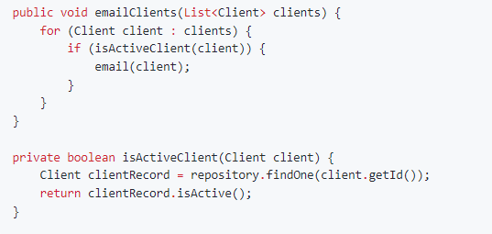
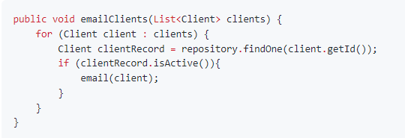
FUNCTIONS
Function arguments
Limiting the amount of function parameters is incredibly important because it makes testing your function easier. Having more than three leads to a combinatorial explosion where you have to test tons of different cases with each separate argument.
Functions should do one thing

Slide 38
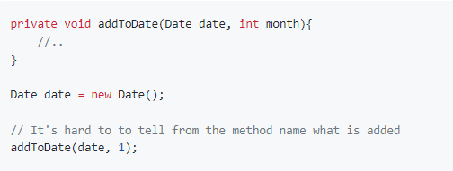
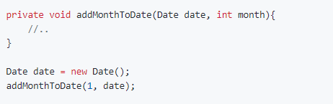
FUNCTIONS
Function names should say what they do

Slide 39
FUNCTIONS
Functions should only be one level of abstraction
Remove duplicate code
Don't use flags as function parameters
Avoid Side Effects
Don't write to global functions
Remove dead code

Slide 40
Objects and Data Structures
Use getters and setters
Make objects have private members
Prefer composition over inheritance
Use Design Patterns & Principles as possible
Let’s see another perspective on https://refactoring.guru/refactoring/what-is-refactoring

Slide 41
MAVEN
Maven is a project management and comprehension tool that provides developers a complete build lifecycle framework. Development team can automate the project's build infrastructure in almost no time as Maven uses a standard directory layout and a default build lifecycle.
In case of multiple development teams environment, Maven can set-up the way to work as per standards in a very short time. As most of the project setups are simple and reusable, Maven makes life of developer easy while creating reports, checks, build and testing automation setups.
To summarize, Maven simplifies and standardizes the project build process. It handles compilation, distribution, documentation, team collaboration and other tasks seamlessly. Maven increases reusability and takes care of most of the build related tasks.

Slide 42
MAVEN EVOLUTION
Maven was originally designed to simplify building processes in Jakarta Turbine project. There were several projects and each project contained slightly different ANT build files. JARs were checked into CVS.
Apache group then developed Maven which can build multiple projects together, publish projects information, deploy projects, share JARs across several projects and help in collaboration of teams.

Slide 43
MAVEN EVOLUTION
Model-based builds − Maven is able to build any number of projects into predefined output types such as jar, war, metadata.
Coherent site of project information − Using the same metadata as per the build process, maven is able to generate a website and a PDF including complete documentation.
Release management and distribution publication − Without additional configuration, maven will integrate with your source control system such as CVS and manages the release of a project.
Backward Compatibility − You can easily port the multiple modules of a project into Maven 3 from older versions of Maven. It can support the older versions also.
Automatic parent versioning − No need to specify the parent in the sub module for maintenance.
Parallel builds − It analyzes the project dependency graph and enables you to build schedule modules in parallel. Using this, you can achieve the performance improvements of 20-50%.
Better Error and Integrity Reporting − Maven improved error reporting, and it provides you with a link to the Maven wiki page where you will get full description of the error

Slide 44
MAVEN - POM
POM stands for Project Object Model. It is fundamental unit of work in Maven. It is an XML file that resides in the base directory of the project as pom.xml.
The POM contains information about the project and various configuration detail used by Maven to build the project(s).
POM also contains the goals and plugins. While executing a task or goal, Maven looks for the POM in the current directory. It reads the POM, gets the needed configuration information, and then executes the goal.
Before creating a POM, we should first decide the project group (groupId), its name (artifactId) and its version as these attributes help in uniquely identifying the project in repository.

Slide 45
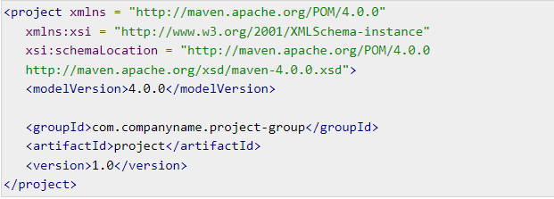
SAMPLE POM FILE

Slide 46
Convention over Configuration
Maven uses Convention over Configuration, which means developers are not required to create build process themselves. (Iterface -> Class , « code to Interface »)
Developers do not have to mention each and every configuration detail. Maven provides sensible default behavior for projects. When a Maven project is created, Maven creates default project structure. Developer is only required to place files accordingly and he/she need not to define any configuration in pom.xml.
As an example, following table shows the default values for project source code files, resource files and other configurations. Assuming, ${basedir} denotes the project location:
Source code → ${basedir}/src/main/java
Resources → ${basedir}/src/main/resources

Slide 47
Features of Maven
Simple project setup that follows best practices.
Consistent usage across all projects.
Dependency management including automatic updating.
A large and growing repository of libraries.
Extensible, with the ability to easily write plugins in Java or scripting languages.
Instant access to new features with little or no extra configuration..

Slide 48
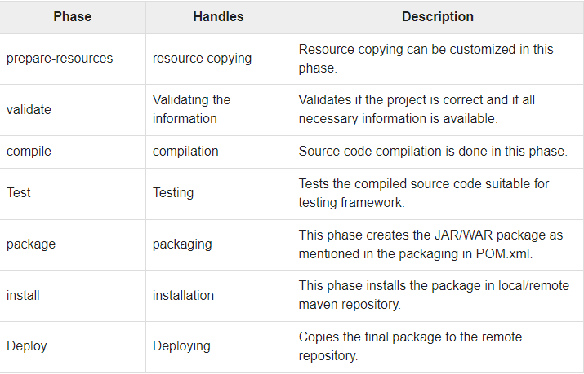
MAVEN Build Lifecycle

Slide 49
Maven - External Dependencies
As you know, Maven does the dependency management using the concept of Repositories. But what happens if dependency is not available in any of remote repositories and central repository? Maven provides answer for such scenario using concept of External Dependency.

Slide 50
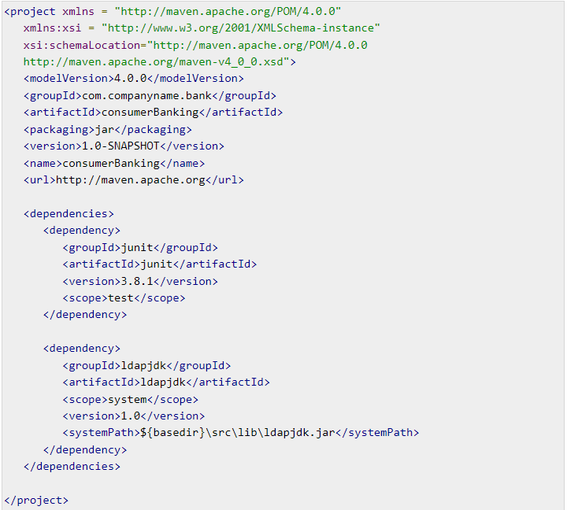
Sample Pom File with External Dependecies

Slide 51
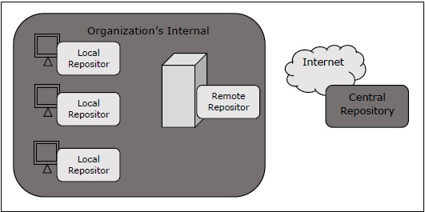
Maven Repository

Slide 52
Maven - Project Templates
Maven provides users, a very large list of different types of project templates (614 in numbers) using the concept of Archetype. Maven helps users to quickly start a new java project using the following command.
What is Archetype ?
Archetype is a Maven plugin whose task is to create a project structure as per its template. We are going to use quickstart archetype plugin to create a simple java application.

Slide 53
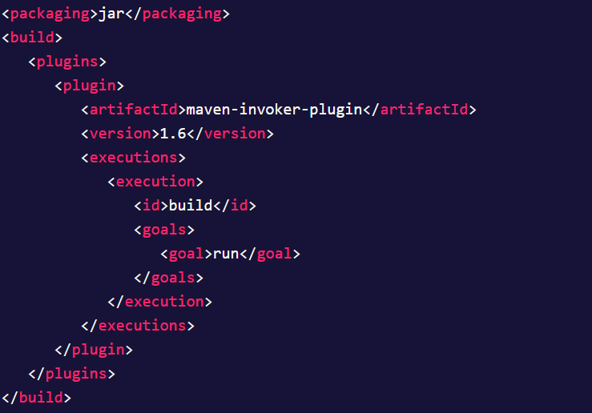
MAVEN – BUILD AUTOMATION
Build automation is the process in which a project gets initiated with the build process whenever a change is made in the workspace and also to ensure that project is stable along with its dependent projects (if the project is used by any other projects).
This is very much essential in the software development life cycle as it is difficult to manage with the failed builds during the development phase. Hence, a process is required in order to ensure the health status of the build all the time and keep an eye on the same.

Slide 54
HW#1
1 – Why we need to use OOP ? Some major OOP languages ?
2 – Interface vs Abstract class ?
3 – Why wee need equals and hashcode ? When to override ?
4 – Diamon problem in Java ? How to fix it?
5 – Why we need Garbagge Collector ? How does it run ?
6 – Java ‘static’ keyword usage ?
7 – Immutability means ? Where, How and Why to use it ?
8 – Composition and Aggregation means and differences ?
9 – Cohesion and Coupling means and differences ?
10 - Heap and Stack means and differences ?
11 – Exception means ? Type of Exceptions ?
12 – How to summarize ‘clean code’ as short as possible ?
13 - What is the method of hiding in Java ?
14 - What is the difference between abstraction and polymorphism in Java ?

