Slide 1
WEEK 5
Authorization & Authentication via Spring Boot Security
JWT Integration
Spring Boot AOP
Spring Boot Actuator
Exception Handling

Slide 2
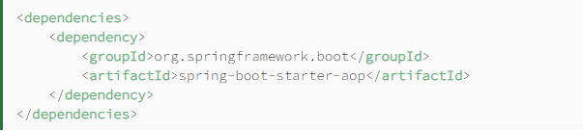
Spring boot AOP
AOP is a programming paradigm that aims to increase modularity by allowing the separation of cross-cutting concerns. It does this by adding additional behavior to existing code without modifying the code itself.
Instead, we can declare the new code and the new behaviors separately.
Spring's AOP framework helps us implement these cross-cutting concerns.

Slide 3
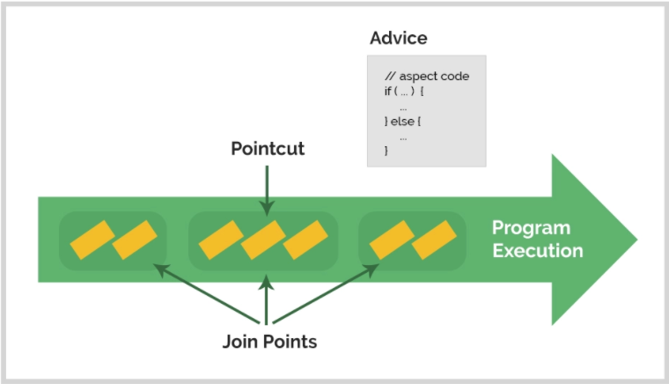
AOP Concepts and Terminology

Slide 4
Terminology
Aspect
An aspect is a modularization of a concern that cuts across multiple classes. Unified logging can be an example of such cross-cutting concern.
Joinpoint
A Joinpoint is a point during the execution of a program, such as the execution of a method or the handling of an exception.
Pointcut
A Pointcut is a predicate that helps match an Advice to be applied by an Aspect at a particular JoinPoint.
We often associate the Advice with a Pointcut expression, and it runs at any Joinpoint matched by the Pointcut.
Advice
An Advice is an action taken by an aspect at a particular Joinpoint. Different types of advice include “around,” “before,” and “after.”

Slide 5
Spring boot actuator
In essence, Actuator brings production-ready features to our application.
Monitoring our app, gathering metrics, understanding traffic, or the state of our database become trivial with this dependency.
The main benefit of this library is that we can get production-grade tools without having to actually implement these features ourselves.
Actuator is mainly used to expose operational information about the running application — health, metrics, info, dump, env, etc. It uses HTTP endpoints or JMX beans to enable us to interact with it.

Slide 6
Actuator Predefined Endpoints
/beans returns all available beans in our BeanFactory. Unlike /auditevents, it doesn't support filtering.
/env returns the current environment properties. Additionally, we can retrieve single properties.
/health summarizes the health status of our application.
/info returns general information. It might be custom data, build information or details about the latest commit.
/logfile returns ordinary application logs.
/metrics details metrics of our application. This might include generic metrics as well as custom ones.
/shutdown performs a graceful shutdown of the application.

Slide 7
Technical Practise Time
LET’S GET OUR HANDS DIRTY
-------------
Spring Security Integration
Security Configurations
JWT Usage

Slide 8
HW#5
1 – What are Authentication and Authorization ?
2 - What is Hashing in Spring Security ?
3 - What is Salting and why do we use the process of Salting ?
4 - What is “intercept-url” pattern ?
5 - What do you mean by session management in Spring Security ?
6 – Why we need Exception Handling ?
7 - Explain what is AuthenticationManager in Spring security ?
8 - What is Spring Security Filter Chain ?
9 – What are the differences between OAuth2 and JWT ?
10 - What is method security and why do we need it ?
11 – What Proxy means and how and where can be used ?
12 – Waht is Wrapper Class and where can be used ?
13 – What is SSL ? What is TLS ? What is the difference ? How can we use them ?
14 - Why do you need the intercept-url ?

