Slide 1
Week 6
TDD
Unit Test / Integration Test
H2 DB Usage for test environment
Microservices Architecture

Slide 2
Software development processes
Behavior-driven development (BDD)
Design-driven development (D3)
Domain-driven design (DDD)
Test-driven development (TDD)
Value-driven design (VDD)

Slide 3
TEST DRIVEN DEVELOPMENT (TDD)
Test Driven Development (TDD) is software development approach in which test cases are developed to specify and validate what the code will do. In simple terms, test cases for each functionality are created and tested first and if the test fails then the new code is written in order to pass the test and making code simple and bug-free.
Test-Driven Development starts with designing and developing tests for every small functionality of an application. TDD framework instructs developers to write new code only if an automated test has failed. This avoids duplication of code.

Slide 4
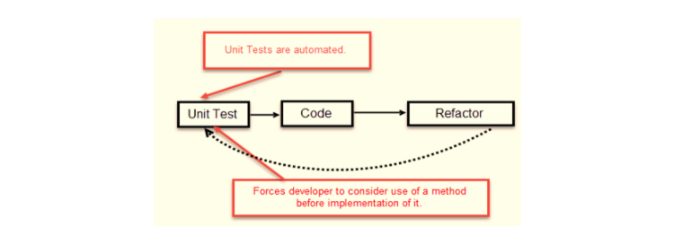
TDD – TEST FIRST DEVELOPMENT

Slide 5
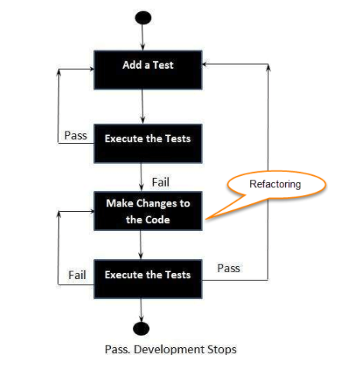
TDD TEST FLOW
Add new test(s)
Run all tests and see if any new test fails
Write some code
Run tests and Refactor code
Repeat
F.e; HackerRank, Coderbyte etc…

Slide 6
TDD –Vs- Traditional Testing
In traditional testing, a successfully executed test discovers one or more than one bugs. The same is in TDD. When a test case fails, there is some development or progress as we know that the problem has to be resolved.
TDD makes sure that the system meets all the specified requirements. It helps build and boost confidence in the system.
TDD emphasizes product code that determines if the testing will be successful or not. While traditional testing focuses on the designing of test cases, and also if the test will execute properly or not to meet the specified requirements.
In TDD, complete coverage of the testing is achieved. Unlike traditional testing, in TDD we test each line of the code.
TDD and traditional testing, when combines, explain why the testing of the system is so important.
In agile modelling, the testing should have a specific purpose. We should be aware of why we are testing and the level of the testing.

Slide 7
MICROSERVICES ARCHITECTURE
Microservice Architecture is a Service Oriented Architecture. In the microservice architecture, there are a large number of microservices. By combining all the microservices, it constructs a big service. In the microservice architecture, all the services communicate with each other.
According to Sam Newman, "Microservices are the small services that work together."
According to James Lewis and Martin Fowler, "The microservice architectural style is an approach to develop a single application as a suite of small services. Each microservice runs its process and communicates with lightweight mechanisms. These services are built around business capabilities and independently developed by fully automated deployment machinery."

Slide 8
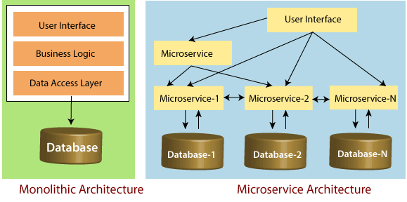
MICROSERVICES ARCHITECTURE
The microservice defines an approach to the architecture that divides an application into a pool of loosely coupled services that implements business requirements. It is next to Service-Oriented Architecture (SOA). The most important feature of the microservice-based architecture is that it can perform continuous delivery of a large and complex application.

Slide 9
Principles of Microservices
Single Responsibility principle
Modelled around business domain
Isolate Failure
Infrastructure automation
Deploy independently

Slide 10
MICROSERVICES ADVANTAGES
Microservices are self-contained, independent deployment module.
The cost of scaling is comparatively less than the monolithic architecture.
Microservices are independently manageable services. It can enable more and more services as the need arises. It minimizes the impact on existing service.
It is possible to change or upgrade each service individually rather than upgrading in the entire application.
Microservices allows us to develop an application which is organic (an application which latterly upgrades by adding more functions or modules) in nature.

Slide 11
MICROSERVICES ADVANTAGES
It enables event streaming technology to enable easy integration in comparison to heavyweight interposes communication.
Microservices follows the single responsibility principle.
The demanding service can be deployed on multiple servers to enhance performance.
Less dependency and easy to test.
Dynamic scaling.
Faster release cycle.

Slide 12
MICROSERVICES DISADVANTAGES
Microservices has all the associated complexities of the distributed system.
There is a higher chance of failure during communication between different services.
Difficult to manage a large number of services.
The developer needs to solve the problem, such as network latency and load balancing.
Complex testing over a distributed environment.

Slide 13
Microservices Challenges
Bounded Context
Dynamic Scale up and Scale Down
Monitoring
Fault Tolerance
Cyclic dependencies
DevOps Culture

Slide 14
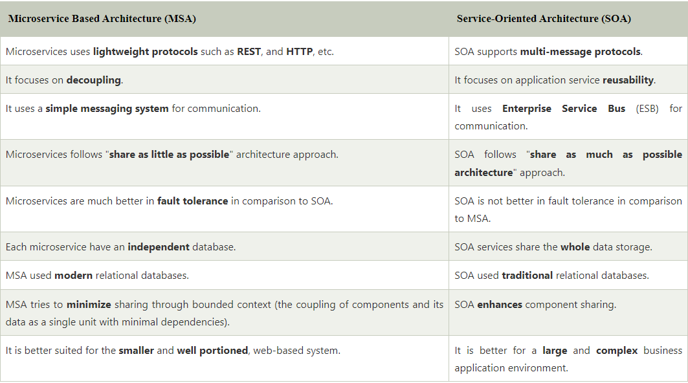
MSA vs SOA

Slide 15
Technical Practise Time
LET’S GET OUR HANDS DIRTY
-------------
Spring Boot Test Usages
Unit Test
Integration Test

Slide 16
HW#6
1 – What is the difference between manual testing and automated testing ?
2 – What does Assert class ?
3 - How can be tested 'private' methods ?
4 – What is Monolithic Architecture ?
5 - What are the best practices to write a Unit Test Case ?
6 - Why does JUnit only report the first failure in a single test ?
7 - What are the benefits and drawbacks of Microservices ?
8 - What is the role of actuator in spring boot ?
9 - What are the challenges that one has to face while using Microservices ?
10 - How independent microservices communicate with each other?
11 - What do you mean by Domain driven design ?
12 – What is container in Microservices ?
13 - What are the main components of Microservices architecture ?
14 - How does a Microservice architecture work?

