Slide 1
Week 2
Clean Code
Maven & CI/CD
Version Controlling Systems
Spring
Spring Boot

Slide 2
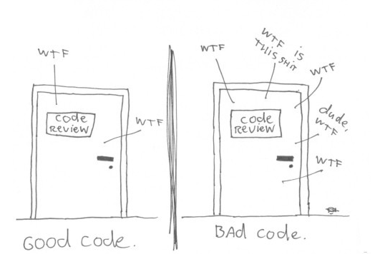
CLEAN CODE

Slide 3
CLEAN CODE
Software engineering principles, from Robert C. Martin's book Clean Code, adapted for Java. This is not a style guide. It's a guide to producing readable, reusable and refactorable software in Java.
Not every principle herein has to be strictly followed, and even fewer will be universally agreed upon. These are guidelines and nothing more, but they are ones codified over many years of collective experience by the authors of Clean Code.

Slide 4
VARIABLES
Use meaningful and pronounceable variable names
> String yyyymmdstr = new SimpleDateFormat("YYYY/MM/DD").format(new Date()); // Bad
> String currentDate = new SimpleDateFormat("YYYY/MM/DD").format(new Date()); // Good
Use the same vocabulary for the same type of variable
// Bad
getUserInfo();
getClientData();
getCustomerRecord();
// Good
getUser();

Slide 5
VARIABLES
Use searchable names
We will read more code than we will ever write. It's important that the code we do write is readable and searchable.
setTimeout(blastOff, 86400000); // Bad
// Declare them as capitalized `const` globals.
public static final int MILLISECONDS_IN_A_DAY = 86400000;
setTimeout(blastOff, MILLISECONDS_IN_A_DAY); // Good

Slide 6
VARIABLES
Use explanatory variables
// Bad
String address = "One Infinite Loop, Cupertino 95014";
String cityZipCodeRegex = "/^[^,\\\\]+[,\\\\\\s]+(.+?)\\s*(\\d{5})?$/";
saveCityZipCode(address.split(cityZipCodeRegex)[0], address.split(cityZipCodeRegex)[1]);
// Good
String address = "One Infinite Loop, Cupertino 95014";
String cityZipCodeRegex = "/^[^,\\\\]+[,\\\\\\s]+(.+?)\\s*(\\d{5})?$/";
String city = address.split(cityZipCodeRegex)[0];
String zipCode = address.split(cityZipCodeRegex)[1];
saveCityZipCode(city, zipCode);

Slide 7
VARIABLES
Avoid Mental Mapping
String [] l = {"Austin", "New York", "San Francisco"}; // Bad
String[] locations = {"Austin", "New York", "San Francisco"}; // Good
Don't add unneeded context
// Bad // Good
class Car {
public String carMake;
public String carModel;
public String carColor;
}
class Car {
public String make;
public String model;
public String color;
}

Slide 8
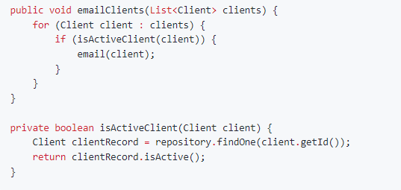
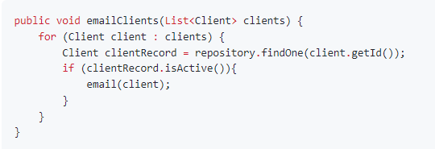
FUNCTIONS
Function arguments
Limiting the amount of function parameters is incredibly important because it makes testing your function easier. Having more than three leads to a combinatorial explosion where you have to test tons of different cases with each separate argument.
Functions should do one thing

Slide 9
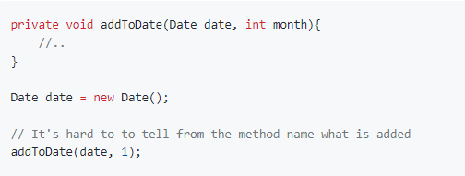
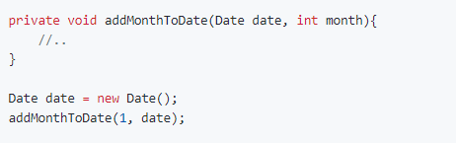
FUNCTIONS
Function names should say what they do

Slide 10
FUNCTIONS
Functions should only be one level of abstraction
Remove duplicate code
Don't use flags as function parameters
Avoid Side Effects
Don't write to global functions
Remove dead code

Slide 11
Objects and Data Structures
Use getters and setters
Make objects have private members
Prefer composition over inheritance
Use Design Patterns & Principles as possible
Let’s see another perspective on https://refactoring.guru/refactoring/what-is-refactoring

Slide 12
MAVEN
Maven is a project management and comprehension tool that provides developers a complete build lifecycle framework. Development team can automate the project's build infrastructure in almost no time as Maven uses a standard directory layout and a default build lifecycle.
In case of multiple development teams environment, Maven can set-up the way to work as per standards in a very short time. As most of the project setups are simple and reusable, Maven makes life of developer easy while creating reports, checks, build and testing automation setups.
To summarize, Maven simplifies and standardizes the project build process. It handles compilation, distribution, documentation, team collaboration and other tasks seamlessly. Maven increases reusability and takes care of most of the build related tasks.

Slide 13
MAVEN EVOLUTION
Maven was originally designed to simplify building processes in Jakarta Turbine project. There were several projects and each project contained slightly different ANT build files. JARs were checked into CVS.
Apache group then developed Maven which can build multiple projects together, publish projects information, deploy projects, share JARs across several projects and help in collaboration of teams.

Slide 14
MAVEN EVOLUTION
Model-based builds − Maven is able to build any number of projects into predefined output types such as jar, war, metadata.
Coherent site of project information − Using the same metadata as per the build process, maven is able to generate a website and a PDF including complete documentation.
Release management and distribution publication − Without additional configuration, maven will integrate with your source control system such as CVS and manages the release of a project.
Backward Compatibility − You can easily port the multiple modules of a project into Maven 3 from older versions of Maven. It can support the older versions also.
Automatic parent versioning − No need to specify the parent in the sub module for maintenance.
Parallel builds − It analyzes the project dependency graph and enables you to build schedule modules in parallel. Using this, you can achieve the performance improvements of 20-50%.
Better Error and Integrity Reporting − Maven improved error reporting, and it provides you with a link to the Maven wiki page where you will get full description of the error

Slide 15
MAVEN - POM
POM stands for Project Object Model. It is fundamental unit of work in Maven. It is an XML file that resides in the base directory of the project as pom.xml.
The POM contains information about the project and various configuration detail used by Maven to build the project(s).
POM also contains the goals and plugins. While executing a task or goal, Maven looks for the POM in the current directory. It reads the POM, gets the needed configuration information, and then executes the goal.
Before creating a POM, we should first decide the project group (groupId), its name (artifactId) and its version as these attributes help in uniquely identifying the project in repository.

Slide 16
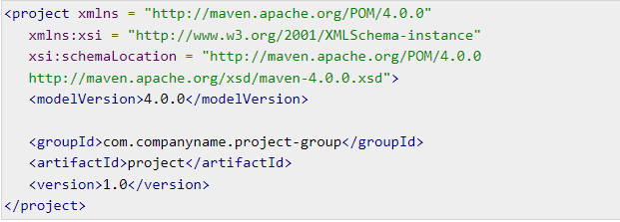
SAMPLE POM FILE

Slide 17
Convention over Configuration
Maven uses Convention over Configuration, which means developers are not required to create build process themselves. (Iterface -> Class , « code to Interface »)
Developers do not have to mention each and every configuration detail. Maven provides sensible default behavior for projects. When a Maven project is created, Maven creates default project structure. Developer is only required to place files accordingly and he/she need not to define any configuration in pom.xml.
As an example, following table shows the default values for project source code files, resource files and other configurations. Assuming, ${basedir} denotes the project location:
Source code → ${basedir}/src/main/java
Resources → ${basedir}/src/main/resources

Slide 18
Features of Maven
Simple project setup that follows best practices.
Consistent usage across all projects.
Dependency management including automatic updating.
A large and growing repository of libraries.
Extensible, with the ability to easily write plugins in Java or scripting languages.
Instant access to new features with little or no extra configuration..

Slide 19
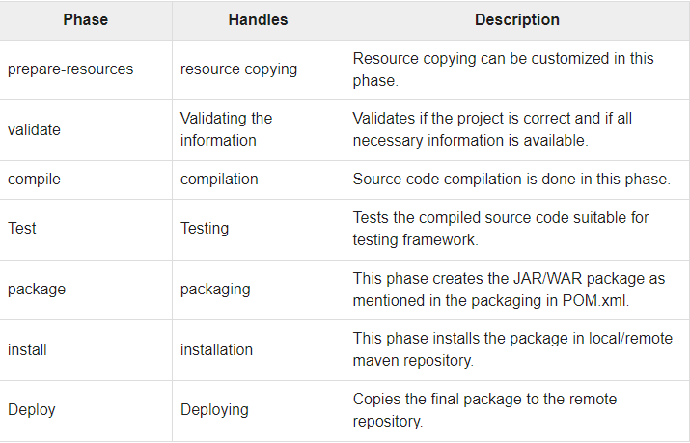
MAVEN Build Lifecycle

Slide 20
Maven - External Dependencies
As you know, Maven does the dependency management using the concept of Repositories. But what happens if dependency is not available in any of remote repositories and central repository? Maven provides answer for such scenario using concept of External Dependency.

Slide 21
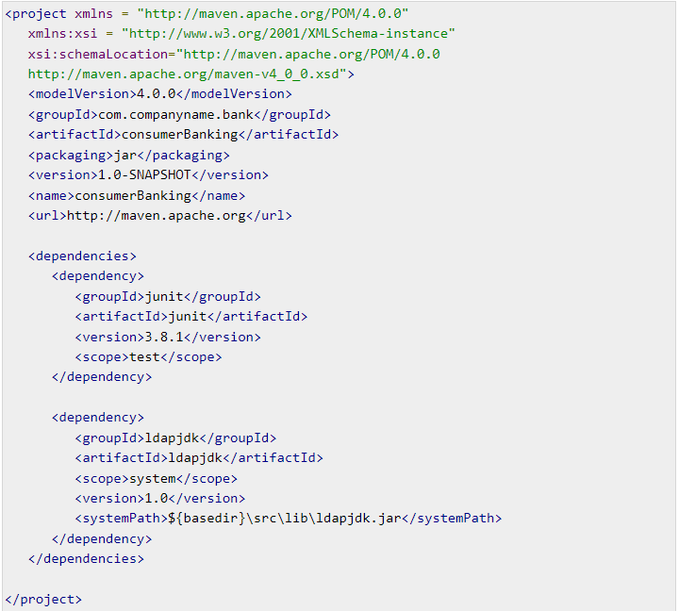
Sample Pom File with External Dependecies

Slide 22
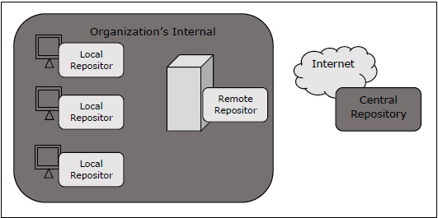
Maven Repository

Slide 23
Maven - Project Templates
Maven provides users, a very large list of different types of project templates (614 in numbers) using the concept of Archetype. Maven helps users to quickly start a new java project using the following command.
What is Archetype ?
Archetype is a Maven plugin whose task is to create a project structure as per its template. We are going to use quickstart archetype plugin to create a simple java application.

Slide 24
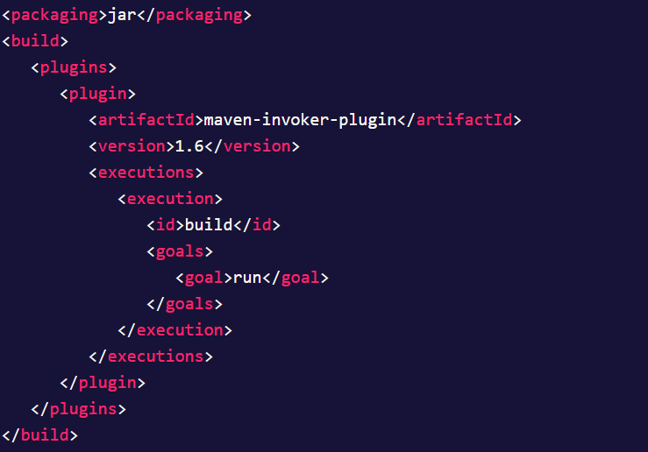
MAVEN – BUILD AUTOMATION
Build automation is the process in which a project gets initiated with the build process whenever a change is made in the workspace and also to ensure that project is stable along with its dependent projects (if the project is used by any other projects).
This is very much essential in the software development life cycle as it is difficult to manage with the failed builds during the development phase. Hence, a process is required in order to ensure the health status of the build all the time and keep an eye on the same.

Slide 25
CI / CD
CI/CD is a method to frequently deliver apps to customers by introducing automation into the stages of app development. The main concepts attributed to CI/CD are continuous integration, continuous delivery and continuous deployment. CI/CD is a solution to the problems integrating new code can cause for development and operations teams (AKA "integration hell").
Specifically, CI/CD introduces ongoing automation and continuous monitoring throughout the lifecycle of apps, from integration and testing phases to delivery and deployment. Taken together, these connected practices are often referred to as a "CI/CD pipeline" and are supported by development and operations teams working together in an agile way with either a DevOps or site reliability engineering (SRE) approach.

Slide 26
CI –vs- CD
The acronym CI/CD has a few different meanings. The "CI" in CI/CD always refers to continuous integration, which is an automation process for developers. Successful CI means new code changes to an app are regularly built, tested, and merged to a shared repository. It’s a solution to the problem of having too many branches of an app in development at once that might conflict with each other.
The "CD" in CI/CD refers to continuous delivery and/or continuous deployment, which are related concepts that sometimes get used interchangeably. Both are about automating further stages of the pipeline, but they’re sometimes used separately to illustrate just how much automation is happening.
Continuous delivery usually means a developer’s changes to an application are automatically bug tested and uploaded to a repository (like GitHub or a container registry), where they can then be deployed to a live production environment by the operations team. It’s an answer to the problem of poor visibility and communication between dev and business teams. To that end, the purpose of continuous delivery is to ensure that it takes minimal effort to deploy new code.

Slide 27
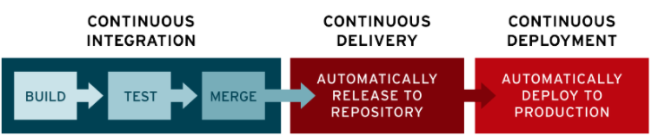
CONTINUOUS DEPLOYMENT
Continuous deployment (the other possible "CD") can refer to automatically releasing a developer’s changes from the repository to production, where it is usable by customers. It addresses the problem of overloading operations teams with manual processes that slow down app delivery. It builds on the benefits of continuous delivery by automating the next stage in the pipeline.

Slide 28
CI / CD Tools
CI/CD tools can help a team automate their development, deployment, and testing. Some tools specifically handle the integration (CI) side, some manage development and deployment (CD), while others specialize in continuous testing or related functions.
Jenkins
GitLab
CircleCI
Travis CI
Atlassian Bamboo

Slide 29
VCS / GIT
Git is a modern and widely used distributed version control system in the world. It is developed to manage projects with high speed and efficiency. The version control system allows us to monitor and work together with our team members at the same workspace.
Git is an open-source distributed version control system. It is designed to handle minor to major projects with high speed and efficiency. It is developed to co-ordinate the work among the developers. The version control allows us to track and work together with our team members at the same workspace.
Git is foundation of many services like GitHub and GitLab, but we can use Git without using any other Git services. Git can be used privately and publicly.

Slide 30
GIT FEATURES
Open Source
Scalable
Distributed
Security
Speed
Supports non-linear development
Branching and Merging
Data Assurance
Staging Area
Maintain the clean history

Slide 31
GIT BENEFITS
A version control application allows us to keep track of all the changes that we make in the files of our project. Every time we make changes in files of an existing project, we can push those changes to a repository. Other developers are allowed to pull your changes from the repository and continue to work with the updates that you added to the project files.
Some significant benefits of using Git are as follows:
Saves Time
Offline Working
Undo Mistakes
Track the Changes

Slide 32
GITHUB
GitHub is a Git repository hosting service. GitHub also facilitates with many of its features, such as access control and collaboration. It provides a Web-based graphical interface.
GitHub is an American company. It hosts source code of your project in the form of different programming languages and keeps track of the various changes made by programmers.
It offers both distributed version control and source code management (SCM) functionality of Git. It also facilitates with some collaboration features such as bug tracking, feature requests, task management for every project.

Slide 33
Features of GitHub
GitHub is a place where programmers and designers work together. They collaborate, contribute, and fix bugs together. It hosts plenty of open source projects and codes of various programming languages.
Collaboration
Integrated issue and bug tracking
Graphical representation of branches
Git repositories hosting
Project management
Team management
Code hosting
Track and assign tasks
Conversations
Wikisc

Slide 34
Benefits of GitHub
GitHub can be separated as the Git and the Hub. GitHub service includes access controls as well as collaboration features like task management, repository hosting, and team management.
The key benefits of GitHub are as follows:
It is easy to contribute to open source projects via GitHub.
It helps to create an excellent document.
You can attract recruiter by showing off your work. If you have a profile on GitHub, you will have a higher chance of being recruited.
It allows your work to get out there in front of the public.
You can track changes in your code across versions.

Slide 35
GIT COMMANDS
https://rogerdudler.github.io/git-guide/

Slide 36
Spring
Spring is a lightweight framework. It can be thought of as a framework of frameworks because it provides support to various frameworks such as Struts, Hibernate, Tapestry, EJB, JSF, etc. The framework, in broader sense, can be defined as a structure where we find solution of the various technical problems.
IOC ( Inversion of Control ) - Specification
DI ( Dependency Injection ) - Implementation

Slide 37
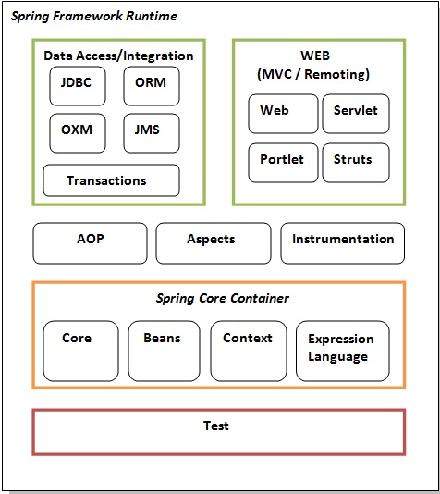
SPRING MODULES

Slide 38
Spring Advantages
1) Predefined Templates
Spring framework provides templates for JDBC, Hibernate, JPA etc. technologies. So there is no need to write too much code. It hides the basic steps of these technologies.
Let's take the example of JdbcTemplate, you don't need to write the code for exception handling, creating connection, creating statement, committing transaction, closing connection etc. You need to write the code of executing query only. Thus, it save a lot of JDBC code.
2) Loose Coupling
The Spring applications are loosely coupled because of dependency injection.
3) Easy to test
The Dependency Injection makes easier to test the application. The EJB or Struts application require server to run the application but Spring framework doesn't require server.
4) Lightweight
Spring framework is lightweight because of its POJO implementation. The Spring Framework doesn't force the programmer to inherit any class or implement any interface. That is why it is said non-invasive.
5) Fast Development
The Dependency Injection feature of Spring Framework and it support to various frameworks makes the easy development of JavaEE application.

Slide 39
IOC & DI
The Inversion-of-Control (IoC) pattern, is about providing any kind of callback (which controls reaction), instead of acting ourself directly (in other words, inversion and/or redirecting control to external handler/controller).
The Dependency-Injection (DI) pattern is a more specific version of IoC pattern, and is all about removing dependencies from your code.
Let’s see an example!

Slide 40
SPRING BEAN
In Spring, the objects that form the backbone of your application and that are managed by the Spring IoC container are called beans. A bean is an object that is instantiated, assembled, and otherwise managed by a Spring IoC container.
Some of most used Spring Bean annotations :
@ComponentScan @RequestBody
@Component @PathVariable
@Repository @RequestHeader
@Service
@Controller
@Configuration

Slide 41
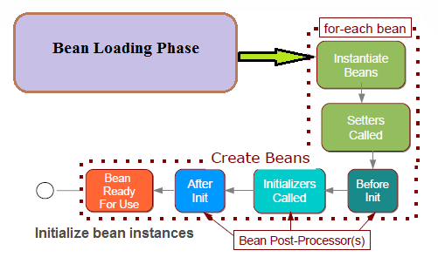
SPRING BEAN LIFE-CYCLE

Slide 42
SPRING BOOT
Spring Boot is a project that is built on the top of the Spring Framework. It provides an easier and faster way to set up, configure, and run both simple and web-based applications.
It is a Spring module that provides the RAD (Rapid Application Development) feature to the Spring Framework. It is used to create a stand-alone Spring-based application that you can just run because it needs minimal Spring configuration.

Slide 43
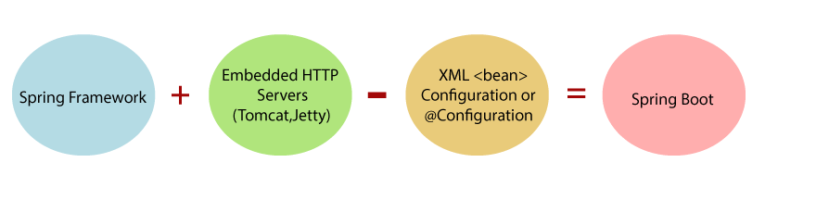
SPRING > to > SPRING BOOT

Slide 44
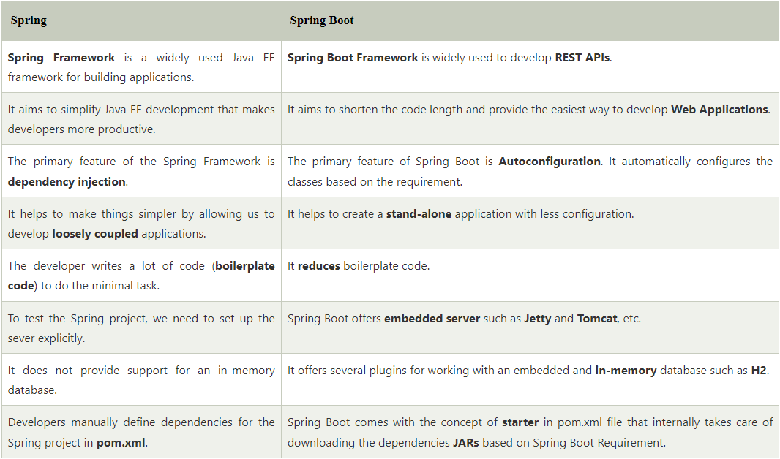
Spring Vs Spring Boot

Slide 45
SPRING BOOT ADVANTAGES
It creates stand-alone Spring applications that can be started using Java -jar.
It tests web applications easily with the help of different Embedded HTTP servers such as Tomcat, Jetty, etc. We don't need to deploy WAR files.
It provides opinionated 'starter' POMs to simplify our Maven configuration.
It provides production-ready features such as metrics, health checks, and externalized configuration.
There is no requirement for XML configuration.
It offers a CLI tool for developing and testing the Spring Boot application.
It offers the number of plug-ins.
It also minimizes writing multiple boilerplate codes (the code that has to be included in many places with little or no alteration), XML configuration, and annotations.
It increases productivity and reduces development time.

Slide 46
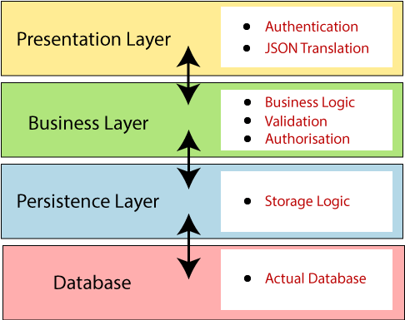
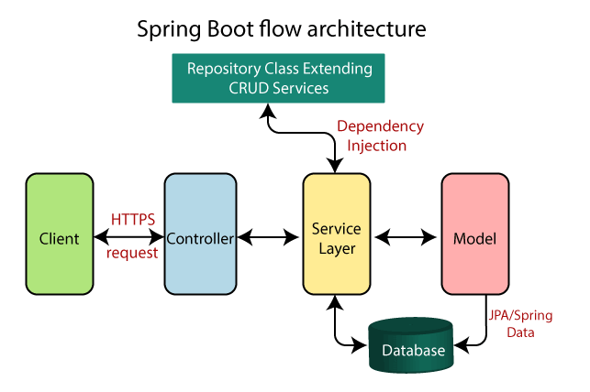
SPRING BOOT ARCHITECTURE

Slide 47
Spring Initializr
Spring Initializr is a web-based tool provided by the Pivotal Web Service. With the help of Spring Initializr, we can easily generate the structure of the Spring Boot Project. It offers extensible API for creating JVM-based projects.
It also provides various options for the project that are expressed in a metadata model. The metadata model allows us to configure the list of dependencies supported by JVM and platform versions, etc. It serves its metadata in a well-known that provides necessary assistance to third-party clients.

Slide 48
Mostly Used Annotations
1. @Bean
2. @Service
3. @Repository
4. @Configuration
5. @Controller
6. @RequestMapping
7. @Autowired
8. @Component
9. @SpringBootApplication
10. @EnableAutoConfiguration
11. @ComponetScan
12. @Required
13. @Qualifier

Slide 49
Technical Practise Time
LET’S GET OUR HANDS DIRTY
-------------
Sample Project initialization with Spring Initializr
GIT Usage

Slide 50
HW#2
1 – IOC and DI means ?
2 – Spring Bean Scopes ?
3 – What does @SpringBootApplication do ?
4 – What is Spring AOP ? Where and How to use it ?
5 – What is Singleton and where to use it ?
6 – What is Spring Boot Actuator and Where to use it ?
7 - What is the primary difference between Spring and Spring Boot ?
8 – Why to use VCS ?
9 – What are SOLID Principles ? Give sample usages in Java ?
10 - What is RAD model ?
11 - What is Spring Boot starter ? How is it useful ?
12 – What is Caching ? How can we achive caching in Spring Boot ?
13 – What & How & Where & Why to logging ?
14 - What is Swagger? Have you implemented it using Spring Boot?

