Slide 1
Week 7
Swagger
Docker
Project Presentations

Slide 2
DOCKER
Docker is a container management service. The keywords of Docker are develop, ship and run anywhere. The whole idea of Docker is for developers to easily develop applications, ship them into containers which can then be deployed anywhere.
Features of Docker :
Docker has the ability to reduce the size of development by providing a smaller footprint of the operating system via containers.
With containers, it becomes easier for teams across different units, such as development, QA and Operations to work seamlessly across applications.
You can deploy Docker containers anywhere, on any physical and virtual machines and even on the cloud.
Since Docker containers are pretty lightweight, they are very easily scalable

Slide 3
DOCKER HUB
Docker Hub is a registry service on the cloud that allows you to download Docker images that are built by other communities. You can also upload your own Docker built images to Docker hub. In this chapter, we will see how to download and the use the Jenkins Docker image from Docker hub.

Slide 4

DOCKER IMAGES
In Docker, everything is based on Images. An image is a combination of a file system and parameters. Let’s take an example of the following command in Docker.
The Docker command is specific and tells the Docker program on the Operating System that something needs to be done.
The run command is used to mention that we want to create an instance of an image, which is then called a container.
Finally, "hello-world" represents the image from which the container is made.

Slide 5


Docker Containers
Containers are instances of Docker images that can be run using the Docker run command. The basic purpose of Docker is to run containers. Let’s discuss how to work with containers.
Running a Container:
Running of containers is managed with the Docker run command. To run a container in an interactive mode, first launch the Docker container.
Listing of Containers:
One can list all of the containers on the machine via the docker ps command. This command is used to return the currently running containers.
a

Slide 6
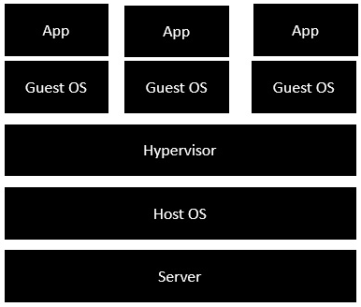
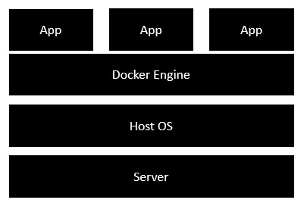
Docker Architecture
Traditional Vertualization
Docker

Slide 7
DOCKER COMPOSE
Docker Compose is used to run multiple containers as a single service. For example, suppose you had an application which required NGNIX and MySQL, you could create one file which would start both the containers as a service without the need to start each one separately.
We can then use the following command to see the compose version :

Slide 8
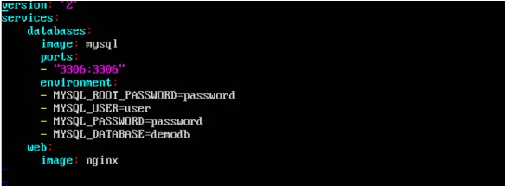
DOCKER COMPOSE
Format of Docker-Compose File:
Now let’s run our Docker Compose file using the following command:
-

Slide 9
Technical Practise Time
LET’S GET OUR HANDS DIRTY
-------------
Swagger Documentation
Docker
Docker Compose

