Slide 1
OBJECT ORIENTED PROGRAMMING
Core Java Overview
Programming Paradigms
OOP Fundamentals

Slide 2
JAVA CORE CONCEPTS
- Conditionals(if-else and switch statements)
- Loops (for, while, do-while)
- Operators ( = , + , - , * , ...)
- Arrays
- Object Creations ways
Detailed tutorials can be found here:
https://www.studytonight.com/java/overview-of-java.php

Slide 3
PROGRAMMING PARADIGMS
- Imperative
- Logical
- Functional
- Object-Oriented
Detailed describtions can be found here:
https://www.makeuseof.com/programming-paradigms-major/

Slide 4
OOP PARADIGM
Object-oriented programming (OOP) is a programming paradigm based upon objects (having both data and methods) that aims to incorporate the advantages of modularity and reusability. Objects, which are usually instances of classes, are used to interact with one another to design applications and computer programs.

Slide 5
CLASS
A class is a user defined blueprint or prototype from which objects are created. It represents the set of properties or methods that are common to all objects of one type. In general, class declarations can include these components, in order:
Modifiers: A class can be public or has default access.
class keyword: class keyword is used to create a class.
Class name: The name should begin with an initial letter (capitalized by convention).
Superclass(if any): The name of the class’s parent (superclass), if any, preceded by the keyword extends. A class can only extend (subclass) one parent.
Interfaces(if any): A comma-separated list of interfaces implemented by the class, if any, preceded by the keyword implements. A class can implement more than one interface.
Body: The class body surrounded by braces, { }.

Slide 6
OBJECT
It is a basic unit of Object-Oriented Programming and represents the real life entities. A typical Java program creates many objects, which as you know, interact by invoking methods. An object consists of :
State: It is represented by attributes of an object. It also reflects the properties of an object.
Behavior: It is represented by methods of an object. It also reflects the response of an object with other objects.
Identity: It gives a unique name to an object and enables one object to interact with other objects.

Slide 7
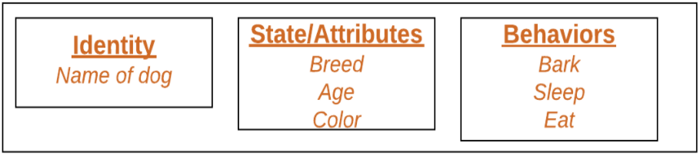
OBJECT
Sample Class detailed usages can be found here:
> https://github.com/ramazansakin/Patika-OOP-Concept-Samples

Slide 8
ENCAPSULATION
Encapsulation is one of our fundemental OOP concepts. The other three are inheritance, polymorphism and abstraction.
Encapsulation is the technique of making the fields in a class private and providing access to the fields via public methods. If a field is decleared as private, it can not be accessed by anyone outside the class, thereby hiding the fields within the class. For this reason, encapsulation is also refered to as data hiding.
Let’s see an example of Class usage!
https://github.com/ramazansakin/Patika-OOP-Concept-Samples/blob/master/src/oop/EncapsulationSampleUsage.java

Slide 9
ABSTRACTION
Abstraction is the process of abstraction in Java is used to hide certain details and only show the essential features of the object. In other words, it details with the outside view of an object(interface).
Abstract class can not be instantiated; the class does not have much use unless it is subclass. This is tipically how abstract classes come about during the design phase. A parent class contains the common functionality of a collection of child classes, but the parent class itself is too abstract to be used on its own.

Slide 10
INTERFACE
An interface in Java is a blueprint of a class. It has static constants and abstract methods.
The interface in Java is a mechanism to achieve abstraction. There can be only abstract methods in the Java interface, not method body. It is used to achieve abstraction and multiple inheritance in Java.
IS-A and HAS-A relationships
Why to use :
- It is used to achieve abstraction.
- By interface, we can support the functionality of multiple inheritance. – Diamond Problem Solution
- It can be used to achieve loose coupling.
Let’s see an example!

Slide 11
INHERITANCE
Inheritance is an important pillar of OOP(Object-Oriented Programming). It is the mechanism in java by which one class is allowed to inherit the features(fields and methods) of another class.
Super Class: The class whose features are inherited is known as superclass(or a base class or a parent class).
Sub Class: The class that inherits the other class is known as a subclass(or a derived class, extended class, or child class). The subclass can add its own fields and methods in addition to the superclass fields and methods.
Reusability: Inheritance supports the concept of “reusability”, i.e. when we want to create a new class and there is already a class that includes some of the code that we want, we can derive our new class from the existing class. By doing this, we are reusing the fields and methods of the existing class.
Let’s see an example & let’s combine interface and inheritance usage!

Slide 12
POLYMORPHISM
Polymorphism means "many forms", and it occurs when we have many classes that are related to each other by inheritance.
Like we specified in the Inheritance chapter; lets us inherit attributes and methods from another class. Polymorphism uses those methods to perform different tasks. This allows us to perform a single action in different ways.
- Method Overriding & Method Loading
Let’s see an example!

