Slide 1
STRUCTURED QUERY LANGUAGE - SQL
- Introduction to SQL
- Basic JDBC Connection Usage

Slide 2
Introduction to SQL
SQL Definition: SQL, or Structured Query Language, is a domain-specific language designed for managing and manipulating relational databases.
Purpose: SQL allows users to interact with databases by defining and manipulating data. It serves as a standard for communication with relational database management systems (RDBMS).

Slide 3
SELECT Statement
The fundamental query used to retrieve data from a database.
Syntax: SELECT columns FROM table WHERE conditions;
Query Examples:
- Retrieve all columns: SELECT * FROM employees;
- Specify columns: SELECT employee_id, first_name, last_name FROM employees;
- Filter data: SELECT * FROM employees WHERE department_id = 10;

Slide 4
Data Modification Statements
INSERT: Adds new records to a table.
UPDATE: Modifies existing records.
DELETE: Removes records from a table.
Examples:
> INSERT INTO employees VALUES (101, 'John', 'Doe', 20);
> UPDATE employees SET salary = salary * 1.1 WHERE department_id = 20;
> DELETE FROM employees WHERE employee_id = 101;

Slide 5
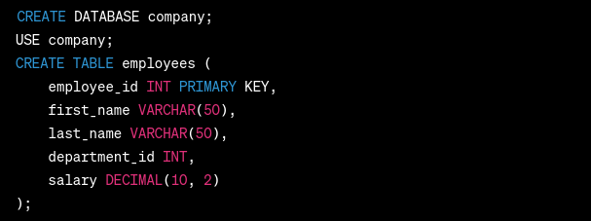
Creating Databases and Tables
Database Creation:
Use CREATE DATABASE to create a new database.
Table Creation:
Use CREATE TABLE to define a new table's structure.

Slide 6
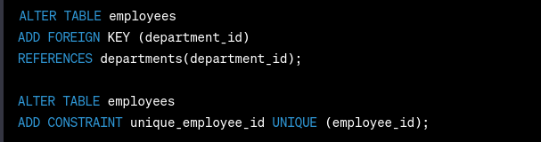
Relationships and Constraints
Relationships:
Define relationships between tables using FOREIGN KEY.
Constraints:
Ensure data integrity using constraints like UNIQUE.

Slide 7
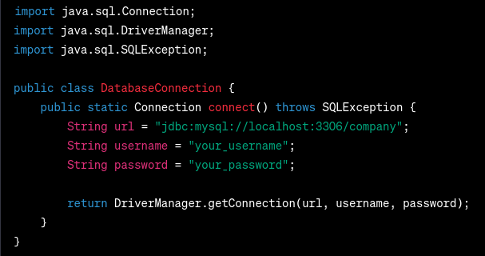
Connecting to Databases using JDBC
JDBC Overview:
Java Database Connectivity (JDBC) is a Java-based API for connecting to and interacting with relational databases.

