Slide 1

XYZ Investment Analysis
G2M
Chris Donaton
16/12/2022

Slide 2

AGENDA
Executive Summary
Problem Statement
Approach
EDA
EDA Summary
Recommendations

Slide 3
Executive Summary
Despite Yellow Cab Company’s overwhelming command of the market, I see Pink Cab Company as the most prime opportunity for investment. Pink Cab has demonstrated sustained growth despite its small size and even out competes Yellow Cab in certain areas. The key to return on investment is strategic investment, informed by my analysis, to achieve dominance in select regional markets.
Given Pink Cab Company’s lower operating cost with a cost to consumer much less than Yellow’s, strategic investment in Pink Cab Company could achieve significantly greater return potential than any commensurate investment in the larger Yellow Cab Company.

Slide 4
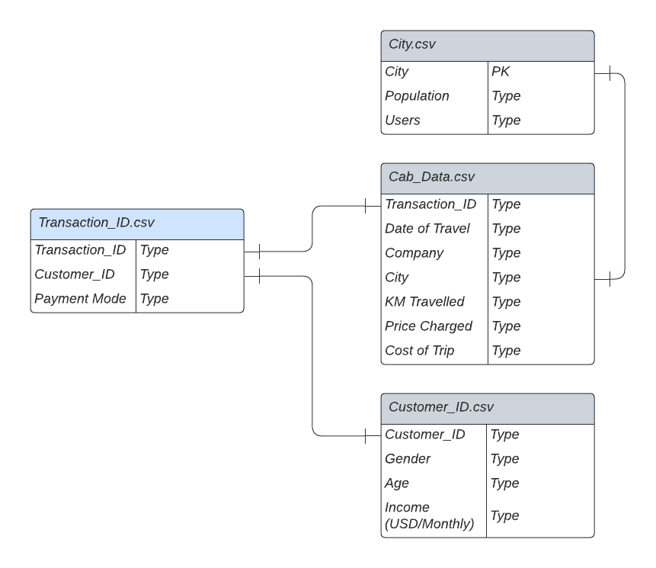
Problem Statement
XYZ is a private equity firm in US. Due to remarkable growth in the Cab Industry in last few years and multiple key players in the market, it is planning for an investment in Cab industry.
Data provided included:
High level transaction summary data
Detailed data for each ride
Limited user biographical data
Limited city data for operating cities

Slide 5
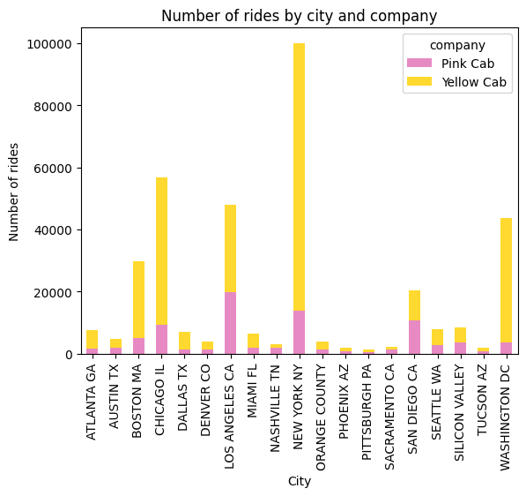
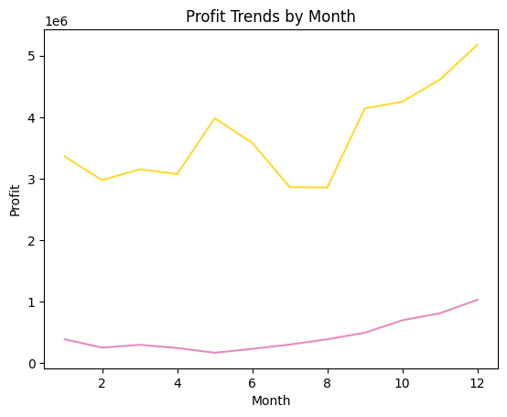
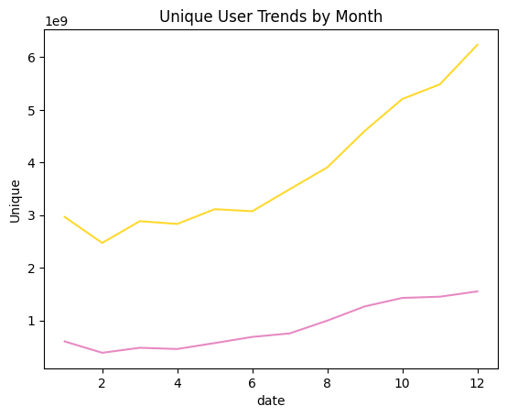
Approach
After cleaning and combining the data, it was obvious that Yellow Cab owns a commanding lead within the United States – so I knew I need to look regionally to consider the differences.
There was also an obvious seasonal trend that need to be broken down to understand each company’s strengths.
Finally, understanding how users moved between the two companies would help crowd source the ‘better cab’ company.

Slide 6
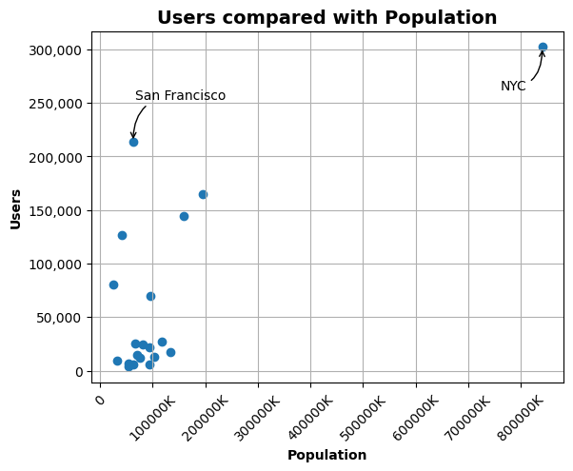
EDA
Longer trips drive down profits
Kilometers traveled is most closely correlated with the company’s expense
Yellow Cab charges customers significantly more for longer trips
Although there were no missing rows within the data,
I immediately identified that we were not provided with cab-level data for the city of San Francisco

Slide 7
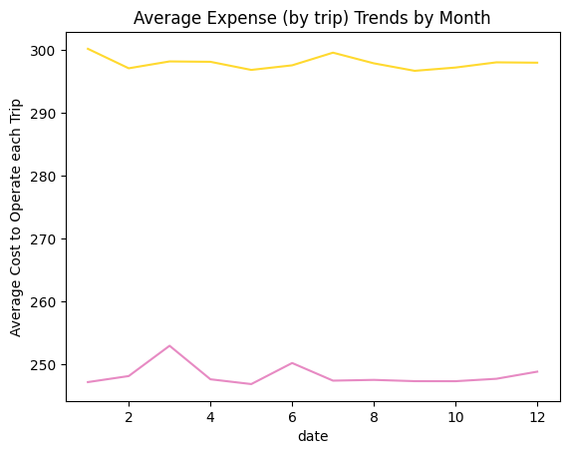
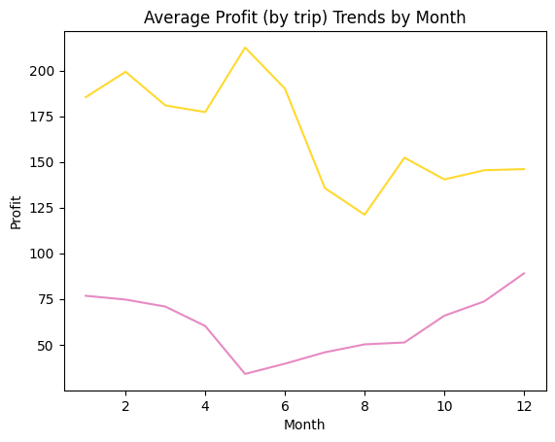
EDA Summary
 | Yellow | Pink
Price per KM | 20.3 | 13.8
Expense per KM | 13.2 | 10.9
Profit per KM | 7.1 | 2.8
Pink Cab costs less to operate and charges consumers $7 less per kilometer while maintaining market share growth in most cities.
Yellow Cab Company costs ~ $50 more per trip to operate throughout the year.
The spikes in May and September suggest a promotion program that takes market share from Pink Cab.

Slide 8

EDA Summary
Growth rates for each company in each city remain equal (within 2% of each other year over year) in all cities except:
Boston, MA
Washington DC
New York NY
Orange County, CA
Austin, TX
Miami, FL
Apart from Miami, FL, Pink Cab leads the growth (number of rides) in all these cities
It makes sense that unique users increase as the weather gets colder, but Yellow Cab does a better job at soliciting new users year over year

Slide 9
Recommendations
Pending an asset inventory to ensure the fleet of Pink Cab is comparable to that of Yellow, I recommend investment in Pink Cab Company with advisement. We need to ensure Pink Cab leadership is open to analytical insight to ensure your investment can be funneled to the most effective regions.
Additionally, investment must fuel a more competitive marketing campaign in the months leading up to May and September when most unique visitors begin using cabs. These are crucial time periods to gain recurring users for the time of the year with the highest volume of ridership.

Slide 10
Thank You

